Slide 1
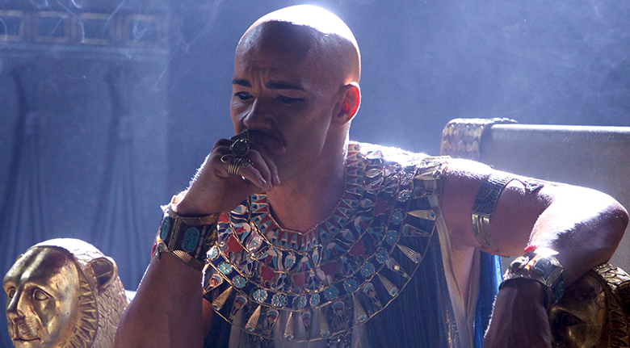
WORLD HISTORY
with Mr. Jim Soto
The Middle & New Kingdoms

Slide 2
Think...
You are a servant to Hatshepsut, ruler of Egypt. You admire her, but some people think women should not rule. She calls herself a king and dresses as a pharaoh – even wearing a fake beard. That was your idea! What could Hatshepsut do to show her authority?
Take a minute to write your answer down.

Slide 3
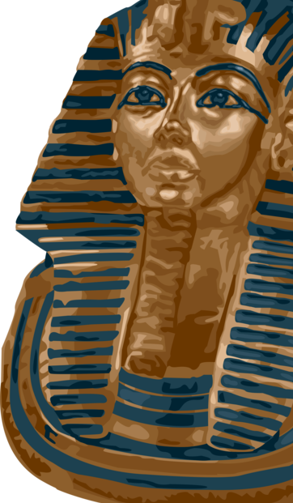
The power of the pharaohs expanded during the Old Kingdom. Society was orderly, based on great differences between social classes. But rulers and dynasties changed, and Egypt changed with them. In time, these changes led to new eras in Egyptian history. Read about them in pages 96 – 100 and complete the section 3 assessment. Show me the completed work when complete.

Slide 4
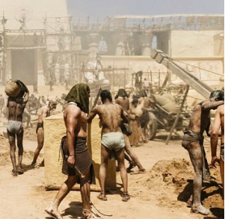
The Middle Kingdom
The excesses of the Old Kingdom pharaoh’s, made their power decline. The noble challenged their power and this led to the collapse of their order. The Middle Kingdom of Egypt (also known as The Period of Reunification) is the period between 2050 BC and 1710 BC, stretching from the reunification of Egypt under the impulse of Mentuhotep II of the Eleventh Dynasty to the end of the Twelfth Dynasty.

Slide 5
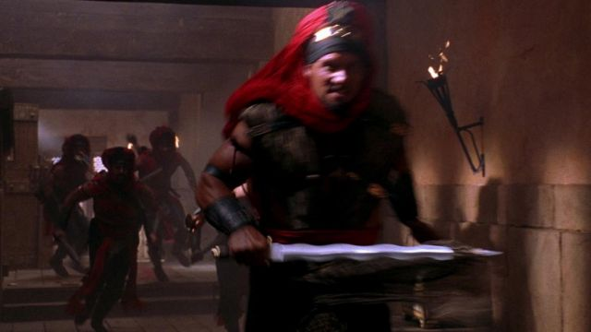
The Hyksos
In 1750 BC a people called the Hyksos invaded Egypt. Through their weapons, the Hyksos were able to change the course of Egyptian history and bring Egypt fully into the Bronze Age, a term used to describe a period of time in which ancient peoples used new technology to create bronze objects.
Click Here!

Slide 6
They assimilated much of the Egyptian culture and ruled as pharaohs for 200 years. Kamose of Thebes began the revolt against Hyksos rule. He sent an army down the Nile to attack the Hyksos in Lower Egypt. Though he was killed in battle, his brother, Ahmose of Thebes, drove the Hyksos across the desert and out of Egypt by 1500 BC.

Slide 7
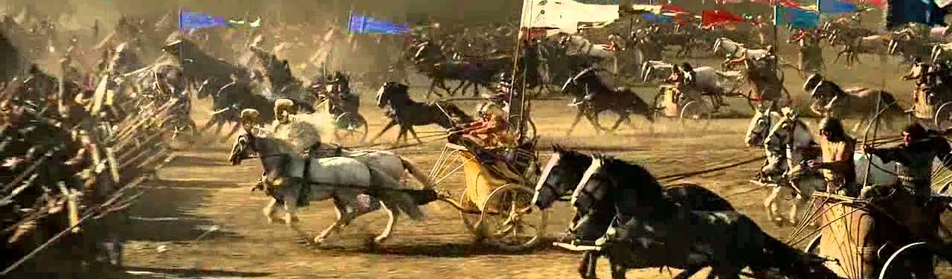
To prevent future invasions from occurring, Egyptian rulers decided to take control of all possible invasion routes. They started expanding by targeting all neighboring nations and invading them. These conquest made Egypt richer and more powerful. This was the beginning of the New Kingdom.

Slide 8
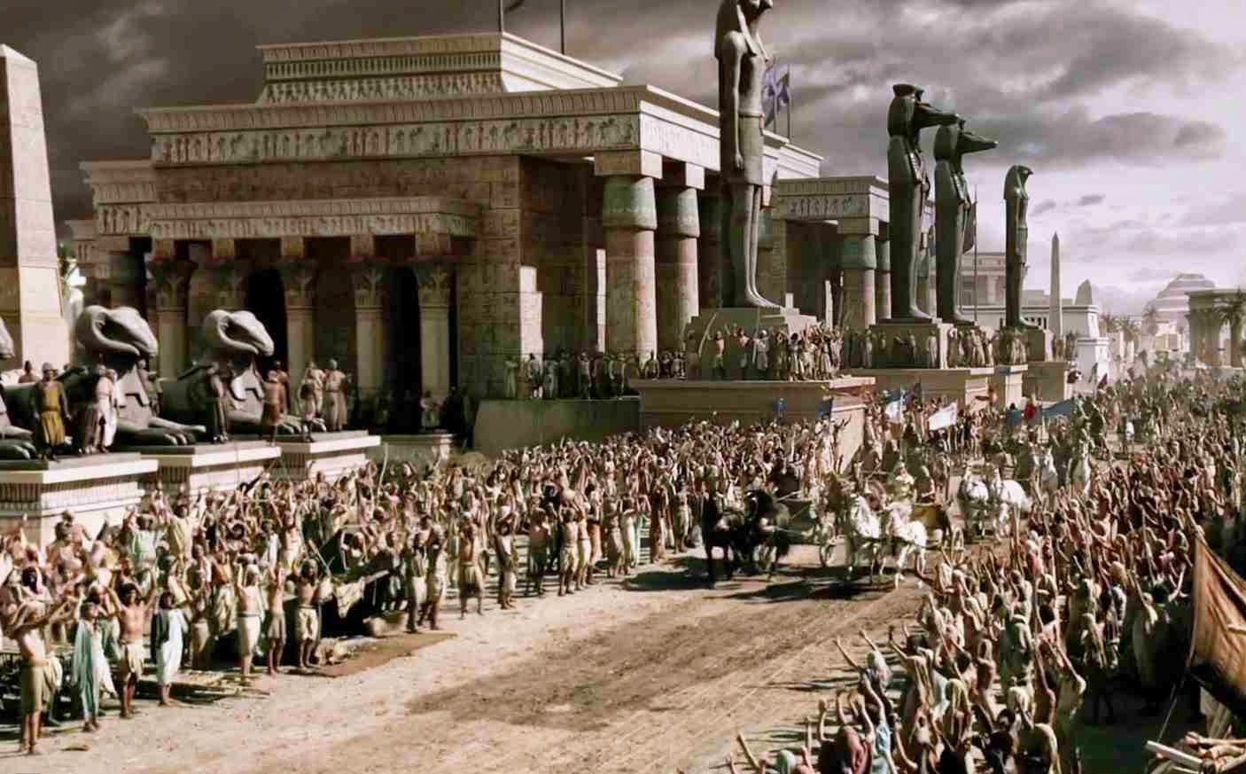
The New Kingdom
The New Kingdom, sometimes referred to as the Egyptian Empire, is the period in ancient Egyptian history between the 16th century BC and the 11th century BC, covering the Eighteenth, Nineteenth, and Twentieth Dynasties of Egypt.

Slide 9
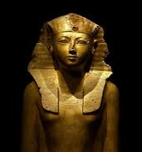
Queen Hatshepsut
Daughter of King Thutmose I, Hatshepsut became queen of Egypt when she married her half-brother, Thutmose II, around the age of 12. Upon his death, she began acting as regent for her stepson, the infant Thutmose III, but later took on the full powers of a pharaoh, becoming co-ruler of Egypt around 1473 BC. Her successful transition from queen to pharaoh was due to her ability to recruit influential supporters, and many of the men she chose had been favored officials of her father.
Click Here!

Slide 10
Work & Daily Life
The ancient Egyptian people were grouped in a hierarchical system with the Pharaoh at the top and farmers and slaves at the bottom. Clearly, the groups of people nearest the top of society were the richest and most powerful.

Slide 11
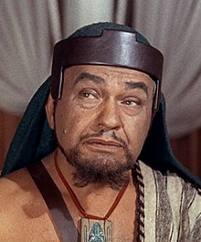
The Vizier was the Pharaoh’s chief advisor and was sometimes also the High Priest. He was responsible for overseeing administration and all official documents had to have his seal of approval. He was also responsible for the supply of food, settling disputes between nobles and the running and protection of the Pharaoh’s household.

Slide 12
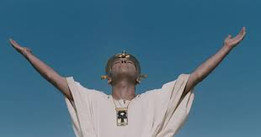
Nobles ruled the regions of Egypt (Nomes). They were responsible for making local laws and keeping order in their region.
Priests were responsible for keeping the gods happy. They did not preach to people but spent their time performing rituals and ceremonies to the god of their temple.

Slide 13
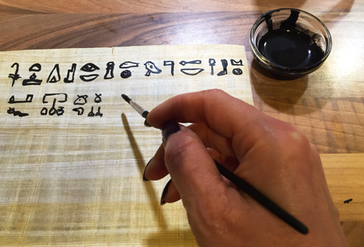
Scribes were the only people who could read and write and were responsible for keeping records. The ancient Egyptians recorded things such as how much food was produced at harvest time, how many soldiers were in the army, numbers of workers and the number of gifts given to the Gods.

Slide 14
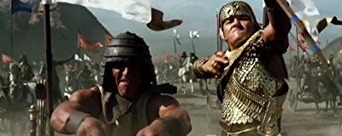
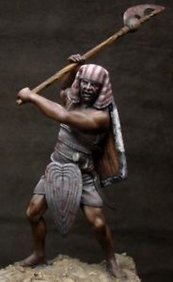
Soldiers were responsible for the defense of the country. Many second sons, including those of the Pharaoh often chose to join the army. Soldiers were allowed to share riches captured from enemies and were also rewarded with land for their service to the country.

Slide 15
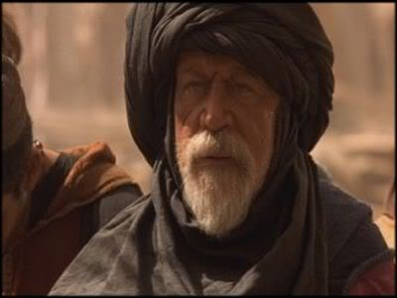
Craftsmen were skilled workers such as – pottery makers, leatherworkers, sculptors, painters, weavers, jewellery makers, shoe makers, tailors. Groups of craftsmen often worked together in workshops.
Naturally, there were people needed to buy goods from artisans and traders. These were the merchants and storekeepers who sold these goods to the public.

Slide 16
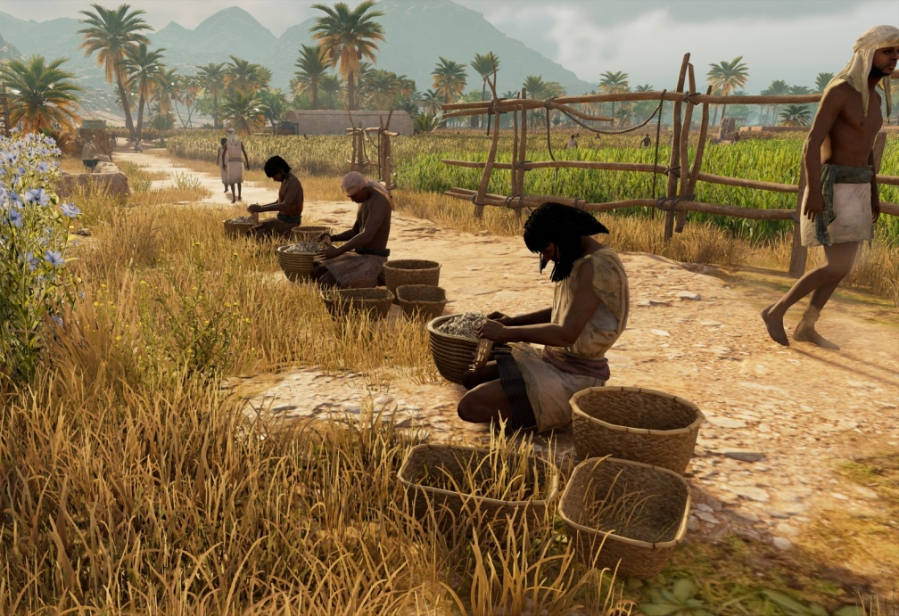
Farmers worked the land of the Pharaoh and nobles and were given housing, food and clothes in return.
Some farmers rented land from nobles and had to pay a percentage of their crop as their rent.

Slide 17
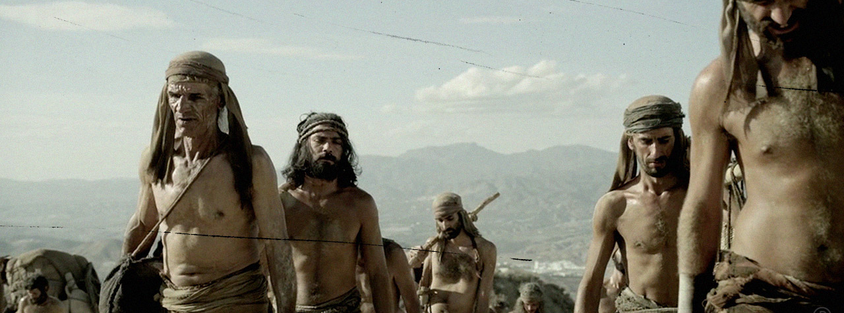
There were no slave markets or auctions in Ancient Egypt. Slaves were usually prisoners captured in war. Slaves could be found in the households of the Pharaoh and nobles, working in mines and quarries and also in temples.

Slide 18
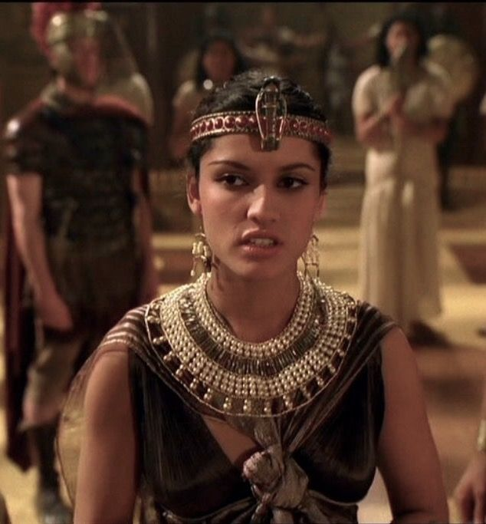
Family Life in Egypt
It’s interesting to note that Egyptian women enjoyed some legal rights that quite unusual when compared to others in antiquity. They could:
Own property
Make contracts
Divorce their husbands
Keep their property after a divorce

Slide 19
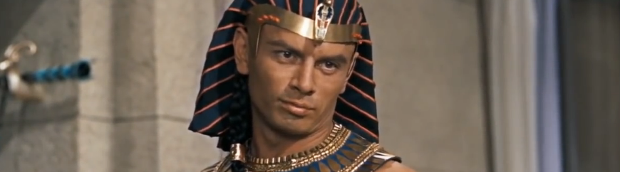
Ramses the Great
Perhaps the greatest of all the Egyptian pharaohs. During his reign, Ramses II led the Egyptian army against several enemies including the Hittites, Syrians, Libyans, and Nubians. He expanded the Egyptian empire and secured its borders against attackers.
Click Here!

Slide 20
Final thoughts
Pharaohs faced many challenges to their rule.
After defeating the Hyksos, the Kingdom expanded in territory and wealth.
People in Egypt worked at many different jobs.

Slide 21
Part II: Achievements
Egyptians had a rich and varied history, but most people today remember them for their cultural achievements, such as their unique writing system. Additionally, Egyptian art, including tomb paintings are admired by millions of people from around the world. Read about them in pages 102 – 106 and complete the section 4 assessment. Show me the completed work when complete.

Slide 22
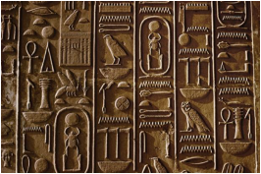
Egyptian Writing
The ancient Egyptians believed that writing was invented by the god Thoth and called their hieroglyphic script "mdju netjer" ("words of the gods"). Hieroglyphics were a writing system, that was one of the first in the world. The last known use of hieroglyphics was in 394 AD.
Hieroglyphic writing began to be replaced by Coptic, a form of Greek writing.

Slide 23
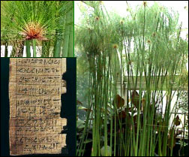
Click Here!
The earliest known examples of Egyptian writing are from 3300 BC. These were carved. Later, papyrus, a long-lasting material made from reeds, was invented. Scribes recorded in writing the everyday life and extraordinary happenings in ancient Egypt. Egyptians kept most of their records on papyrus.

Slide 24
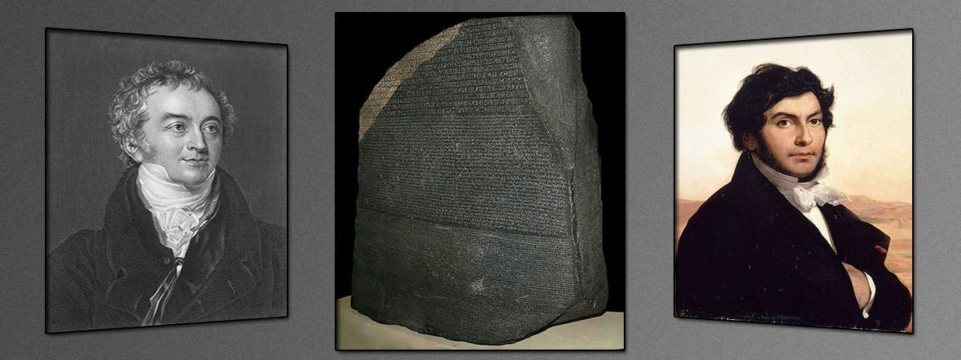
The Rosetta Stone
The Rosetta Stone is one of the most important objects in the British Museum as it holds the key to understanding Egyptian hieroglyphs.

Slide 25
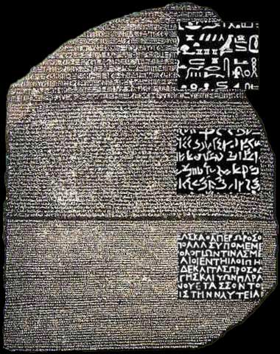
Click Here!
Before it was discovered, nobody knew how to read ancient Egyptian hieroglyphs! Because the inscriptions say the same thing in three different scripts, and scholars could still read Ancient Greek, the Rosetta Stone became a valuable key to deciphering the hieroglyphs. A door was opened to understand a great number of ancient texts.

Slide 26
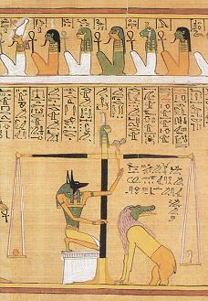
Egyptian Texts
Ancient Egyptian literature was preserved on a variety of media. This includes papyrus scrolls, limestone, wooden writing boards, monumental stone edifices and coffins. Texts unearthed by modern archaeologists are but a small fraction of their literary material. Examples include the well-preserved Book of the Dead, funerary papyri placed in tombs to act as afterlife guides for the ka of the deceased.

Slide 27
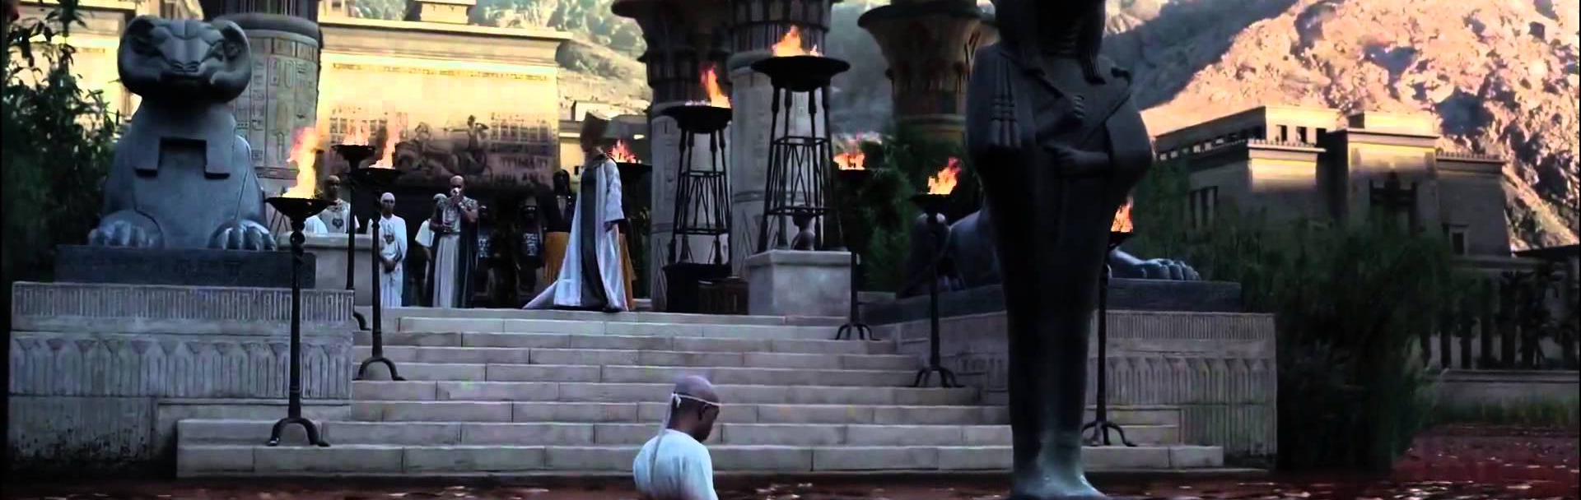
Egypt’s Great Temples
Egyptians are believed to be responsible for some of the most impressive buildings ever made. They built their pyramids, tombs, temples and palaces out of stone, the most durable of all building materials.

Slide 28
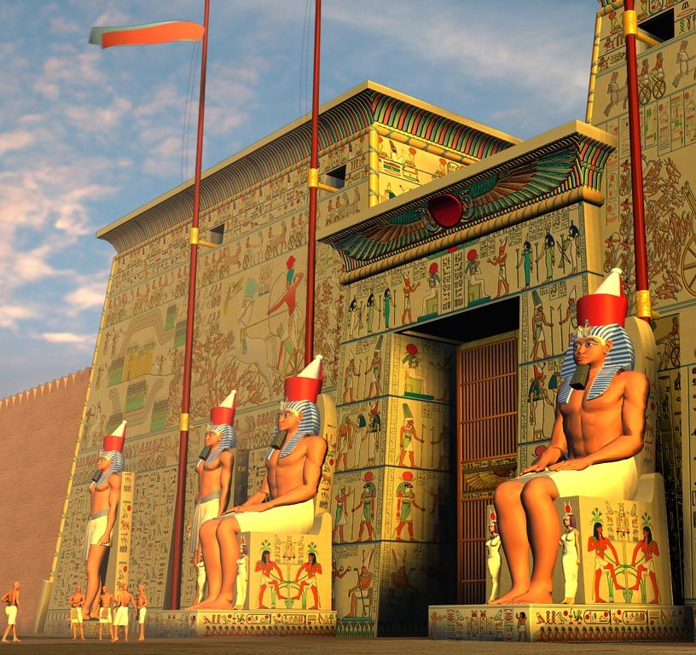
Among the most impressive examples of their architecture are:
The Sphinx of Giza
Click Here!
Egyptians built sphinxes (mythic creatures with bodies of lions and heads of humans) statues to guard important areas such as tombs and temples. The most famous Sphinx is the Great Sphinx of Giza.

Slide 29
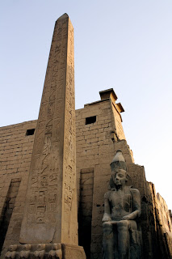
The Obelisk
Were tall four-sided monolithic pillars, originally erected in pairs at the entrances of ancient Egyptian temples. represented the benben, the primordial mound upon which the god Atum stood at the creation of the world. The Obelisk of Queen Hatshepsut at Karnak is one of the most famous obelisks.

Slide 30
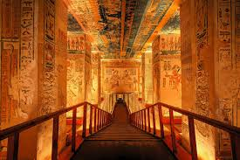
Temple of Karnak - Ipet-isut
The pharaohs of the New Kingdom lavished attention on the Temple of Amun. ... The importance of Karnak resided in its being the contact point between Amun, the supreme ruler of the universe, and the pharaoh, the supreme ruler on Earth. It is The largest religious building ever constructed.

Slide 31
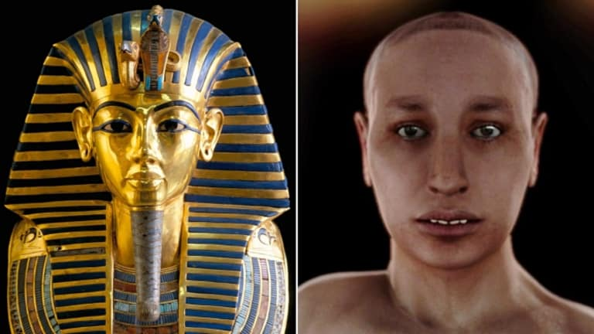
King Tutankhamen
Click Here!
Tutankhamen, an Egyptian pharaoh of the 18th dynasty, during the period of Egyptian history known as the New Kingdom, is the most famous and instantly recognizable pharaoh in the modern world. He is known chiefly for his treasure-filled tomb, discovered in the Valley of the Kings in 1922. His beautiful golden sarcophagus is now a symbol almost synonymous with Egypt. Tutankhamen unexpectedly died in his 19th year.

Slide 32
Final thoughts
Ancient Egypt developed one of the best-known culture of Antiquity.
Some elements of their culture can still be seen in the Modern world.

Slide 33
Assessment
Complete the Chapter 4 Review from pages 115-116.
Complete the Chapter 4 Standardized Test Practice from page 117.

