Slide 1
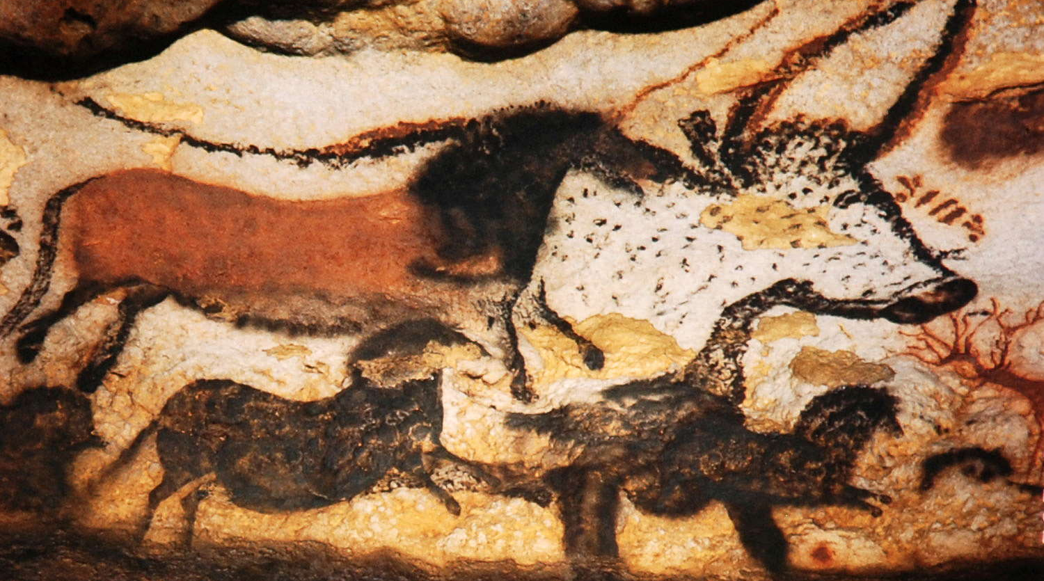
WORLD HISTORY
The First People
with Mr. Jim Soto

Slide 2
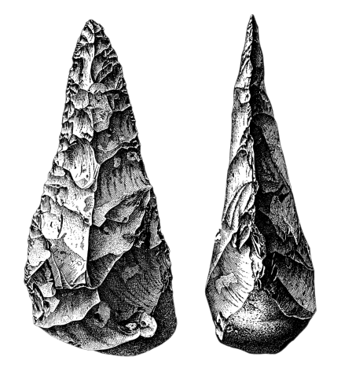
Think...
The year is 200,000 B.C.
Some offers to teach you a new skill. Your mentor strikes two black flint rocks together. A fragment flakes off. You try to copy the maneuver, but the rocks just break. Finally you learn to strike the rock just right. You now have a sharp stone knife! How will you use your new skill?
Take a minute to write it down.

Slide 3
Over millions of years early people learned many things. Making tools was one of the most valuable skills they developed. We can learn a lot about these early humans from the tools and objects they made.

Slide 4
Scientists Study Remains
There exist two prevailing views regarding the origin of the human species.
The first one is that humans are the result of intelligent design. In other words, were created.
The second one postulates that humans are the result of what is called an evolutionary process.
The authors of your text book embrace this view.

Slide 5
Maybe neither view should be taken as definitive, however this doesn’t mean you can’t choose a position.
To learn more about this topic read pages 28 thru 35 and complete the section 1 assessment. Show me the completed work when complete.

Slide 6
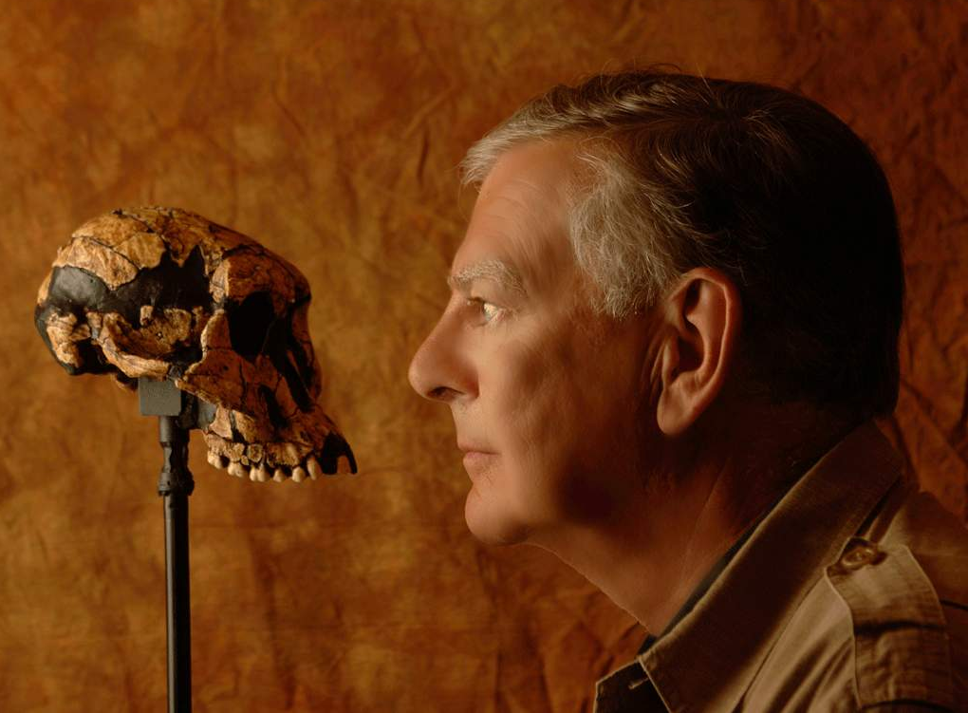
Hominids
The study of history that predates the invention of writing is called prehistory.
This type history relies heavily on the work of archaeologists and anthropologists.
An important discovery in evolutionary anthropology was made by Donald Johansson in 1974. He found the remains of a 3 million year old hominid (or early ancestor to humans) he called “Lucy”.

Slide 7
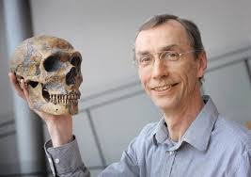
Carbon 14 Dating
Click Here!
In 1994 Tim White found remains that are believed to be 4.4 million years old. However not all scientist agree since carbon dating has proven to have a spotty reputation. Let’s watch a video on the subject.

Slide 8
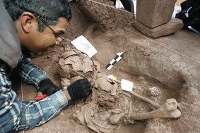
Carbon dating, or system of calculating the age of a very old object by measuring the amount of radioactive carbon it contains, is very controversial and a number of scientists disagree about its reliability. Let’s watch another video on the subject, but from a different perspective.
Click Here!

Slide 9
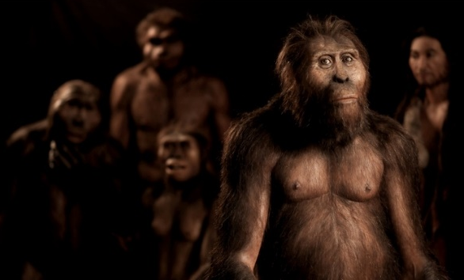
Other Hominids & Early Humans
According to some scientists, hominids began appearing in Africa 1.5 million years ago and started spreading to Eurasia. Some of their names include:
Australopithecus
Homo erectus
Homo neanderthalensis
Cro-Magnon
Other scientists refute the idea of hominids’ existence.
Click Here!

Slide 10
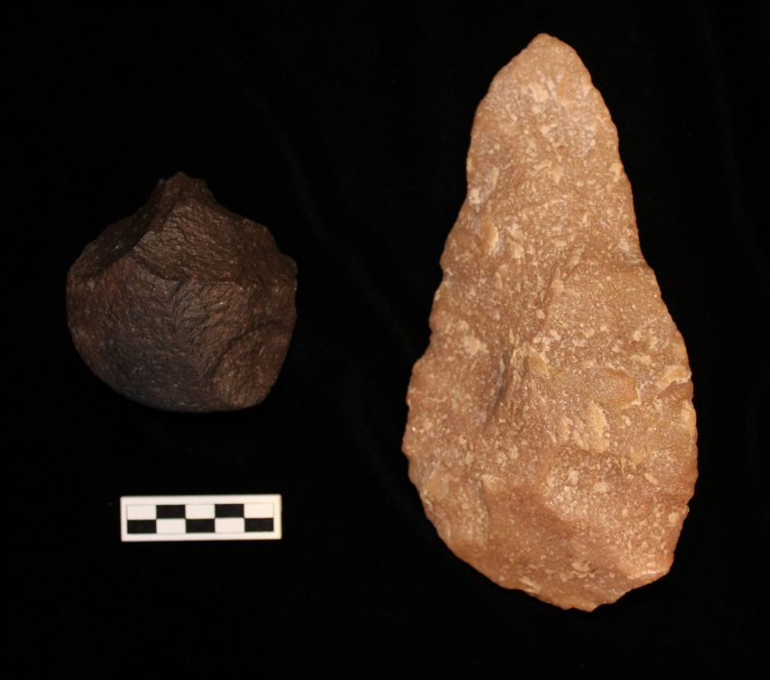
Stone Age Tools
Archaeologists find it useful to divide what they call the Stone Age, a broad prehistoric period during which stone was widely used, into three distinct eras, based on the kinds of tools used at a time. They were:
The Paleolithic
The Mesolithic
The Neolithic
Click Here!
What could the first tool have been?

Slide 11
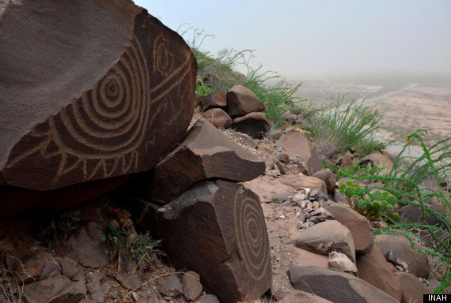
Click Here!
The Stone Ages, which span a huge period of human history, were a remarkable time of discovery in human history. Lets watch a video that explains it…

Slide 12
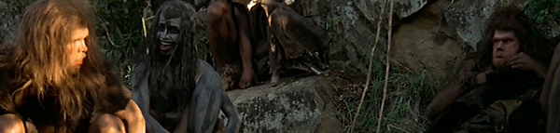
Hunter- Gatherers
The earliest human societies were Hunter-gatherers, people who lived by hunting and collecting food rather than by farming. Most of the hunting was probably done by the men. Gathering was most likely done by the women. There are still groups of hunter-gatherers living in some parts of the world.

Slide 13
Language, Art, & Religion
Probably, the most important development of the Paleolithic was language. This, however, was not the only mode of human expression, since art and religion also are. Humans have always been artistic and religious. Art expresses how humans perceive their reality and religion how humans understand the meaning of that reality.
Click Here!

Slide 14
Final thoughts
History is the study of the past.
There are two prevailing views regarding the origin of humanity: one is we are the result of intelligent design and the other that we are the result of an evolutionary process.
That humans began appearing in Africa 1.5 million years ago and then spread to Eurasia.
That the Stone Age was a remarkable time of discovery in human history.

Slide 15
NEXT
Migration
Jim Soto © 2018

