Slide 1
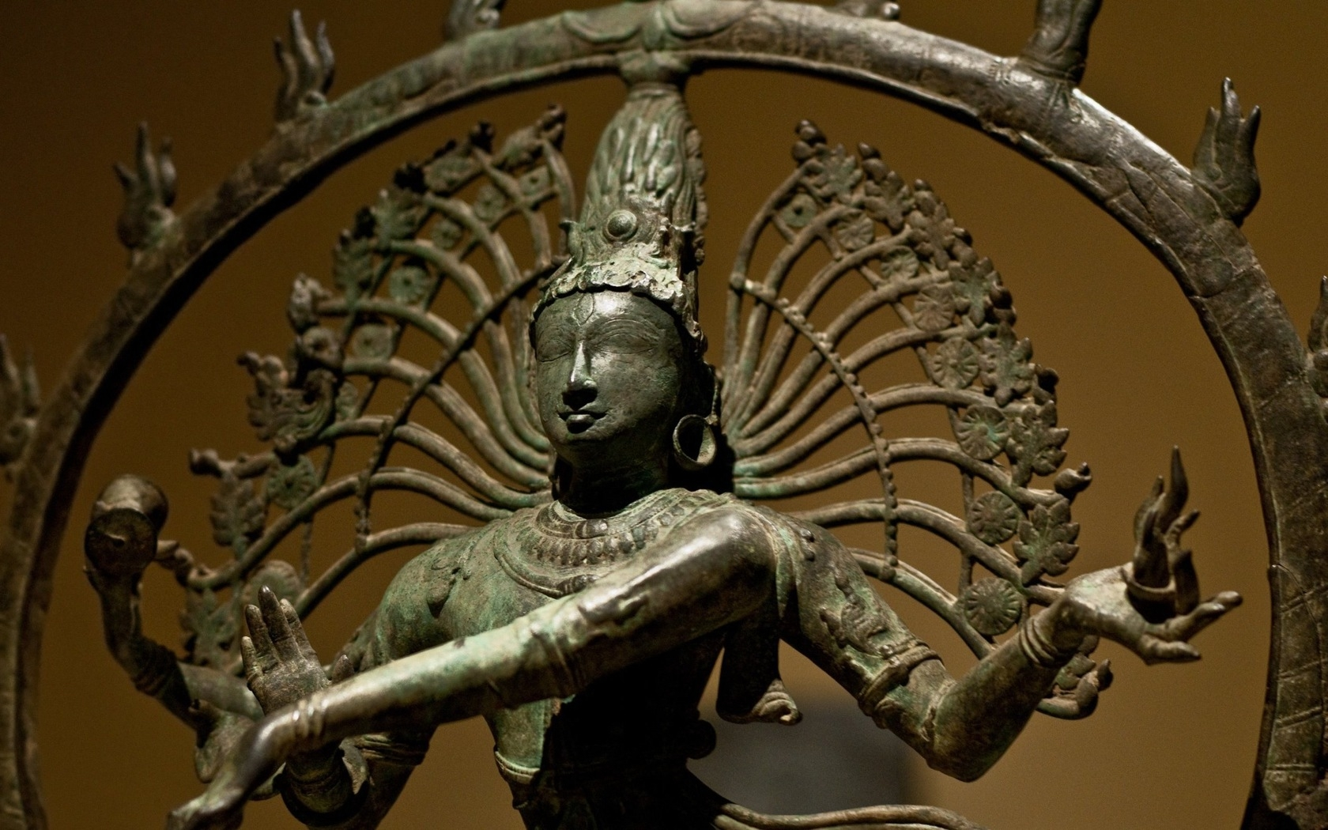
WORLD HISTORY
Origins of Hinduism
with Mr. Jim Soto

Slide 2
Think...
Your family are skillful weavers that make beautiful cotton cloth. You belong to the class of people in Aryan society who are farmers, traders and craftspeople. Often the raja of your town leads the warriors into battle. You admire their bravery but you know you can never be one of them. To be an Aryan warrior, you must be born into that noble class. Instead, you have your own duty to carry out. How do you feel about remaining a weaver?
Take a minute to write down your answer.

Slide 3
As the Aryans moved into India, they developed a strict system of social classes. As the Aryans’ influence spread through India, so did their class system. Before long, this class system was a key part of Indian society.
To learn more about this topic and others, read pages 130 thru 135 and complete the section 2 assessment. Show me the completed work when complete.

Slide 4
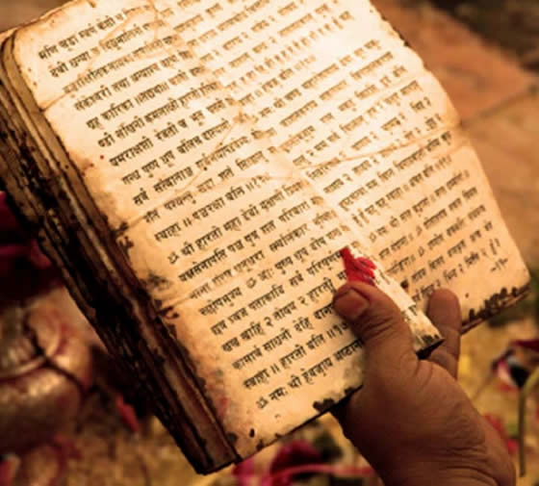
Indian Society Divides
As Aryan society developed, their religion and society became more complex. The Vedas, a collection of hymns and other ancient religious texts written between about 1500 and 1000 BC.
It included elements such as religious material as well as mythological accounts, poems, prayers, and formulas considered to be sacred.
Click Here!

Slide 5
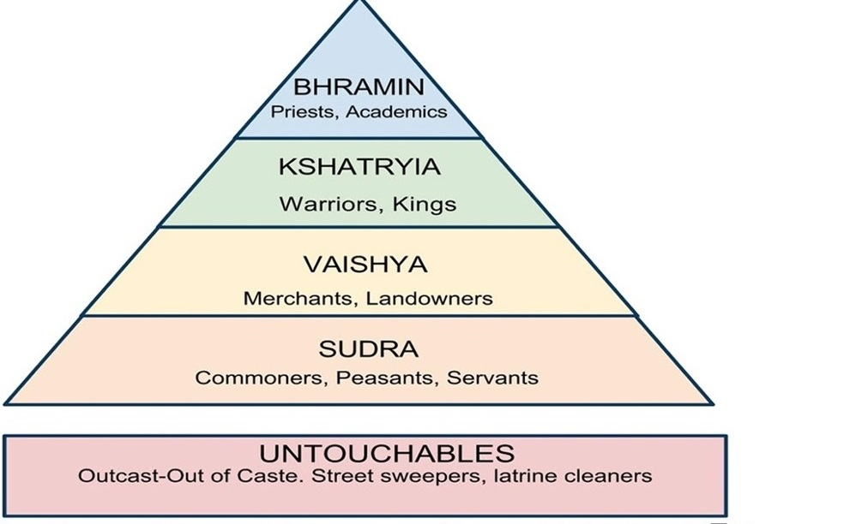
The Vedas prescribed four main varnas in society. Varna is a Sanskrit word which means type, order, color or class. It refers to the four social classes. Lets observe each one.

Slide 6
Brahmins
(priests, scholars and teachers)
What does it mean to be a Brahmin? A person who knows God; a priest. Brahmin is one of the four Hindu castes. Representing the fourth and highest Hindu caste or varna in the ancient system. Brahmins are characterized by their contemplative nature. In sharing their spiritual wisdom. Brahmins are believed to be both inspired and inspiring.

Slide 7
Kshatriyas
(rulers, warriors and administrators)
Kshatriyas fall in the second category of the Varna system after Brahmans. Like a Brahman is the one who has found inner peace and found God in himself, similarly a Kshatriya is the one who has found God in action. Thus, Kings, rulers and warriors are called Kshatriyas.

Slide 8
Vaishyas
(agriculturalists and merchants)
Vaishya is the third highest status of the four varnas, traditionally described as commoners. The Vaishyas were commoners, not servile groups. Their role lay in productive labor, in agricultural and pastoral tasks, and in trading.

Slide 9
Shudras
(laborers and service providers)
The Shudras are the lowest-ranking of the four varnas; but they are definitely higher in rank than the Untouchables or Panchamas, a category so demeaned in status that it is not even referred to in the classical varna model.

Slide 10
Panchamas / Dalits / Sudras
(manual scavengers, the removers of human waste and dead animals, leather workers, street sweepers)
Those who fall out of this system because of their grievous sins are ostracized as outcastes (untouchables) and considered so despicable that they fell outside the varna system. Their mere touch was considered "polluting" to a caste member. Thus, the concept of "untouchability" was born.
Click Here!

Slide 11
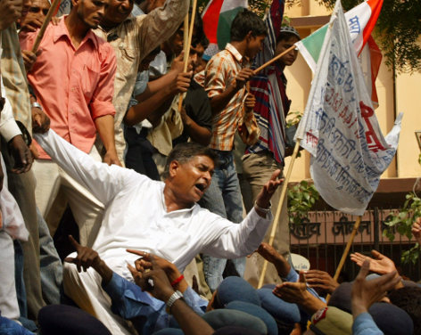
Today
The Caste System has been illegal in India for over fifty years now, but it still shapes people’s lives in 2018. The Indian government has given the untouchables certain employment privileges, and granted them more representation in the Indian government. Although they are treated more fairly, they still have fewer educational and employment opportunities than Indians from higher castes.

Slide 12
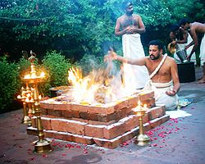
Brahmanism
Religion was an important aspect of Aryan life. Because the religious leaders were called Brahmins their religion came to be called Brahmanism.
Brahmanism is considered to be the predecessor of Hinduism. Brahmanism is the central theme and belief of Vedic followers, its thoughts and philosophical concept gave rise to Hinduism.

Slide 13
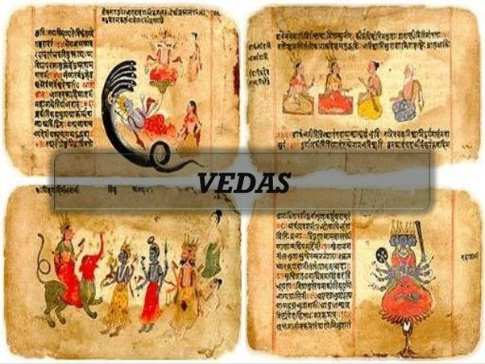
More About the Vedas
Almost every religion has an important or sacred text. In Brahmanism/Hinduism there are several. The oldest one is the Vedas, a collection of hymns, liturgical material, mythological accounts, poems, prayers, and formulas considered to be sacred. There are four Vedas. Since they considered women inferior, they weren’t allowed to read them.
Click Here!

Slide 14
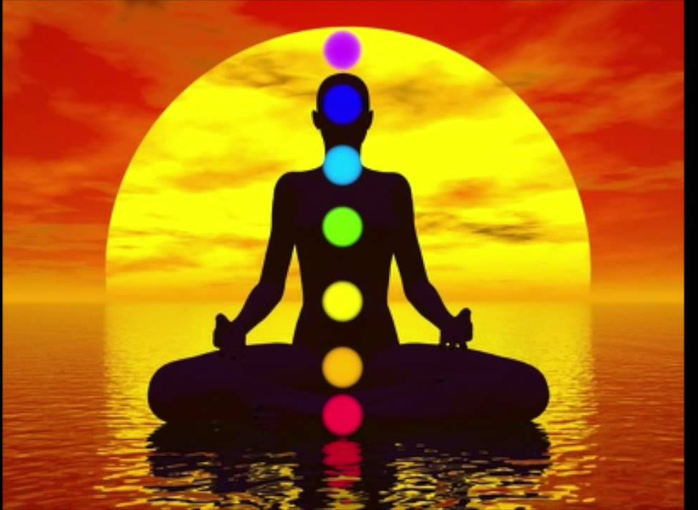
Other Vedic Writings
In addition to the Vedas, there are the Upanishads, which comprise the final Vedas and concern the soul (Atman) and its pursuit of “ultimate reality” (Brahman). The teachings of the scriptures are both religion and philosophy, and constitute the basic principles for eastern religions, like Hinduism and Buddhism.

Slide 15
Hinduism Develops
These writing have remained the basis for Indian religion for millennia. Eventually these ideas mixed with those of other cultures, especially those of people from Persia and Central Asia. This blending made Brahmanism evolve into Hinduism, the largest religion in India.

Slide 16
Hindus believe in many gods, all 33 million of them.
Click Here!
BRHAMA
VISHNU
SHIVA
There is a triumvirate or Trimurti consisting of three gods in charge of the creation, upkeep and destruction of reality. Vishnu is the preserver of the universe, while Shiva's role is to destroy it. Brahma's job was creation of the world and all creatures. His name should not be confused with Brahman, who is the supreme God force present within all things. Therefore, everything that exists is part of Brahman.

Slide 17
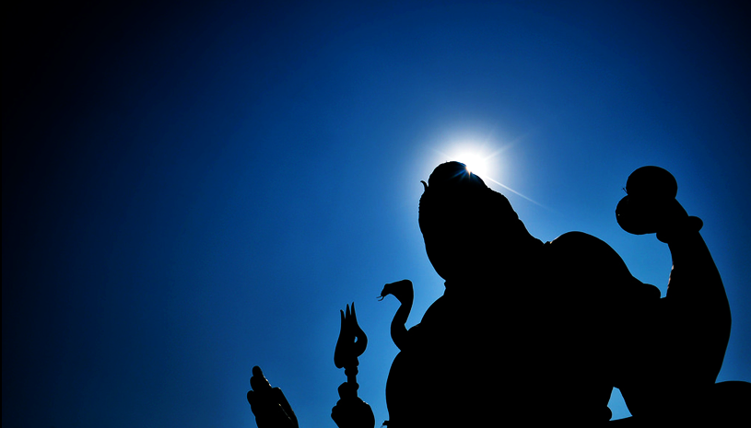
Hindus believe that the soul (atman) passes through a cycle of successive lives (samsara) and its next incarnation, or reincarnation, is always dependent on how the previous life was lived (karma). Moksha is the end of the death and rebirth cycle and is classed as the fourth and ultimate artha (goal).
Click Here!

Slide 18
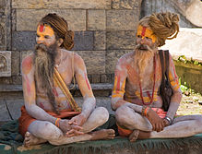
Karma, or the effects that good and bad actions have on a person’s soul, is not assigned by any god; it's simply earned by an individual and passed down through subsequent lives. But while good karma can eventually earn a person a higher place in the caste system in a future life, the ultimate goal of any Hindu adherent is Moksha, or salvation from samsara.

Slide 19
Jainism
Not everyone agreed with the beliefs of Hinduism. Jainism emerged about the 6th century BC in reaction to Brahmanic Hinduism. Jainism is based upon the teaching of Mahavira. One of their most important principles is the practice of nonviolence (ashima). This makes them practical Vegans.

Slide 20
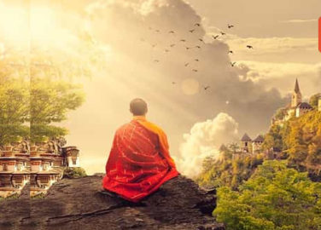
Jains do not have one God, but Jain gods are innumerable and their number is continuously increasing as more living beings attain liberation. In other words, freedom from samsara = godhood. Jains believe that since the beginning of the time every living being (soul) because of its ignorance, is associated with karmas.

Slide 21
Final thoughts
Aryans developed a strict system of social classes called varnas in order to structure their society.
Brahmanism, the Vedic religion of the Aryans, evolved into Hinduism.
Jainism was another offshoot of Brahmanism.

Slide 22
NEXT
BUDDHISM
Jim Soto © 2018

