Slide 1
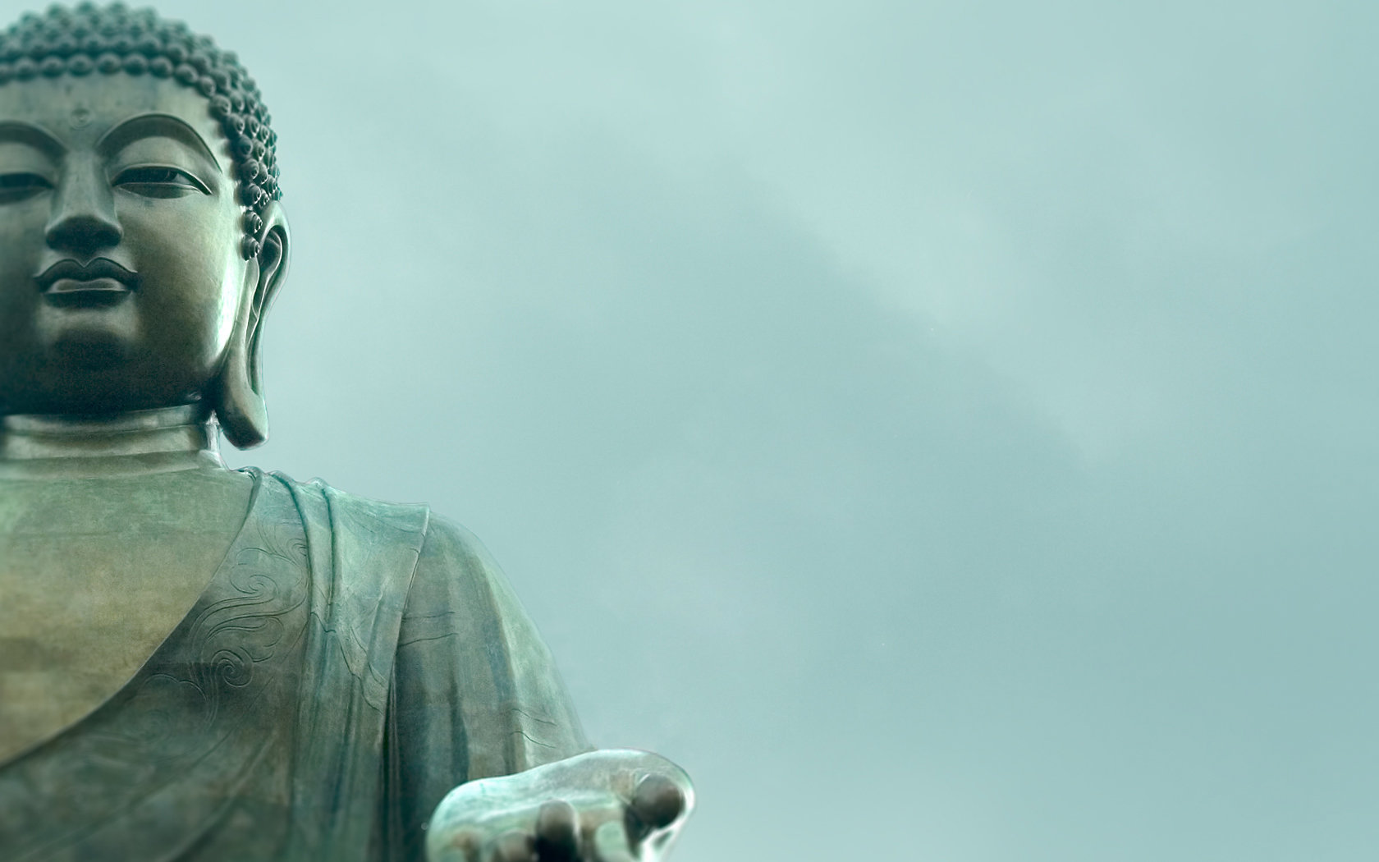
WORLD HISTORY
Origins of Buddhism
with Mr. Jim Soto

Slide 2
Think...
You are a trader traveling to northern India in about 520 BC. As you pass through the town, you see a crowd of people sitting silently in the shade of a huge tree. A man sitting at the foot of the tree talks about how one ought to live. His words are like nothing you have heard from a Hindu priest. Will you stay and keep on listening? Why or why not?
Take a minute to write down your answer.

Slide 3
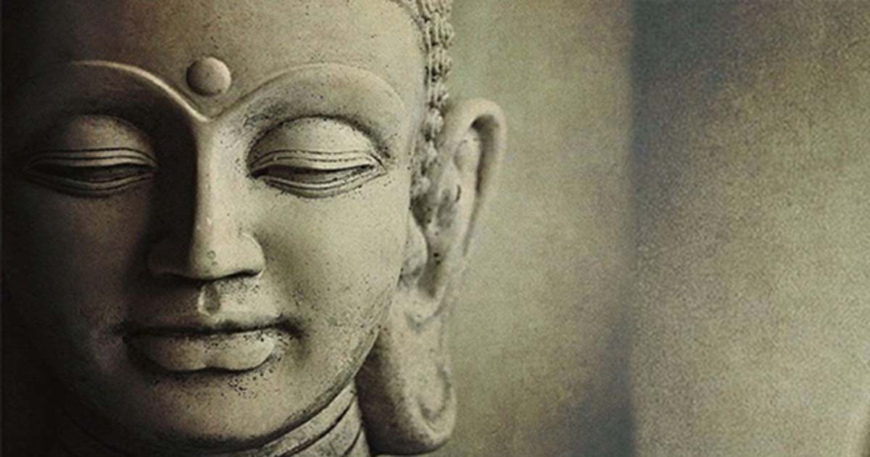
The Jains weren’t the only ones to break from Hinduism. In the 500s BC a young Indian prince attracted many people to his teachings about how we should live. Read about it in pages 136 – 141 and complete the section 3 assessment. Show me the completed work when complete.

Slide 4
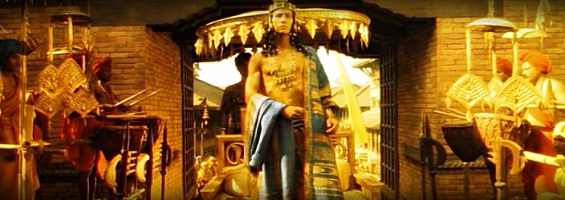
Siddhartha Gautama, known as the Buddha, was born in the 6th century BC in what is now modern Nepal. His father, Suddhodana, was the ruler of the Sakya people and Siddhartha grew up living the lavish life of a young prince.
Click Here!

Slide 5
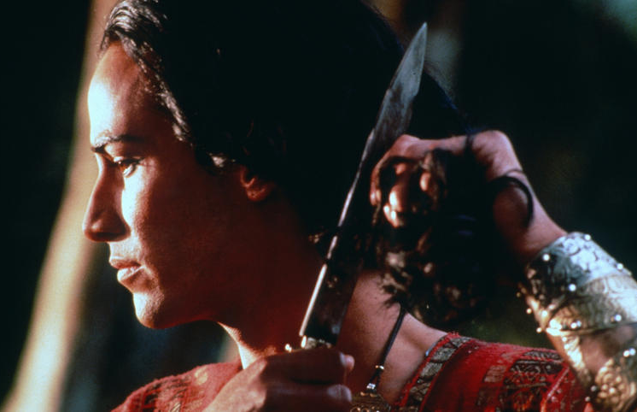
Siddhartha's Search for Wisdom
His father had ordered that he live a life of total seclusion, but one day Siddhartha ventured out into the world and was confronted with the reality of the inevitable suffering of life. The next day, at the age of 29, he left his kingdom and newborn son to lead an ascetic life and determine a way to relieve universal suffering.
Click Here!

Slide 6
The Buddha Finds Enlightenment
Click Here!
For 6 years, he submitted himself to rigorous ascetic practices, studying and following different methods of meditation with various teachers. But he was never fully satisfied. One day, after fasting and meditating, he was offered a bowl of rice from a young girl and he accepted it. In that moment, he realized that physical austerities were not the means to achieve liberation. From then on, he encouraged people to follow a path of balance rather than extremism. He called this The Middle Way.

Slide 7
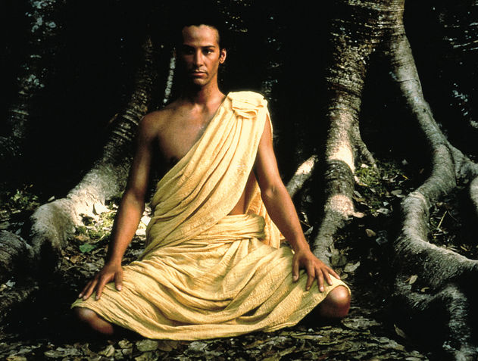
That night Siddhartha sat under the Bodhi tree, and meditated until dawn. He purified his mind of all defilements and attained enlightenment at the age of 35, thus earning the title Buddha, or "Enlightened One". For the remainder of his eighty years, the Buddha preached the Dharma in an effort to help other’s reach enlightenment.
Click Here!

Slide 8
Teachings of Buddhism
As he traveled, the Buddha gained many followers, especially among India’s merchants and artisans. He even taught a few kings. These followers were the first believers in Buddhism, the religion based on the teachings of the Buddha. At the heart of his teachings were The Four Noble Truths, the essence of Buddha's teachings, though they leave much left unexplained. They are the truth of suffering, the truth of the cause of suffering, the truth of the end of suffering, and the truth of the path that leads to the end of suffering.
Click Here!

Slide 9
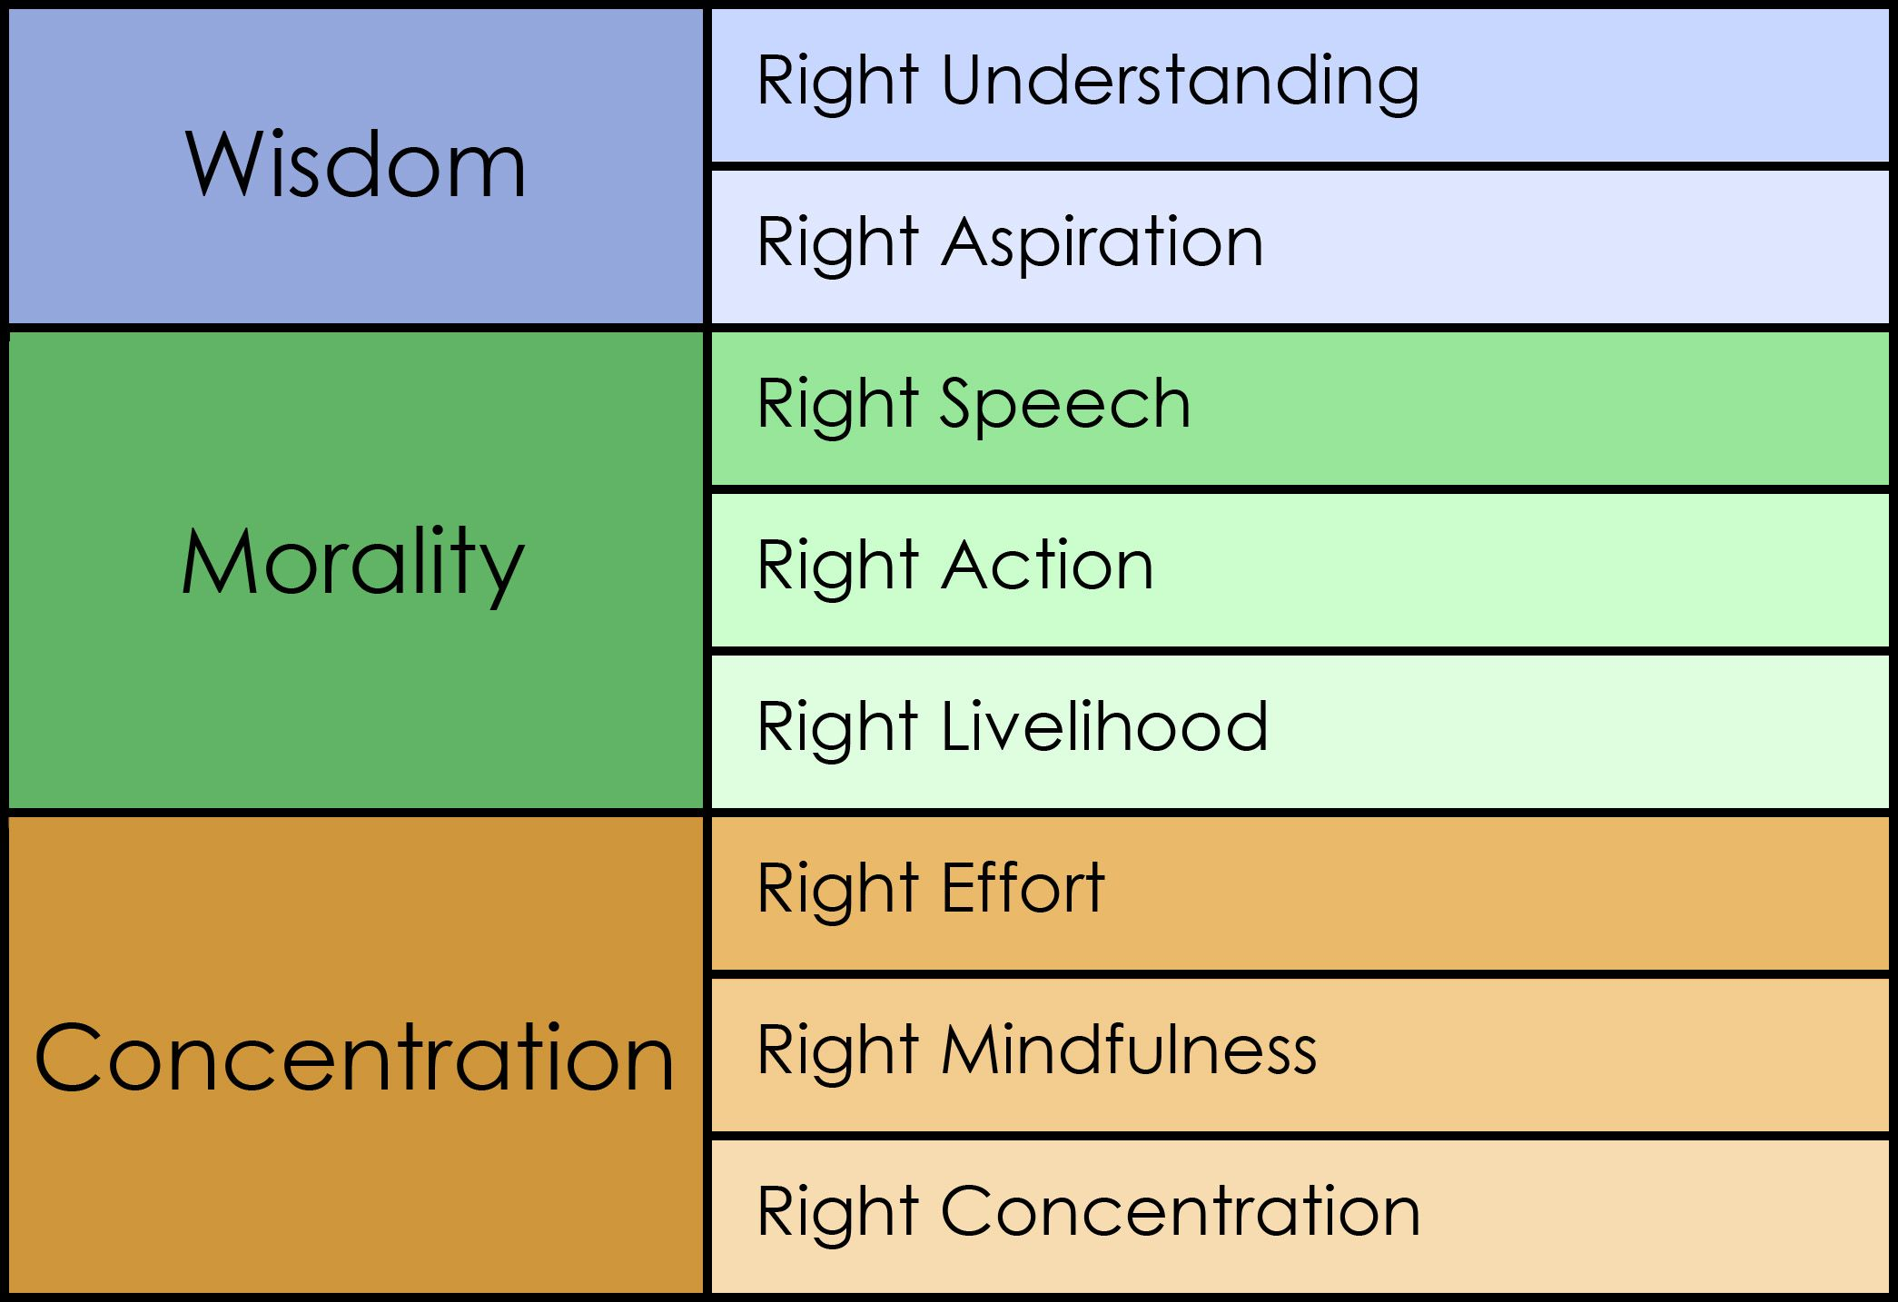
The Eightfold Path
The Eightfold Path is an early summary of the path of Buddhist practices leading to liberation from samsara, the painful cycle of rebirth. It’s the road to Nirvana through rightness of belief, resolve, speech, action, livelihood, effort, thought, and meditation.

Slide 10
Buddhism and Hinduism agree on karma, dharma, moksha and reincarnation. They are different in that Buddhism rejects the priests of Hinduism, the formal rituals, and the caste system. Buddha urged people to seek enlightenment through meditation.

Slide 11
Buddhism Spreads: In India
Buddhism spread outside of the Magadha Kingdom during the Buddha's lifetime. The Buddhist Emperor Asoka promoted Buddhist expansion by sending missionaries, people that spread a religious belief, to surrounding territories to share the teachings of the Buddha. A wave of conversion began, and Buddhism spread not only through India, but also internationally.

Slide 12
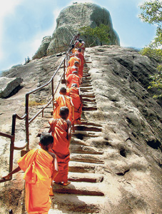
Buddhism Spreads: Beyond India
There are many factors contributed to the early spread of Buddhism out of India. The main one being that it has always been a missionary religion. Buddhism spread due to the work and travel of missionaries. It spread throughout Central and south east Asia. The Silk Road helped its spread to China, Korea, then Japan.

Slide 13
Splits within Buddhism
Even as Buddhism spread, it began to change. Not all Buddhists agreed on their beliefs. Eventually there was a split within the ranks. Buddhism today is divided into two major branches known to their respective followers as Theravada, the Way of the Elders, and Mahayana, the Great Vehicle. Followers of Mahayana refer to Theravada using the derogatory term Hinayana, the Lesser Vehicle.

Slide 14
Final thoughts
Buddhism is one of India’s major Religions.
Buddhism grew more popular once it was adopted by Ancient India’s great emperors.
The two major branches of Buddhism are Theravada and Mahayana.

Slide 15
NEXT
INDIAN
EMPIRES
Jim Soto © 2018

