Slide 1
WORLD HISTORY
with Mr. Jim Soto
Indian Empires

Slide 2
Think...
You’re an Indian merchant in about 240 BC. You travel from town to town on your donkey, carrying bolts of colorful cloth. In the summer heat, you are grateful for the banyan trees on the side of the road that shelter you from the blazing sun. You stop at wells for cool drinks of water and rest houses for a break in your trip. You know these are all the work of your king, Asoka. How do you feel about your king?
Take a minute to write it down.

Slide 3
For centuries after the Aryan arrival, India was divided into small states. Each state had it own ruler and India had no central government. Then, in the 3000s BC, a foreign conqueror, Alexander the Great, invaded northwestern India. Although, he wasn’t there too long, his influence affected Indian society for a long time.

Slide 4
To learn more about this topic read pages 142 thru 145 and complete the section 4 assessment. Show me the completed work when complete.

Slide 5
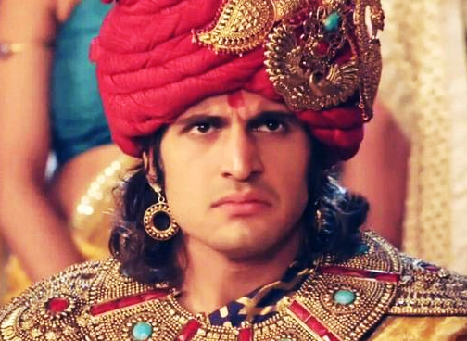
Mauryan Empire Unifies India
In the 320s BC, military, military leader Chandragupta Maurya took control of the northern part of India. was the founder of the Mauryan Empire and the first emperor to unify India into one state. He succeeded in conquering and subjugating almost all of the Indian subcontinent by the end of his reign. He ruled from 322 BC until his voluntary retirement and abdication in favor of his son Bindusara in 298 BC.
Click Here!

Slide 6
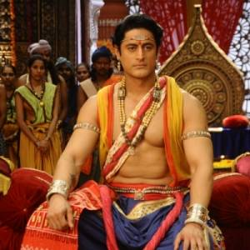
Asoka
Around 270 BC Chandragupta’s grandson, Asoka became ruler. The lethal war with Kalinga transformed the vengeful Emperor Asoka to a stable and peaceful emperor and he became a patron of Buddhism. Nevertheless, his patronage led to the expansion of Buddhism in the Mauryan empire and other kingdoms during his rule, and worldwide from about 250 BC.
Click Here!

Slide 7
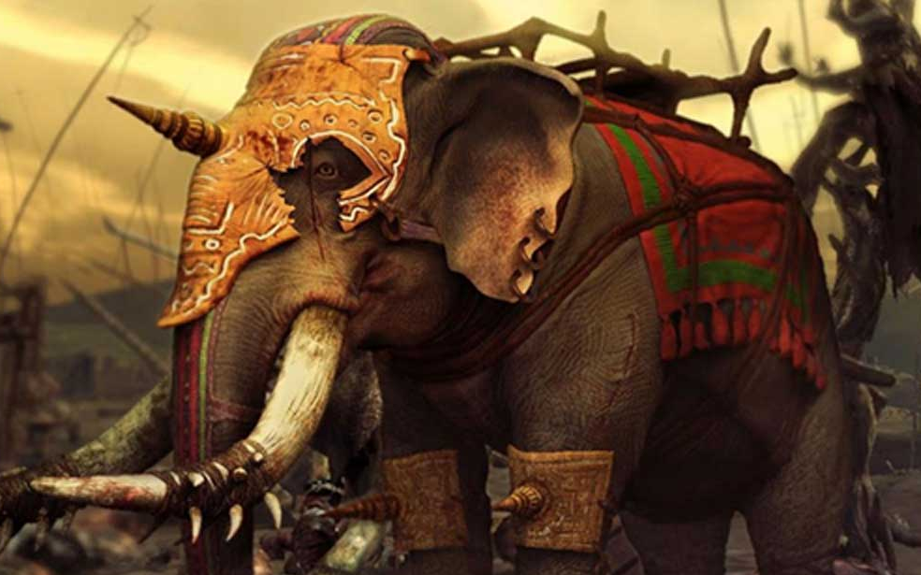
The decline of the Maurya Dynasty was rather rapid after the death of Asoka. One obvious reason for it was the succession of weak kings. Another immediate cause was the partition of the Empire into two. Yet another, is the anger resulting from what the Hindu Brahmins considered demeaning religious policies by Asoka.

Slide 8
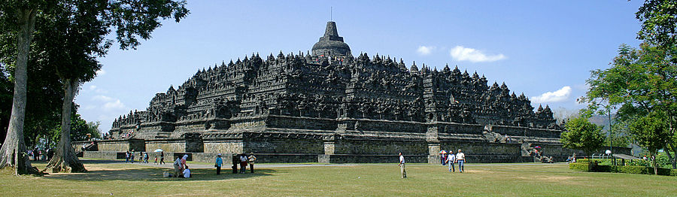
Gupta Rulers Promote Hinduism
Around 320 AD new dynasty appeared: the Guptas. Under Chandra Gupta India united once again. Since the members of this dynasty were Hindi, Hinduism flourished once again under their rule. They built many Hindu temples and promoted Hindu writings and worship practices.

Slide 9
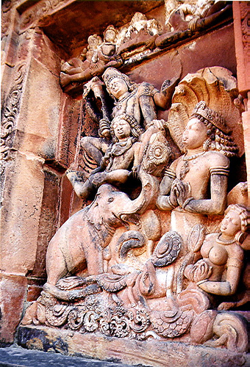
India, under the Gupta Empire (320-480 AD), experienced its most prosperous era in history. Thriving in trade, crafts, and agriculture, the Empire soon became the perfect place for a “tolerant and happy” religion, more suited to living well, to gain popularity. Not containing the demands of Buddhism (the dominant religion in India for 7 centuries) and Jainism; Hinduism was quickly gaining the support of the Royal Guptas.
Click Here!

Slide 10
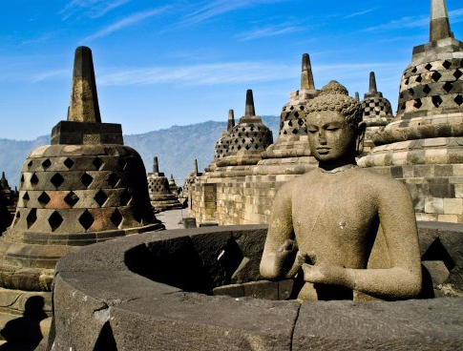
Hinduism soon grew in complexity; adding more rituals, drawing more form astronomy, and copying aspects of both Buddhism and Jainism. Hinduism today owes much of its popularity to the Gupta Empire.

Slide 11
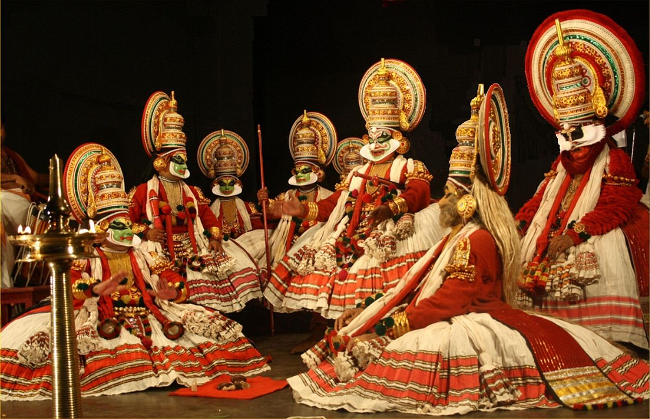
Gupta Society
Chandragupta and Samudragupta used strong armies to expand the empire. Travelers enjoyed freedom of movement to nearby village marketplaces. The Gupta empire had a monopoly on salt. Music, Sculpture, Painting and Dance flourished; math, science, medicine, languages and literature were studied.

Slide 12
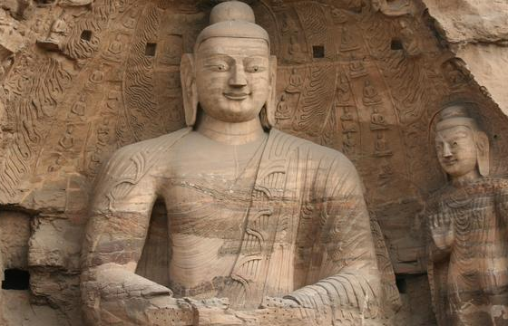
Like the Aryans, the social structure of the Gupta Empire was highly influenced by religion. Hinduism divided the people of the Gupta Empire into five classes. The highest was composed of the priest and teachers, underneath that were the rulers and warriors, then the merchants and artisans, and ending with the unskilled workers.

Slide 13
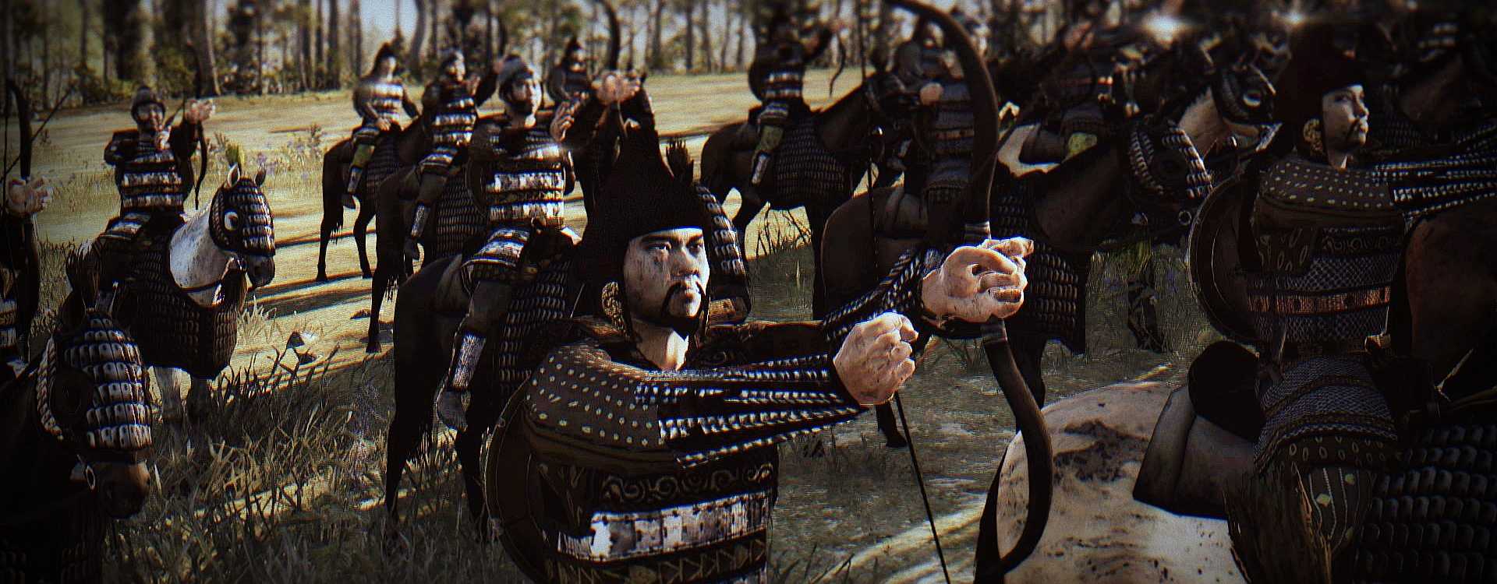
The Guptas remained strong until the late 400s. Around that time a people from Central Asia named the Huns invaded northern India. By the 500s, The Guptas were gone and India divided into smaller kingdoms again.

Slide 14
Final Thoughts
The Mauryans and the Guptas united much of India in their empires.
The Gupta Dynasty is considered the most prosperous time in India’s history.

Slide 15
NEXT
achievements
Jim Soto © 2018

