Slide 1
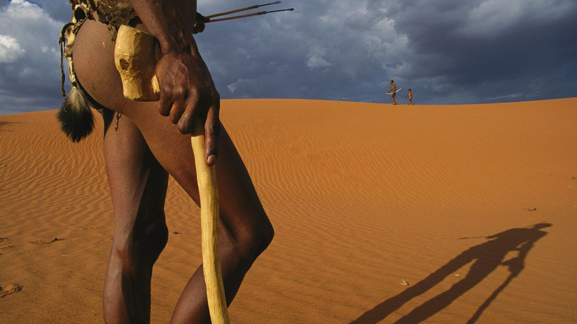
WORLD HISTORY
Early Human Migrations
with Mr. Jim Soto

Slide 2
Think...
You’re a hunter-gatherer. After many years of living in a certain region, there’s hardly any fruit to collect or animals left to hunt. The tribe leader decides it’s time to move to a new home, far beyond the farthest place anyone has been to, how would you feel about this?
Take a minute to write down your thoughts.

Slide 3
Read...
Now, in your textbook, read pages 36 thru 39.
After reading, answer the section 2 assessment. Show completed work to the teacher.

Slide 4
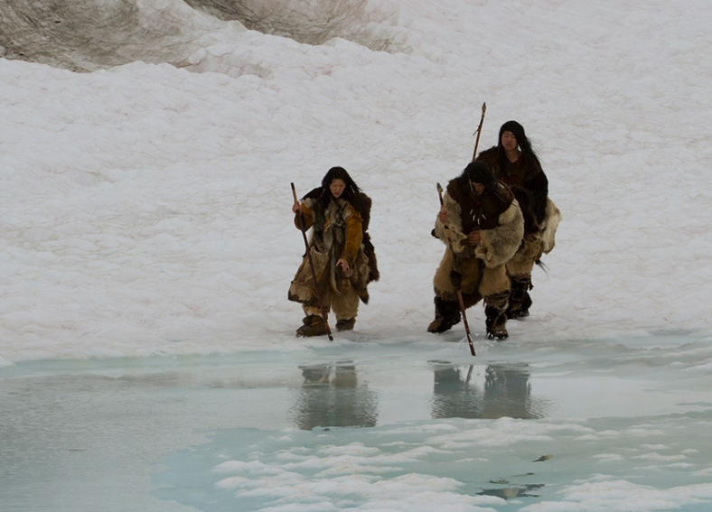
Moving Out of Africa
There have been instances of climate patterns changing drastically in a natural way. There have been periods when most of earth has frozen. The most recent Ice Age ended 10,000 years ago. Huge sheets of ice cover and change the landscape, sometimes connecting separate land masses.
These extreme events have force humans to find new places to live.
Click Here!

Slide 5
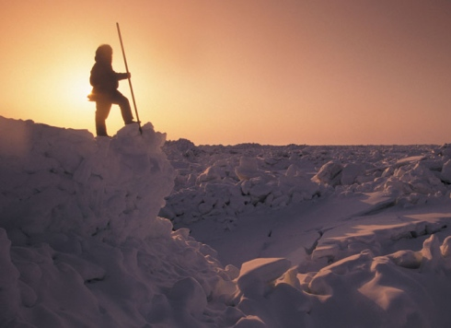
Adapting to New Environments
As people moved to new lands trough thousands of years, they found new environments, with different climates, fauna, and flora. In order to survive, they had to adapt.
New forms of clothing and sheltering had to be developed, and also new, more advanced tools.

Slide 6
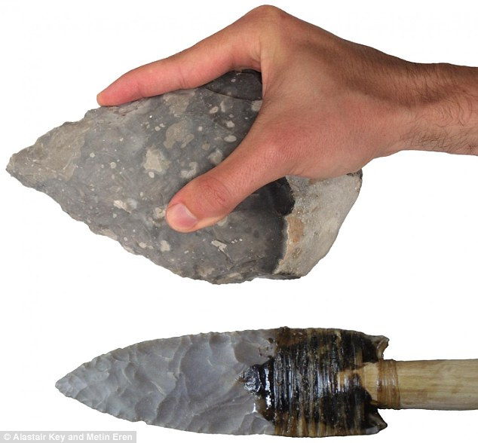
The Mesolithic
Tools became more efficient as time moved on. Bones and rock were the main resources for tool building. Those living near water invented hooks and fishing spears. Others invented the bow and arrow.

Slide 7
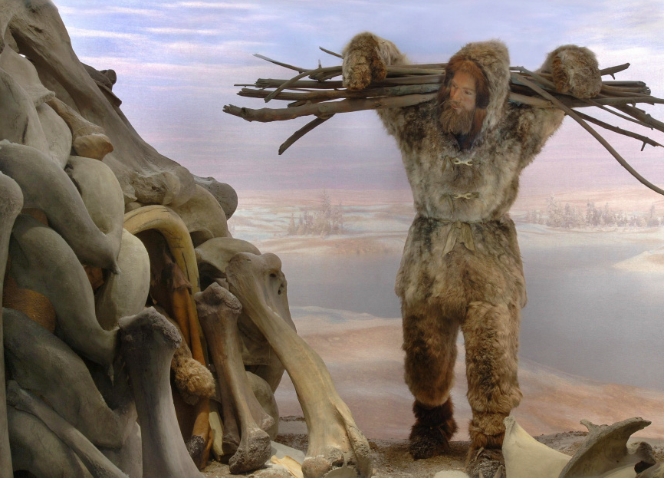
Additionally, some learned how to build canoes by hollowing out tree logs, pottery was invented and the first pets appeared.
Humans moved out of caves and began using animal hides, bones, twine, and timber to build new living habitats. Lets watch some students build a house using Mesolithic materials.
Click Here!

Slide 8
Final thoughts
Humans moved out of Africa looking for resources needed to survive new environmental conditions created by climate changes.
Early people adapted to new environments developing new kinds of clothing, shelter, and tools.

Slide 9
NEXT
Agriculture
Jim Soto © 2018

