Slide 1
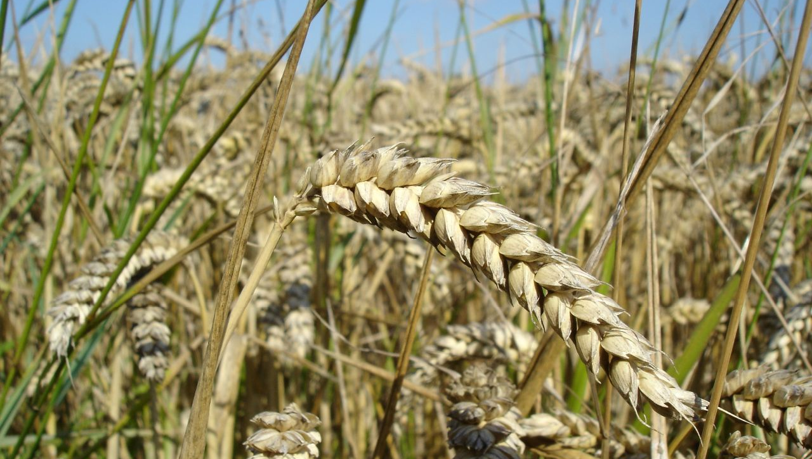
WORLD HISTORY
Beginnings of Agriculture
with Mr. Jim Soto

Slide 2
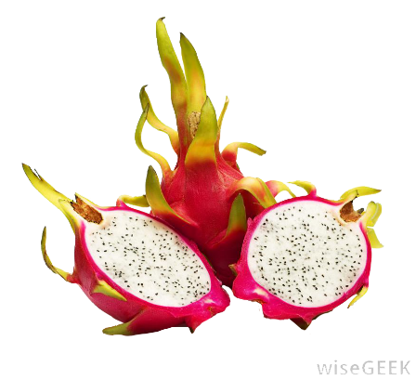
Think...
As a gatherer, you know where to find the sweetest fruits. Every summer, you eat many of these fruits, dropping seeds on the ground. One day you return to find new plants all over. You realize that the plants grew from the seeds you dropped. How could this change the way you live?
Take a minute to write it down.

Slide 3
The discovery that plants grew from seeds was a major advance of the late Stone Age. It change the way we live forever.
To learn more about this topic read pages 40 thru 43 and complete the section 3 assessment. Show me the completed work when complete.

Slide 4
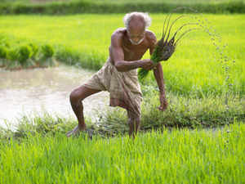
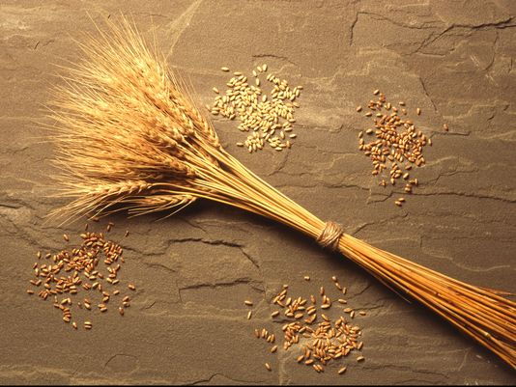
The First Farmers
After having developed some rudimentary tools, farming was invented 9,500 years ago in the Fertile Crescent region of southwest Asia during the Neolithic Era, or the New Stone Age. This era ended when man began using metal.

Slide 5
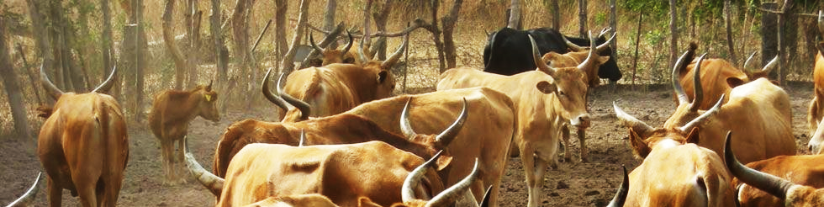
After the last Ice Age passed, new plants stared spreading out. They grew in the wild and people started becoming dependent on them for food. They soon learned that they could plant the seeds and grow their own crops. Eventually, people learned to change plants to make them more useful. The process of changing plants or animals to make them more useful to humans is called domestication.

Slide 6
Farming Changes Societies
The Neolithic Revolution change the way humans lived. With survival more certain, people could now focus on activities other than finding food.
The domestication of animals created a new dynamic where humans could use them in other ways than just eating them.

Slide 7
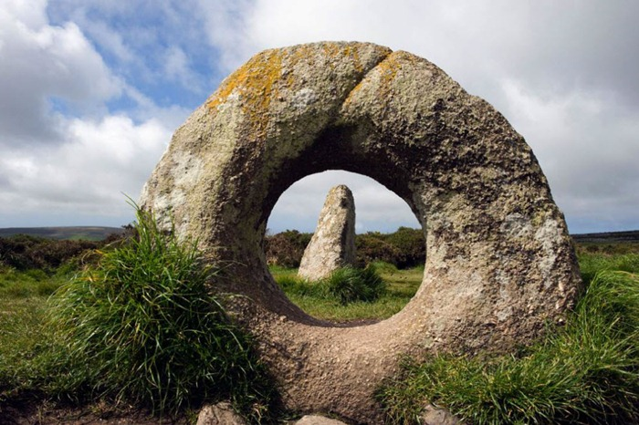
Megaliths
Agriculture and animal husbandry also allowed humans to settle into communities and develop the first towns. People expressed their religious beliefs in group ceremonies. Some built megaliths, or huge stones used as monuments. Many of these has ceremonial utility.

Slide 8
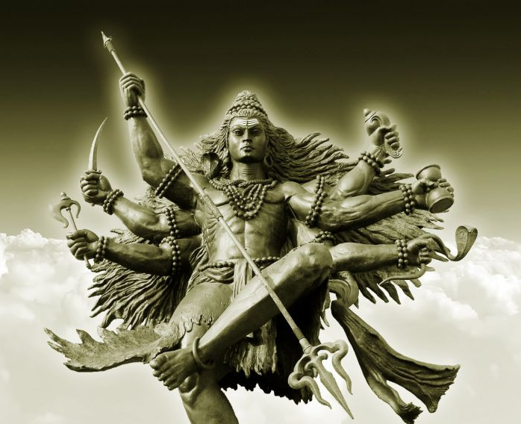
The earliest religions were pantheistic, people thought their gods were part of nature. That’s why there were river gods, thunder gods, sky gods, etc. Modern religions such as Hinduism are highly pantheistic.

Slide 9
Assessment
Complete the Chapter 2 Review from pages 46-47.
Complete the Chapter 2 Standardized Test Practice from page 47.

Slide 10
Final thoughts
Stone Age people adapted to new environments by domesticating plants and animals.
These changes allowed for the development of religion and the growth of towns.

Slide 11
NEXT
FERTILE
CRECSENT
Jim Soto © 2018

