Slide 1
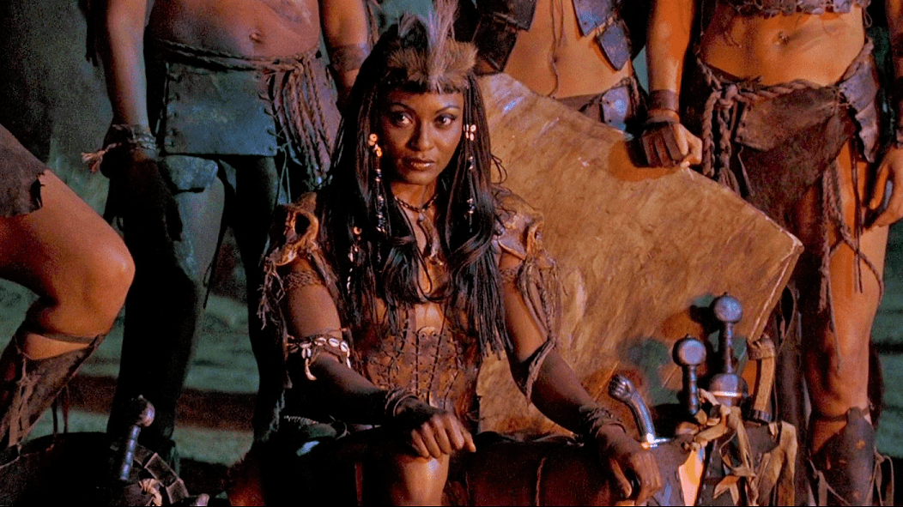
WORLD HISTORY
with Mr. Jim Soto
Ancient Kush

Slide 2
Think...
You live along the Nile, where it moves quickly through rapids. A few years ago, armies from the Kingdom of Egypt took over your country. Some Egyptians have moved to your village. Now your sister has a new baby and she wants to give it an Egyptian name! This upsets your family. How do you feel about following Egyptian customs?
Take a minute to write down your answer.

Slide 3
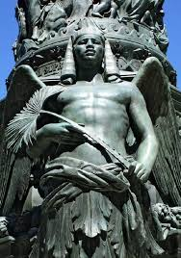
Part I: Geography & Early Kush
Egypt dominated the lands along the Nile, but it was not the only ancient culture to develop in the area. A kingdom called Kush arose south of Egypt. Through trade, conquest, and political dealings, the histories of Egypt and Kush became closely tied together.
To learn more about this topic and others, read pages 107 thru 113 and complete the section 5 assessment. Show me the completed work when complete.

Slide 4
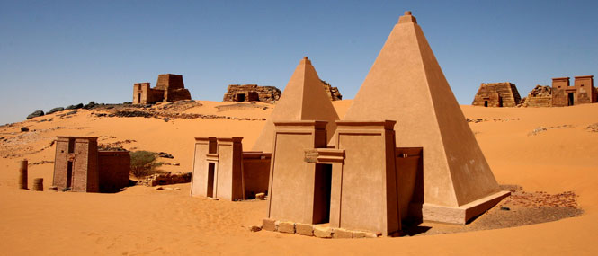
Nubia
Nubia was divided into two regions. The southern part, which extended to the southern end of the second cataract of the Nile was known as Upper Nubia; or Kush under pharaohs of Egypt and was called Ethiopia by the Greeks.

Slide 5
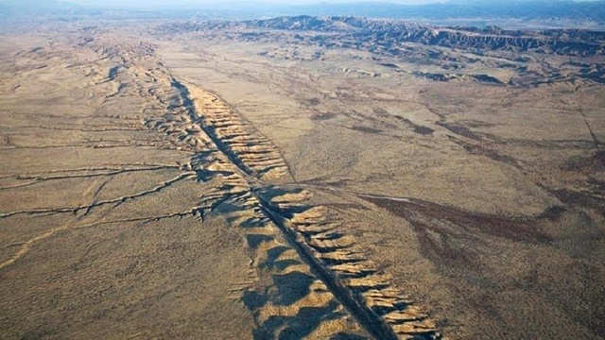
Today desert covers much of Nubia, but in ancient times the region was more fertile than today. In addition to fertile soil, Nubia was rich in minerals such as gold, copper, and stone. These resources play a role in the region’s wealth and history.
Click Here!

Slide 6
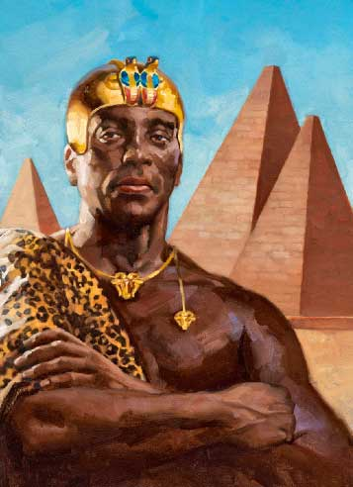
Early Civilization in Nubia
Like the Egyptians, the Nubians were blessed with fertile land and a climate that allowed them to plant and harvest around the year. There was also plenty of grazing land for livestock.
By 2000 BC, the most successful farmers developed the villages into a kingdom that became Kush.

Slide 7
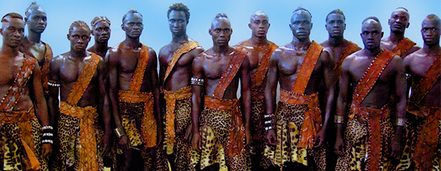
The Kushite era of rule in Nubia was established after the collapse and the disintegration of the New Kingdom of Egypt. Kush was centered at Kerma, kept impregnable by neighboring rapids and cataracts, during its early phase.

Slide 8
Egypt Controls Kush
Because of its location, Nubia controlled commerce between central Africa and Egypt. Nubian traders supplied Egypt with many goods from the African interior.

Slide 9
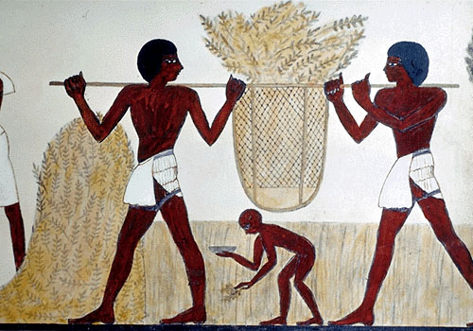
To protect this valuable trade, Egypt gradually conquered most of Nubia. The Nubians also had to pay tribute to the pharaoh. Tribute is a payment made by a conquered people to a stronger power. One year’s tribute payment to the pharaoh Thutmose III included hundreds of pounds of gold, cattle, slaves, ostrich feathers, and ivory from Nubia.

Slide 10
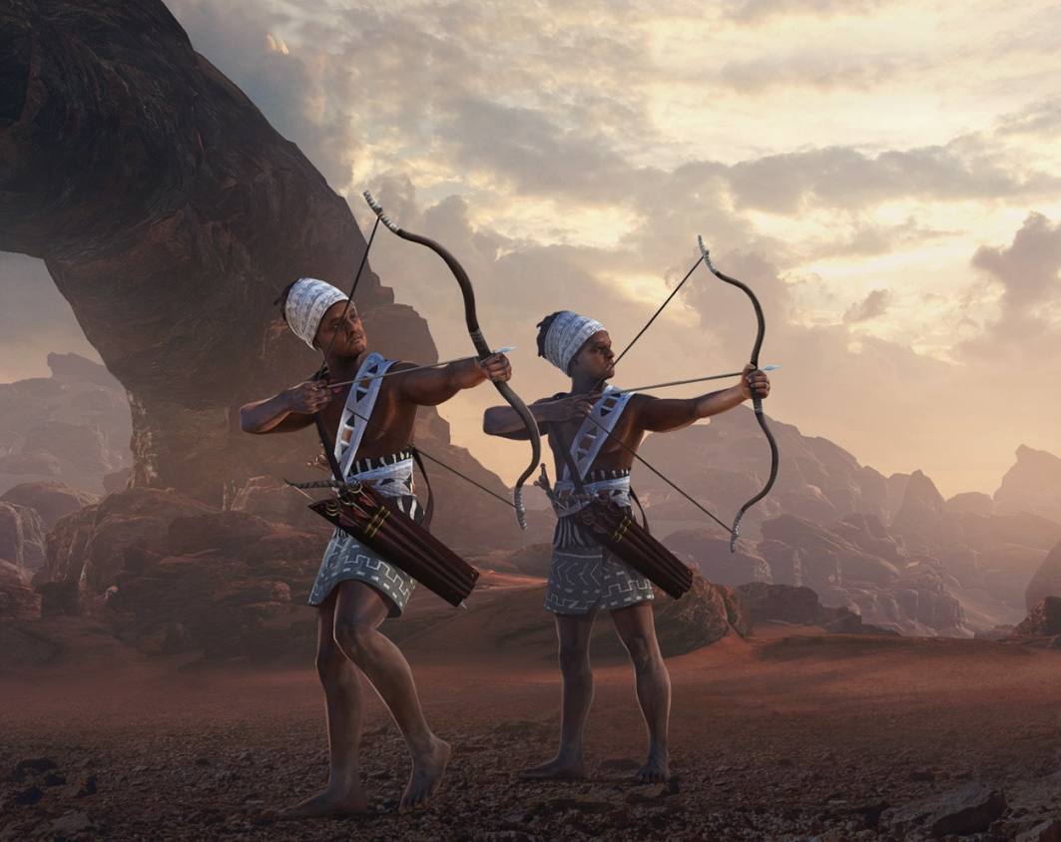
Over time, the Nubians adopted many aspects, or features, of Egyptian culture. They wore Egyptian clothes and worshiped Egyptian gods. They spoke the Egyptian language. Nubian soldiers, who were famous as archers, served in Egypt’s army. Some Nubians rose to become high government officials.

Slide 11
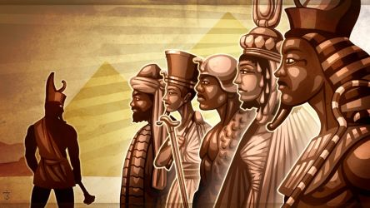
Kush Rules Egypt
When Ramses II died Egypt fell into chaos. Rival leaders were so busy fighting one another that they neglected their control of Kush. This was a huge oversight. Left on its own, Kush became an independent kingdom ruled by Nubian kings.

Slide 12
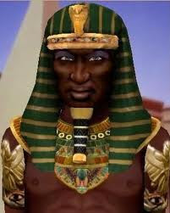
In the mid-700s BC, a Nubian king conquered the Egyptian town of Thebes. The next ruler of Kush, a king named Piye (also Piankhi), expanded the Kushite empire by conquering one Egyptian city after another. Piye declared himself the new pharaoh of a united Egypt and Kush. Pharaohs from Kush ruled Egypt for almost a century. The rulers from the south encouraged an Egyptian-style culture. They built temples to honor Nubian and Egyptian gods.
Click Here!

Slide 13
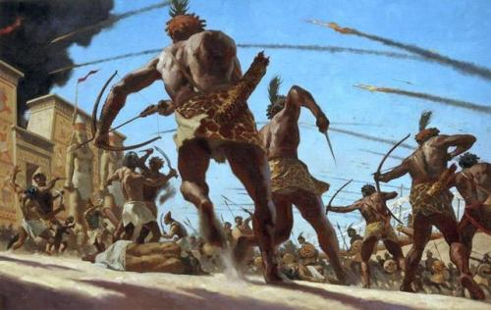
The rulers from Kush might have remained in power longer if they had been content to govern only Egypt. Instead, they tried to expand their power. They went to war with the Assyrians, skillful warriors who had recently conquered the Fertile Crescent. This error in judgment led to the Nubians’ downfall. Assyrian troops invaded Egypt in 663 BC. After suffering many losses in battle, the Nubians retreated from Egypt to Kush.

Slide 14
Part 2: Later Kush
The Assyrians drove the Kushites out of Egypt in 600 BC, partly through their use of iron weapons. Although they lost control of Egypt, their kingdom did not disappear. In fact, they built up another empire in the African interior, based on their trade and their own iron industry.

Slide 15
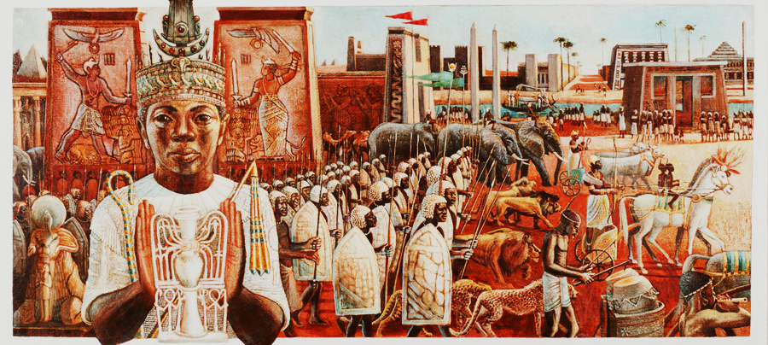
Kush’s Economy Grows
After losing control of Egypt, the people of Kush devoted themselves to increasing agriculture and trade in order to improve the kingdom. Within a few centuries Kush became rich and powerful again.

Slide 16
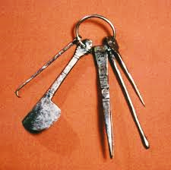
Meroe, the kingdom’s new capital, developed an iron industry. Iron ore and wood for furnaces helped Kush’s industry grow.

Slide 17
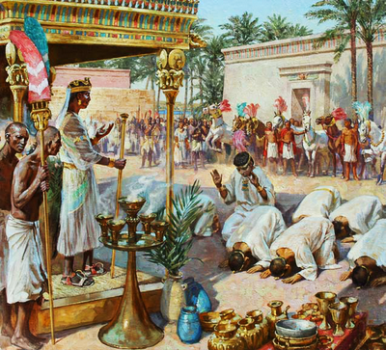
Kush’s Economy Grows
Meroe became the center of a large trade network, or a system of people in different lands who trade goods back and forth. Kush’s exports, or items sent to other regions for trade, included gold, pottery, iron tools, slaves, and ivory. Kush’s imports, or goods brought in from other places, included fine jewelry and other luxury items.

Slide 18
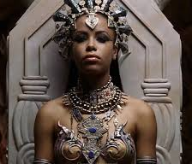
Kush’s Society & Culture
Kushite culture was influenced by Egypt. They worshipped Egyptian gods, built pyramids, wore Egyptian clothing, and had rulers called pharaohs.
Women were very active in society. During this time Shanakdakheto, a Black African queen, ruled prosperously when the Kingdom was centered at Meroe. She is the earliest known ruling queen of Nubia, and reigned from about 177 to 155 BC.
Kushites also had their own written language called Meriotic.

Slide 19
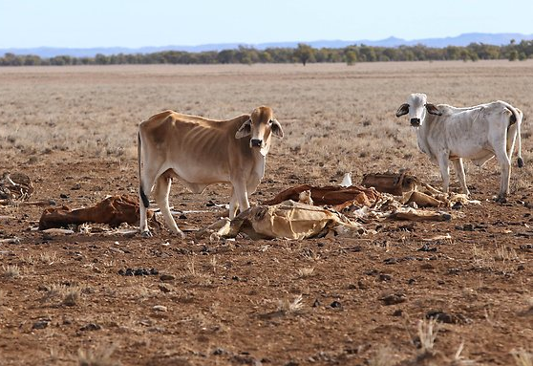
Kush’s Decline
Cattle overgrazed the land and left nothing to hold down the soil.
Iron makers used up the forests and military power declined when weapons weren’t produced.

Slide 20
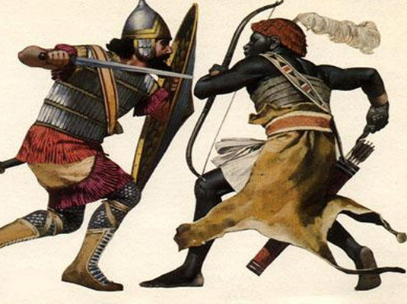
Kush was also weakened by a loss of trade due to new trade routes that went around Kush.
The Aksumite army of King Ezana took over when Kush’s power started to decline.
In the late 300s, the rulers of Aksum became Christian with Nubians also converting 300 years later, leaving the influences of Kush completely forgotten.
Click Here!

Slide 21
Final thoughts
The Kingdom of Kush was born south of Egypt and was a major commercial link between Egypt and the rest of the continent.
Kush was conquered by Egypt, but later Kushites controlled Egypt.

