Slide 1
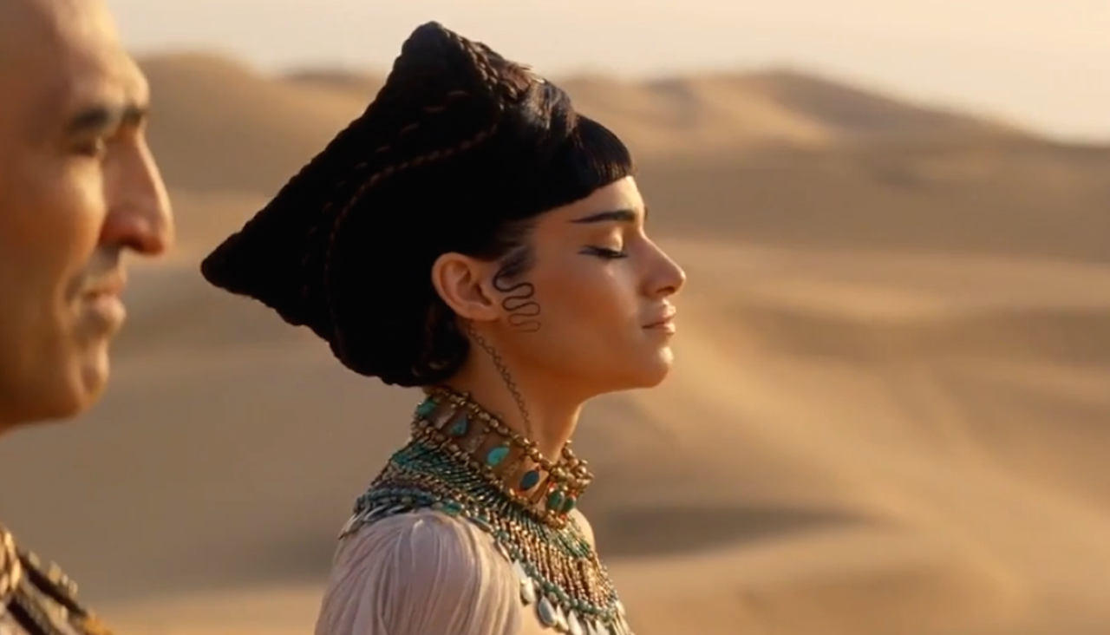
WORLD HISTORY
with Mr. Jim Soto
Ancient Egypt

Slide 2
Think...
Your family farms in the Nile Valley. Each year when the river’s flood waters spread rich soil on the land, you help your father plant barley. When you are not in the fields, you spin fine linen thread from flax you have grown. Sometimes you and your friends hunt birds in the tall grasses along the river banks. Why do you live in the Nile Valley?
Take a minute to write it down.

Slide 3
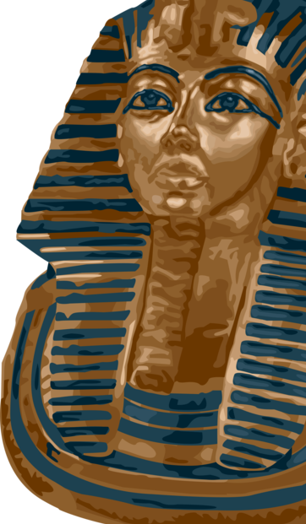
Part I: Geography & Early Egypt
Like the rivers of Mesopotamia, the narrow valley of the Nile River in Egypt also provided fertile land that drew people there. The culture that developed there was more stable and long-lasting than those of Mesopotamia.
To learn more about this topic and others, read pages 86 thru 89 and complete the section 1 assessment. Show me the completed work when complete.

Slide 4
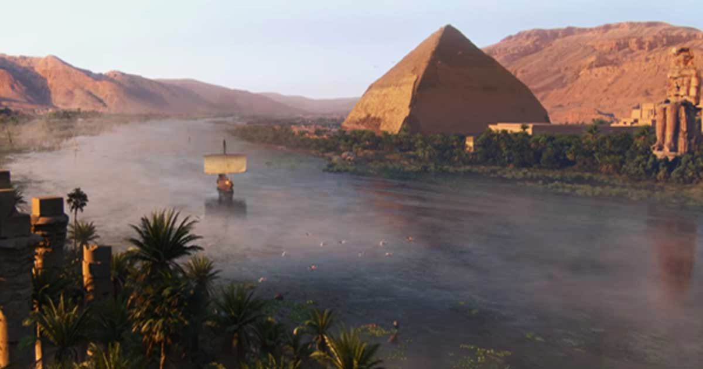
The Gift of the Nile
The world's longest river, located in Egypt, the Nile flows 4,132 miles northward to the Mediterranean Sea. It was considered the source of life by the ancient Egyptians and has played a vital role in the country's history.

Slide 5
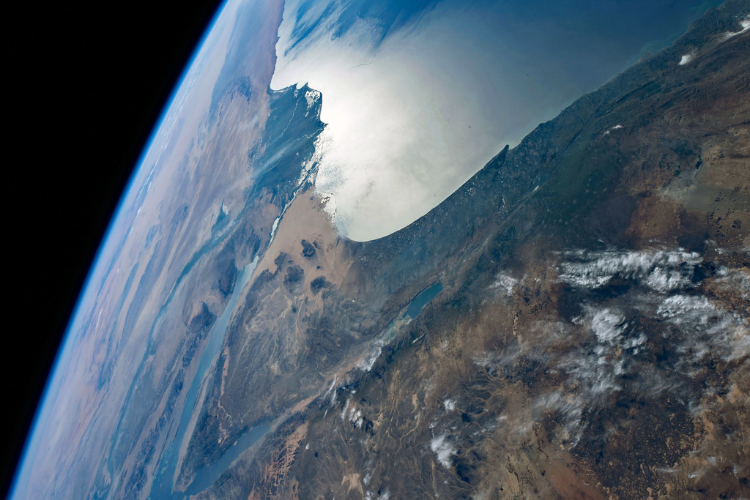
The waters of the Nile were essential to the development of ancient Egypt. Every year the river gently flooded the valley, enriching the soil with silt and minerals. However, at either side of these fertile areas, as you can see, lay hundreds of miles of bleak desert sands. Lets learn more about the Nile in this video.
Click Here!

Slide 6
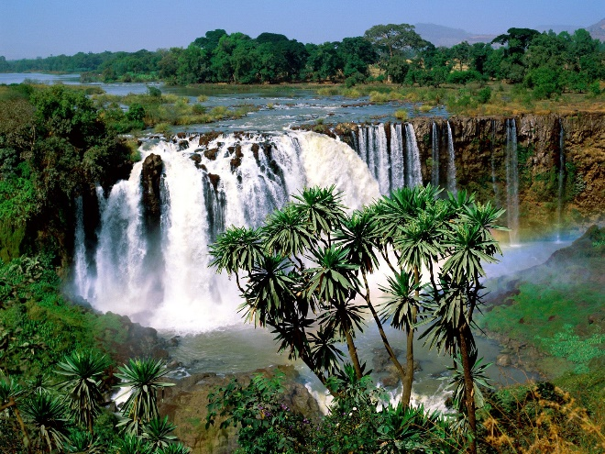
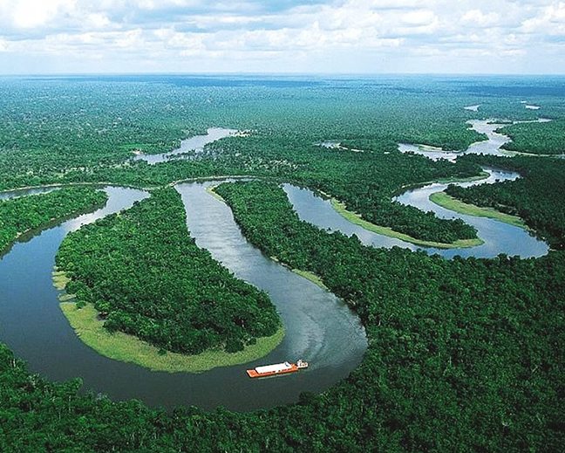
Upper Egypt, in the southern part of Egypt, is characterized by terrain with cataracts and stronger currents. Sailing here is difficult.
Lower Egypt is where the Nile fans out into several branches that for a delta, a triangular shaped area of land made from soil deposited by the river. Two thirds of Egypt’s fertile farmland was located on the Nile Delta.

Slide 7
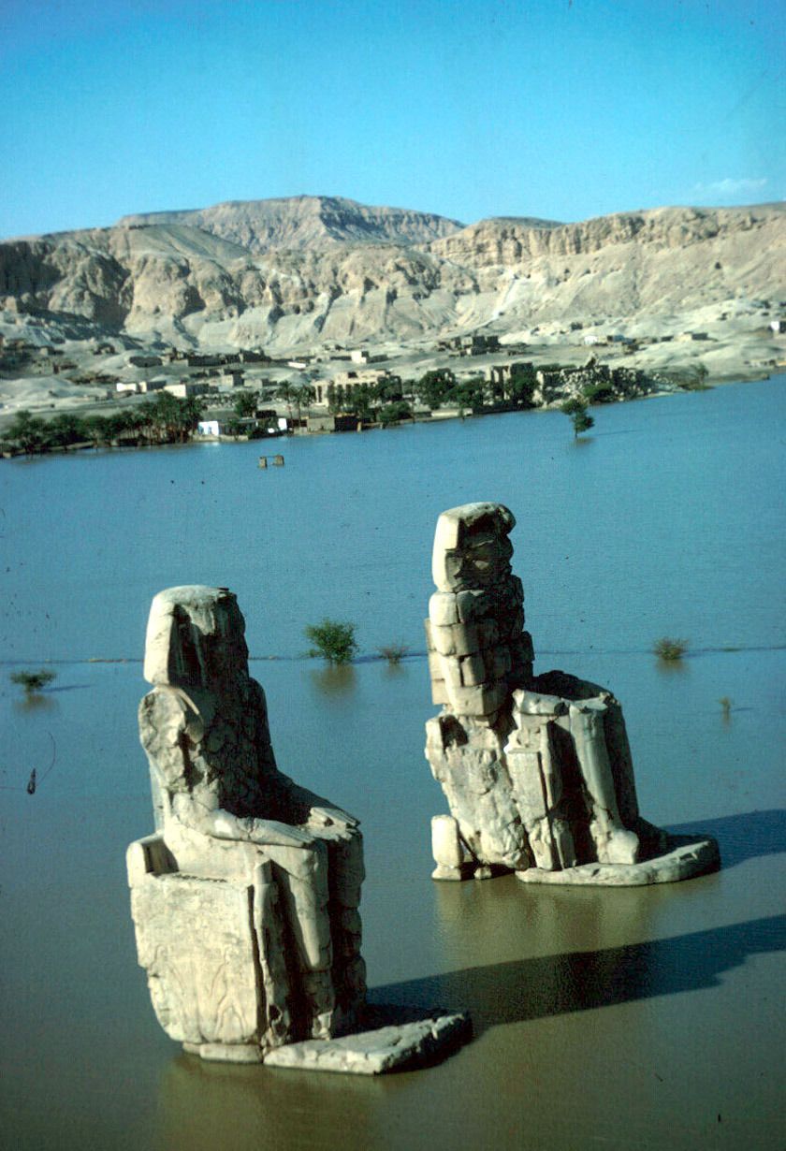
Floods
The Nile flooded onto the desert land because of the rain and melting snow causing a torrent of water to invade the river's banks from the Ethiopian Mountains. The silt made the land a dark rich, color. That is why they used to call their country the “black land”. Now, the Nile doesn't flood anymore because of the construction of the Aswan dam in the 1960's.

Slide 8
Increased Food Production
Hunter-gatherers first entered the Nile Valley 12,000 years ago because of the abundance of resources in the area. By 4500 BC, farmers grew wheat and barley in the area. Egyptian irrigation systems, contrary to Mesopotamian, only consisted of simple canals connected to the river.

Slide 9
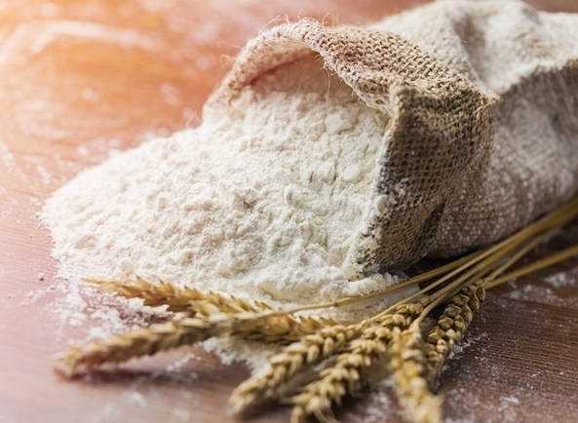
Ancient Egyptians grew wheat, barley, fruit and vegetables. They also raise cattle and sheep. The river provided a great variety of fish and hunters caught wild geese and ducks. They enjoyed a pretty varied diet.

Slide 10
Two Kingdoms
In addition to stable food supplies Egypt's natural barriers made the country hard to invade. The desert to the west was too big and hard to cross. To the north, the Mediterranean Sea kept enemies away. The Red Sea provided protection against invasion as well. The villages of Egypt grew because of the protection from invasion. By 3200 BC, two kingdoms developed: Upper Egypt and Lower Egypt.

Slide 11
Kings Unify Egypt
Around 3100 BC, Menes rose to power in Upper Egypt. He wanted to unify all Egypt. His armies invaded Lower Egypt. He then united the two kingdoms. He wore both the white crown of Upper Egypt and the red crown of Lower Egypt, symbolizing his leadership over both kingdoms. Later, he combined the two crowns into one.
Click Here!

Slide 12
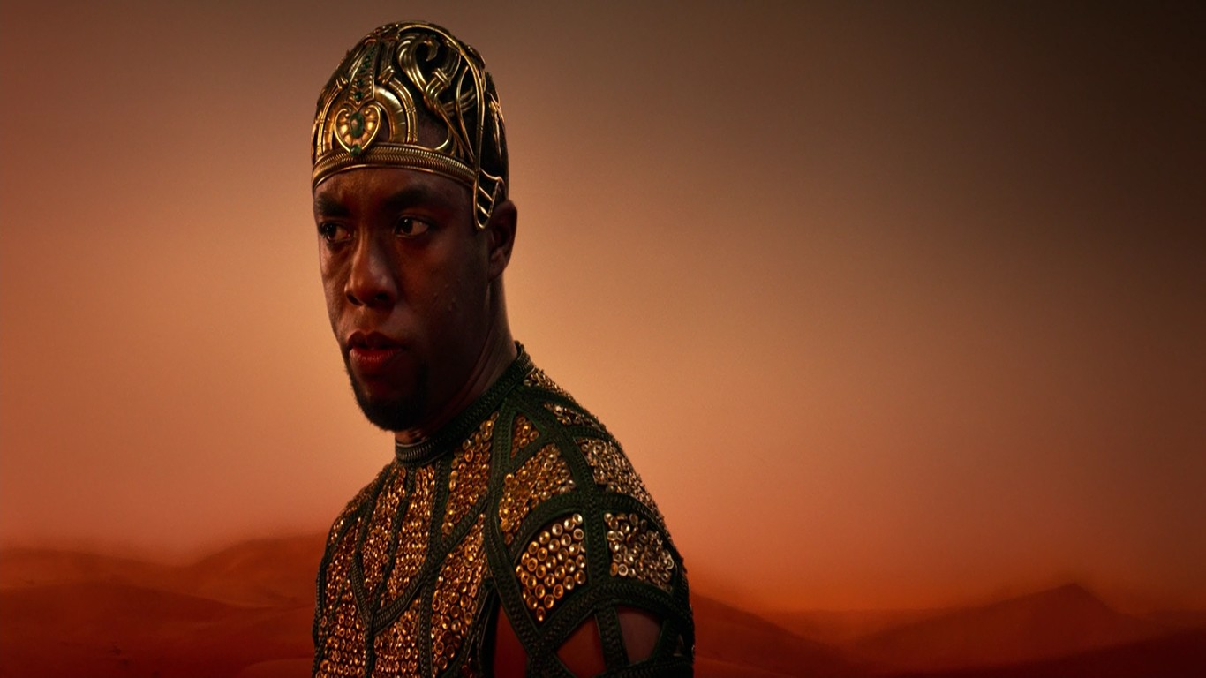
Historians consider Menes to be Egypt’s first pharaoh, which means great house. Menes also founded Egypt’s first dynasty, or series of rulers from the same family.
Why do you think Menes wanted to rule over both kingdoms of Egypt?

Slide 13
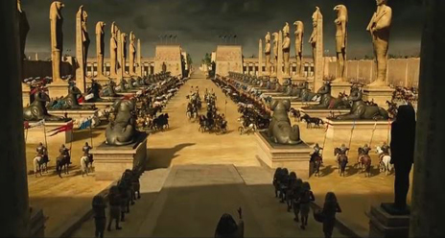
Menes built a capital city named Memphis at the southern delta. The First Dynasty lasted for about 200 years. Pharaohs after Menes extended Egyptian territory southward along the Nile; however, rivals challenged the first dynasty for power. These challengers took over Egypt and established the Second Dynasty.

Slide 14
Final thoughts
Ancient Egypt began in the fertile Nile River Valley.
Two different kingdoms developed.
These two kingdoms were later united under one ruler as the territory grew.

Slide 15
Part II: The Old Kingdom
As in other ancient cultures, Egyptian society was based on strict orders of social classes. A small group of royalty and nobles ruled Egypt. They depended on the rest of the population to supply food, crafts and labor. Few people questioned this arrangement in society.
To learn more about this topic and others, read pages 90 thru 95 and complete the section 2 assessment. Show me the completed work when complete.

Slide 16
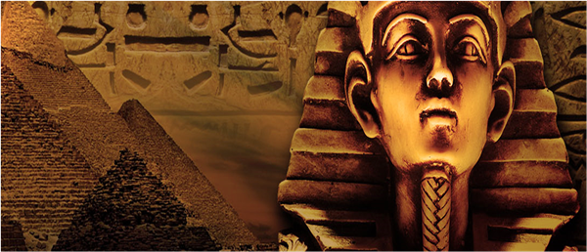
The Early Pharaohs
The 1st and 2nd Dynasties rules Egypt for about 4 centuries. By 2700 BC a new, 3rd dynasty rose to power. Thus began the Old Kingdom.

Slide 17
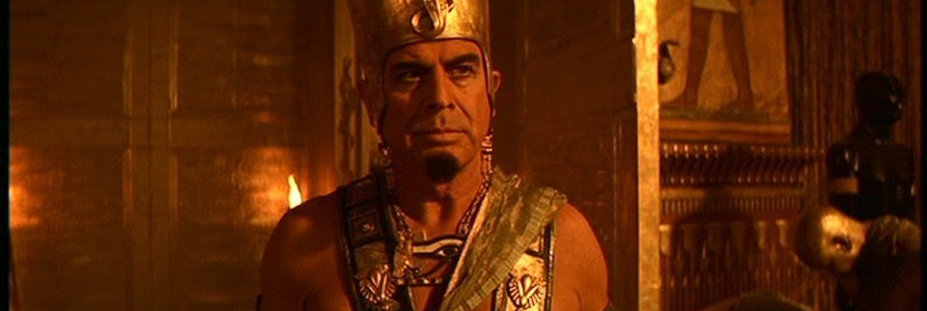
The Old Kingdom was a period in Egyptian history that lasted about 500 years, from 2700 BC to 2200 BC. During this time, Egyptians continued to develop their political system. It was based on the belief that the pharaoh, the ruler of Egypt, was both a king and a god.

Slide 18
As supreme ruler of the people, the pharaoh was considered a god on earth, the intermediary between the gods and the people. When the pharaoh came to the throne he was instantly associated with Horus - the god who had defeated the forces of chaos and restored order - and when he died, he was associated with Osiris, the god of the dead.
Because of this people expected a lot from their king. The pharaoh’s status came with many responsibilities. If things went well, the people would credit the pharaoh. If not… well.

Slide 19
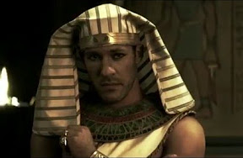
The most famous pharaoh of the Old Kingdom was Khufu. He is believed to have had three wives. He is famous for building the Great Pyramid at Giza, one of the seven wonders of the world, but apart from this, we know very little about him.
Khufu was the first pharaoh to build a pyramid at Giza. The sheer scale of this monument stands as testament to his skills in commanding the resources of his kingdom.

Slide 20
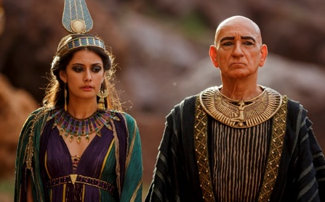
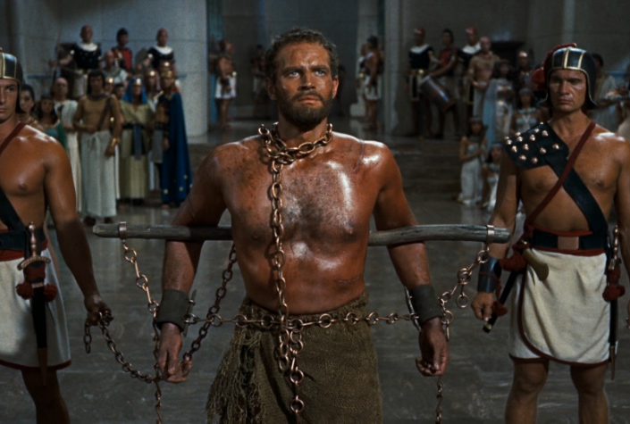
Society & Trade
By the end of the Old Kingdom, Egypt had around 2 million inhabitants. It was believed that a well-ordered society would make the kingdom strong. The Pharaoh was at the top, followed by the priests and key government personnel. Many Priests and officials were nobles, or people from rich and powerful families. Next, were the scribes and craftspeople, followed by farmers, servants, and slaves.

Slide 21
The ancient Egyptians were great traders. They traded gold, papyrus, linen, and grain for cedar wood, ebony, copper, iron, ivory, and lapis lazuli. Ships sailed up and down the Nile River, bringing goods to various ports. Egyptians imported gold, incense, ebony, copper, ivory, and exotic animals from tropical Africa through Nubia. As trade between Egypt and Nubia increased, so did wealth and stability.

Slide 22
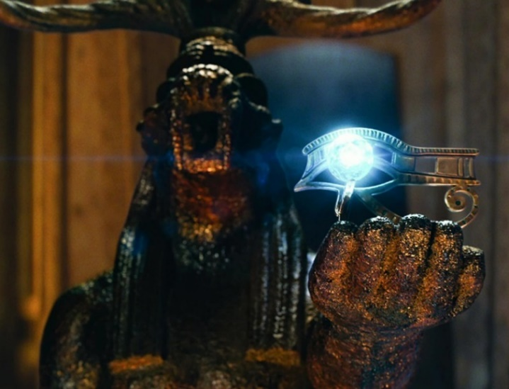
The Gods of Egypt
There were many gods in Ancient Egypt. Some images of Ancient Egyptian gods and goddesses show them with a human body and the head of an animal. Animals were chosen to represent the powers of the god. Major deities included:
Atum, the Sun God Ra
Tefnut, Goddess of Rain
Nut, Goddess of Sky
Isis, Goddess of Love
Nephthys, Goddess of Divine Assistance
Geb, God of the Earth
Osiris, God of Death and the Afterlife
Set, God of the desert, storms, disorder and violence
Shu, God of Wind
Click Here!

Slide 23
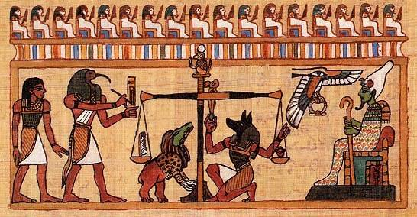
The Afterlife
Much of Egyptian religion focused on the afterlife, or life after death. In Ancient Egyptian religion, when the body died, part of its soul known as ka would go to the afterlife. Egyptians believed that after you died you would go to a heavenly place called the Land of Two Fields. One of the reasons the god Osiris was so honored in ancient Egypt is because it was Osiris who opened the door to the afterlife for everyone.

Slide 24
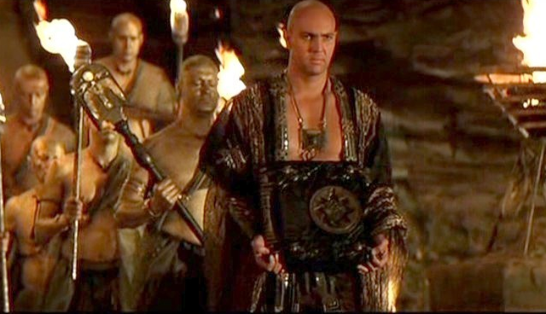
Burial Practices
Ideas about the afterlife had an impact on the burial practices of the Egyptians. They believed that the body had to be prepared for the afterlife before burial. According to their beliefs, the body had to be kept from decaying because it would cause a catastrophic separation between body and ka.

Slide 25
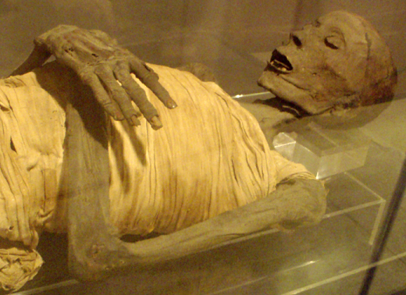
To ensure that the dead had a comfortable afterlife, various funerary practices, procedures and rituals were carried out, such as mummification. The methods of embalming, or treating the dead body, that the ancient Egyptians used is called mummification. Using special processes, the Egyptians removed all moisture from the body, leaving only a dried form that would not easily decay. Only the elite, or people of wealth and power could afford this.
Click Here!

Slide 26
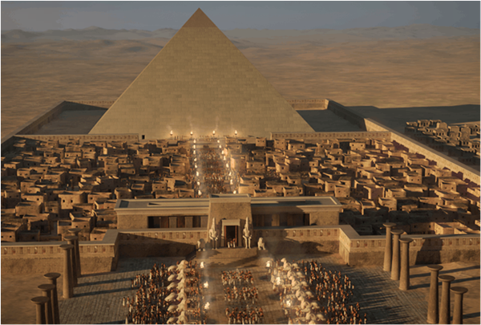
Pyramids
A pyramid is a structure whose outer surfaces are triangular and converge to a single point at the top, making the shape roughly a pyramid in the geometric sense. They are considered marvels of engineering.

Slide 27
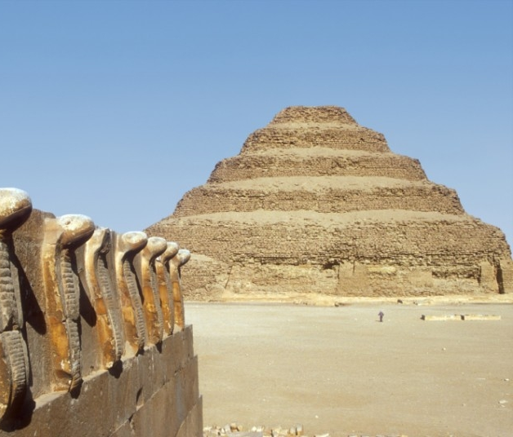
As of November 2008, sources cite 138 as the number of identified Egyptian pyramids. Most were built as tombs for the pharaohs and their consorts during the Old and Middle Kingdom periods.
The earliest known Egyptian pyramids are found at Saqqara, near Memphis. The earliest among these is the Pyramid of Djoser (constructed 2630 BC–2611 BC) which was built during the 3rd dynasty.

Slide 28
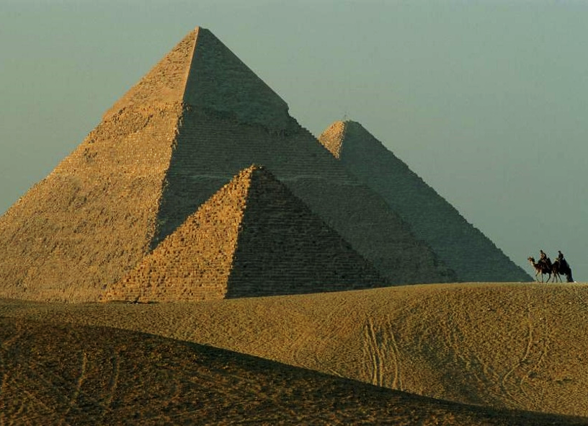
Of all pyramid, the most famous one has to be the Great Pyramid of Giza was built for the Fourth Dynasty Pharaoh Khufu (or Cheops), and was completed around 2560 BC. It is part of a complex of 3 large pyramids in the Giza Necropolis near modern Cairo, Egypt. The Egyptians built pyramids as tombs for the pharaohs and their queens.
Click Here!

Slide 29
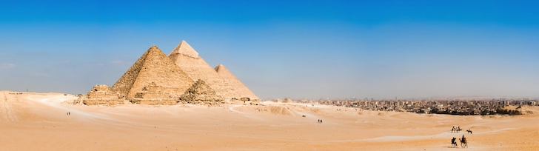
To this day, these pyramids baffle modern day scientists with features that suggest a level of technological development far superior than what would be expected for the time.
Click Here!

Slide 30
Final thoughts
During the Old Kingdom, new political and social orders Egypt.
Religion was important and many pyramids were built for the pharaohs.

