Slide 1
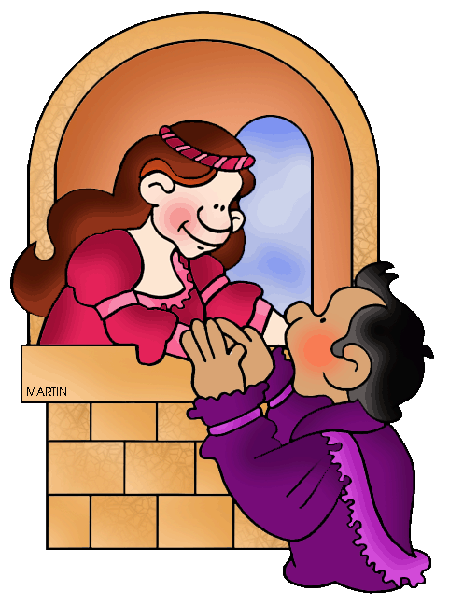
Peer Responding
Jim Soto

Slide 2
Lesson Objective
To understand the guidelines for peer responding
To practice responding to peer’s writing
pgs. 29-32

Slide 3
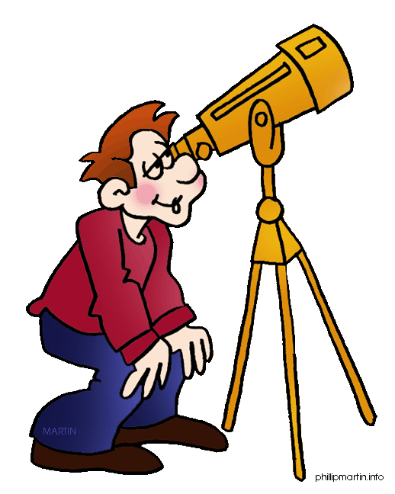
Its Importance
Peer responding is an important part of the writing process. If you listen carefully during a peer-responding session, both the writer and the responders will gain valuable information because helpful suggestions about the writing are shared.

Slide 4
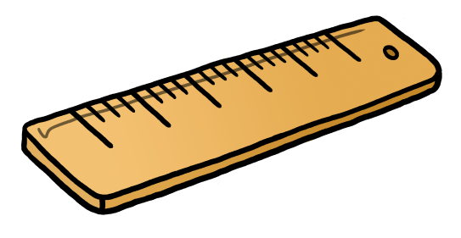
Guidelines: As a Writer
Introduce your piece of writing.
Read your writing out loud.
Invite your group member to comment.
Take notes.
Answer all questions.
Ask for help from your group.

Slide 5
Guidelines: As a Responder
Listen (or read) carefully.
Look for what is good.
Tell what you think can be improved.
Ask questions is necessary.
Make other suggestions.

Slide 6
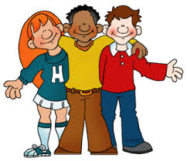
Guidelines
You shouldn’t be intimidated by the idea of sharing your writing with others because peer-responding sessions are designed to help you. Read pages 30-32 to learn how it works. Complete the Practice activity at the bottom of page 32.

Slide 7
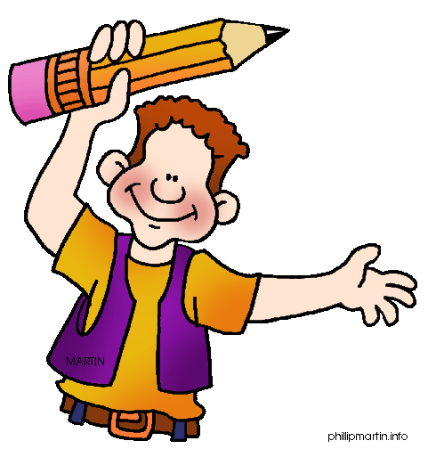
Homework
In your Skills Book complete pgs. 35-39. Here:
Italics and Parentheses
Apostrophes 1
Apostrophes 2
yowzah!

Slide 8
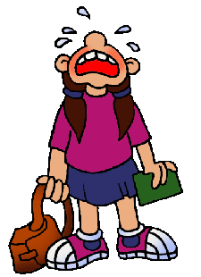
Next
Listening and Speaking
Jim Soto © 2015

