Slide 1
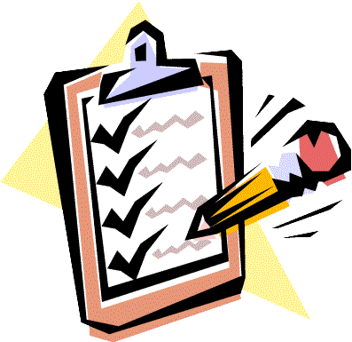
Using a Rubric
Jim Soto

Slide 2
Lesson Objective
Understand how to read a rubric
Learn how to revise and edit a rubric
Learn how to assess with a rubric
Pages 45-56

Slide 3
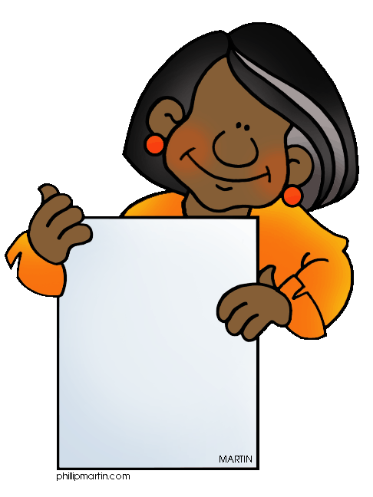
What is a Rubric?
A rubric is a scoring guide that helps teachers evaluate student performance, based on a range of criteria. A rubric lists the criteria, or characteristics, that student work should exhibit and describes specific quality levels for those criteria.
Le Rubric

Slide 4
What is a Rubric?
Your book contains rubrics for four important kinds of writing: narrative, expository, persuasive, and responses to literature. Each rubric rates writing for the six traits: Ideas, Organization, Voice, Word Choice, Sentence, Fluency, and Conventions.

Slide 5
Rating Guide
6
Amazing
5
Strong
4
Good
3
Okay
2
Poor
1
Incomplete
Your written works can be rated for each of the main traits of writing. For example, in one of your essays the ideas may be “strong” , but the organization be only “good”.

Slide 6
Rating Guide
A 6 means that the writing is truly Amazing.
This is what the rating scale means.
A 5 means that the writing is Strong.
A 4 means you writing is Good.
A 3 means your writing is Okay.
A 2 means your writing is Poor.
A 1 means your writing is Incomplete.

Slide 7
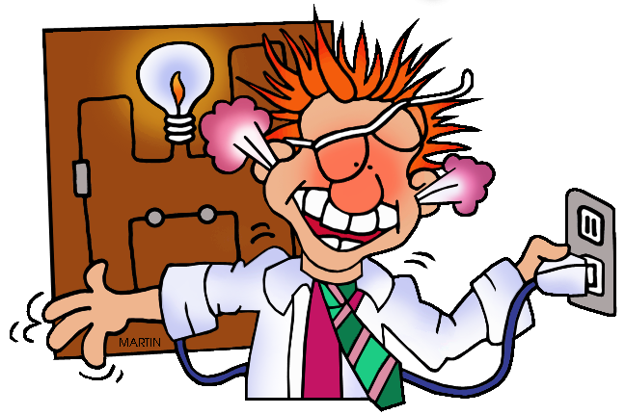
Learn more about rubrics by taking a few minutes to read pages 47 - 55.
Complete the assessments at the bottom of pages 47, 49, 50, 51, and 52.

Slide 8
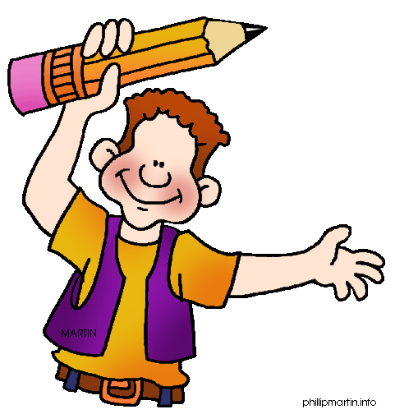
Homework
In your Skills Book complete pgs. 29-34. Here:
Semicolons and Colons
Punctuating Dialogue
Quotation Marks and Italics
Oh, My!

Slide 9
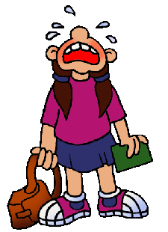
Next
Peer Responding
Jim Soto © 2015

Slide 10
Rating Guide

