Slide 1
Writing a Descriptive Paragraph
Jim Soto

Slide 2
Lesson Objective
Understand the content and structure of a descriptive paragraph
Choose a topic to write about
Plan, draft, revise, and edit a descriptive paragraph
Pages 71-74

Slide 3
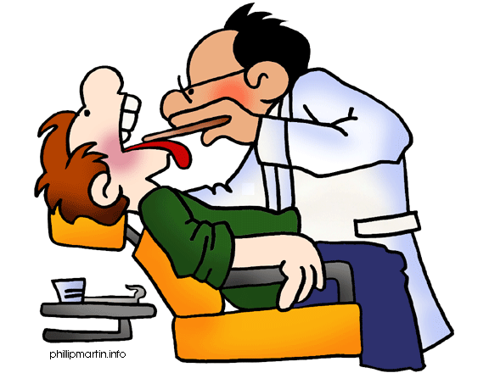
Descriptive writing
Everybody has a place where they like to spend time. It could be a room or somewhere in the neighborhood. Soon, you will write a paragraph describing a favorite place. Sensory details will be very important to help the readers feel like they were there.

Slide 4
Your Descriptive Paragraph writing
A descriptive paragraph uses sensory details to help the reader clearly imagine a person, a place, a thing, or an idea. An effective paragraph contains three main parts:
a topic sentence
the body
a closing sentence
Lets see an example in page 527.

Slide 5
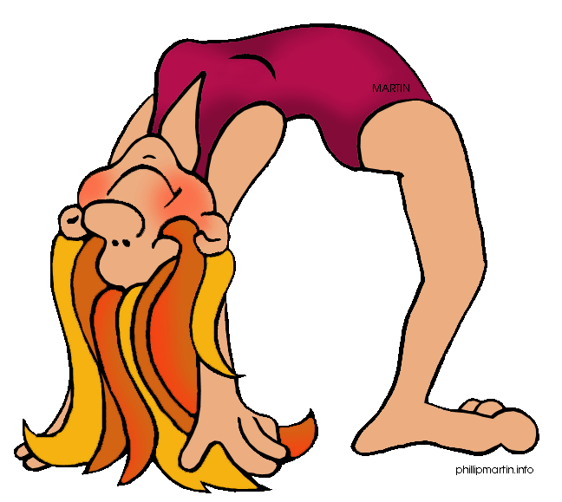
Seatwork
You will be writing a descriptive paragraph for your portfolio today. Remember, all steps of Writing Process must be presented. But first read and complete the activity on page 72.

Slide 6
Seatwork
Now, read pages 73 and 74 to complete the favorite place description paragraph. Don’t forget that sensory details will be very important. Try drawing a sketch of the place before you try to describe it.

Slide 7
Homework
In your Skills Book complete pgs. 15-20. Here:
Commas to Set Off Nonrestrictive...1
Commas to Set Off Nonrestrictive...2
Commas with Interruptions, Direct...
coolio!

Slide 8
Next
Describing a Place
Jim Soto © 2015

