Slide 1
CAREERS IN FILMMAKING
A PowerPoint lesson by Jim Soto

Slide 2
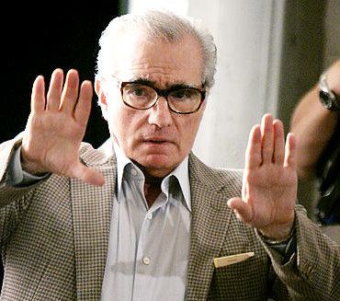
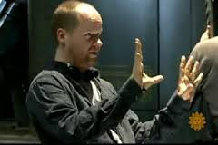
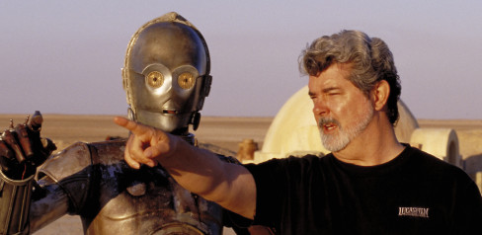
Film Industry talent as diverse as Martin Scorsese, George Lucas and Joss Whedon got their start at a film school, some of which are named and ranked here on this list taken from The Hollywood Reporter's inaugural list (comprised with help from industry insiders) of the world's best.

Slide 3
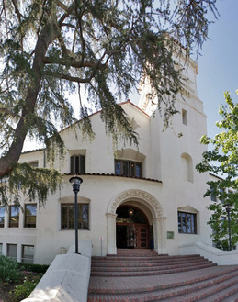
THE WORLD’S TOP FIVE FILM SHOOLS
1. American Film Institute
Among the most selective film schools, AFI's Center for Advanced Film and Television Studies in Los Angeles offers a two-year conservatory program specializing in directing, producing and writing, often coming to the institute after working in the industry or having attended other schools. AFI benefits from speakers and teachers drawn from the highest levels of the industry. Students are guaranteed the freedom to make a thesis film and are given access to SAG members for their casts and $13,500 in financing.
DEGREES MFA, certificate of completion
NOTABLE ALUMNI David Lynch (Blue Velvet), Darren Aronofsky (Black Swan)

Slide 4
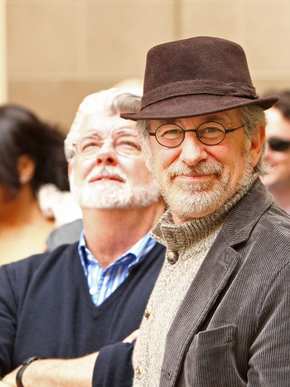
2. University of Southern California
The richest film school on earth, USC has more graduates inside the industry than any other school. It has the greatest support from the industry itself, with 10,000-plus alums who donate millions for state-of-the-art facilities . Says Dean Elizabeth Daley: "One of the hardest things to understand is the culture of filmmaking. You're not getting that from a book. Come here and you'll understand." Thanks to unrivaled facilities, an emphasis on film history and technique and its ties with Hollywood -- USC is a vast dream factory.
DEGREES Critical studies, B.A., M.A., MFA and Ph.D. programs in everything from film and TV to animation and digital arts
NOTABLE ALUMNI George Lucas (Star Wars), Ron Howard (A Beautiful Mind)

Slide 5
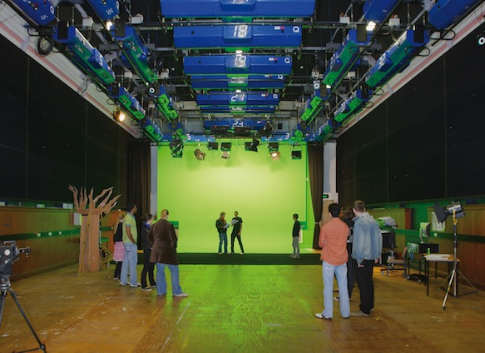
3. Beijing Film Academy
It is China's most elite school for film direction, production and writing. Each year, it accepts about 500 applicants -- primarily from China -- out of 100,000. It's the place where such directors as Zhang Yimou and Chen Kaige -- the ones who created arguably the most distinct new wave of filmmaking since America in the early 1970s -- cut their teeth.
DEGREES B.A., M.A. and Ph.D. programs in everything from performance and direction to cinematography and animation. All degree programs are conducted in Chinese, though international students may take some courses in English or study Chinese at the Film Academy.
NOTABLE ALUMNI Zhang Yimou (House of Flying Daggers), Chen Kaige (Farewell My Concubine)

Slide 6
4. New York University Tisch School of the Arts
New York is a very different beast than Hollywood, but for gritty artists like Martin Scorsese, Oliver Stone and Breaking Bad creator Vince Gilligan, NYU has proved a direct route to the top. Where else can you sit in a class of 12 and hear alum James Franco teach you how to turn a poem into a movie? Graduates also vie for a $200,000 prize to complete a debut feature film -- a gift no other school offers. Summer programs include professional workshops and noncredit certificate courses.
DEGREES B.A., BFA, MFA, MPS, M.A. and Ph.D. degrees in moving-image archiving and preservation as well as performance studies or cinema studies
NOTABLE ALUMNI Todd Phillips (The Hangover), Joel Coen (No Country for Old Men)

Slide 7
5. University of California Los Angeles
UCLA's School of Theater, Film and Television has a multicultural campus that ranks among the best in California. It has benefited from such prestigious graduates as Francis Ford Coppola and Alexander Payne; from teachers like producer Peter Guber; and from its connection with the respected UCLA Film & Television Archive, whose collection is second only to the Library of Congress!
DEGREES B.A., M.A., MFA and Ph.D.
NOTABLE ALUMNI Francis Ford Coppola (The Godfather), Tim Robbins (Dead Man Walking)

Slide 8
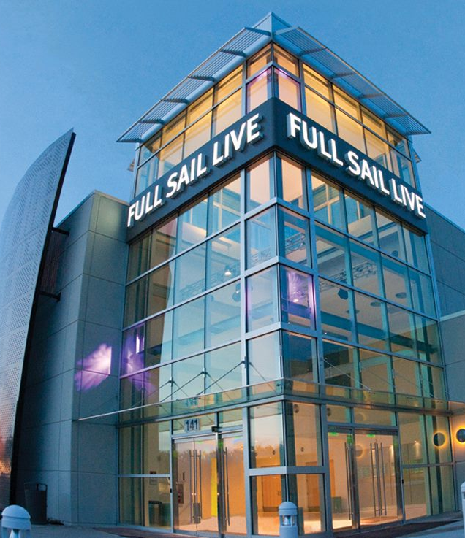
HONORABLE MENTION
Full Sail University
It was founded in 1979 in Dayton, Ohio as Full Sail Recording Workshop. Full Sail relocated to Winter Park, Florida in 1980, adding video production and film production courses and, with the move in 1989 to its current campus, expanded its curriculum to include other areas of study. Full Sail University offers campus and online degree programs that are designed for the world of entertainment, media, arts, and technology. Offering associate's, bachelor's, and master's degrees, Full Sail's approach is centered on real-world industry experience and creative problem solving.)
Click Here

Slide 9
opinions about film school
Anonymous • This list is laughable, just like film school. all you need in this industry is a good idea, hands on experience, and drive. Most of these graduates will go into serious debt after pouring money into their project which is ultimately an unmarketable product. They'll then spend the next 10-15 years of their life working on TV shows, films, and commercials as PA's or some below the line position instead of doing that after film school, just move to LA and do it, no debt required...
Savage • My guess is that:
You haven't been to Film School.
You've never lived in L.A. and
You've never had a movie made. With that said, try putting what you preach into practice so you don't sound ignorant. If filmmaking was as easy as you claim, everyone would be George Lucas. Go back to your car dealership commercials.

Slide 10
Aokiji •A) I went to film school. B) I lived in that s#!?hole. And C) I've made a movie. I agree that the practical is more informative than the class and book. I've practiced it and preached the good word and THANK GOD I'm not George Lucas. Yes getting a background in the classics is always going to help you, and an intimate knowledge of film will never hurt you. I dare say go out, buy yourself a good DSLR, and shoot and see what... You'll find you are capable of much with very little, but let's not forget there is more to a film than just "shooting one". Write a compelling story, shoot it with a flair you don't see in every modern movie, and learn to edit. Then there is grading, sound mastery… Go back to commercials, after all David Fincher and many others started there and music videos, and most people think Alien 3 is a P.o.S. and there is a director I've always admired … Be creative, have fun.

Slide 11
What about puerto rico
Puerto Rico that offers degrees in key film production positions (cast or crew) and choose a film career in which they would major and find employment.
Colegio de Cinematografía, Artes y Televisión (CCAT)
Atlantic University College
Columbia Centro Universitario
Liceo de Arte y Tecnología
Click Here

Slide 12
CLICK
CLICK
CLICK
CLICK
Click on the links and explore what these local film schools have to offer to anyone looking for a degrees in several filmmaking fields. The information gathered there will be used for an important project later on.
Click Here

Slide 13
Liceo de Arte y Tecnologia offers 1 Cinematography And Film/video Production Degree program. In 2015, 29 students graduated in the study area of Cinematography And Film/video Production with students earning 29 Certificates degrees.
Colegio de Cinematografía Artes y Television offers 1 Cinematography And Film/video Production Degree program. In 2015, 31 students graduated in the study area of Cinematography And Film/video Production with students earning 31 Associate's degrees.
Columbia Central University/Caguas offers 2 Cinematography and Film/video Production Degree programs. In 2015, 7 students graduated in the study area of Cinematography and Film/video Production with students earning 5 Associate's degrees, and 2 Certificates degrees.
Atlantic University College offers 2 Cinematography and Film/video Production Degree programs. In 2015, 8 students graduated in the study area of Cinematography and Film/video Production with students earning 8 Bachelor's degrees.

Slide 14
FOR YOUR PORTFOLIO
Having done some research, imagine that you decided to pursue a career in the film industry and had to choose from several institutions of higher learning, what would you study and where? Write a 300 word (minimum) essay identifying an institution in Puerto Rico that offers degrees in key film production positions (cast or crew) and choose a film career in which you would major and find employment. Essay should be typed in Word or Docs, Calibri font, size 11. Correct grammar and formatting. Turn it in in two days. Value is 50 points.

Slide 15
Well, this is it. I hope you found this course interesting and informative. By now, you must have acquired several skills that should allow you, not only to be able to better express yourselves using visual literacy but most importantly, understanding visual communications in ways you couldn’t before you began this course. Many of my ex-students have informed me that is the case. It has been my joy and honor to have been your teacher and wish you success in all your endeavors.

Slide 16
Jim Soto © 2022

