Slide 1
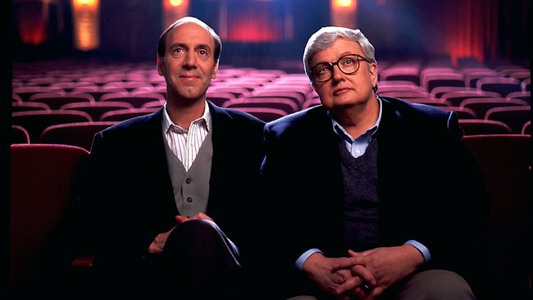
HOW TO REVIEW A MOVIE
A PowerPoint lesson by Jim Soto

Slide 2
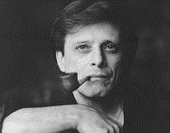
“You are not entitled to your opinion. You are entitled to your informed opinion. No one is entitled to be ignorant.” ― Harlan Ellison, writer of short stories, novellas, teleplays, essays, and criticism.

Slide 3
Anyone watching a movie will formulate an opinion about it.
Film critics specialize in analyzing films and producing reviews and articles for newspapers, magazines, radio, TV, social media channels and websites.
In other words, they share their opinions about movies. However, there are opinions and… there are opinions.

Slide 4
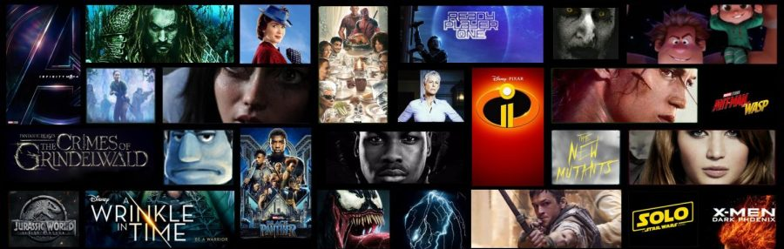
Can you offer a critique of a movie? Of course, assuming that you have something to say about movies—not just opinions, but opinions based on a broad knowledge of film, which means having watched a lot of them and having spent time seriously thinking and reading about and discussing them. But don’t expect to make a living at it, because very few critics do.

Slide 5
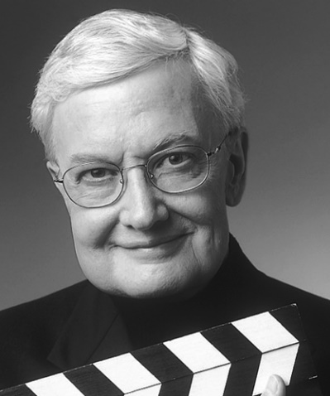
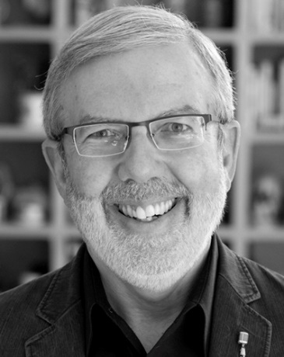
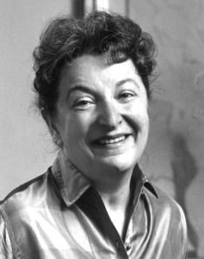
How to Write a Movie Review: Become a Movie Reviewer
Writing movie reviews can become a lifelong profession in its own right with Critics such as Leonard Maltin, Pauline Kael, and Roger Ebert becoming household names.
The process of how to write a movie review entails much more, though than simply giving readers a recommendation to watch or avoid a film. Let’s find out why!

Slide 6
How Do You Write A Film Review?

Slide 7
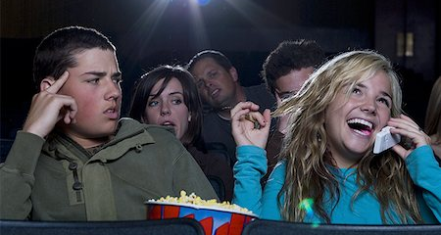
1. Watch the Film
Of primary importance is getting rid of distractions. That’s a high demand nowadays, but for someone wanting to be serious about Film Criticism, it’s the least that the movies reviewed deserve.

Slide 8
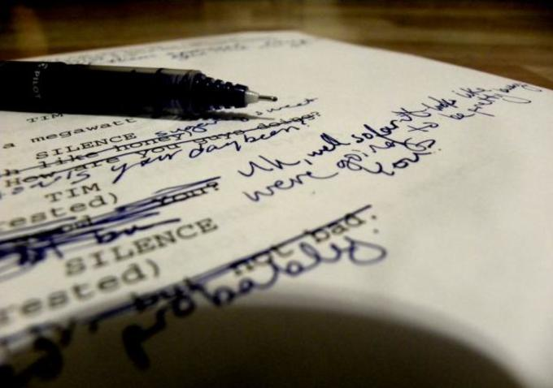
2. Take Notes
In an ideal world, Film Critics would have the opportunity to watch a movie at least twice—once to simply experience the film and once more to write down observations during it. But in reality this doesn’t happen. That’s why when learning how to write a movie review, Critics should become accustomed to jotting down notes during a film screening.

Slide 9
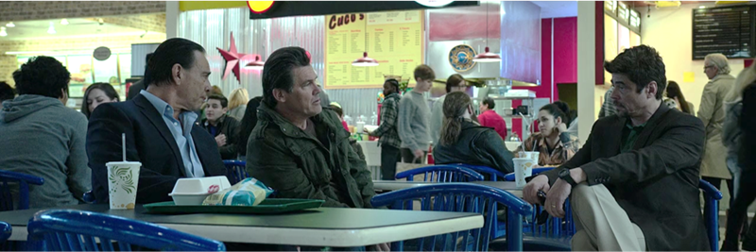
3. Break Down the Film
Films have many “moving parts”, therefore it’s important to critique a movie according to its many elements in order to do it justice:

Slide 10
Acting
Actors carry a lot of the responsibility in a film’s success or failure. Most movie lovers identify them like this: “That’s the new Henry Cavill flick!” or “It’s the latest Zendaya movie.” It’s only fair to write a movie review with the acting in mind.

Slide 11
Directing
Evaluating a director’s success on a film can be hard. Some directors, such as Spielberg and Scorsese, pretty much have free rein on their films.
Others who are not so well established may be more at the mercy of their producers, studio executives—and even star actors! But for better or worse, the director is typically the “captain of the ship”, so if the film feels like a well-oiled machine or not, the praise or blame usually rests with him/her.

Slide 12
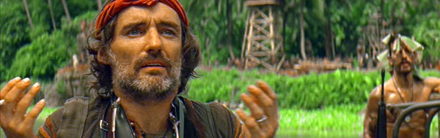
Cinematography
Truth is most moviegoers don’t even think about the work that goes into making a good looking film. So when writing a movie review, it may take some practice to appreciate the choices such as the shots, angles, and focus made cinematographers.

Slide 13
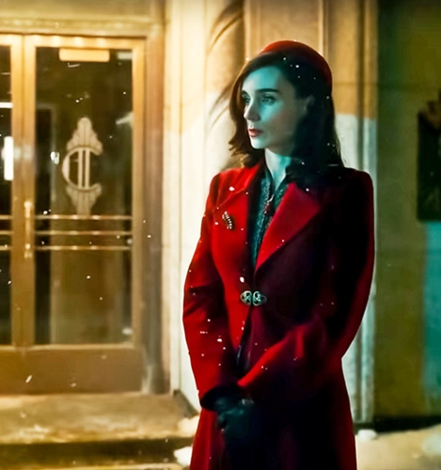
Production Design
Production Designers are another frequently overlooked specialist on a film. Their job of making the world of the movie look realistic—whether that means the surface of Mars or Main Street, U.S.A.—is often done so well that the casual viewer doesn’t notice.
While that typically signals a job well done, it’s up to the Film Critic to take into consideration just how expertly the production design is executed and if it enhances or detracts from a film.

Slide 14
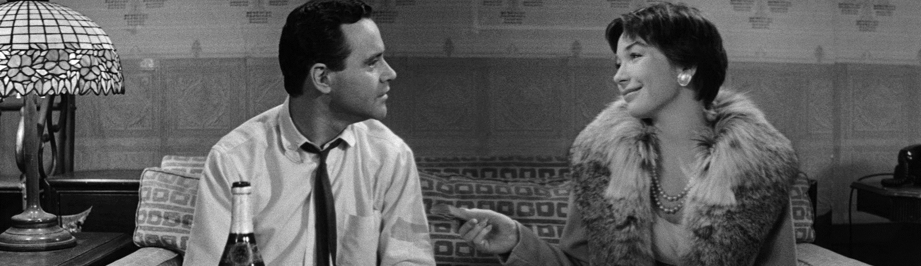
Screenwriting
It’s said that a movie is made for the first time when it’s written. As a Film Critic, being able to discern whether the story flows well, offers surprises -and most importantly-keeps the viewer engaged, will in large part due to the success or failure of the screenplay.

Slide 15
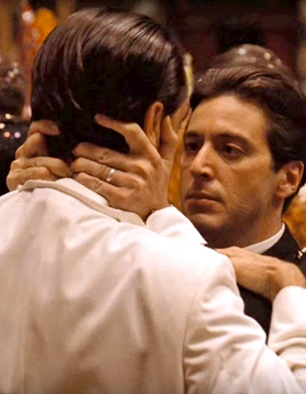
Theme
The Godfather is about a young man who takes over the illegal activities of his family. That’s the short version. It’s also about family loyalty. Morality versus that family loyalty. The attraction of power. And the ways in which power can warp people.
These are a few of the themes of The Godfather, so when reviewing a film , a critic shouldn’t downplay the importance of theme. While some may initially be interested in a movie because of it’s stars or director, it’s the universal themes of love, revenge, grief and so on that will likely have the most lasting impression.

Slide 16
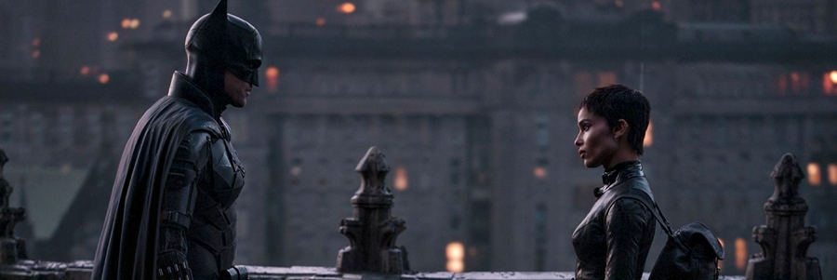
Editing
An editor can make or break a film, and part of a great film is one that moves at a clip appropriate to the material. What’s good for a comedy may not work for a superhero-laden action flick—and that’s okay! But it’s up to the reviewer to know the difference.

Slide 17
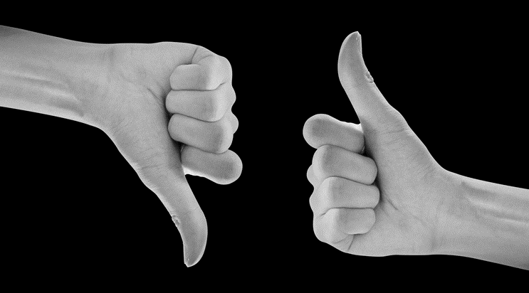
4. Formulate a Supported Viewpoint
A review offers an valid opinion about a film; otherwise, it would just be a synopsis. However, a good film critic should be mindful to offer a comprehensive viewpoint without spoiling the film, as that may ruin the experience for those seeing new releases. Viewpoints on films often clash, as any art form is subjective. If a critic can back up that opinion, though, they’ll gain the respect of their readers even if it differs from theirs.

Slide 18
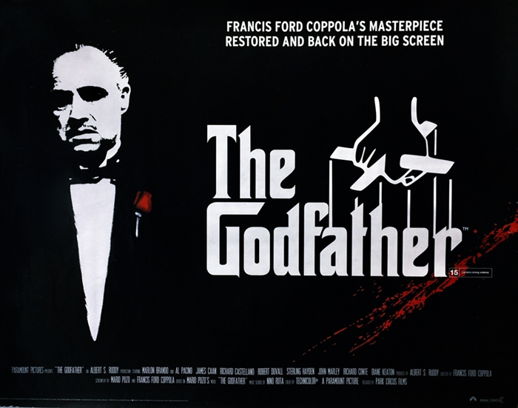
5. Example of How to Write a Film Review
Once the viewing is over and notes compiled, write a draft with the following steps:
1. Give an introduction.
That means providing the reader with baseline information about the film, such as the title, the year of theatrical release, the major cast members, the Director, and the Writer.
Here’s an example, the movie review should include: The Godfather; 1972; Marlon Brando, Al Pacino, James Caan, John Cazale, Diane Keaton and Talia Shire; Francis Ford Coppola; Mario Puzo and Francis Ford Coppola.

Slide 19
2. Include a synopsis.
It’s a vital piece of information that essentially sets the stage for the review.
That being said, while not as critical for a film that’s been around for many years, don’t forget that a movie synopsis should not reveal all major plot points.
3. Provide an analysis.
This is the most critical part of how to write a movie review. As mentioned, it’s okay to have a viewpoint that may not line up with popular opinion.
This is where the film reviewer states their opinions on those many film elements, including acting, directing, cinematography, production design, screenwriting, theme, and editing. Some potential topics may include arguing that X-Director should have won the Oscar or that X-Actor should have won it. Whatever opinions are put forth, back them up!

Slide 20
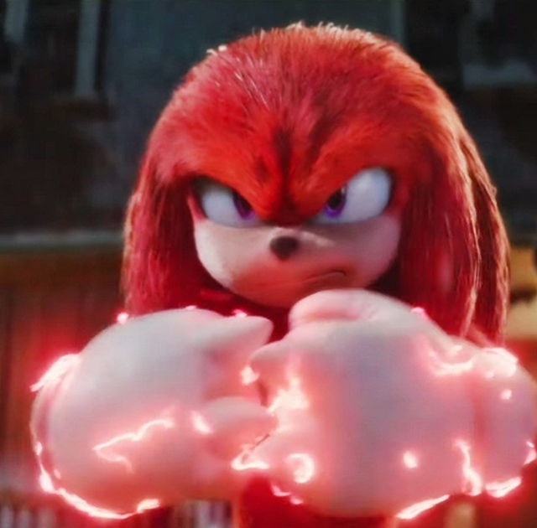
4. Offer a conclusion.
Should people revisit this film? Or would those two hours of viewing time be better spent on another film? End the film review on a confident note with a definite opinion.

Slide 21
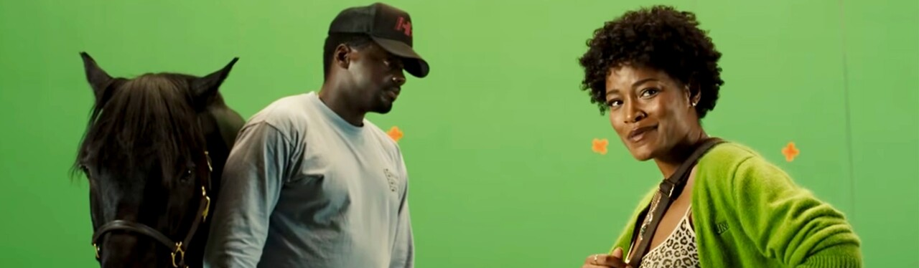
For Your Portfolio
For 30 points, watch any movie and write a full page film review with no less than 500 words. Use step #5 of this presentation as a guide. Print and turn in three days. Don’t forget to include your name, homeroom number and date on the top of the page.

Slide 22
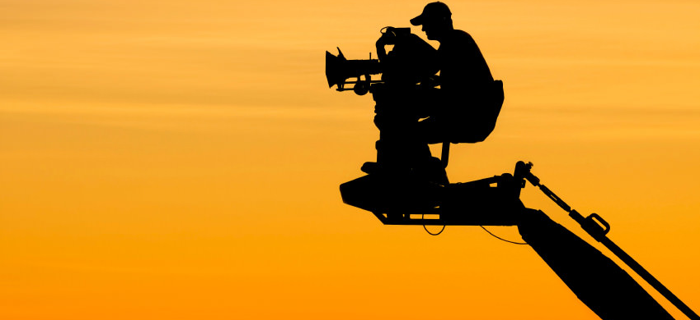
Next: Get a Job!
Jim Soto © 2022

