Slide 1
Understanding the Traits of Writing
Jim Soto

Slide 2
Lesson Objective
Understanding each of the six traits of effective writing
Apply the concept of the traits to writing
Pages 33-44

Slide 3
Traits of writing
Writing is made of six traits or qualities. They are:
Ideas
Organization
Voice
Word Choice
Sentence Fluency
Conventions

Slide 4
IDEAS
Good writing needs to be clear and focused in the message it presents.

Slide 5
ORGANIZATION
Strong writing has a beginning, middle, and ending. Overall, everything is well organized and easy to follow.

Slide 6
VOICE
Good writing reveals the special way the writer says things.

Slide 7
WORD CHOICE
Good writing contains strong words that help deliver the message with clarity.

Slide 8
SENTENCE FLUENCY
Writing should flow smoothly from one sentence to the next.

Slide 9
CONVENTIONS
Good writing is carefully edited to ensure understanding. Writing must follow the rules of punctuation, grammar and spelling.

Slide 10
Time to Get Our Feet Wet...
Most of the time students ask how many paragraphs should they write. My response is always: “As many as are necessary to express your topic clearly.”
However, keep in mind that whenever you write, you should have at least two or three main points to help support and organize your writing ideas. Each point must be explored in separate paragraphs.

Slide 11
Time to Get Our Feet Wet...
Using details can help you better explain or develop your main points. Details can come from personal thoughts or experiences.
The three types of personal experiences include:
Sensory details – come from our senses
Reflective details – come from our thoughts and feelings
Memory details – come from our experiences and knowledge

Slide 12
Time to Get Our Feet Wet...
Choose a topic to write about:
Our school cafeteria food
Our teachers
Froebel’s extracurricular clubs
Doing homework
Froebel’s student uniform
Write an effective focus statement. You can begin by recalling a specific event that meant a lot to you. Use details to make it interesting.

Slide 13
Time to Get Our Feet Wet...
Start with interesting information and state the focus.
Beginning
Good writing is organized writing. You can better organize your work through a process called “framing”. It looks like this:
Present the main supporting points and details.
Middle
Review the essay and offer a final thought.
Ending

Slide 14
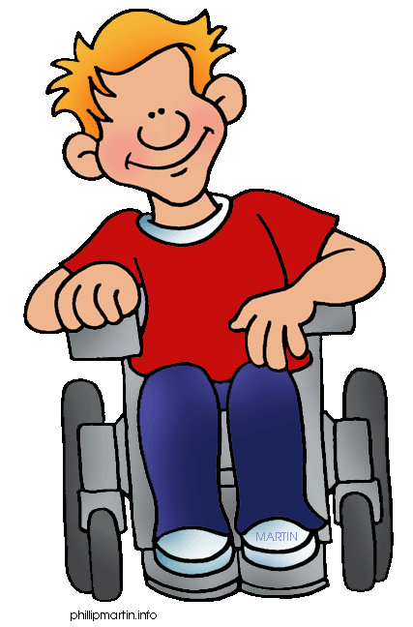
Time to Get Our Feet Wet...
Linking words are something that can really help our fluency in English, as they help us to create longer sentences. For example: I bought a hotdog. I bought a dog because I was really hungry.
Using transitions can help you organize the details of your narrative, description, and essay. Transitions are linking words and phrases.

Slide 15
Time to Get Our Feet Wet...
Transitions can help with:
Descriptions
across | below | in the front | near
Personal Narratives
after | during | first | then
Comparison/Contrast Essays
comparing: | like | in the same way | similarly
contrasting: | but | on the other hand | unlike
Persuasive Essays
first of all | in addition | equally as important | most importantly

Slide 16
Time to Get Our Feet Wet...
If the real you shines through in your writing, it will have voice. You must be honest to yourself in your writing.
Your audience will impact the tone of your voice:
For Adults – serious, formal, respectful
For Peers – informal, casual, relaxed

Slide 17
Time to Get Our Feet Wet...
Your choice of words can make your reading more pleasurable...or not. Which sentence creates a clearer image?
Josie served delicious, spicy, homemade beef tamales.
or,
Josie served delicious, beef tamales.
Sometimes less is more.

Slide 18
Time to Get Our Feet Wet...
Your sentences need to be fluid. In other words each thing you write about comes from a previous sentence. Keep in mind that:
Every sentence is important.
Whoever reads your paper should like the sound of it.
You should combine short sentences with longer ones.
Use transition words and phrases to connect ideas.

Slide 19
Time to Get Our Feet Wet...
Avoid using the following too much:
There is...
There are...
is, are, was, were...
and...

Slide 20
Seatwork / Homework
Following all five steps of the Writing Process, you will compose an essay using one of the titles from slide #12.
Oh, boy! Oh Boy!

Slide 21
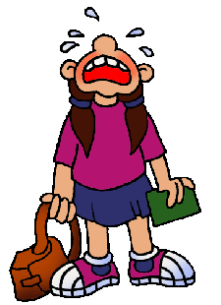
Next
Writing a Descriptive Paragraph
Jim Soto © 2015

