Slide 1
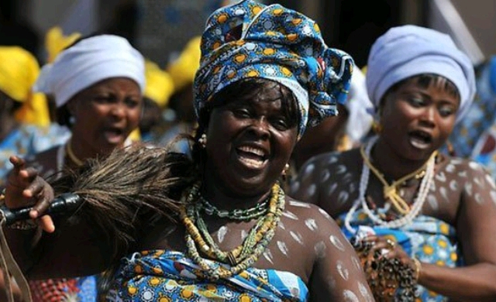
WORLD HISTORY
with Mr. Jim Soto
African Historical and Artistic Traditions

Slide 2
Think...
You are the youngest and smallest in your family. People often tease you for not being very strong. In the evenings, when work is done, your village gathers to listen to storytellers. One of your favorite stories is about the hero Sundiata. As a boy he was small and weak, but he grew to be a great warrior and hero.
How does the story of Sundiata make you feel?
Take a minute to write down your thoughts.

Slide 3
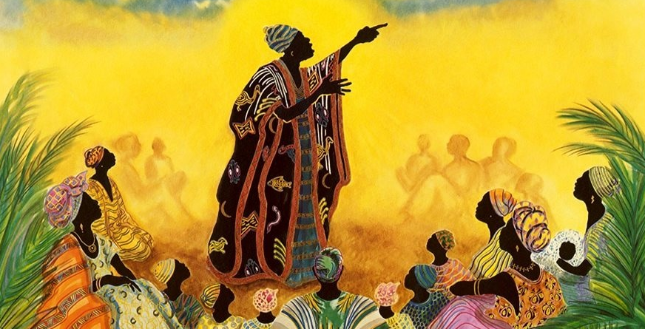
Although the people of West Africa did not have a written language, their culture has been passed down through oral history, writings by other people, and the arts. Geography, resources, culture, and trade influenced the growth of societies in West Africa.

Slide 4
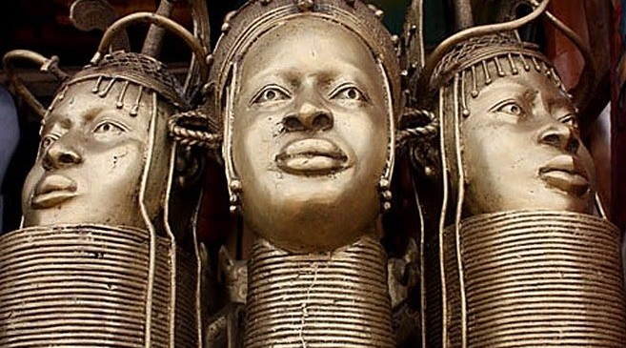
Read...
Now, in your textbook, read pages 396 thru 399.
After reading, answer the section 4 assessment. Show completed work to the teacher.

Slide 5
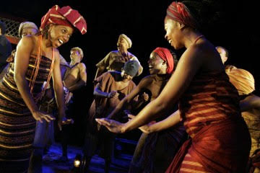
Preserving History
Even though Timbuktu and Djenne' were known for their libraries and universities, writing wasn't common in West Africa, none of their major civilizations of developed a written language. Arabic was used many Muslim traders as well as government officials, and religious leaders. However, a lack of written language didn't keep West Africans from knowing their history.

Slide 6
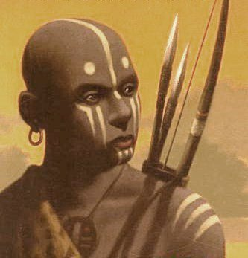
Proverbs and Epics
Information passed with oral histories, oral history: a spoken record of past events. The task of remembering their history was entrusted to storytellers.
Griots, or West African storytellers, were highly respected in their communities due to the fact that the people of West Africa were interested in the deeds of their ancestors. Griots kept history alive for new generations in an entertaining and informative way. They told of past events and deeds of people's ancestors.
Click Here!

Slide 7
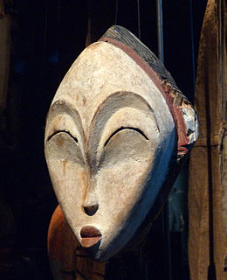
Art, Music, and Dance
Click Here!
Similar to most peoples, West Africans valued the arts. The art they produced took multiple forms.
Common West African art forms included sculpture, dance, mask-and-cloth-making, and music.
African sculpture helped inspire some European artists of the 1900's -this includes Henri Matisse and Pablo Picasso. in many West African societies, music as well as dance were as important as visual arts.

Slide 8
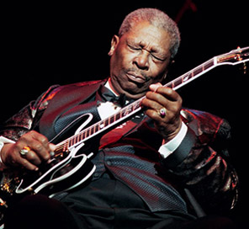
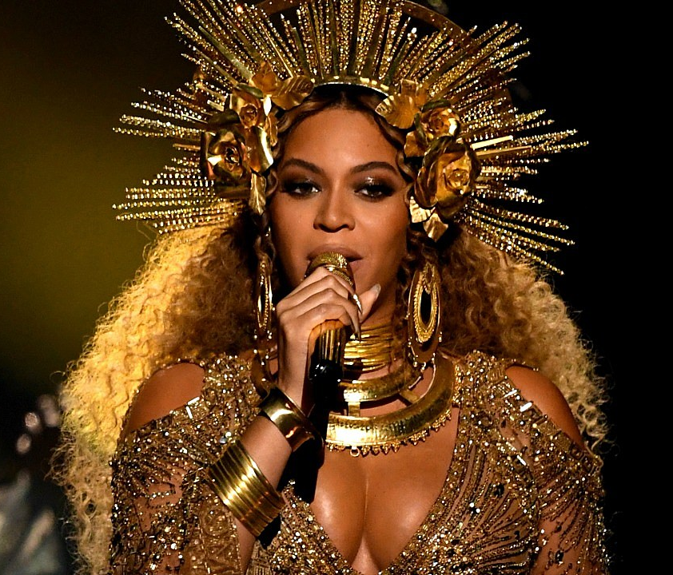
Click Here!
Many genres of popular music, including blues, jazz and rumba, derive to varying degrees from musical traditions from Africa, taken to the Americas by enslaved Africans. These rhythms and sounds have subsequently been adapted by newer genres like rock and rhythm and blues.

Slide 9
Final thoughts
The societies of West Africa did not have written languages, but they preserved their histories and culture through story telling and the arts.

Slide 10
NEXT
TEST 5
Jim Soto © 2019

