Slide 1
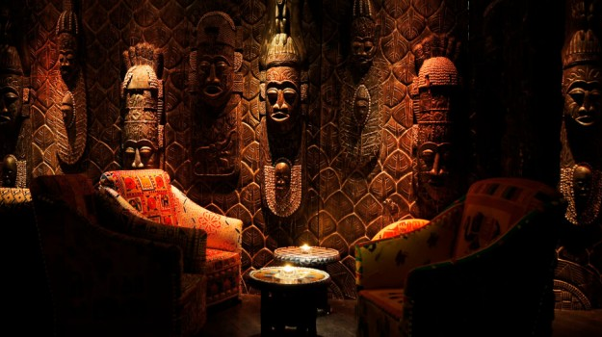
WORLD HISTORY
The Empire of Ghana
with Mr. Jim Soto

Slide 2
Think...
You’re a trader in a caravan heading into West Africa around AD 1000. The caravan carries many goods, but the most precious is salt. Salt is so valuable that people traded gold for it. The gold traders never meet you face to face, though. You wish you could talk to them to find out where they get their gold.
Why do you think the traders are so secretive?
Take a minute to write down your thoughts.

Slide 3
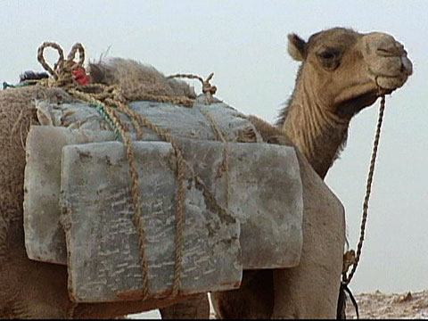
The various regions of Africa provided people with different resources. West Africa, for example, was rich in both fertile soils and minerals, especially gold and iron. Other regions had plentiful supplies of other resources, such as salt. Over time, trade developed between the regions with different resources. This trade led to the growth of the first great empire in West Africa.

Slide 4
Read...
Now, in your textbook, read pages 386 thru 389.
After reading, answer the section 2 assessment. Show completed work to the teacher.

Slide 5
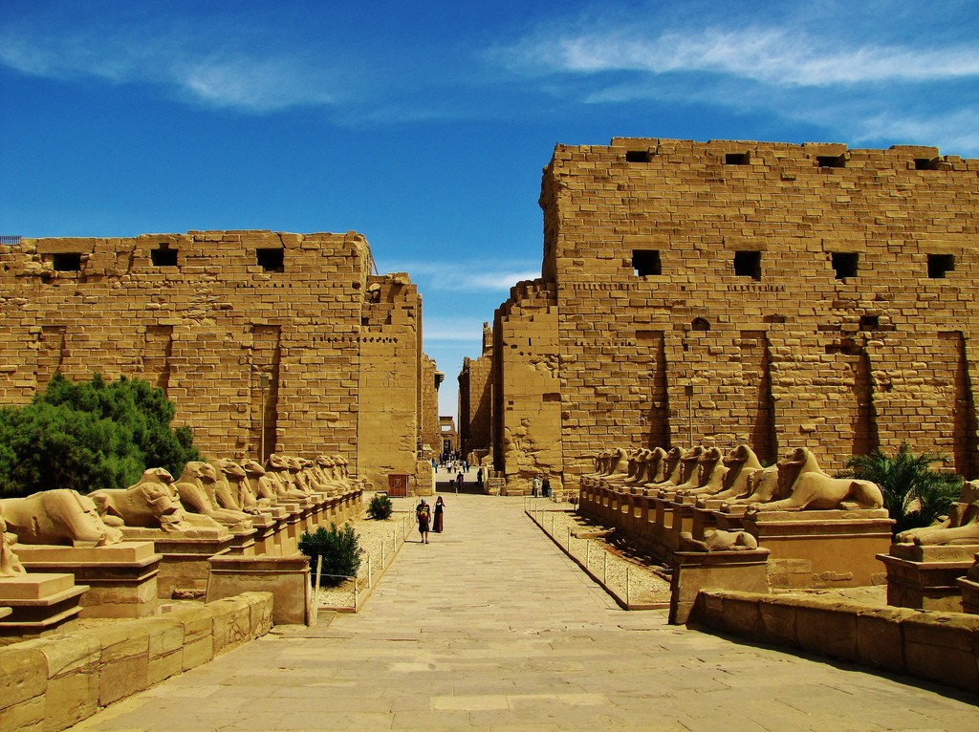
Ghana Controls Trade
For hundreds of years, trade crisscrossed West Africa. For most of that time, West Africans did not profit much from the Saharan trade because the routes were run by Berbers, a tribe from northern Africa. Eventually, that situation changed. A succession of three kingdoms came to power as their people, gained control of valuable trade routes in West Africa. Ghana was the first of these empires.
Click Here!

Slide 6
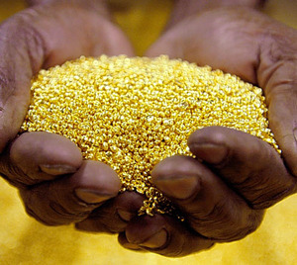
Click Here!
Silent trading was mainly used during the period 500 to 1500. Silent trade might be used because of an inability to speak the other traders' language, or to protect the secrets of where the valuable gold and salt came from. Silent bartering was invented by the ancient Ghana Empire.

Slide 7
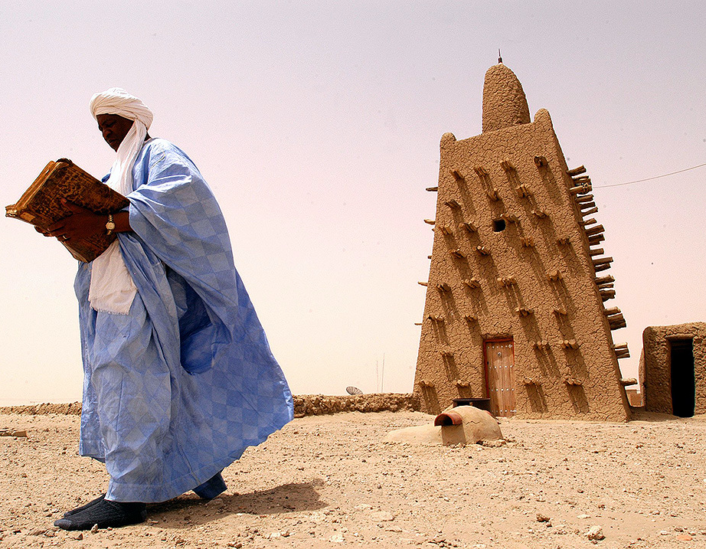
Ghana Builds an Empire
Ghanas were threatened by nomads, who wanted to take the farmers' food and water to provide for their animals. The farmers banded together, marking the beginning of the rise of Ghana. Population grew, food production grew exponentially, thus began Ghana's rise. As trade routes were established, ancient Ghana became an important trading center and cultural crossroads between AD 400 and 1200. Ancient Ghana was a society with a complex court system, military organization and gold trade.

Slide 8
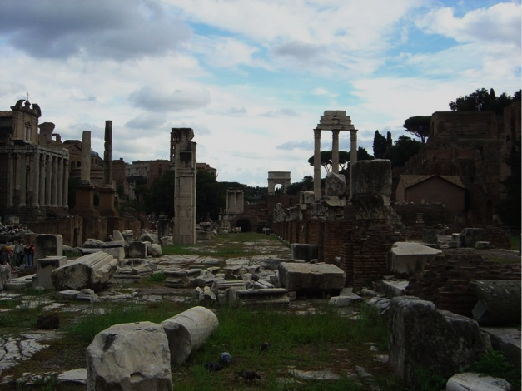
Ghana’s Decline
Click Here!
Ghana was combined in the kingdom of Mali in 1240 marking the end of the Ghana Empire. A tradition in history maintains that Ghana fell when it was sacked by the Almoravid movement in 1076–77. Another factor contributing to the fall of Ghana was overgrazing that led to the failure of farming.

Slide 9
Final thoughts
The empire of Ghana in West Africa grew rich and powerful through its control of trade routes and its gold production.
The empire lasted from AD 800 to AD 1200.

Slide 10
NEXT
Later African
Jim Soto © 2019

