Slide 1
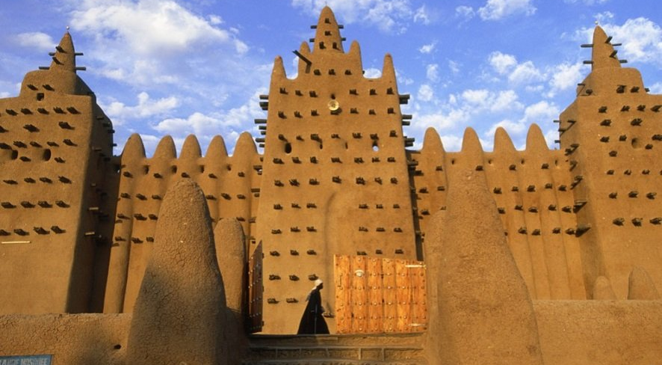
WORLD HISTORY
Geography & Early Africa
with Mr. Jim Soto

Slide 2
Think...
You live in a village near the great Niger River in Africa around AD 800. The river is full of life – birds, fish, crocodile. You use the water to plant crops and raise cattle. Traders use the river to bring wood, gold and other products from the forest.
Why is this a good place to live?
Take a minute to write down your thoughts.

Slide 3
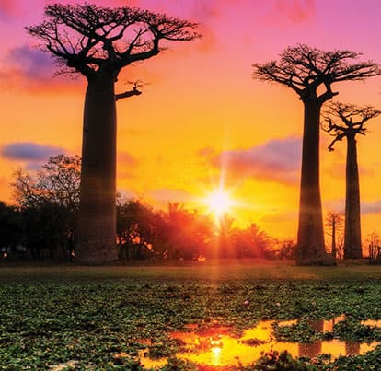
The continent of Africa is so large that it includes a great variety of terrain, from barren deserts to thick rain forests. Each region has a different climate and provides resources for the people living there.
In West Africa rivers provide water to grow crops in dryer areas. The land is also rich in minerals such as gold and iron. These two resources played a large role in the development of West African cultures.

Slide 4
Read...
Now, in your textbook, read pages 380 thru 383.
After reading, answer the section 1 assessment. Show completed work to the teacher.

Slide 5
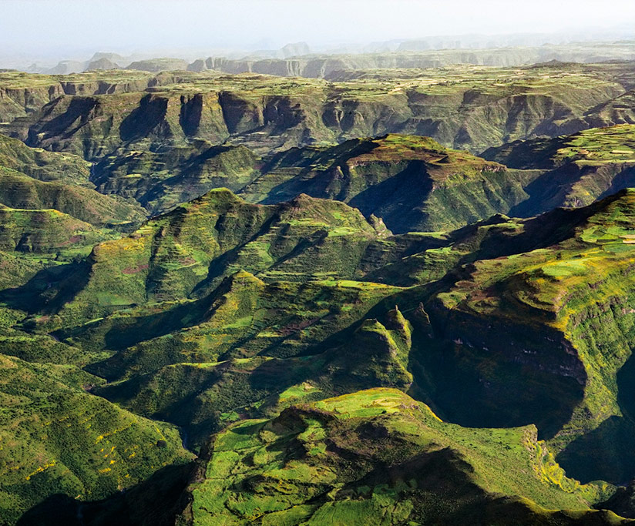
Landforms, Climate & Resources
The climate of Africa is a range of climates. The continent's northern half is primarily desert or arid, while its central and southern areas contain both savanna plains and very dense jungle (rainforest) regions. Africa is the hottest continent on earth; dry lands and deserts comprise 60% of the entire land surface.
Click Here!

Slide 6
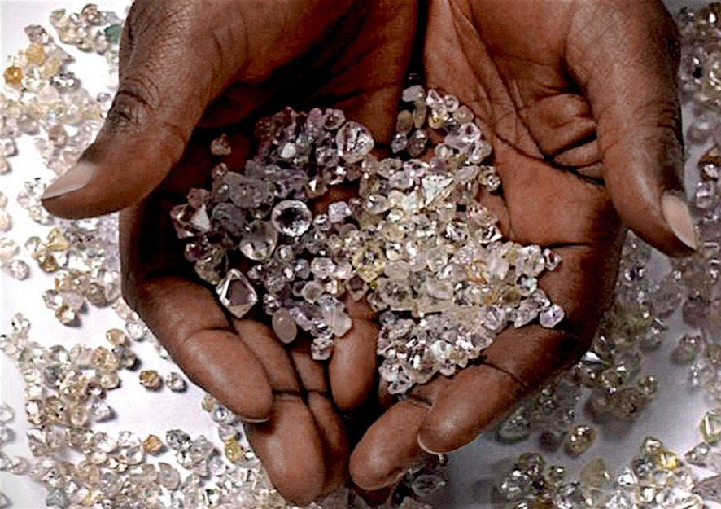
Africa has a large quantity of natural resources, including diamonds, sugar, salt, gold, iron, cobalt, uranium, copper, bauxite, silver,
petroleum and cocoa beans, but also woods and tropical fruits.
North Africa has vast oil and natural gas deposits, the Sahara holds the most strategic nuclear ore, and many other resources are abundant on the continent.
Click Here!

Slide 7
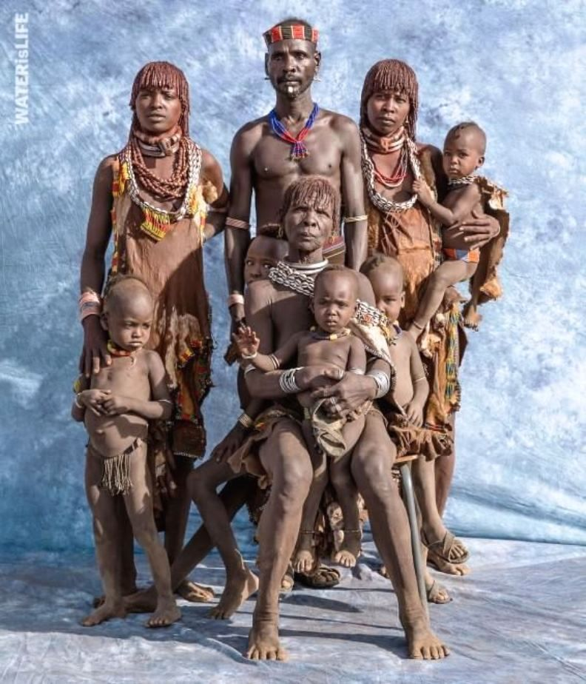
Early People’s Way of Life
Family is very important throughout Africa. Families, not individuals, are the building blocks of African society. Most people live in households that include not only the nuclear family (mother, father, children) but also members of their extended family (grandparents, aunts, uncles, cousins, and others).

Slide 8
The original religion in West Africa was Animism. It developed simultaneously in different parts of the world. Scientists believe that animistic beliefs go back to the Paleolithic age.
Animism believes that all material phenomena have agency, that there exists no hard and fast distinction between the spiritual and physical (or material) world and that soul or spirit or sentience exists not only in humans, but also in other animals, plants, rocks, geographic features such as mountains.

Slide 9
Final thoughts
Physical geography affected culture and trade in West Africa.
When Africans developed iron technology, communities grew.
Trade, especially in gold and salt, expanded

Slide 10
NEXT
GHANA
Jim Soto © 2019

