Slide 1
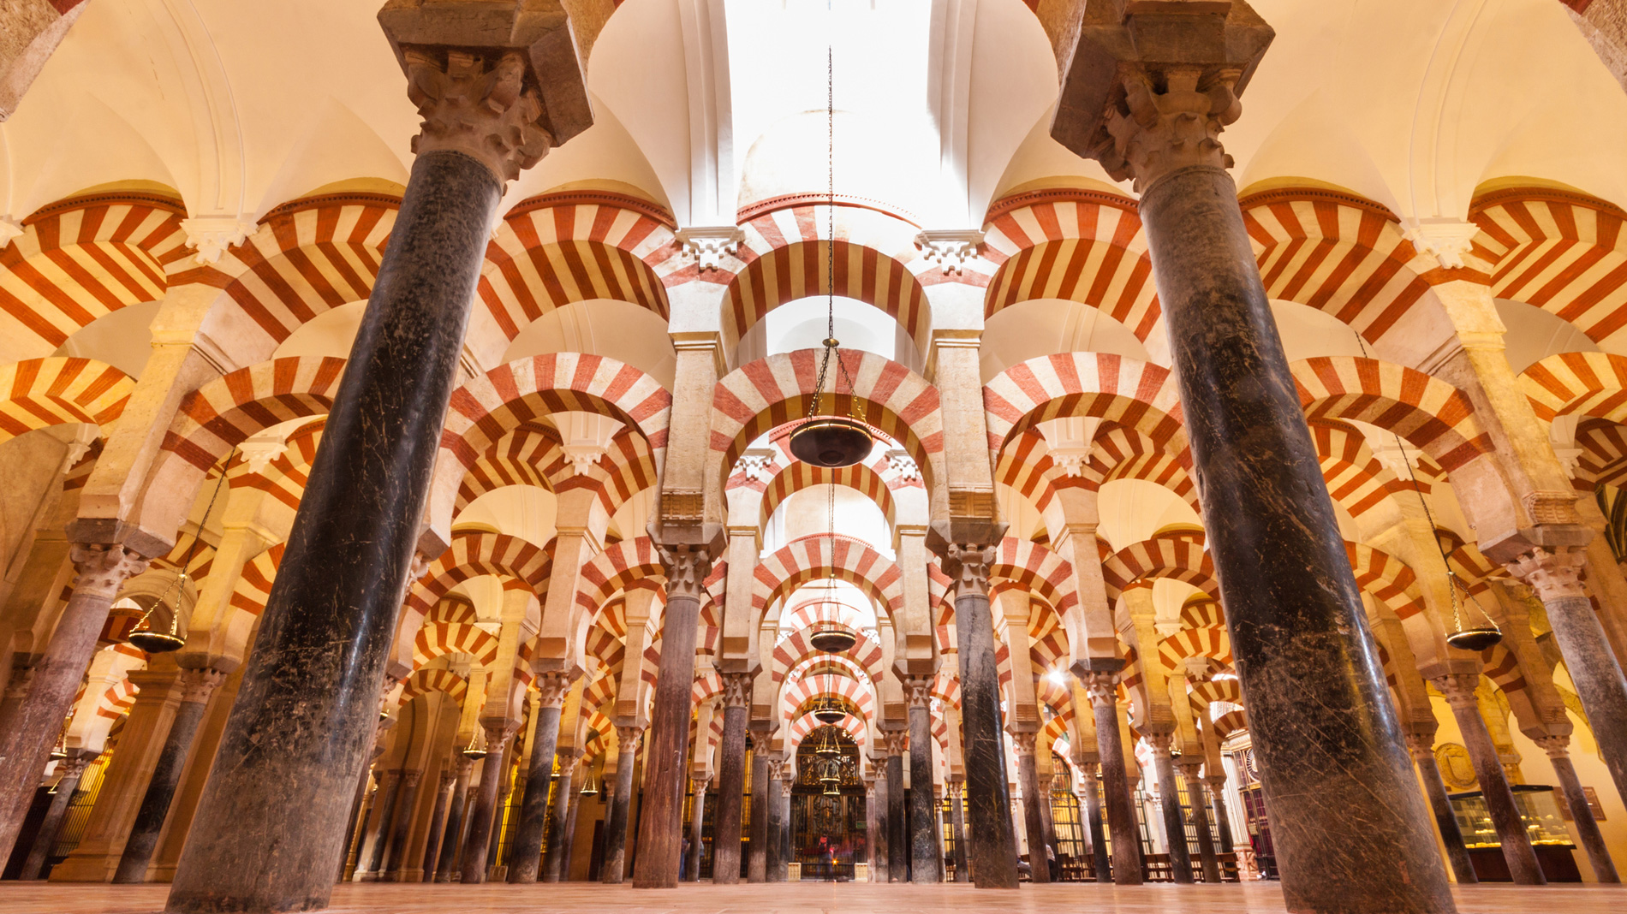
WORLD HISTORY
with Mr. Jim Soto
Islamic Achievements

Slide 2
Think...
You are a servant in the court of a powerful Muslim ruler. Your court life is comfortable, though not one of luxury. Now the ruler is sending your master to explore unknown lands and distant kingdoms. The dangerous journey will take him across seas and deserts. He can take only a few servants with him. He has not ordered you to come but has given you a choice. Would you join your master’s expedition or stay at home?
Take a minute to write down your answer and explanation.

Slide 3
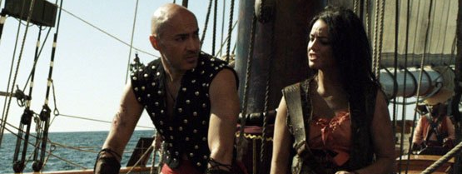
Muslim explorers traveled far and wide to learn about new places. They used what they learned to make maps. Their contributions to geography were just one way Muslim scholars made advancements in science and learning.

Slide 4
To learn more about this topic read pages 368 thru 371 and complete the section 4 assessment. Show me the completed work when complete.

Slide 5
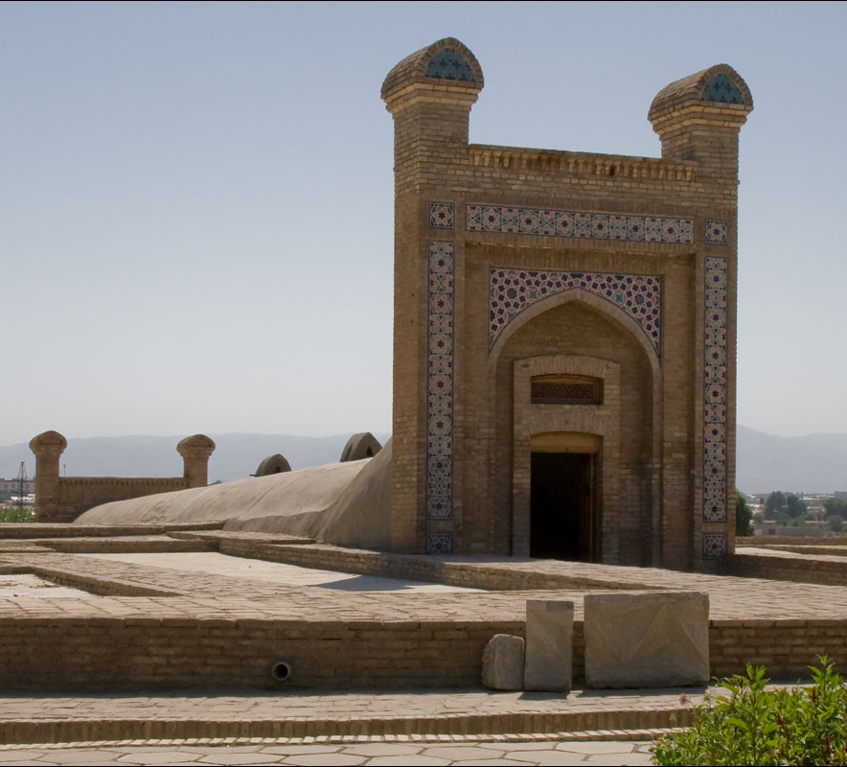
Science and Philosophy
The empires of the Islamic world contributed to the achievements of Islamic culture. Muslim scholars made advances in astronomy, geography, math, and science. Scholars at Baghdad and Córdoba translated many ancient writings on these subjects into Arabic. Having a common language helped scholars throughout the Islamic world share what they learned with each other.
Click Here!

Slide 6
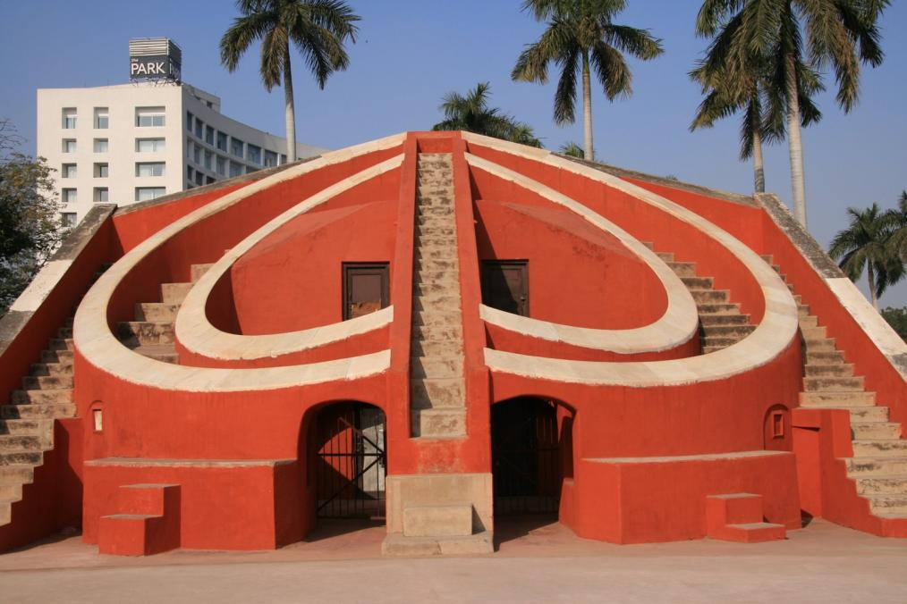
Islamic Achievements
Muslim scientists used astrolabes to figure out their location, direction, and even the time of day. Although the Greeks invented the astrolabe, Muslim scholars greatly improved it. The use of observatories allowed Muslim scientists to make other significant advances in astronomy too. This observatory was built in the 1700s in Delhi, the capital of Mughal India. Muslim mathematicians combined Indian and Greek ideas with their own to dramatically increase human knowledge of mathematics.
Click Here!

Slide 7
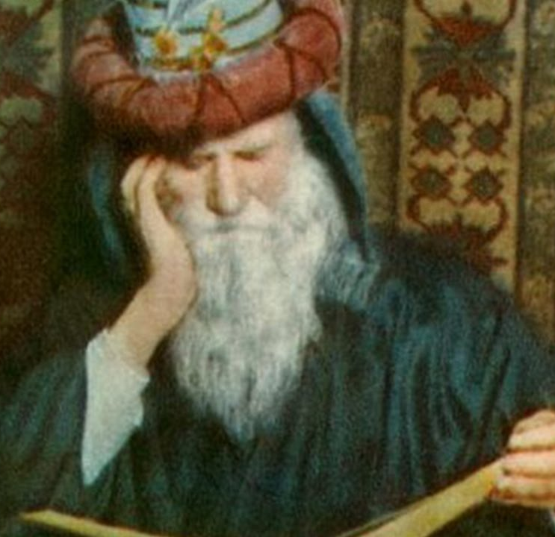
Literature and the Arts
Literature, especially poetry, was popular in the Muslim world. Much poetry was influenced by Sufism. Sufi poets often wrote about their loyalty to God. One of the most famous Sufi poets was Omar Khayyám (OH-mahr ky-AHM). Muslims also enjoyed reading short stories. One famous collection of short stories is The Thousand and One Nights. It includes tales about legendary characters such as Sinbad, Aladdin, and Ali Baba.
Click Here!

Slide 8
Final thoughts
Islamic culture produced great achievements in science, philosophy, literature, architecture, and art.

Slide 9
NEXT
Government
Jim Soto © 2019

