Slide 1
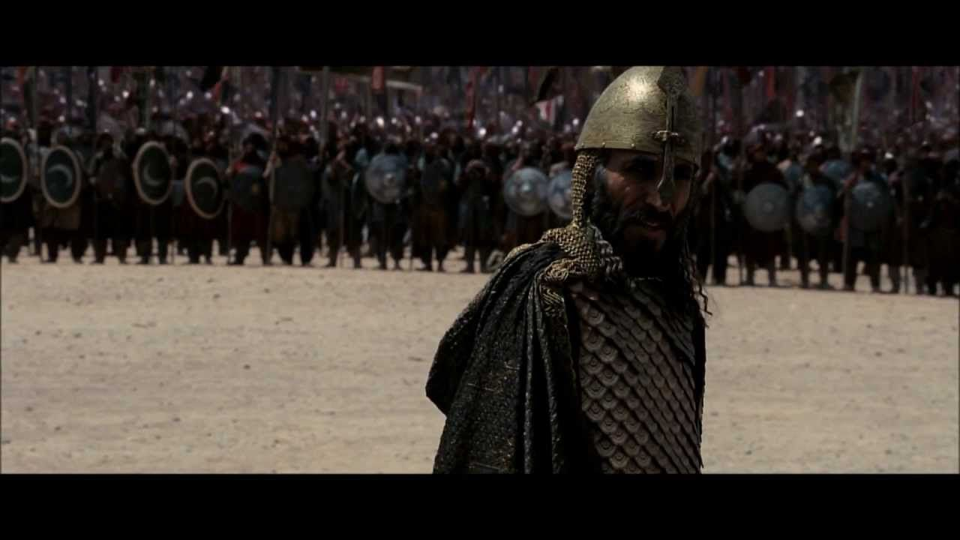
WORLD HISTORY
with Mr. Jim Soto
Islamic Empires

Slide 2
Think...
You are a farmer living on the coast of India. For centuries your people have raised cotton and spun its fibers into a soft fabric. One day, a ship arrives in the harbor carrying Muslim traders from far away. They bring interesting goods you have never seen before.
What ideas might you learn from these traders?
Take a minute to write down your answer and explanation.

Slide 3
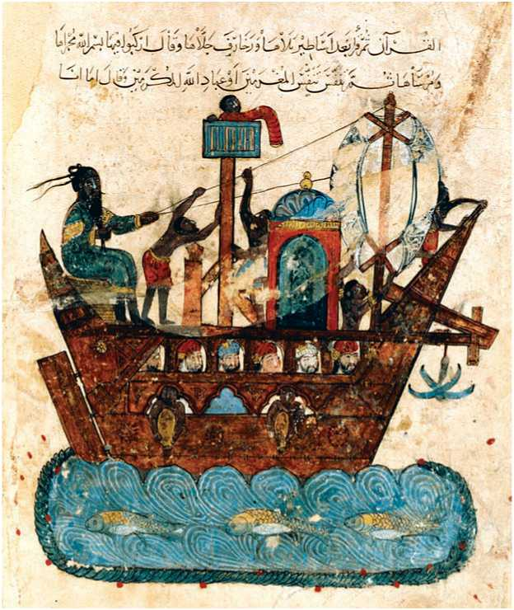
For years traders traveled through Arabia to markets far away. Along the way, they picked up new goods and ideas. They introduced these to the people they met. Some of these new ideas the traders spread were Islamic ideas.

Slide 4
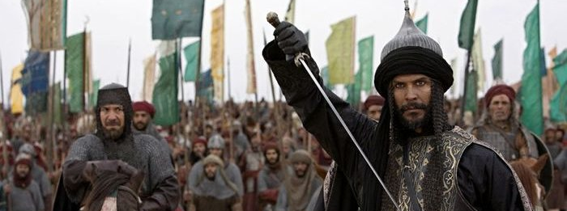
To learn more about this topic read pages 362 thru 367 and complete the section 3 assessment. Show me the completed work when complete.
Click Here!

Slide 5
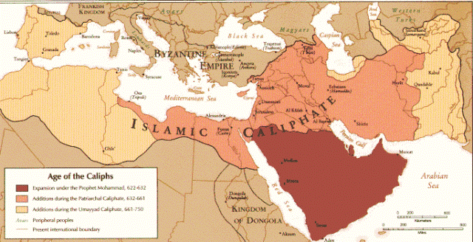
Muslim Armies Conquer Many Lands
Following Muhammad’s death Abu Bakr became the new leader of Islam. He was the first caliph (successor), the highest leader in Islam. He led a series of military and trade efforts that ushered in a vast Islamic empire.

Slide 6
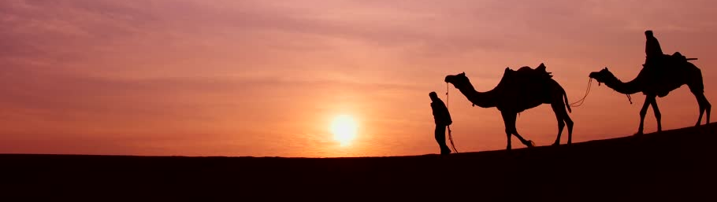
Trade Helps Spread Islam
Muslim traders traveled all around the middle east, Southern Europe, Asia and Africa using their trade routes to spread Islam. As they remained in contact with other races, Muslims practiced a degree of tolerance with those they conquered.

Slide 7
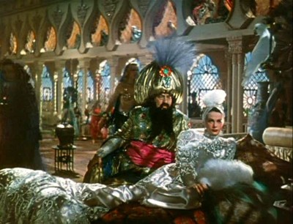
Three Muslim Empires
The great era of Arab expansion lasted until the 1100s. After ward, non-Arab Muslim groups built large, powerful empires that spanned from Asia to Europe. The Ottomans, Safavids and Mughals built great empires and continued the spread of Islam.
Click Here!

Slide 8
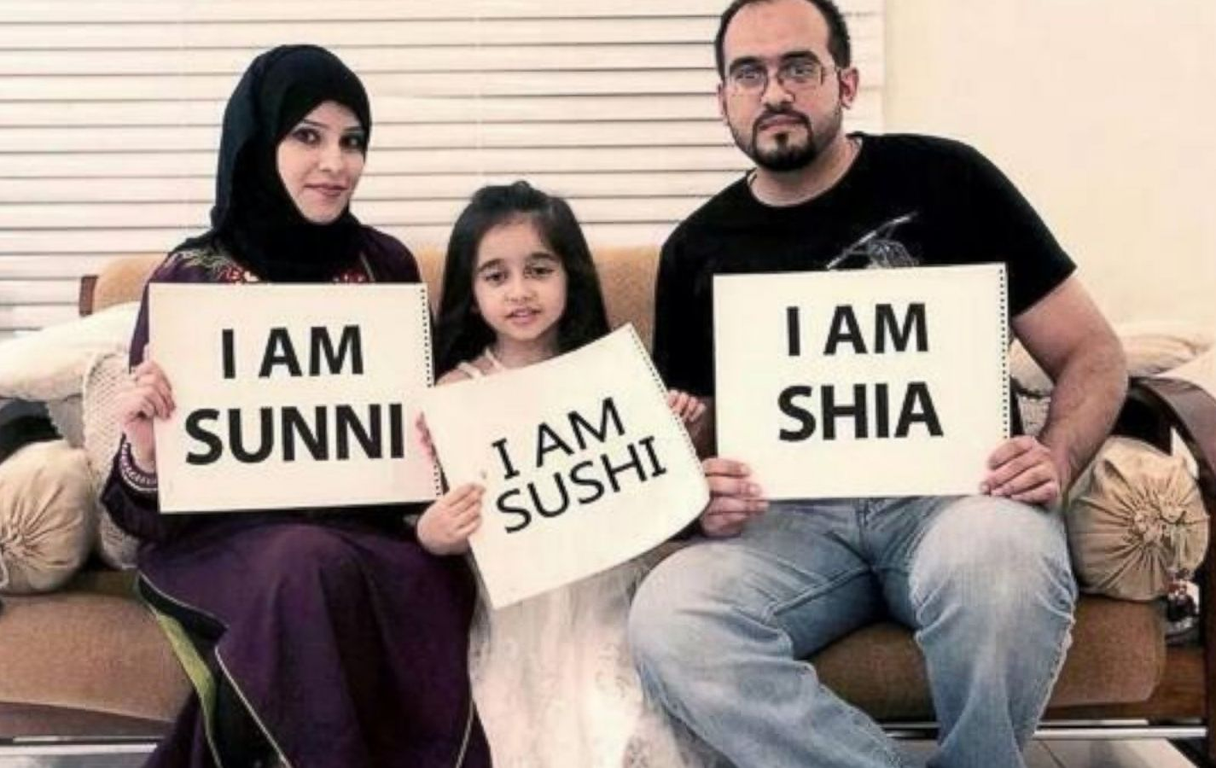
Sunni vs. Shia
The greatest division amongst Muslims spilt Islam in two factions. What do Sunni and Shia disagree on? Shiites say the prophet's cousin and son-in-law, Ali, was his rightful successor but he was cheated when authority went to those the Sunnis call the four “Rightfully Guided Caliphs” — Abu Bakr, Omar, Othman and, finally, Ali. Sunnis are the majority across the Islamic world.

Slide 9
Final thoughts
Islam spreads beyond Arabia through warfare and trade.
The Ottomans, Safavids and Mughals built great empires and continued the spread of Islam.

Slide 10
NEXT
ACHIEVEMENTS
Jim Soto © 2019

