Slide 1
WORLD HISTORY
with Mr. Jim Soto
Islamic Beliefs and Practice

Slide 2
Think...
Your family owns an inn in Mecca. Usually business is pretty calm, but this week your inn is packed. Travelers have come from all over the world to visit your city. One morning you leave the inn and are swept up in a huge crowd of these visitors. They speak many different languages, but everyone is wearing the same white robes. They are headed to the mosque.
What might draw so many people to your city?
Take a minute to write down your answer and explanation.

Slide 3
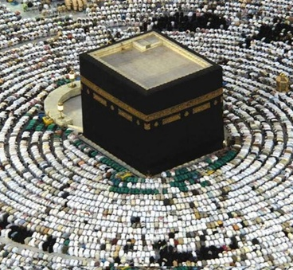
To learn more about this topic read pages 358 thru 361 and complete the section 2 assessment. Show me the completed work when complete.

Slide 4
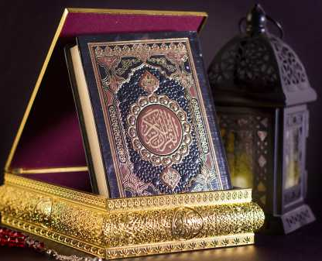
The Qurán
The Quran is the central religious text of Islam, which Muslims believe to be a revelation from God. Muslims believe that the Quran was verbally revealed by God to Muhammad through the angel Gabriel (Jibril), gradually over a period of approximately 23 years, beginning on 22 December 609 CE, when Muhammad was 40, and concluding in 632, the year of his death.
Click Here!

Slide 5
The Sunnah
The word Sunnah is an Arabic word meaning "tradition" or "way." For Muslims, Sunnah means "the way of the prophet". The Sunnah is made up of the words and actions of Muhammad, the prophet of Islam. Muslims believe Muhammad's life is a good model for them to follow in their own lives.
Click Here!

Slide 6
The main duties of Islam are known as The Five Pillars of Islam. They are considered mandatory by believers and are the foundation of Muslim life.
Click Here!
Shahada
Sawm
Hajj
Salat
Zakat

Slide 7
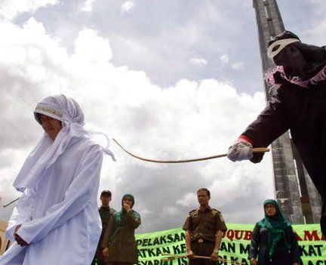
Islamic Law
Because in addition to not just being a religious system, but also a political one, Islam has a civil code. Sharia law or Islamic law is a set of religious principles which form part of the Islamic culture. The Arabic word sharīʿah, refers to the revealed law of God and originally meant "way" or "path". Its penal code is an extreme form of “Lex Talionis”.
Click Here!

Slide 8
Final thoughts
The Qur’an, the Sunnah, and Sharia teach Muslims how to live every aspect of life.

Slide 9
NEXT
EMPIRES
Jim Soto © 2019

