Slide 1
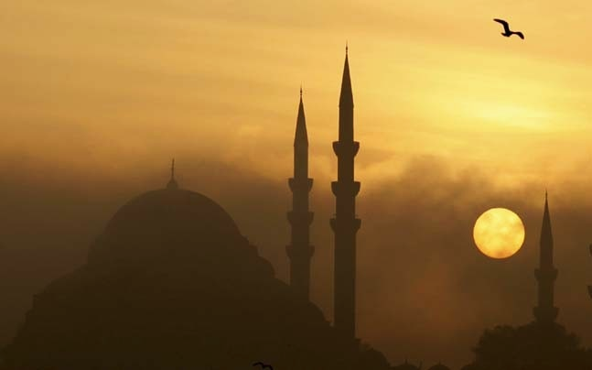
WORLD HISTORY
with Mr. Jim Soto
The Roots of Islam

Slide 2
Think...
You live in a town in Arabia, in a large merchant family. Your family has grown rich from selling goods brought by traders crossing the desert. Your house is larger than most others in town, and you have servants to wait on you. Although many townspeople are poor, you have always taken such differences for granted. Now you hear that some people are saying the rich should give money to the poor. How might your family react to this idea?
Take a minute to write down your answer and explanation.

Slide 3
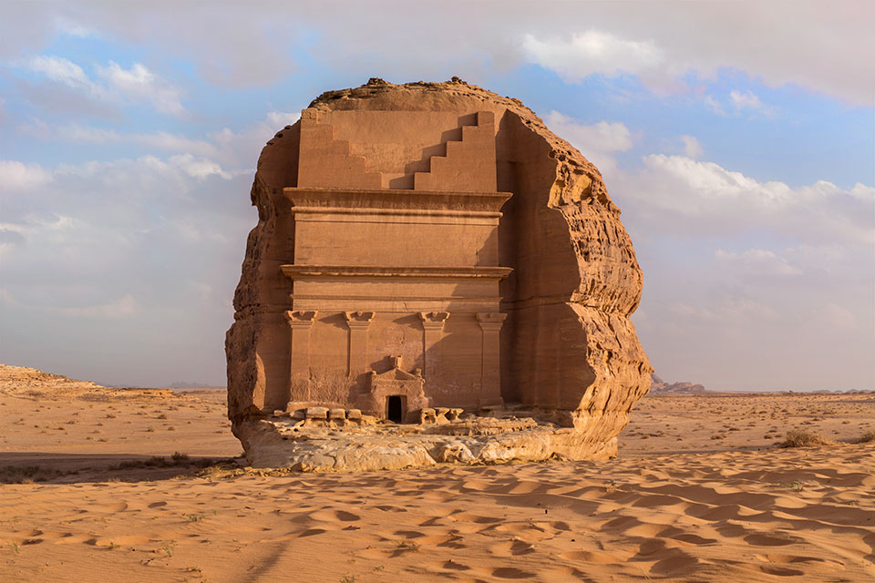
To learn more about this topic read pages 354 thru 357 and complete the section 1 assessment. Show me the completed work when complete.

Slide 4
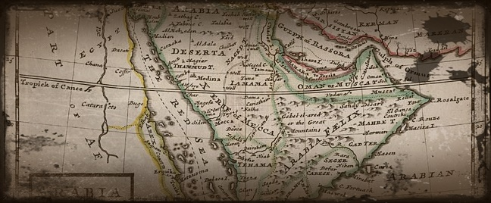
Saudi Arabia is, for the most part, an uninhabited desert land, which includes the Rub' Al Khali Desert, the larges mass of sand in the world, and the An-Nafud Desert - where sand dunes often exceed 100 ft. in height.
Click Here!

Slide 5
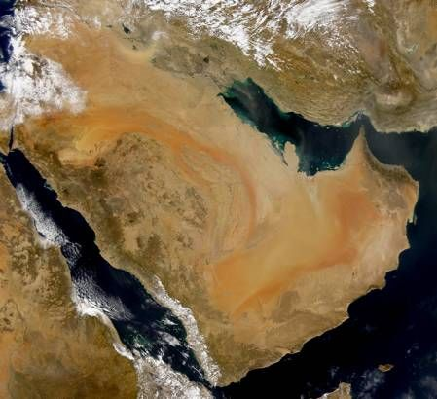
Life in a Desert
Arabia lies in a region with hot and dry air. It’s destitute of freshwater, but ironically nearly surrounded by seas such as: the Red Sea, Gulf of Aden, Arabian Sea, Gulf of Oman, and Arabian Gulf.
Because of the arid climate, life is hard. If you lived near an oasis, you could settle. If there were no oases nearby, you’d have to lead a nomadic life.

Slide 6
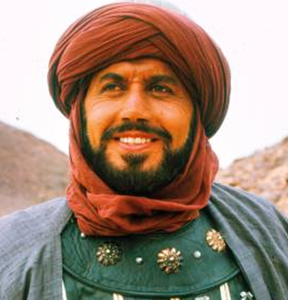
A New Religion
Early Arabs were polytheistic, but that change when a merchant named Muhammad created a new religion. He claimed to have received angelic messages that formed the basis of Islam, or “submission to God”. Those messages were eventually collected in a book called the Qur’an.
Click Here!

Slide 7
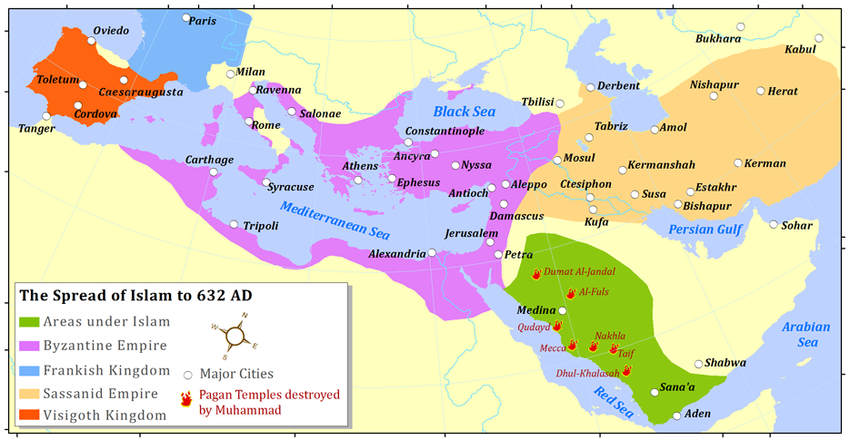
In time, Islam spread throughout the Arabian peninsula and into the middle east.

Slide 8
Final thoughts
The geography of Arabia encouraged trade and influenced the development of nomadic and sedentary lifestyles.
In the early 600s, Muhammad introduced a new religion to Arabia.
Many Arabians converted to this religion, thus becoming Muslims.

Slide 9
NEXT
BELIEFS
Jim Soto © 2019

