Slide 1
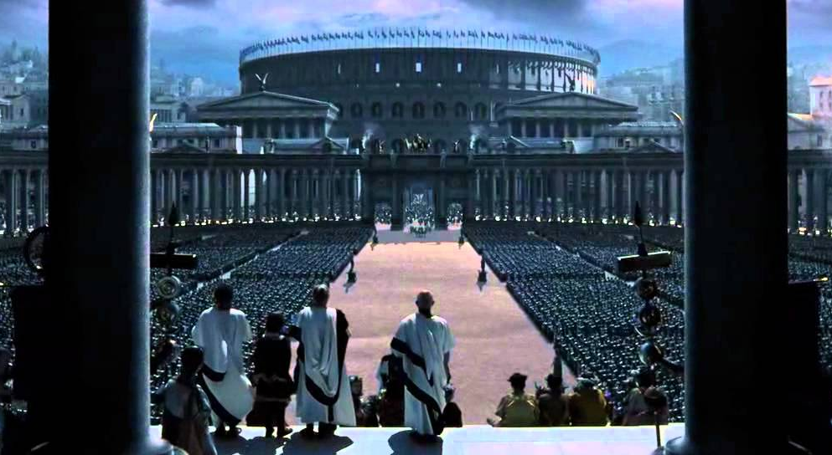
WORLD HISTORY
with Mr. Jim Soto
The End of the Roman Empire

Slide 2
Think...
You are a former Roman soldier who settled on lands in Gaul. In the last few months, groups of foreigners have been raiding local towns and burning farms. The commander of the local army post is an old friend, but says he is short of loyal soldiers. Many troops have been called back to Rome. You don’t know when the next raid will come.
How will you defend your lands?
Take a minute to write down your answer and explanation.

Slide 3
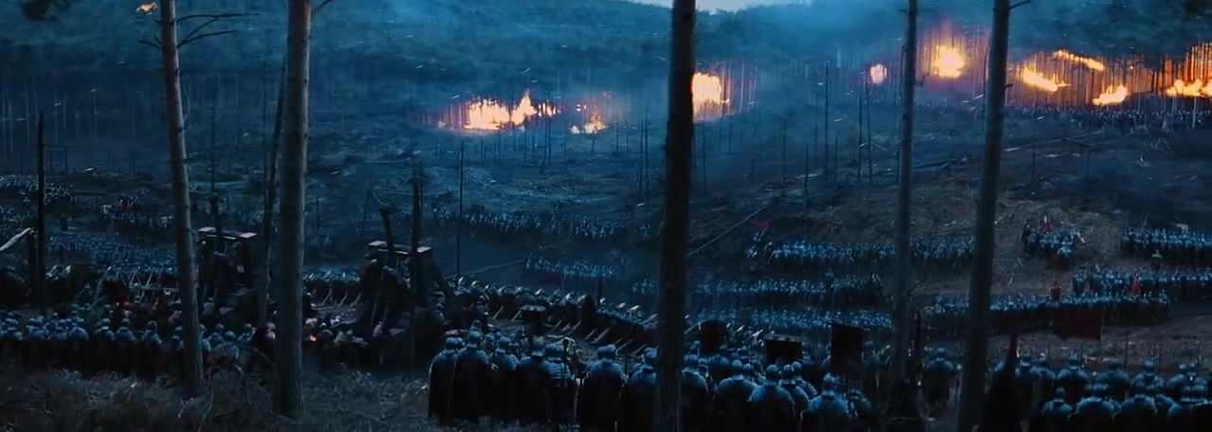
Though the Roman empire remained large and powerful, it faced both external and internal threats. Beyond the borders of the empire, many other nations were on the move. They threatened the peace in the provinces and eventually attacked the heart of the empire itself.

Slide 4
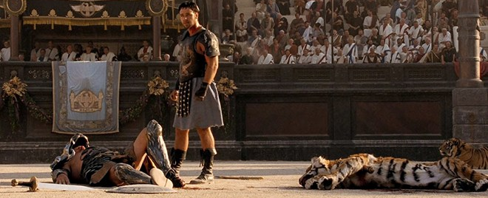
To learn more about this topic read pages 339 thru 343 and complete the section 3 assessment. Show me the completed work when complete.

Slide 5
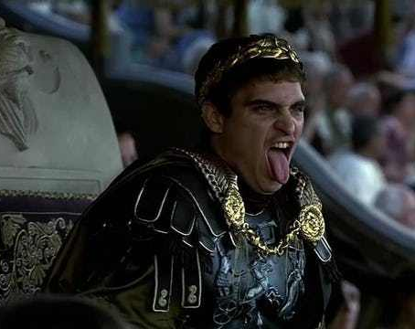
Problems in the Empire
By 100 AD, Rome had reached the height of its size. A hundred years later it was already giving up land it had conquered because it could not defend it. External threats such as: Germanic and Persian invaders and internal threats such as: pandemics, high taxation and political problems were taking their toll.

Slide 6
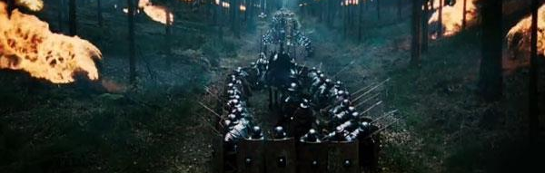
The Decline of Rome
With the empire divide into two parts (a Western and an Eastern), the empire weakened. Huns, Goths, Visigoths, Ostrogoths and political corruption precipitated the empire’s fall.
Click Here!

Slide 7
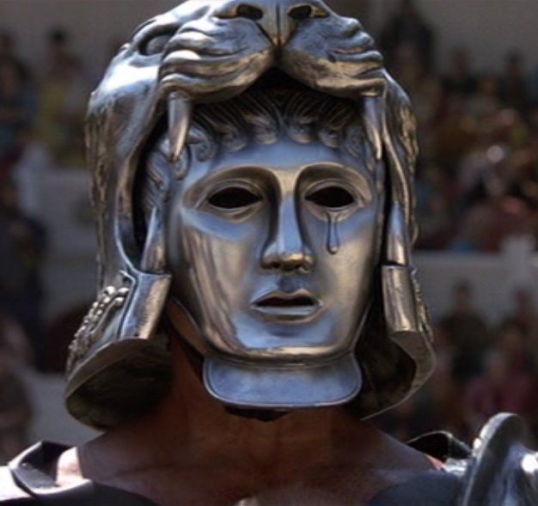
A New Eastern Empire
While the Western Empire crumbled, the Eastern thrived. This new empire was quite different and lasted longer than the original Western empire. It became known as the Byzantine Empire. Christianity, now the official religion of the Romans also transformed. The official church was call Roman Catholic.
In the end, the new capital of Constantinople was also the home of the new Orthodox Church.
Click Here!

Slide 8
Final thoughts
After the fall of Rome, Roman power shifted east.
The Orthodox Church became a mayor force in the Byzantine Empire.

Slide 9
NEXT
ISLAM
Jim Soto © 2019

