Slide 1
Journals & Learning Logs
Jim Soto

Slide 2
Lesson Objective
Write in a travel journal
Learn about the purpose of keeping other kinds of journals
Make entries in other kinds of journals
Create a learning log
pgs.431-440

Slide 3
Journals and Logs
Sometimes you have some very cool thoughts that sometimes go away and never come back. How can you keep this from happening? Journals and learning logs can help you capture and organize these thoughts to help you be a better writer.

Slide 4
What is a Journal?
A journal provides a quiet space to organize thoughts, clarify opinions, and think through courses of action.

Slide 5
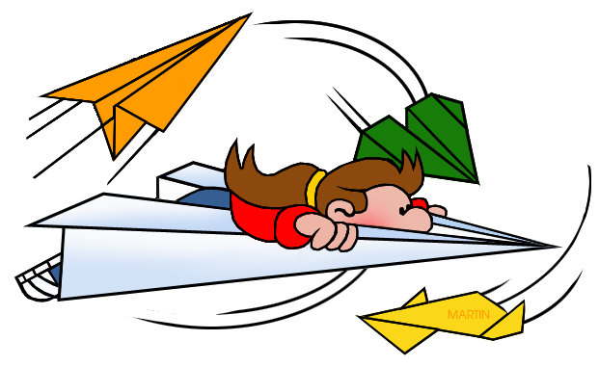
Writing a Travel Journal
Travel is a fun time, full of new experiences, and seeing more of the world. If you're travelling, you'll want to remember everything you did. A travel journal will help preserve your memories of the experience.

Slide 6
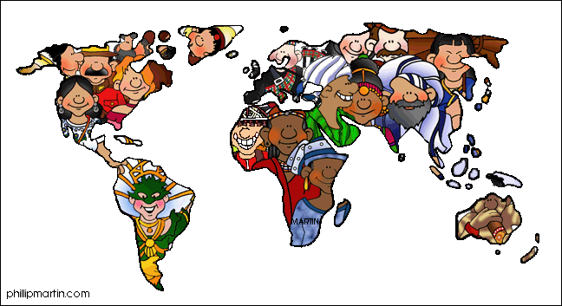
Writing a Travel Journal
You will need:
A folder
Composition paper
Colored pencils or markers
Photographs
Take three minutes to read pg.432.

Slide 7
Now, get up! You’re going on a trip.

Slide 8
Writing a Travel Journal
Now that we’re back, meet with your team leader, read pgs. 433 so you can see how a travel journal is written and create one with your team. You’ll have 20 minutes to present it to the class. Hurry!

Slide 9
What is a Learning Log?
Learning logs are a place for students to record what they are learning in school as they are learning it.

Slide 10
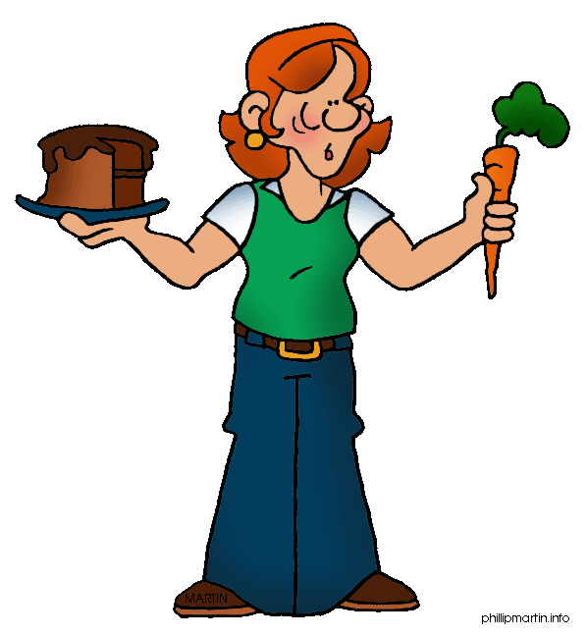
Writing a Learning Log
A Learning Log is a journal which evidences your own learning and skills development. It is not just a diary or record of “What you have done” but a record of what you have learnt, tried and reflected upon.

Slide 11
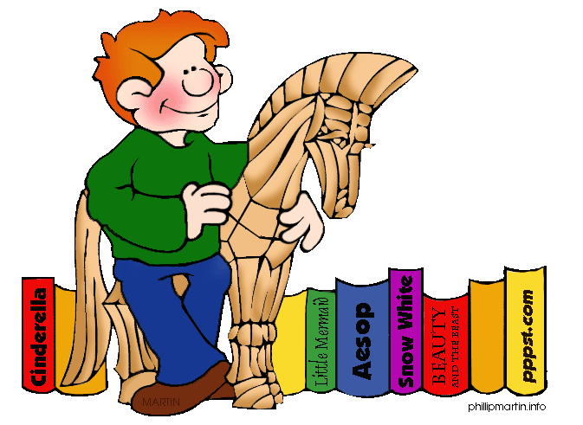
Writing a Learning Log
Take a few minutes to read pgs. 434-448 to see how a learning log is written. Complete the Log on in ... Activities in pgs 436-438. You will share the results with the class later.

Slide 12
Homework
In your Skills Book complete pgs. 9-14.
Commas Between Items in a Series 2
Other Comma Uses 1
Other Comma Uses 2
yay!

Slide 13
Next
Understanding the Traits of Writing
Jim Soto © 2015

