Slide 1
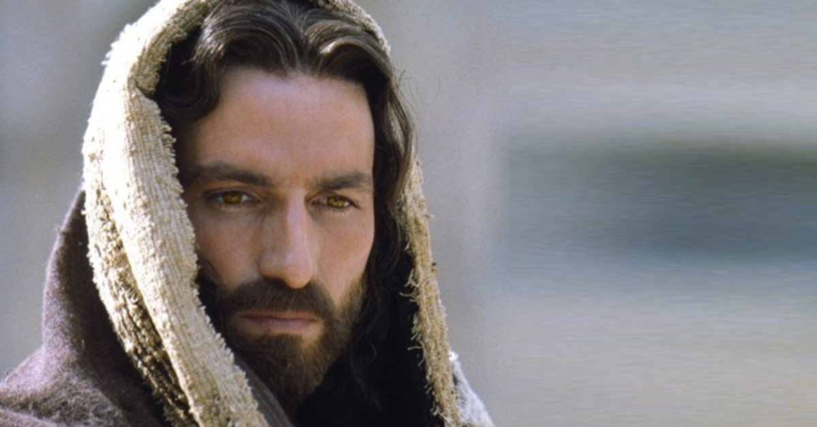
WORLD HISTORY
The Roman Empire & Christianity
with Mr. Jim Soto

Slide 2
Think...
You are a Roman soldier stationed in one of the empire’s farthest provinces. You are proud that you’ve helped bring Roman culture to this place far from the city of Rome. But one group of local people refuses to take part in official Roman holidays and rituals, saying it is against their religious beliefs. Other than that, they are peaceful. Even so, some think this group is dangerous.
What will you do about this group?
Take a minute to write down your answer.

Slide 3
As the Roman empire expanded, it came to include many races that had different cultures and world views. While the Roman government was usually somewhat tolerant of local religions and cultures, they didn’t allow ANYTHING that challenged their authority.

Slide 4
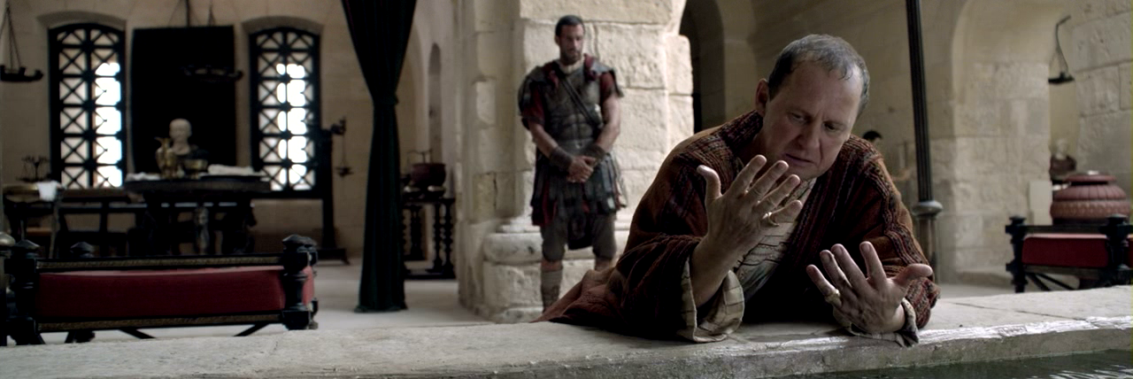
To learn more about this topic read pages 332 thru 338 and complete the section 2 assessment. Show me the completed work when complete.

Slide 5
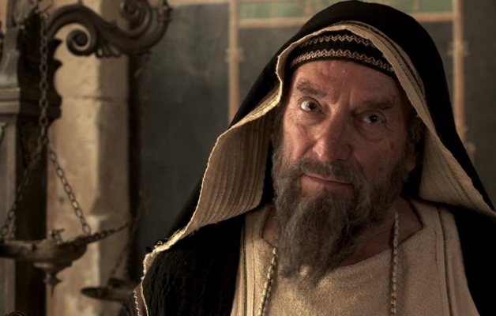
Religious Tolerance &Conflict
Rome was usually tolerant with the different belief systems within the Empire, however it did not extend to religions that it perceived as threats to public order within the empire. Cults such as Isis-worship were banned from time to time, when their practice caused unrest. Judaism and a new religion: Christianity, were viewed as problematic.

Slide 6
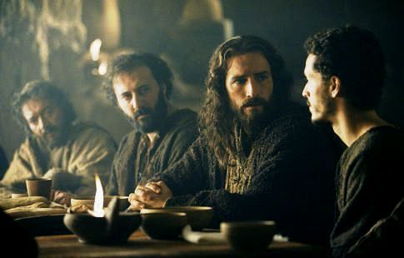
A New Religion
Within Rome, Christianity was banned and Christians were punished for many years.
Although it is often claimed that Christians were persecuted for their refusal to worship the emperor, general dislike for them likely arose from their refusal to worship the gods or take part in sacrifice, which was expected of those living in the Empire.
Click Here!

Slide 7
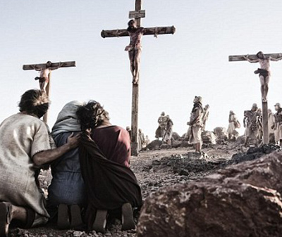
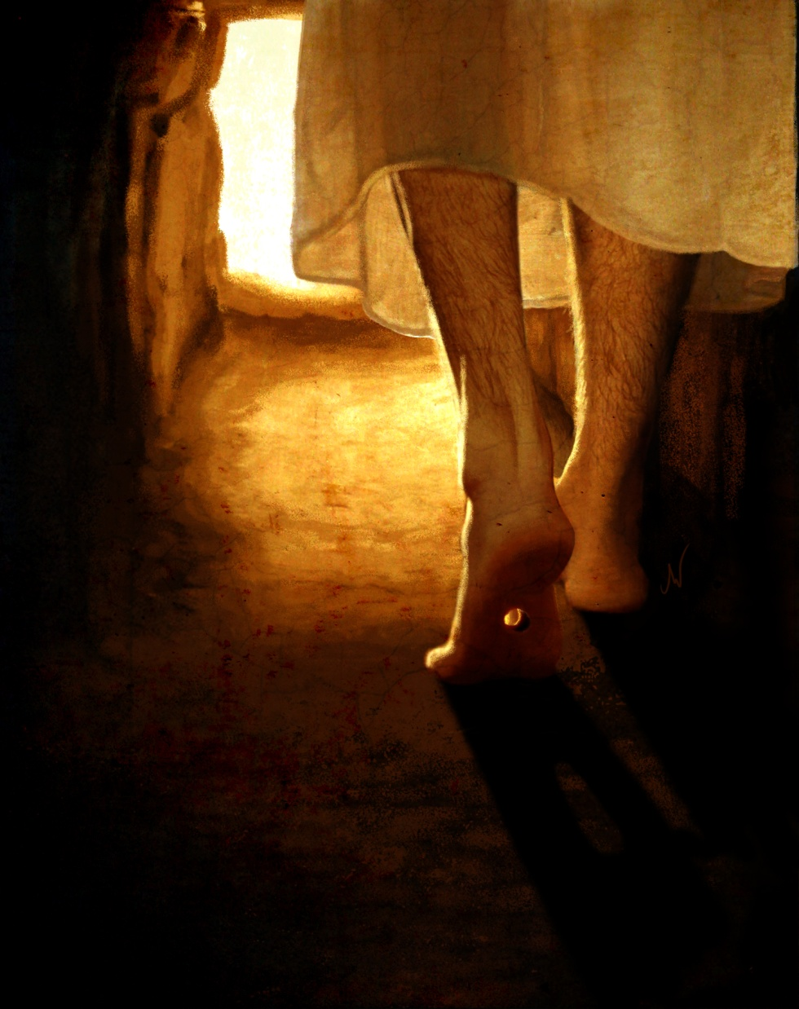
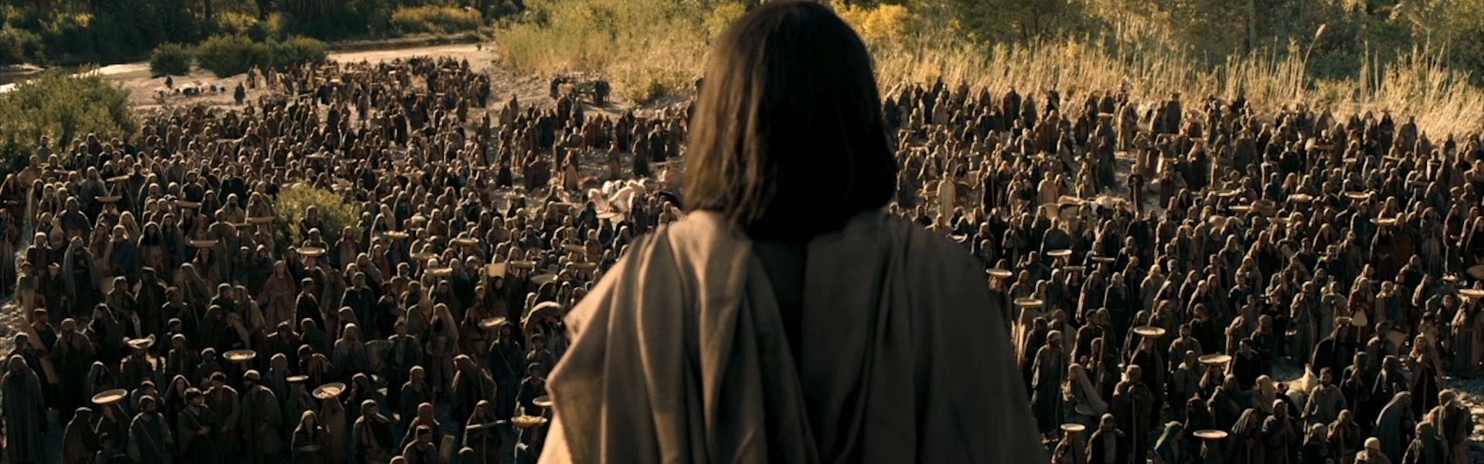
Jesus of Nazareth
Jesus of Nazareth or Jesus Christ, was a 1st century Jewish preacher and healer in the Roman province of Judea. He is the central figure of Christianity. Christians believe he is the incarnation of God the Son and the awaited Messiah (Christ) prophesied in the Old Testament.
Click Here!

Slide 8
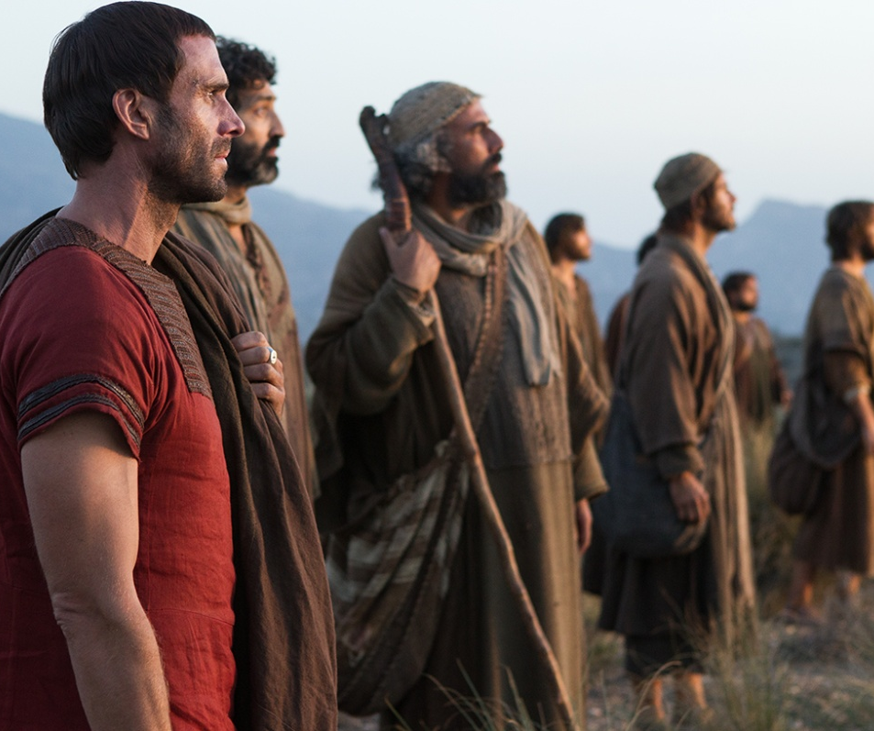
The Growth of Christianity
The message of Christianity was spread around the Roman Empire by St. Paul & St. Peter who founded Christian churches in Asia Minor and Greece. Eventually, he took his teachings to Rome itself and it took a life of its own.
Click Here!

Slide 9
Final thoughts
Although usually tolerant, Roman authorities persecuted Jews and Christians in the empire. Both, however survived.
Ironically, Christianity eventually became the empire’s official religion.

Slide 10
NEXT
EMPIRE FALLS
Jim Soto © 2019

