Slide 1
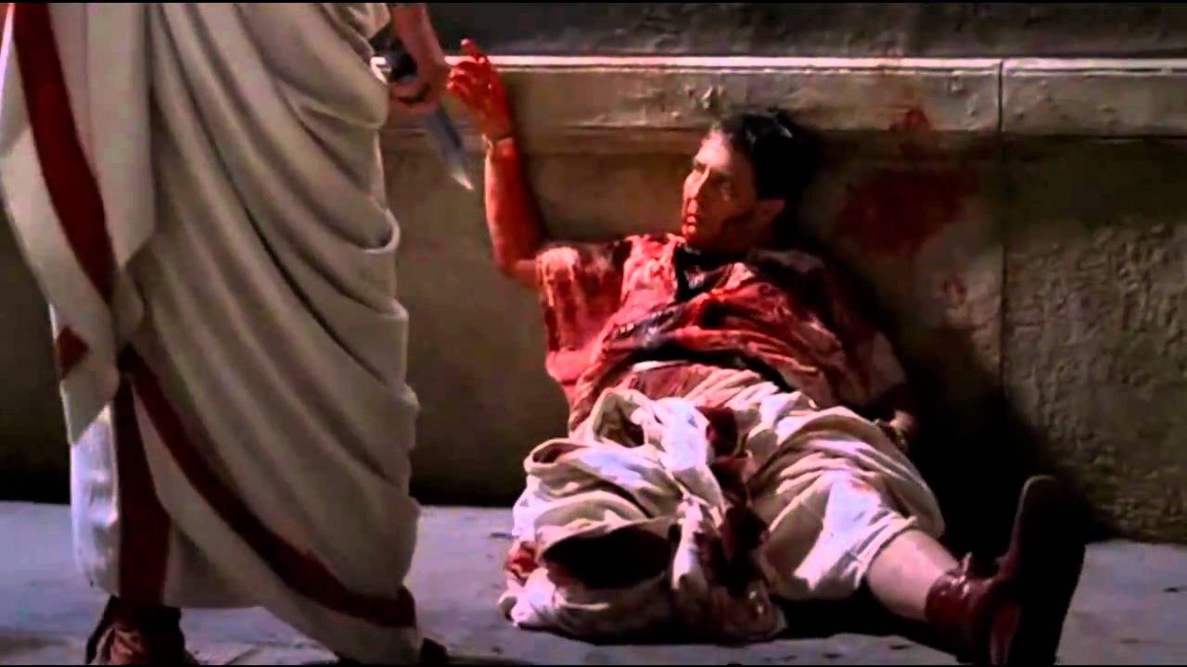
WORLD HISTORY
From Republic to Empire
with Mr. Jim Soto

Slide 2
Think...
You are a friend of a famous Roman Senator. He is worried about the growing power of military men in Rome’s government. Some other senators want to take violent action to stop generals from taking over as dictators. Youe friend wants your advice: Is violence justified to save the Republic? What advise will you give your friend?
Take a minute to write down your answer and explanation.

Slide 3
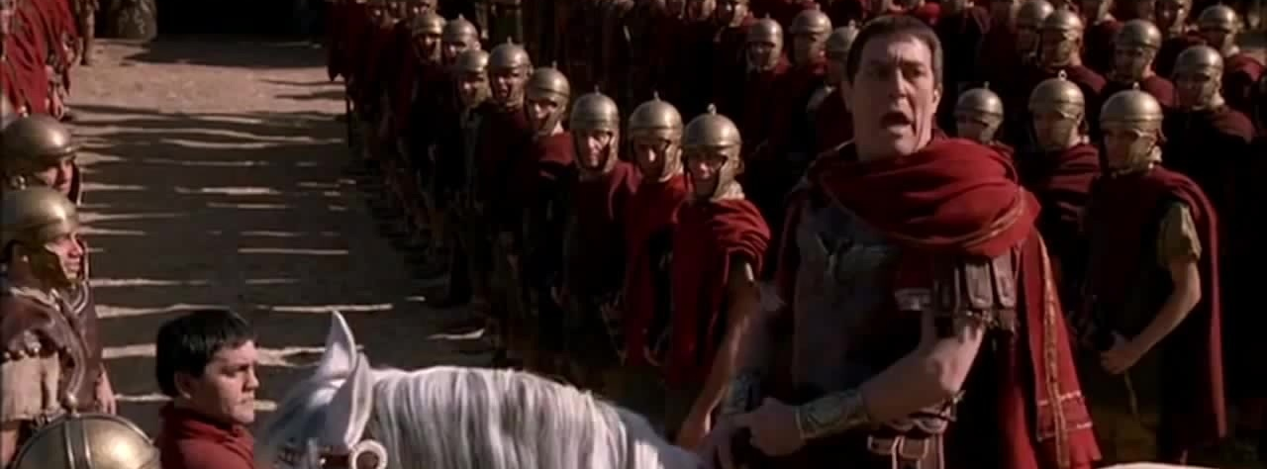
By the first century BC, the government of the Republic of Rome was in trouble. Politicians looked for other ways to solve problems. Philosophers offered ideas, too. In the end, however, the Republic was not going to survive.
Click Here!

Slide 4
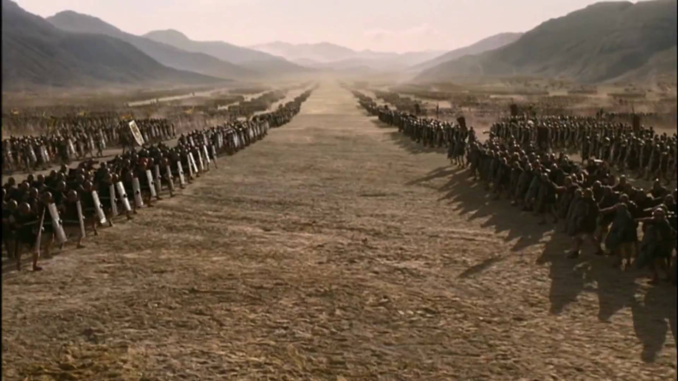
To learn more about this topic read pages 322 thru 328 and complete the section 1 assessment. Show me the completed work when complete.

Slide 5
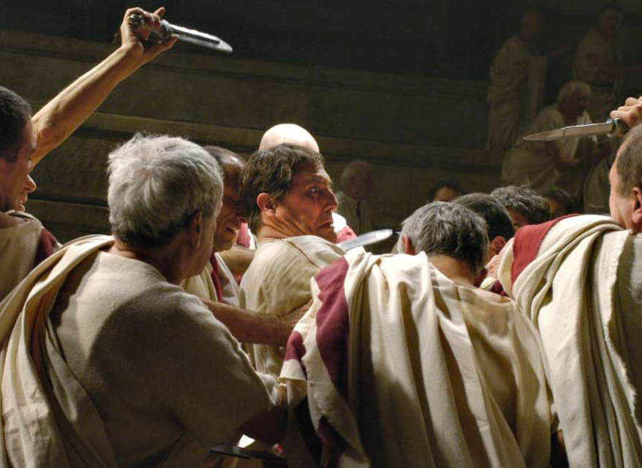
Disorder in the Republic
Rome in the 70s BC was a dangerous place. Unemployment, power hungry generals and politicians, and immigration were seeding chaos in the fragile Republic.
Three powerful leaders: Caesar, Pompeii, and Crassus, would clash and bring the end of the Republic. Julius Caesar was Rome’s last dictator.
Click Here!

Slide 6
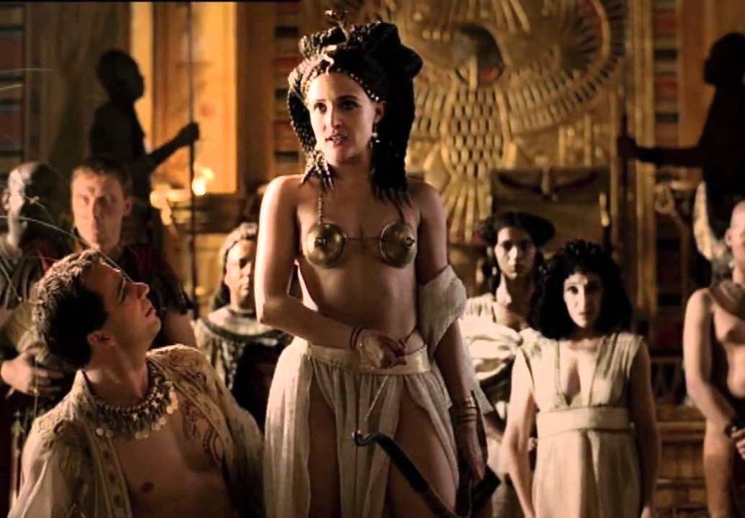
The End of the Republic
The assassination of Caesar sent the Republic into chaos. Mark Antony and Octavian fought for control of Rome. The final defeat of Mark Antony and his ally Cleopatra at the Battle of Actium, and the Senate's grant of extraordinary powers to Octavian as Augustus in 27 BC – which made him emperor – ended the Republic.
Click Here!

Slide 7
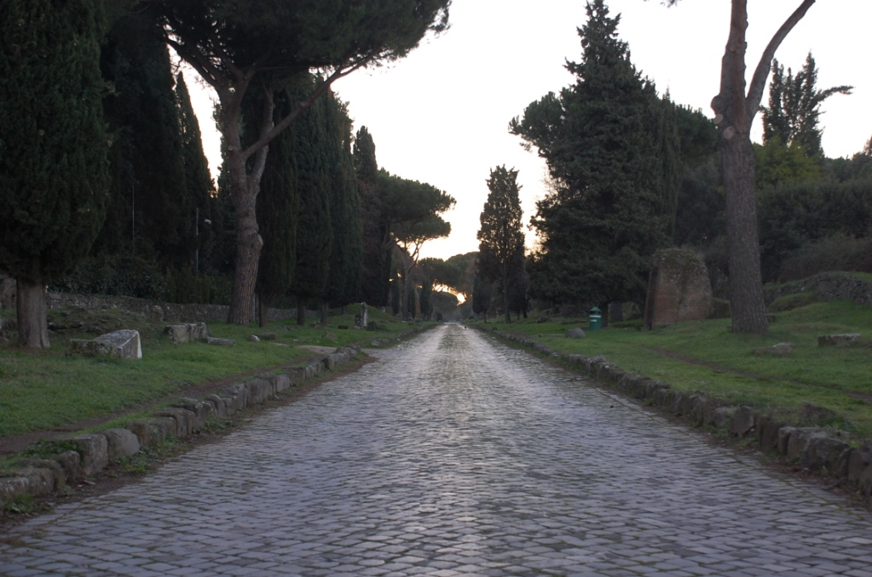
The Empire & its Accomplishments
Roman accomplishments are too many to mention here. The Romans did not invent drainage, sewers, the alphabet or roads, but they did develop them. They did invent under floor heating, concrete and the calendar that our modern calendar is based on. Let’s watch a video about their other accomplishments.
Click Here!

Slide 8
Final thoughts
Augustus made the Roman Republic into an empire.
The empire grew during the next 200 years, and the Roman made lasting contributions to the world.

Slide 9
NEXT
CHRISTIANITY
Jim Soto © 2019

