Slide 1
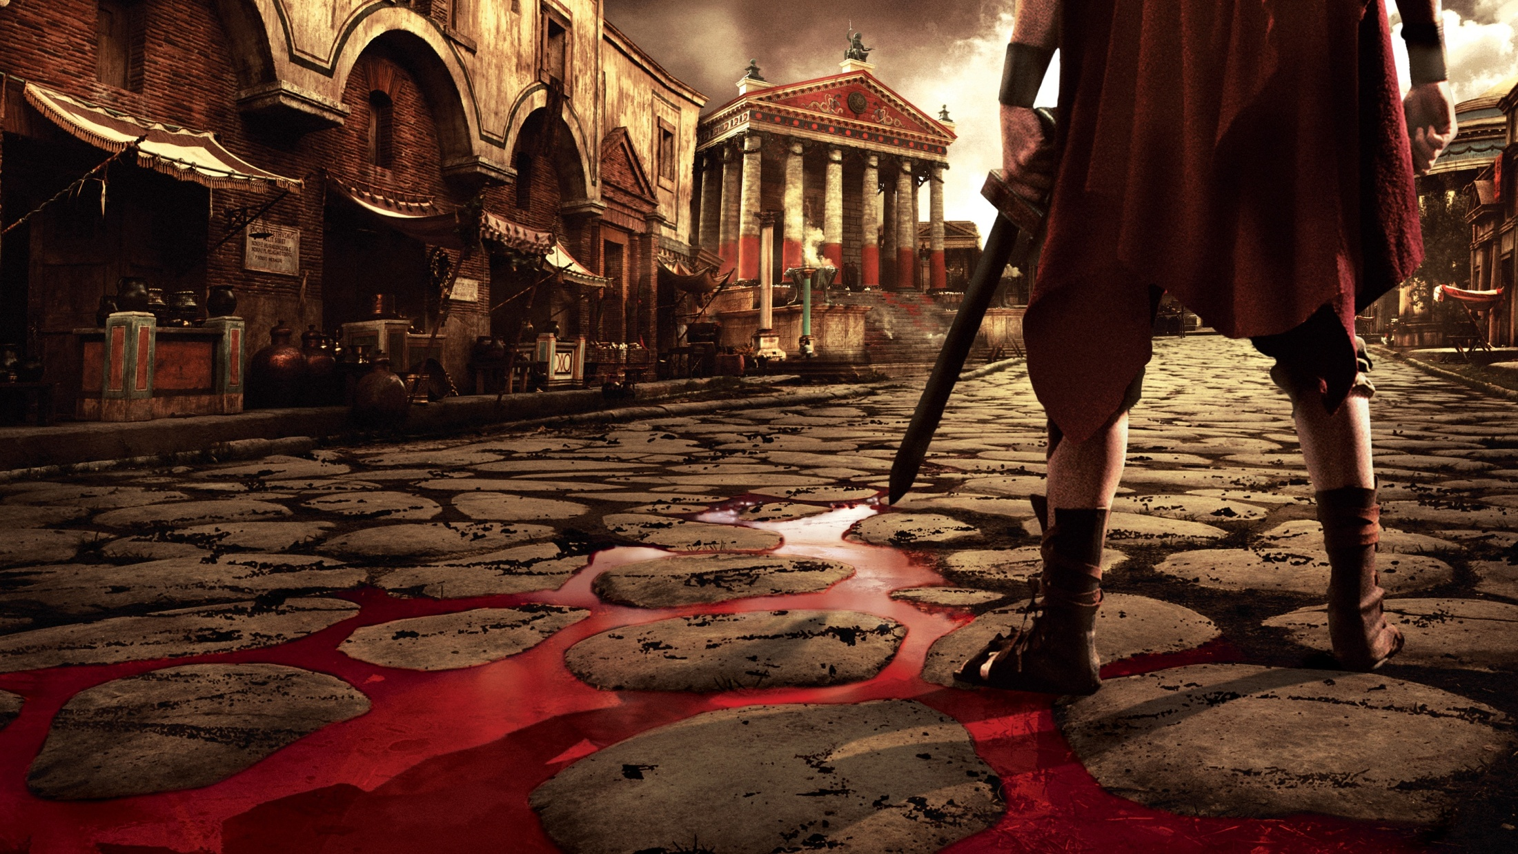
WORLD HISTORY
The Late Republic
with Mr. Jim Soto

Slide 2
Think...
You are a farmer in Italy during the Roman Republic. You are proud to be a Roman citizen, but times are hard. Rich landowners are buying farmland and many farmers like you have lost their jobs. Some are moving to the city, but you have heard that there are not many jobs there, either. You’ve also heard that a famous general is raising an army to fight in Asia. That seems very far away, but it could mean good pay. What might convince you to join the army?
Take a minute to write down your answer and explanation.

Slide 3
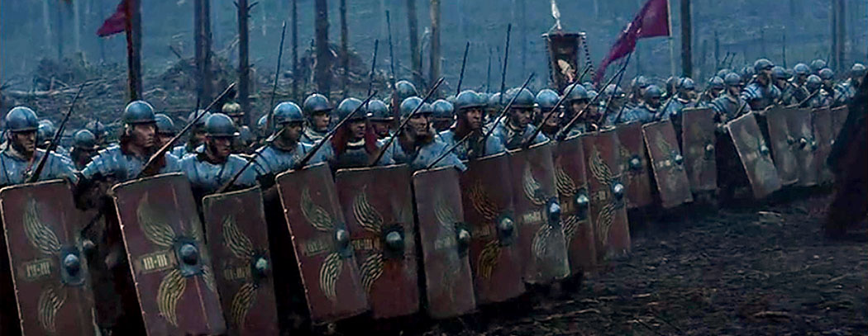
The army played a vital role in the expansion of the Republic. Roman soldiers were well trained and defeated many enemies. As they did so, the Romans took over new lands. Traders would then move in and open new markets.

Slide 4
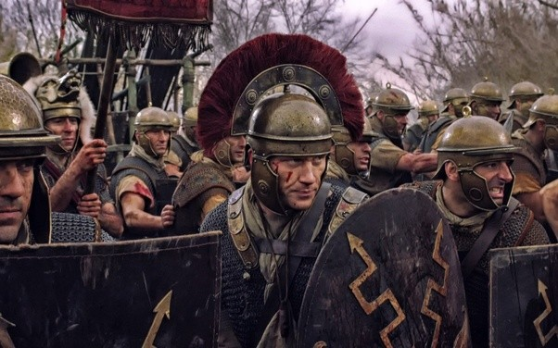
To learn more about this topic read pages 308 thru 313 and complete the section 3 assessment. Show me the completed work when complete.

Slide 5
Growth of Territory & Trade
After 400 BC, Rome grew quickly, becoming an economic and military power in the Mediterranean. If its territory grew, was mainly because external threats such as the Gauls and the Phoenicians.

Slide 6
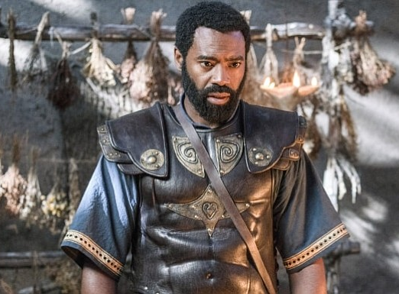
Growing Beyond Italy
Roman expansion in the Mediterranean was seen as problematic to the Carthaginians. This instigated the Punic Wars, a series of three wars fought between Rome and Carthage from 264 BC to 146 BC.
The Roman victories over Carthage in these wars gave Rome a preeminent status it would retain until the 5th century AD.
Click Here!

Slide 7
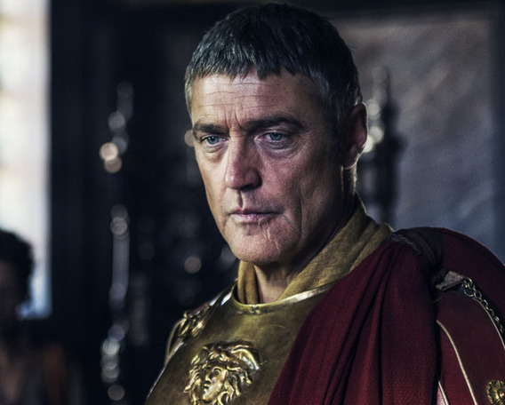
Crises Strike the Republic
As Rome grew, internal problems also sparked. When the rich get richer and the poor get poorer, that’s a recipe for disaster.
Civil unrest can lead to civil wars as happened during the rule of consul Lucius Cornelius Sulla.
Click Here!

Slide 8
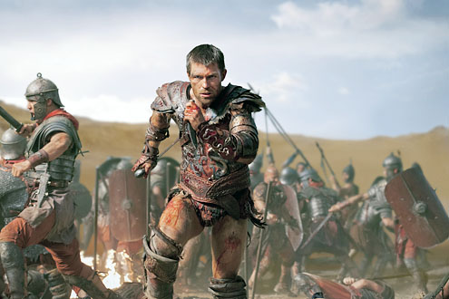
Gladiator Rebellion
Click Here!
Another great crisis at the end of the Republic era was a slave revolt led by Spartacus, a Thracian gladiator. Little is known about him before he became one of the slave leaders in the Third Servile War, the slave uprising war against the Roman Republic in 73 BC.

Slide 9
Final thoughts
The crises that arose during the late Roman Republic were too much for it to bear and eventually led to great changes, as we will see in the next chapter.

Slide 10
NEXT
EMPIRE
Jim Soto © 2019

