Slide 1
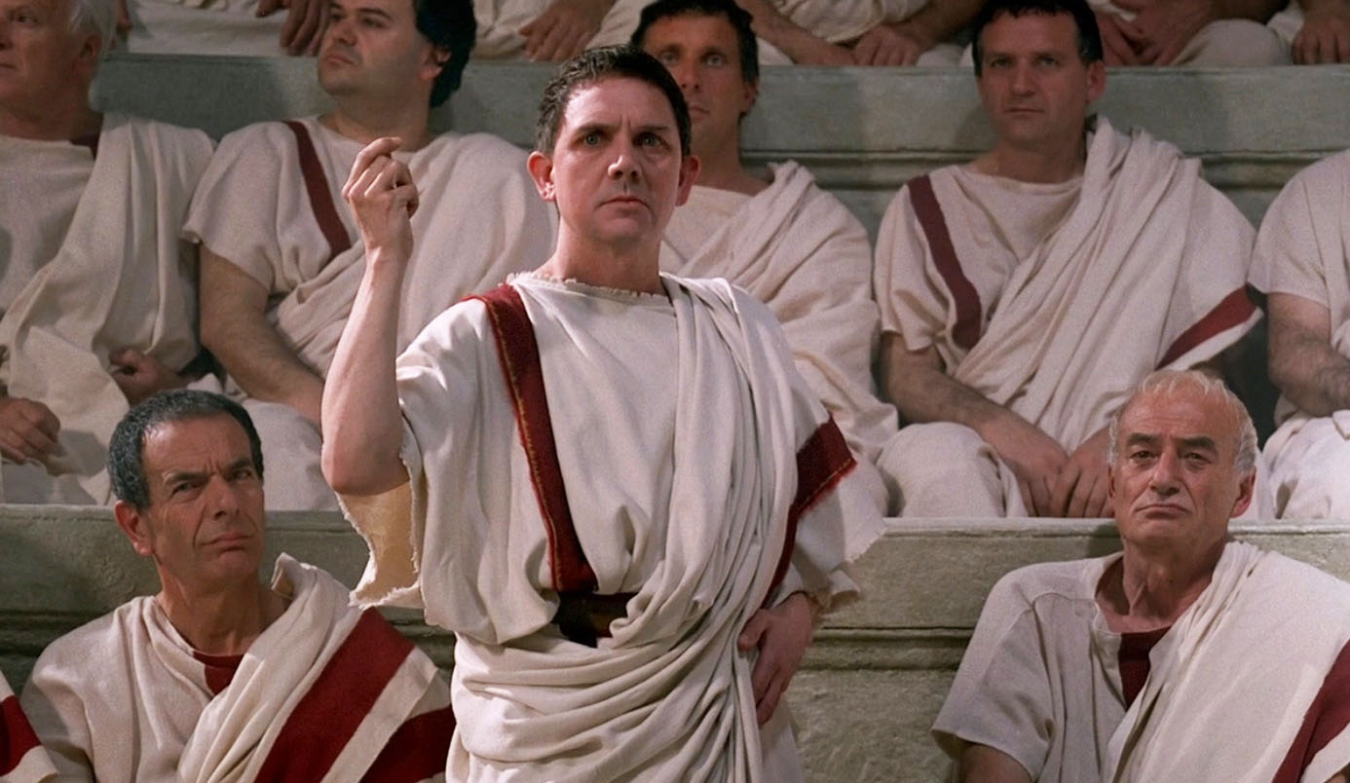
WORLD HISTORY
Roman Government & Society
with Mr. Jim Soto

Slide 2
Think...
You have just been elected as a government official in Rome. Your duty is to represent the plebeians, the common people. You hold office for only one year, but you have one important power – you can stop laws from being passed. Now city leaders are proposing a law that will hurt plebeians. If you stop the new law, it will hurt your future in politics. If you let it pass it will hurt the people you are supposed to protect.
Will you let the new law pass?
Take a minute to write down your answer and explanation.

Slide 3
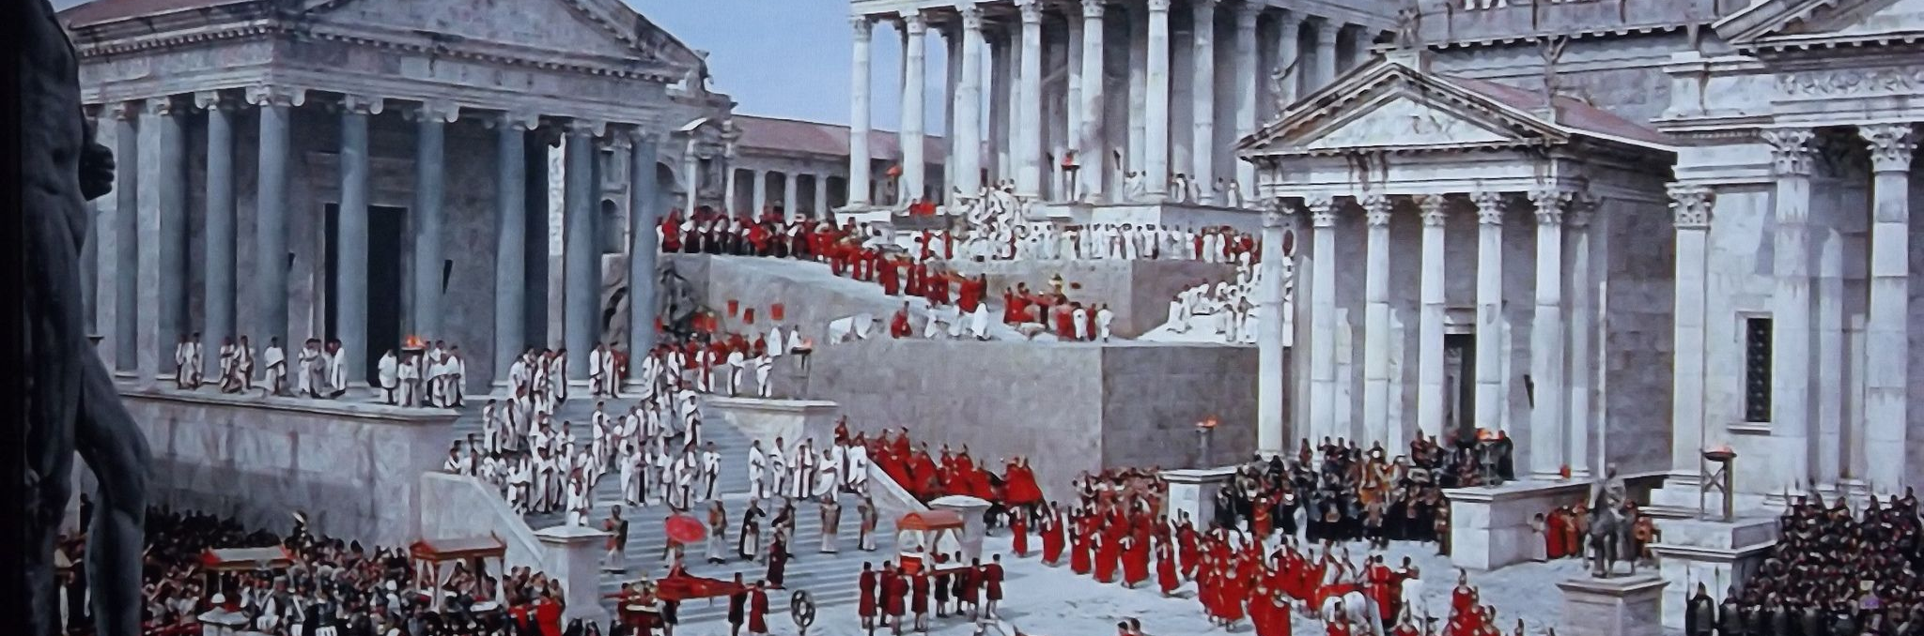
Governing in Rome was often a balancing act. Leaders had to make compromises and risk the anger of other officials to keep the population happy. To keep anyone from gaining too much power, the government divided power among many different officials.

Slide 4
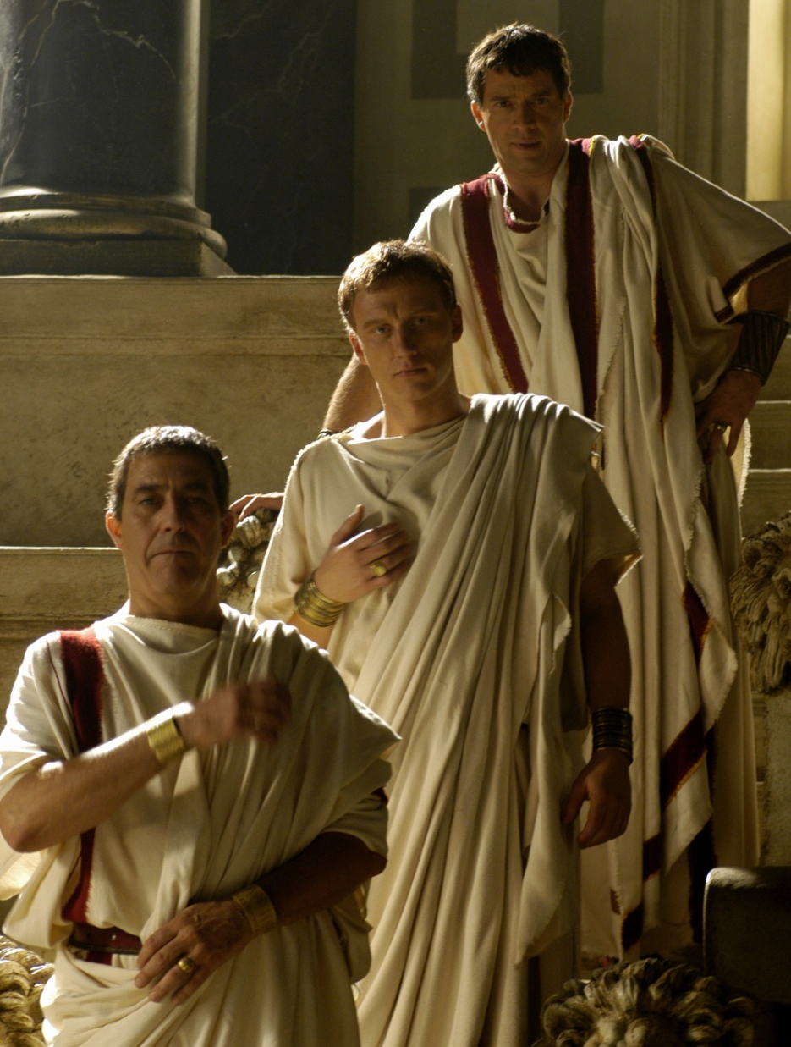
To learn more about this topic read pages 302 thru 307 and complete the section 2 assessment. Show me the completed work when complete.

Slide 5
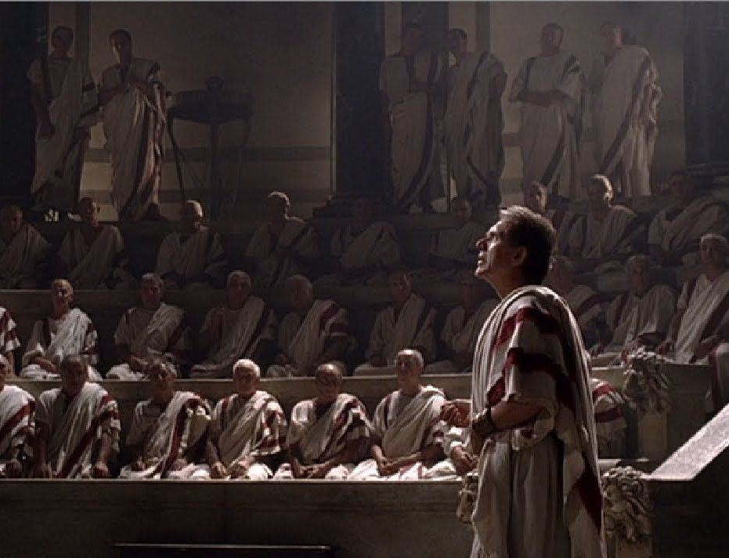
Roman Government
The three main parts of the government were the Senate, the Consuls and the Assemblies. The Senate was composed of leaders from the patricians, the noble and wealthy families of ancient Rome. They were the law makers. At this time, lower-class citizens, or plebeians, had virtually no say in the government.

Slide 6
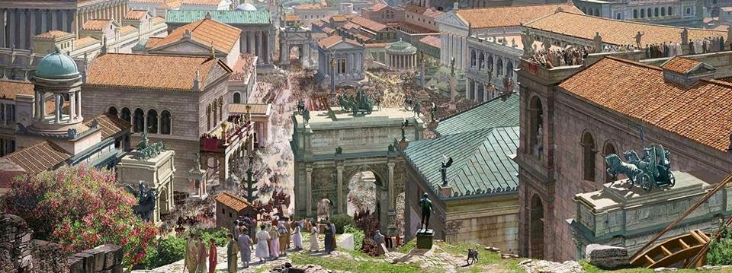
The Concilium Plebis or Plebeian Assembly was the principal assembly of the Republic. It functioned as a legislative assembly, through which the plebeians could pass laws, elect magistrates, and try judicial cases.
Click Here!

Slide 7
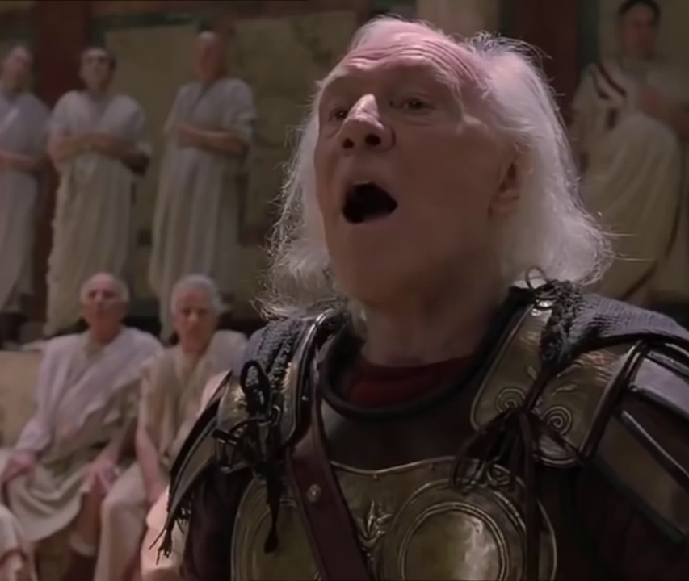
Written Law Keeps Order
Romans created a legal system that included the legal developments spanning over 1000 years of jurisprudence, from the Twelve Tables to the Corpus Juris Civilis. Roman law forms the basic framework for the modern civil legal system used today. The historical importance of Roman law is reflected by the continued use of Latin legal terminology in many legal systems influenced by it, including common law.

Slide 8
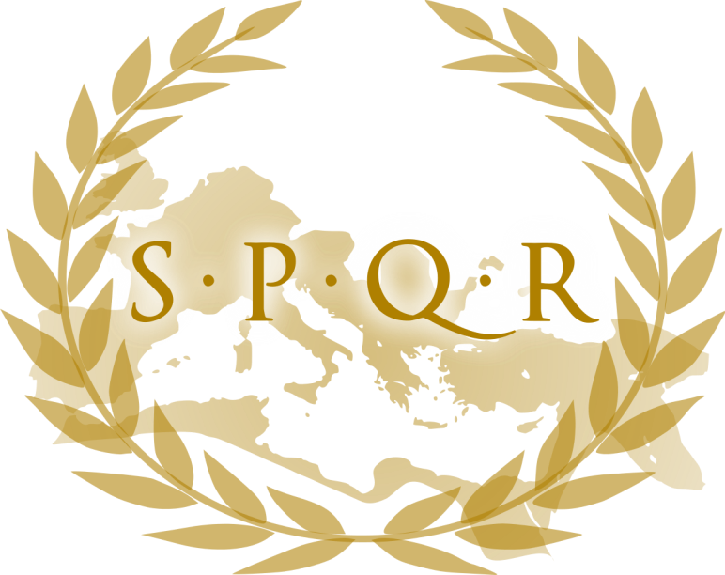
The Roman Forum
A Forum was the main center of a Roman city. Usually located near the physical center of a Roman town. Very much like a Greek Agora, it served as a public area in which commercial, religious, economic, political, legal, and social activities occurred. Fora were common in all Roman cities, but none were as grand as the fora of Rome itself because the Law of the Twelve Tables was kept there.

Slide 9
Final thoughts
Romans created a government system that serves as the basis of many modern day republics around the world.

Slide 10
NEXT
THE END?
Jim Soto © 2019

