Slide 1
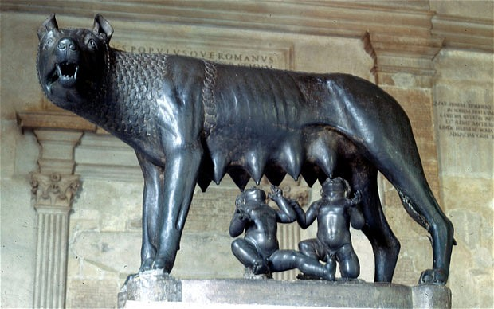
WORLD HISTORY
Geography & Rise of Rome
with Mr. Jim Soto

Slide 2
Think...
You are the leader of a group of people looking for a site to build a new city. After talking with your advisors, you have narrowed your choice to two possible sites. Both locations have plenty of water and good soil for farming, but they are otherwise very different. One is on top of a tall rocky hill overlooking a shallow river. The other is on a wide open field right next on a wide open field right next to the sea. Which site will you use for your city? Why?
Take a minute to write down your answer and explanation.

Slide 3
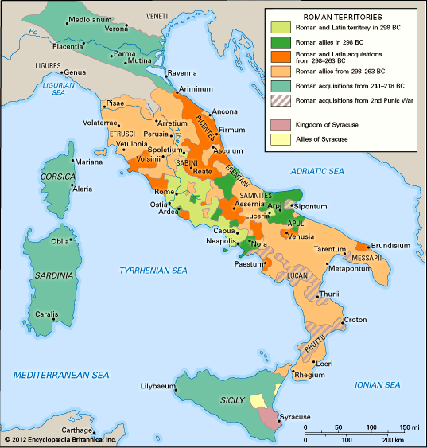
From a small town on the Tiber River, Rome grew into a mighty power. Rome’s geography – its central location and good climate – were important factors in its success and growth. The city’s rise as a military power began when the Romans went to war and conquered neighboring Italian tribes.

Slide 4
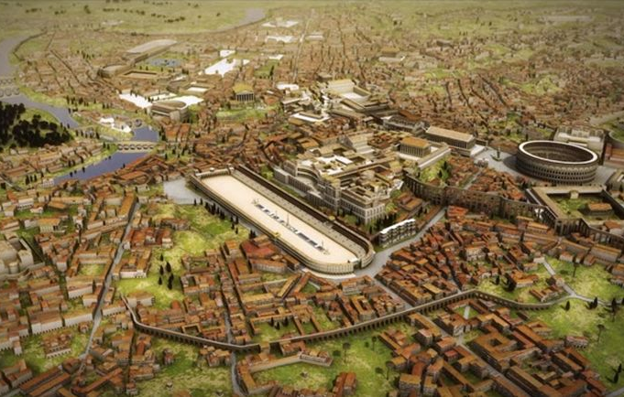
To learn more about this topic read pages 294 thru 299 and complete the section 1 assessment. Show me the completed work when complete.

Slide 5
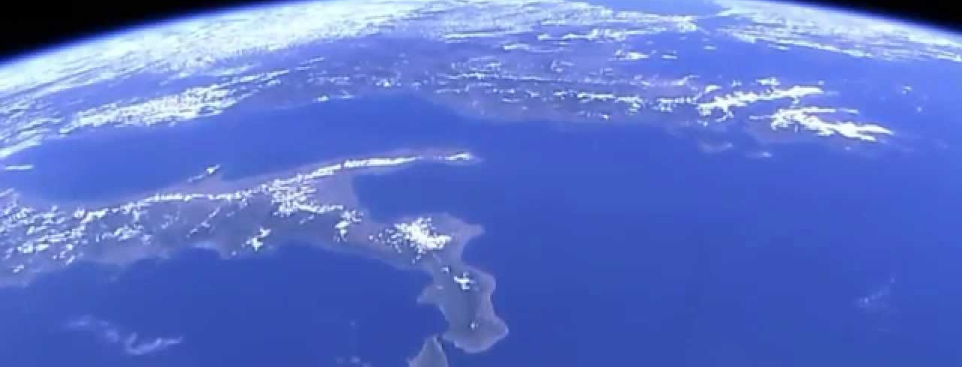
Italy, where Rome was built, is a peninsula in southern Europe. Most observers claim that it looks like a high-heeled boot.
Italian Peninsula

Slide 6
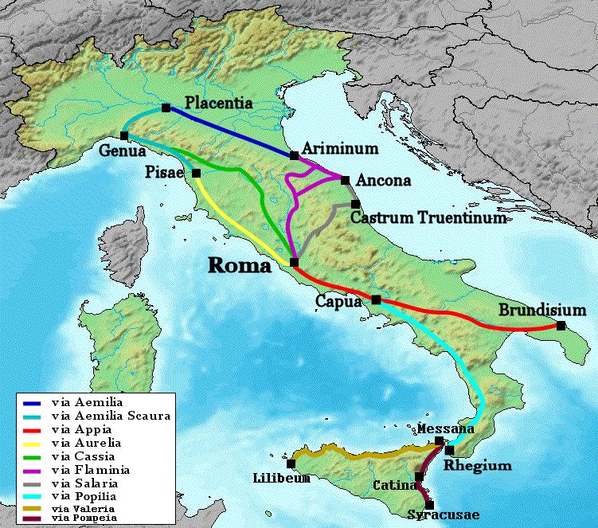
The Geography of Italy
Italy, comprises the Italian Peninsula, the southern side of the Alps, the large plain of the Po Valley and the islands of Sicily and Sardinia. Corsica, although belonging to the Italian geographical region, has been a part of France since 1769.
It has hot, dry summers and cool, wet winters. Italy’s climate is Mediterranean. Winters in are cool and humid in the north and the mountainous zone.

Slide 7
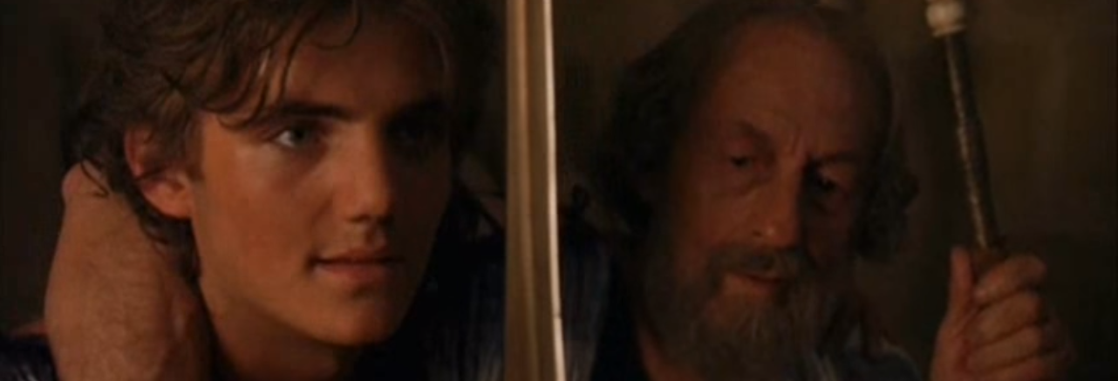
Aeneas was said to be the legendary founder of the Roman race (the mixed offspring of the native Italians and the Trojans). The city founded by his son was not Rome but Alba Longa (a nearby settlement that did have strong connections with early Rome), and it was there that Romulus and Remus were born many generations later.
Click Here!

Slide 8
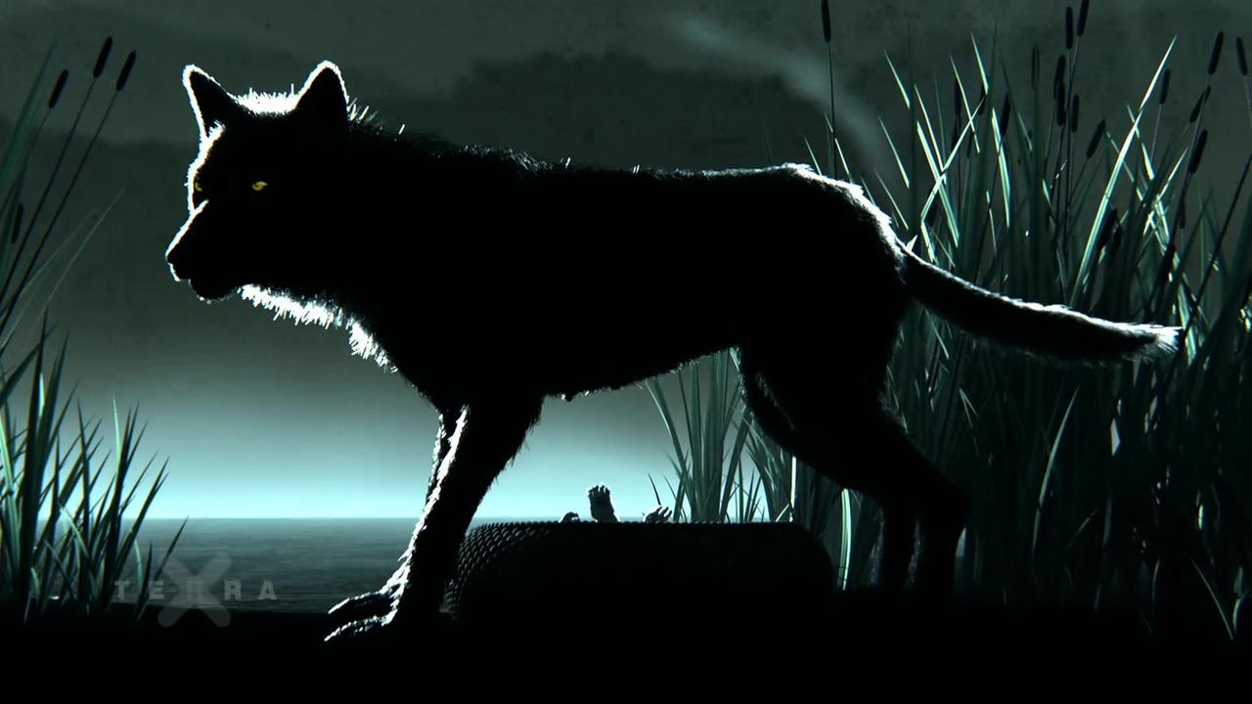
Rome’s Legendary Origins
According to the legend, Romulus and Remus were the sons of Rhea Silvia, the daughter of King Numitor of Alba Longa. It is said that the twin brothers, apparent sons of the god Mars and descendants of the Trojan hero Aeneas, were condemned to death by drowning in the river Tiber to later be rescued and suckled by a she-wolf after being abandoned.

Slide 9
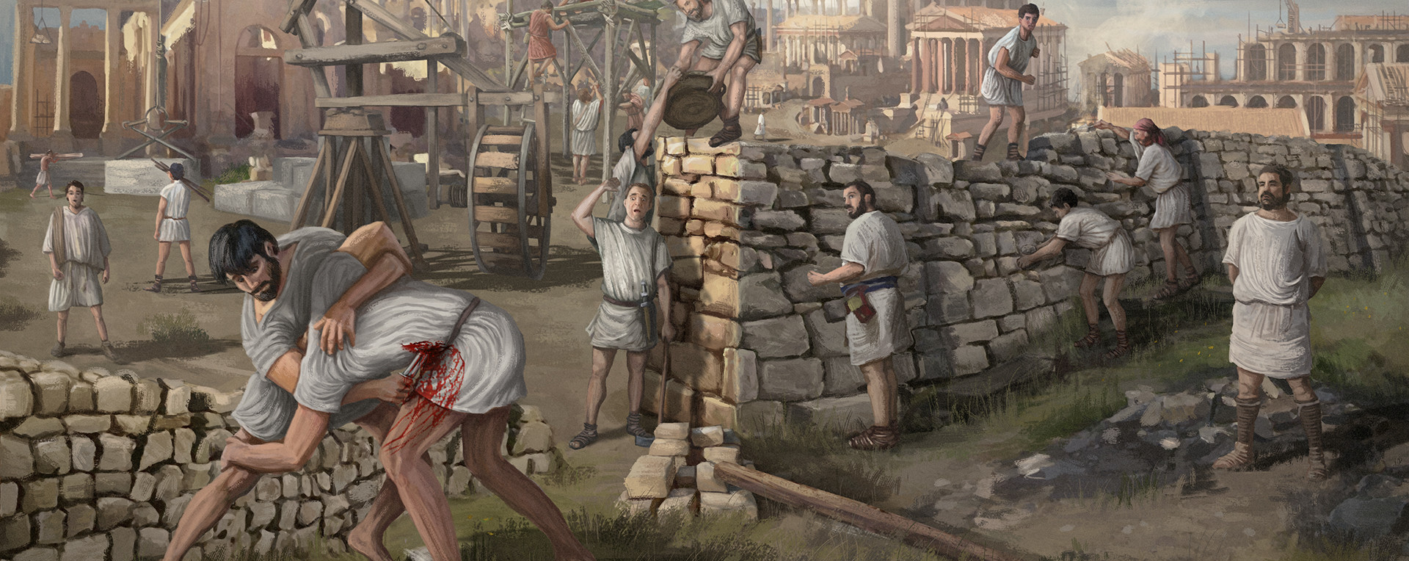
They then decided to build a city. The brothers argued, Romulus killed Remus, and then named the city Rome after himself.
Click Here!

Slide 10
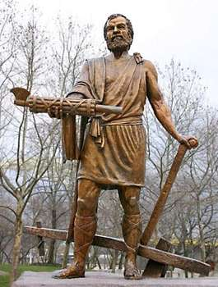
The Early Republic
It is believed that Rome was founded in 753 BC and that the republic had begun in 509 BC, following the overthrow of Lucius Tarquinius Superbus, the last of Rome's 7 kings.
In Roman society, the aristocrats were known as patricians. The highest positions in the government were held by two consuls, or leaders, who ruled the Roman Republic. A senate composed of patricians elected these consuls. At this time, lower-class citizens, or plebeians, had virtually no say in the government.
Click Here!

Slide 11
Final thoughts
During the early part of its history, Rome was ruled by monarchs.
As Rome developed, its government became republican.

Slide 12
NEXT
Government
Jim Soto © 2019

