Slide 1
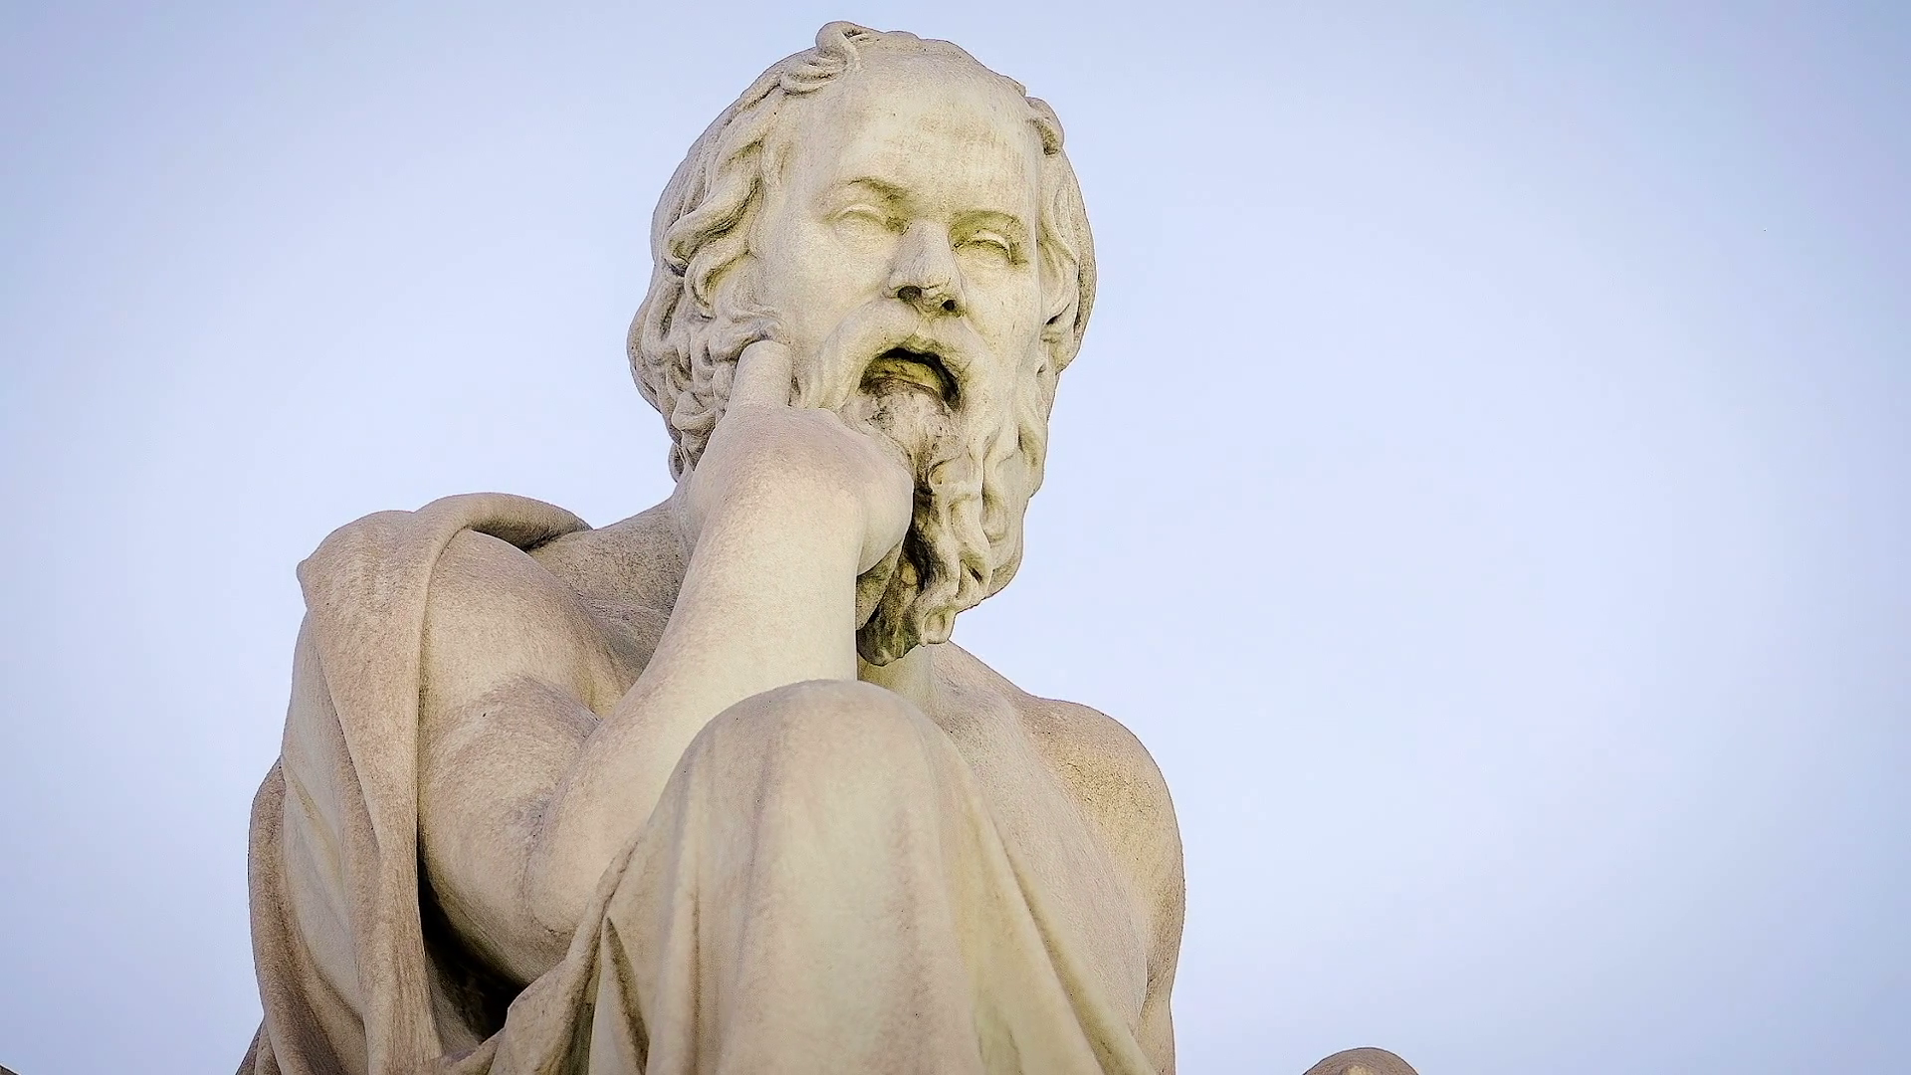
WORLD HISTORY
with Mr. Jim Soto
Greek Achievements

Slide 2
Think...
Everyone in Athens has been talking about a philosopher and teacher named Socrates, so you decide to go and see him for yourself. You find him sitting under a tree, surrounded by his students. “Teach me about life”, you say. But instead of answering, he asks you, “What is life?” You struggle to reply. He asks another question. Then another. If he’s such a great teacher, you wonder, shouldn’t he have all the answers? Instead, all he seems to have are questions. What do you think of Socrates?
Take a minute to write down your answer.

Slide 3
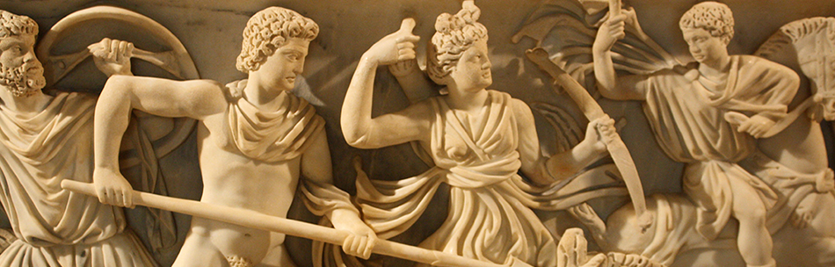
Socrates was only one of the brilliant philosophers who lived in Athens in the 400s BC. The city was also home to some of the world’s greatest artists and writers. In fact, all over Greece, men and women made great advances in the arts and sciences. Their work inspired people for centuries.

Slide 4
To learn more about this topic and others, read pages 277 thru 283 and complete the section 4 assessment. Show me the completed work when finished. After everybody has finished a group reading and discussion will ensue.

Slide 5
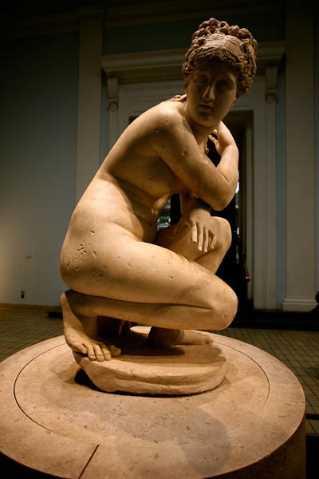
The Arts
Ancient Greek art stands out among that of other cultures for its naturalistic but idealized depictions of the human body, in which mostly nude figures were generally the focus of innovation. The rate of stylistic development was remarkable by ancient standards, and in surviving works is best seen in sculpture. There were important innovations in painting, which are essentially reconstructed due to the lack of original survivals of quality, other than the distinct field of painted pottery.
Click Here!

Slide 6
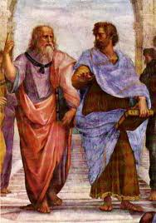
Philosophy
Ancient Greek philosophy (or love of knowledge) arose in the 6th century BC and continued throughout the Hellenistic period and the period in which Ancient Greece was part of the Roman Empire. Philosophy was used to make sense out of the world in a non-religious way. It dealt with a wide variety of subjects, including: political philosophy, ethics, metaphysics, ontology, logic, biology, rhetoric and aesthetics.
Click Here!

Slide 7
Science
Greeks achievements in math and astronomy were one of the finest in antiquity. Math developed first, aided by the influence of Egyptian math; astronomy bloomed later after Alexander’s the conquests, aided by the influence of Babylon.
Click Here!

Slide 8
Final thoughts
Through their art, philosophy, and science, the Greeks have greatly influenced Western civilization.

Slide 9
NEXT
ROME
BEGINS
Jim Soto © 2019

