Slide 1
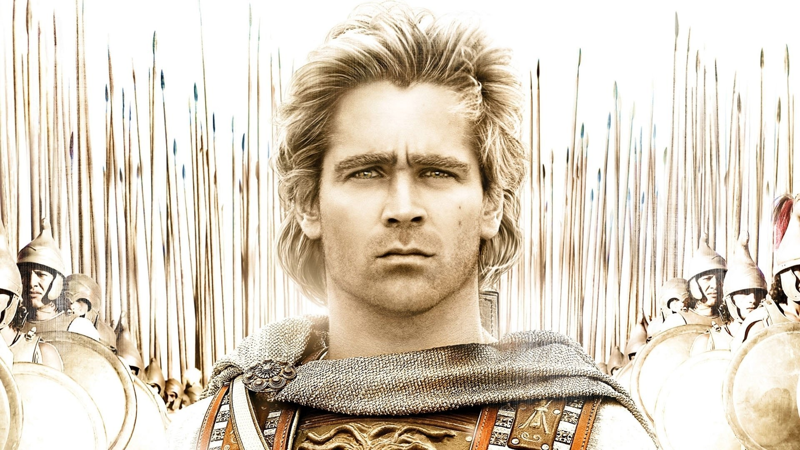
WORLD HISTORY
with Mr. Jim Soto
Alexander

Slide 2
Think...
You are a soldier in the most powerful army in the world. In just eight years, you and your fellow soldiers have conquered an enormous empire. Now your generals want to push farther into unknown lands in search of greater glory. But you're thousands of miles from home, and you haven’t seen your family in years. Do you agree to go on fighting? Why or why not?
Take a minute to write down your answer.

Slide 3
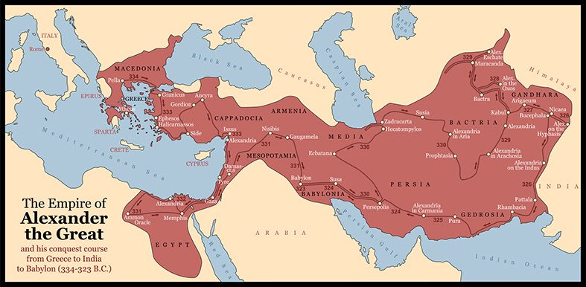
The worlds most powerful army in the 300 BCs was from Macedonia, a kingdom in northern Greece. The other Greeks had long dismissed the Macedonians as unimportant. They thought them unsophisticated because they spoke a broken kind of Greek and lived in small villages. Underestimating them proved to be a big mistake.

Slide 4
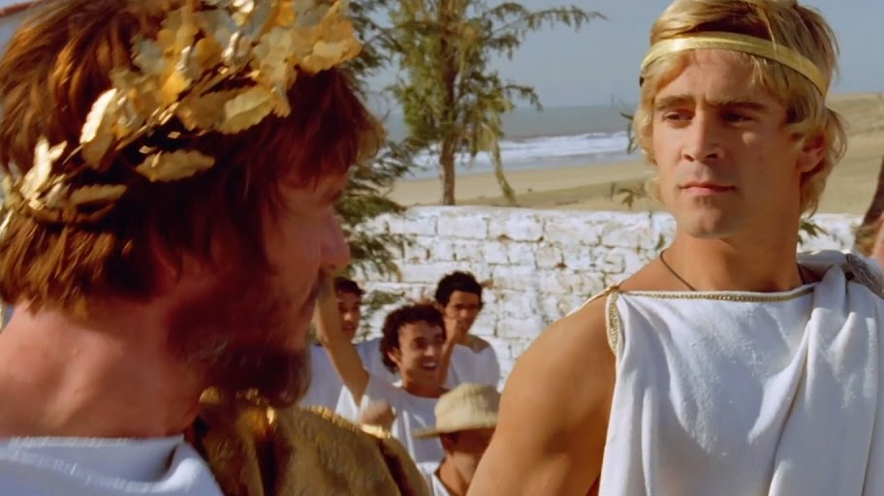
To learn more about this topic and others, read pages 272 thru 276 and complete the section 3 assessment. Show me the completed work when finished. After everybody has finished a group reading and discussion will ensue.

Slide 5
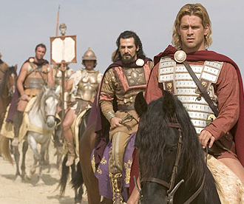
Macedonia Conquers Greece
Because of the wars between the Greek city-states and the Persian Empire, Greece was easily conquered by Macedonia because they had grown weak and were unable to cooperate with each other against this formidable invader.
The Battle of Chaeronea where the Macedonians defeat the Greeks on August 2,338 BC, marks an end of Greek history and the beginning of the Macedonian Era.

Slide 6
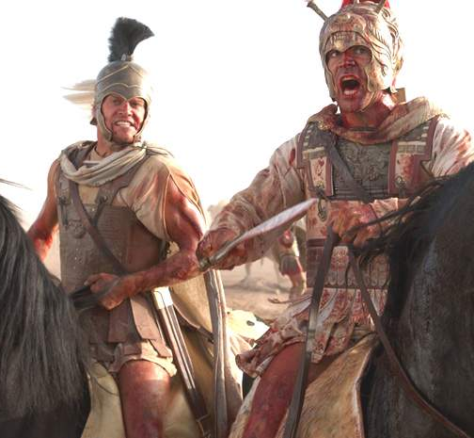
Alexander Builds an Empire
In 334 BC, Alexander invaded the Achaemenid Empire (Persian Empire) and began a series of campaigns that lasted 10 years. Following the conquest of Anatolia, Alexander broke the power of Persia in a series of decisive battles, most notably the battles of Issus and Gaugamela.
Click Here!

Slide 7
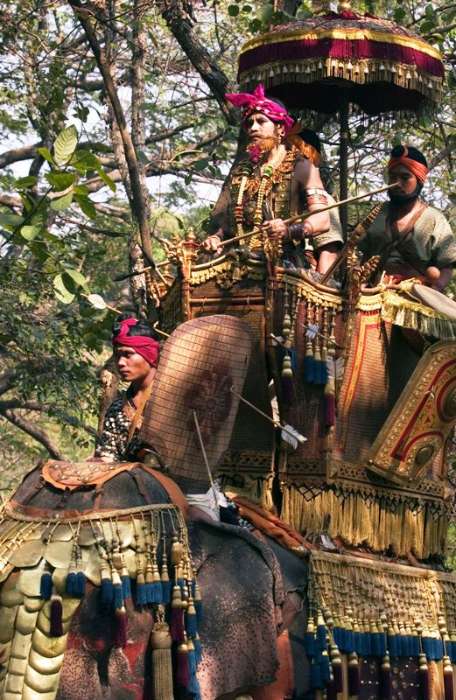
Alexander conquered most parts of the Western World, but there is a great deal of controversy over his invasion of India. In 327 BC, Alexander came to India, and tried to cross the Jhelum river for the invasion, but was then confronted by King Purushottama (King Porus).
He defeated King Porus at the Battle of Hydaspes, but with high casualties. Soldiers missed their families, and became tired of endless battles. Greek soldiers feared the 6,000 Nanda war elephants, so most defected the army, shrinking its size.

Slide 8
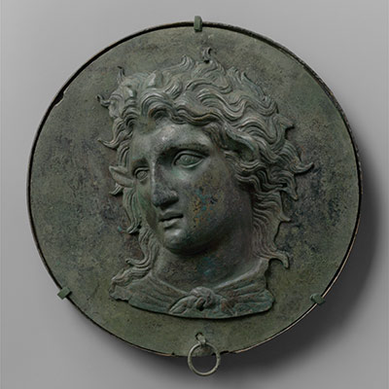
Hellenistic Kingdoms
After Alexander's death, having left no heir behind, his vast empire disintegrated into the Hellenistic kingdoms that were established: the Ptolemies in Egypt; the Seleucids in Asia, Asia Minor, and Palestine; and the Antigonids in Macedonia and Greece. These kingdoms got their names from three of Alexander's generals: Ptolemy, Seleucus, and Antigonus.
Click Here!

Slide 9
Final thoughts
Alexander the Great caused major political changes in Greece.
His conquests had a profound impact on eastern and western culture. With the expansion of his empire, Hellenism, or Greek-influenced, culture spread from the Mediterranean to Asia.

Slide 10
NEXT
ACHIEVEMENTS
Jim Soto © 2019

