Slide 1
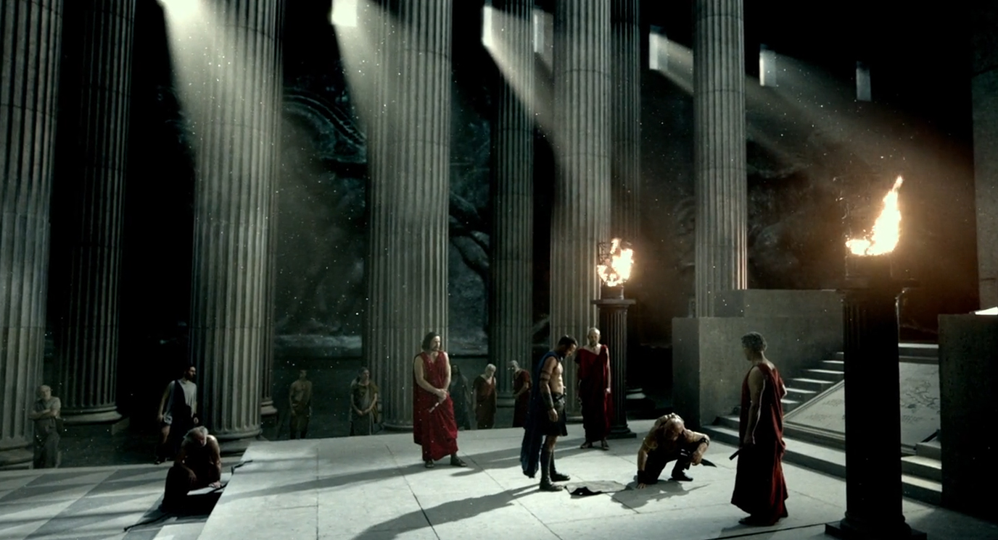
WORLD HISTORY
with Mr. Jim Soto
Sparta & Athens

Slide 2
Think...
Your Father, a wandering trader, has decided it is time to settle down. He offers the family a choice between two cities. In one city, everyone wants to be athletic, tough, and strong. They’re good at enduring hardships and following orders. The other city is different. There. You’d be admired if you think deeply and speak persuasively, if you knew a lot about astronomy, or history, or if you sang or played beautifully. Which city would you choose? Why?
Take a minute to write down your answer.

Slide 3
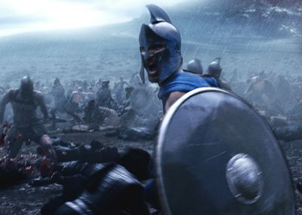
To learn more about this topic and others, read pages 266 thru 271 and complete the section 2 assessment. Show me the completed work when finished. After everybody has finished a group reading and discussion will ensue.

Slide 4
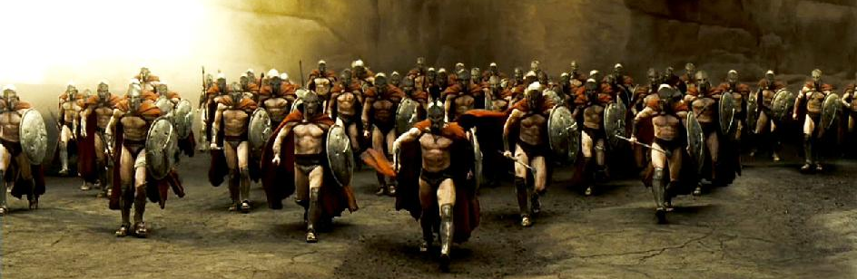
Sparta and the Body
Spartans militaristic society put country over family. Their obsession with the defense of the state, created a world where the body was the greatest asset.
Click Here!

Slide 5
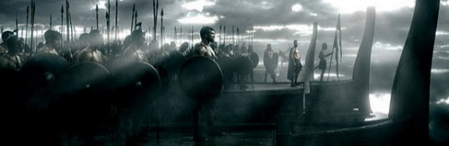
Athens and the Mind
Athenians more holistic view of the world created a society where there was space for warfare, but also for science and the arts.
Click Here!

Slide 6
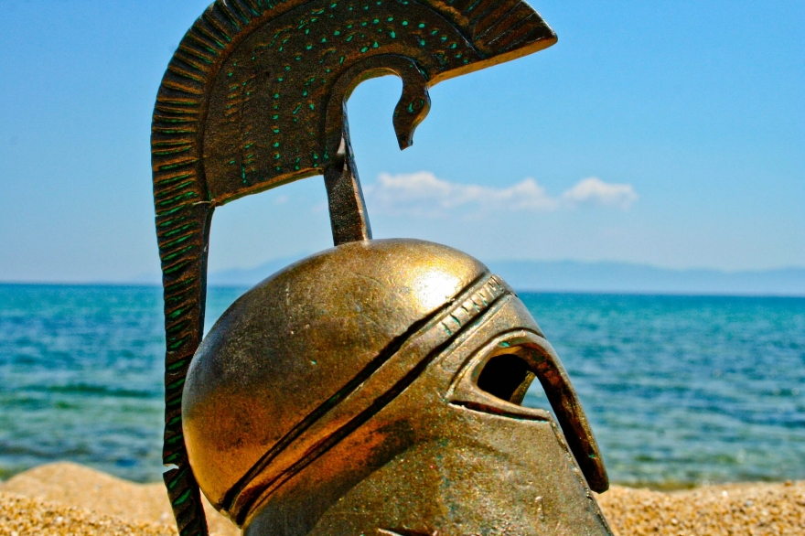
Athens and Sparta Fight
Worries over the Delian League stepping on the shoes of the Peloponnesian League sparked the Peloponnesian War, when Sparta preemptively move against Athens in 431 BC.
Click Here!

Slide 7
Final thoughts
Athens and Sparta, the two most powerful city states, fought for control of Greece.
This left Greece open to foreign invasion.

Slide 8
NEXT
ALEXANDER
Jim Soto © 2019

