Slide 1
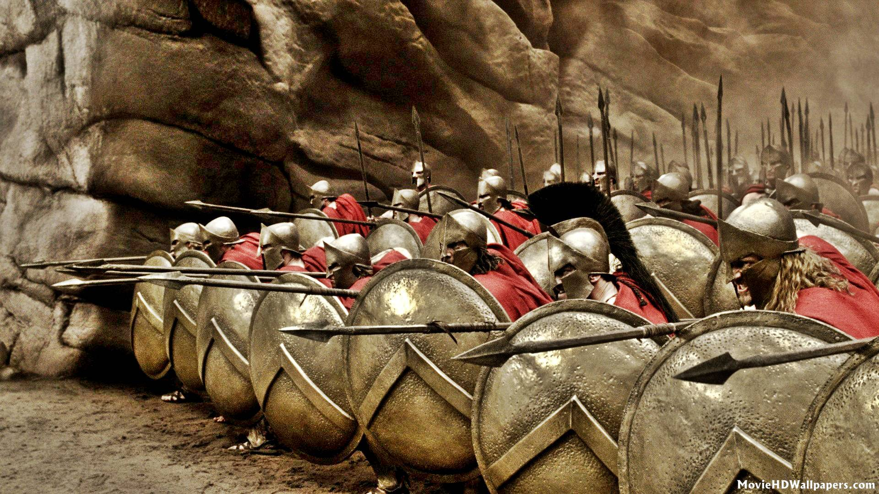
WORLD HISTORY
with Mr. Jim Soto
Greece and Persia

Slide 2
Think...
You’re a great military leader and the ruler of a great empire. You control everything in the nations you’ve conquered. One of your advisers urges you to force conquered people to give up their customs. He thinks that they should adopt your way of life. But other disagree. Let them keep their ways, and you’ll earn their loyalty. Whose advise will you take? Why?
Take a minute to write down your answer.

Slide 3
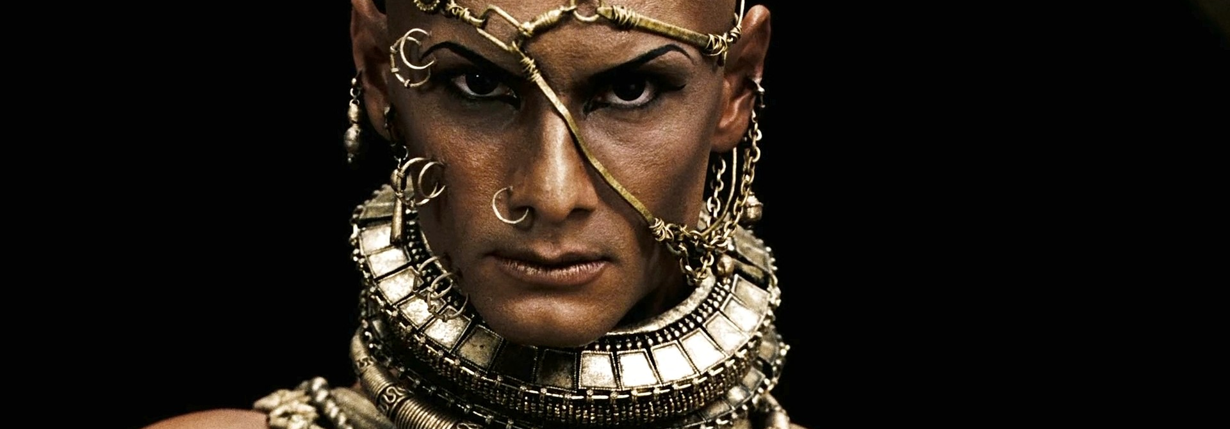
Among the rules that faced such decisions were the ruler of Persian Empire. In the span of only 30 years, beginning in 550 BC, Cyrus, Darius and Xerxes ruled like gods. And their eyes were set on Greece!

Slide 4
To learn more about this topic and others, read pages 260 thru 265 and complete the section 1 assessment. Show me the completed work when finished. After everybody has finished a group reading and discussion will ensue.

Slide 5
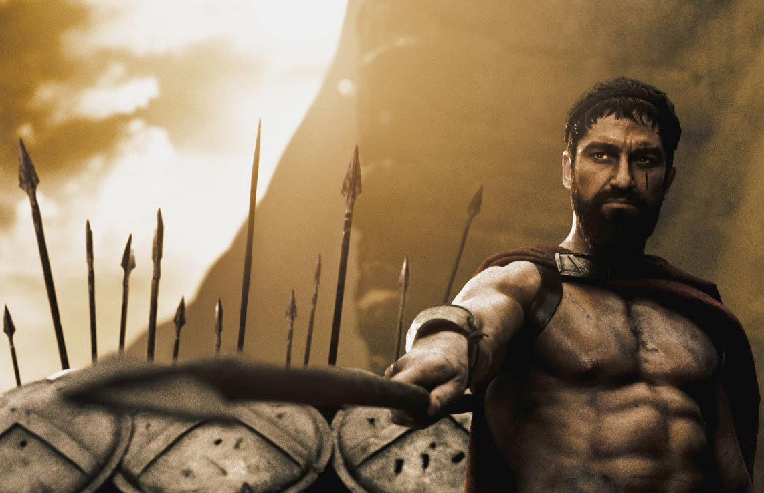
The Persian Wars
The Persian Wars were fought between the Greeks and Persians over two thousand years ago. Their battles originated for many of the same reasons wars happen today - resources, pride, revenge and prejudice.
Click Here!

Slide 6
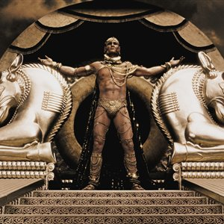
Battle of Thermopylae and the 300
Thermopylae, or the Hot Gates is a mountain pass near the sea in northern Greece which gave quick access to Sparta. In August 480 BC Xerxes sent his massive military to take southern Greece. Despite being greatly inferior in numbers, the Greeks held the narrow pass for three days with Spartan King Leonidas fighting a last-ditch defense with a small force of Spartans and other Greek hoplites.
Click Here!

Slide 7
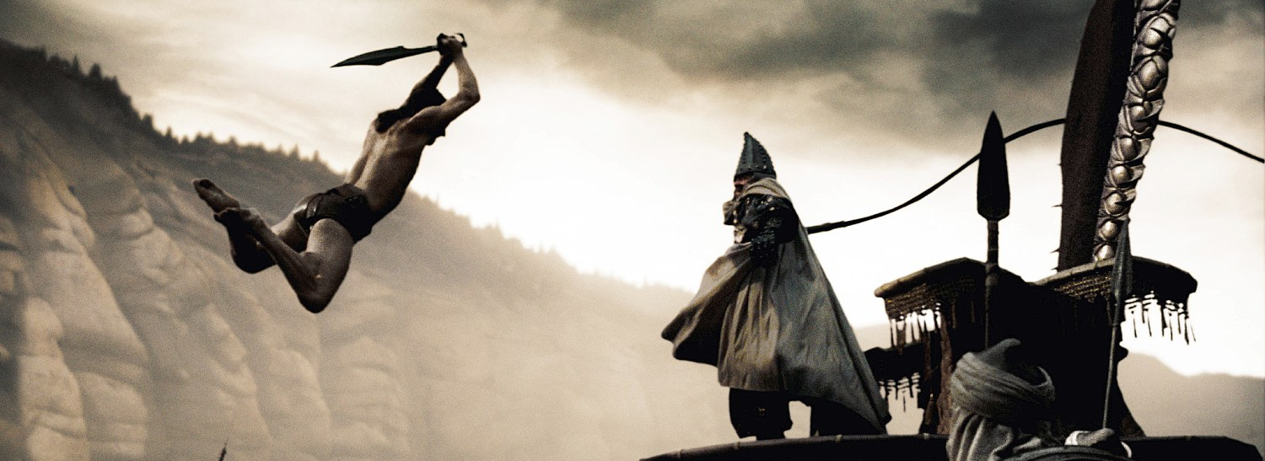
Ultimately the Persians took control of the pass, but the heroic defeat of Leonidas would assume legendary proportions for later generations, and within a year the Persian invasion would be repulsed at the battles of Salamis and Plataea.
Click Here!

Slide 8
Final thoughts
Athens and Sparta fought together against Persia.
The alliance between these two city-states didn’t last forever, though.

Slide 9
NEXT
ATHENS v SPARTA
Jim Soto © 2019

