Slide 1
Q4
Taking Notes
Jim Soto

Slide 2
Lesson Objective
Learn how to take good classroom notes
Learn how to take reading notes
Learn various organizers for taking notes while reading
Pages 441-448

Slide 3
How Do You Take Notes?
Taking notes is indispensable in many courses that you take. Sometimes a class doesn’t have a textbook, so taking notes from the teacher’s conference or discussion is a must if you want to succeed. Learning how to take good notes is very beneficial.

Slide 4
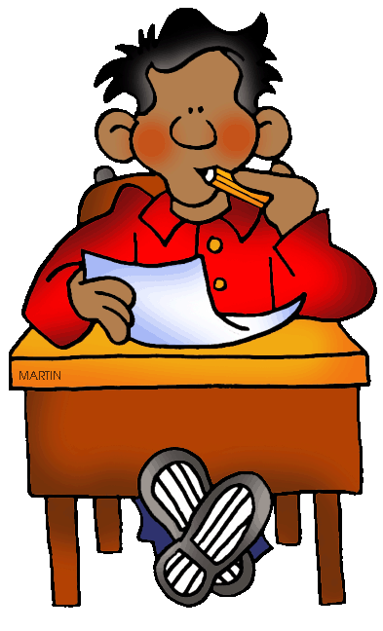
How Do You Take Notes?
Answer this test in your notebook...
When you take notes, do you...
Write in complete sentences? Phrases? Abbreviations?
Arrange information in lists? Clusters? Outlines?
Use visual aids such as drawings? Diagrams? Charts?

Slide 5
Taking Classroom Notes
Taking notes can help you learn new material and prepare for tests. Note taking helps you...
pay attention
understand better, and
remember.

Slide 6
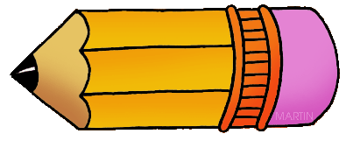
Guidelines for Taking Notes
write the topic and date at the top of each page.
when teacher introduces the topic, listen for the main ideas
be alert for signal words
put the main ideas in your own words
organize your notes with numbers, words, or symbols
write down new/important terms and meanings
pay attention to what is written on the board

Slide 7
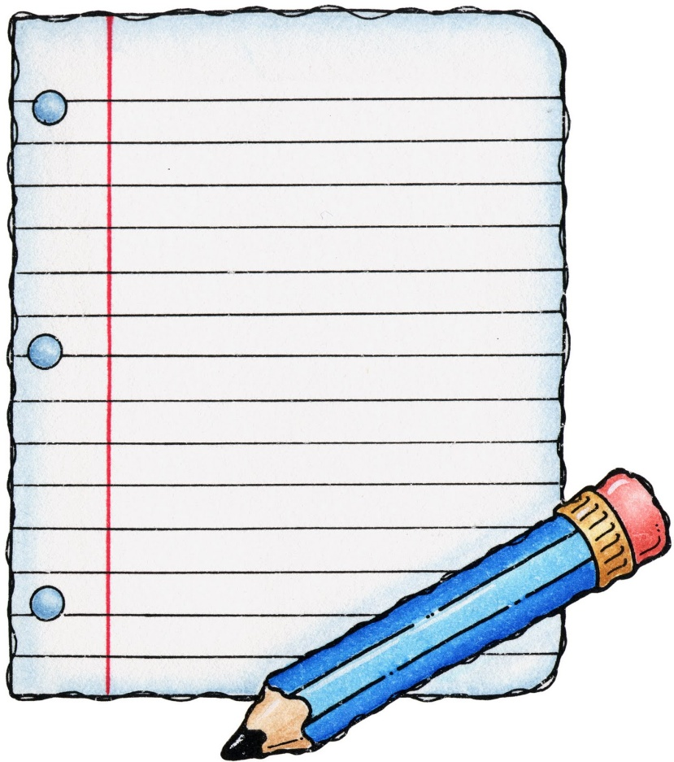
Setting Up/Reviewing Your Notes
Read Setting Up/Reviewing Your Notes in pages 443-444 of your text book, then complete the Review your work assessment. Prepare for a discussion in seven minutes.

Slide 8
Taking Reading Notes
skim an assignment before reading it.
note each heading or subtopic
write your notes in your own words (paraphrase)
summarize information graphically
read challenging material out load
list words that are new to you
go through your notes
take notes while you read.
add graphic organizers to your work.
Read Taking Reading Notes in page 445 of your text book, then complete the Try IT assessment.

Slide 9
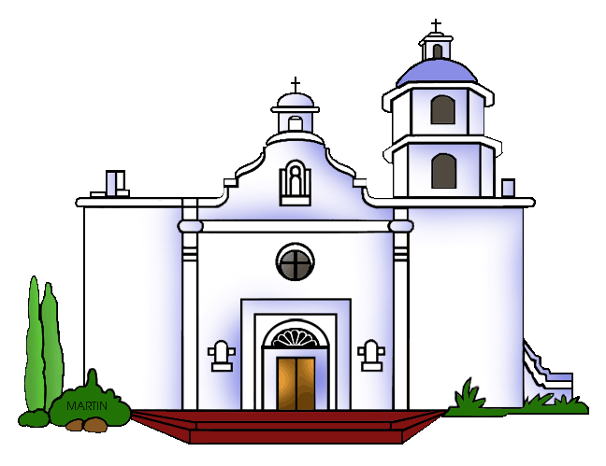
Taking More Reading Notes
Using cause-effect organizers
Cause -and-effect writing shows how or why things happen. It may be that one cause may have several effects. Read more about it in page 446, then complete the Try IT assessment. Prepare for a discussion in ten minutes.

Slide 10
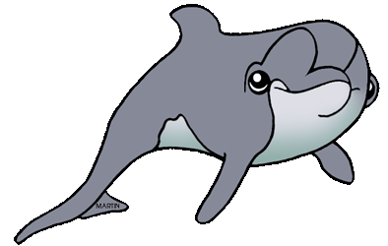
Taking More Reading Notes
Using a table organizer
Meep!
Some types of writing are organized around a main idea. Main ideas are supported by details. A table organizer shows this structure with clarity. Read more about this in page 447, then complete the Try IT assessment. Prepare for a discussion in ten minutes.

Slide 11
Taking More Reading Notes
Using a cycle diagram
Science writing often describes various processes that are repeated. Cycle diagrams are an effective way to record the steps in that process. Read more about this in page 448, then complete the Try IT assessment. Prepare for a discussion in ten minutes.
lungs
heart
body
tissues
heart
veins
O+
O-
arteries
capillaries

Slide 12
Homework
In your Skills Book complete pgs. 147-154.
Specific Nouns
Pronouns & Antecedents
Types of Pronouns 1
Types of Pronouns 2
HEY!

Slide 13
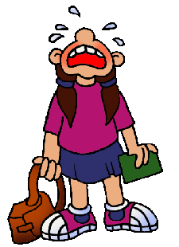
Next
Research Reports
Jim Soto © 2016

