Slide 1
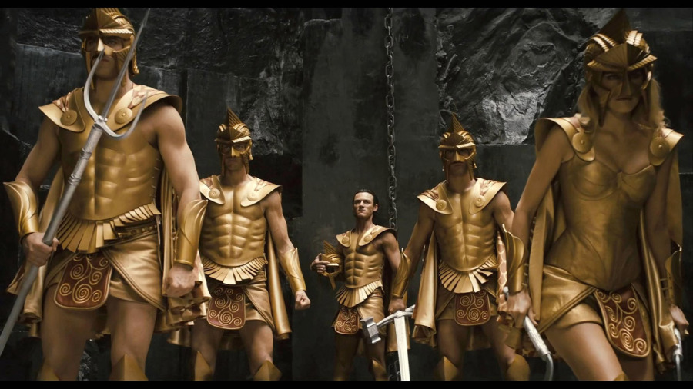
WORLD HISTORY
Greek Mythology & Literature
with Mr. Jim Soto

Slide 2
Think...
As a Farmer in ancient Greece, your way of life depends on events in nature. The crops you grow need sunshine and rain, though thunder and lightning scare you. When you look up at the night sky, you wonder about the twinkling lights you see there. You know that at certain times of the year, the weather will turn cold and gray and plants will die. Then, a few months later, green plants will grow again. How might you explain these natural events?
Take a minute to write down your answer.

Slide 3
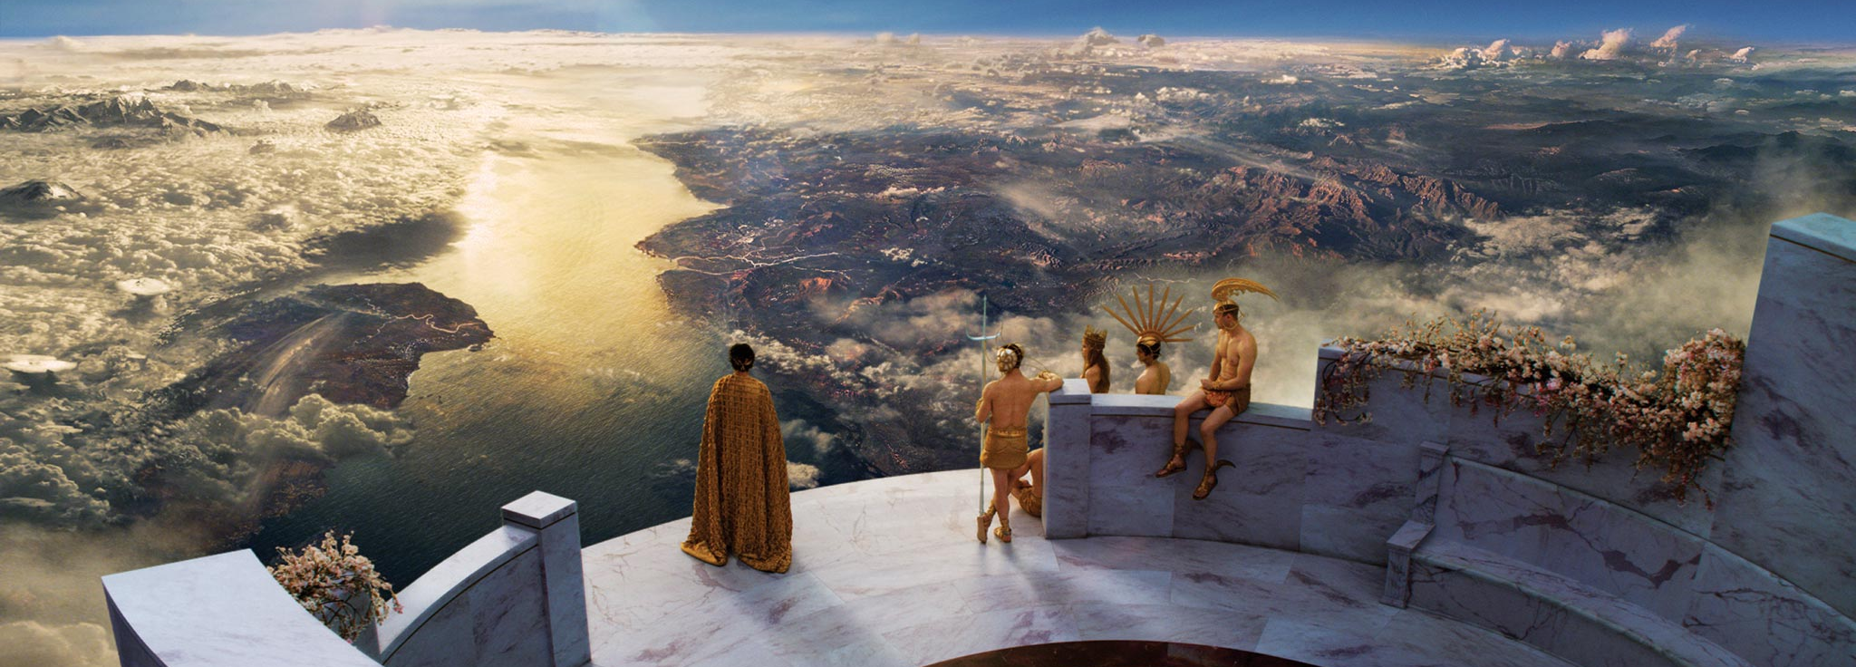
The Greeks lived in a time long before the development of science. To them, natural events like storms and changing seasons were a mystery. Today we can explain what causes these events. But to the Greeks, they seemed like the work of powerful gods.

Slide 4
To learn more about this topic and others, read pages 242 thru 249 and complete the section 3 assessment. Show me the completed work when finished. After everybody has finished a group reading and discussion will ensue.

Slide 5
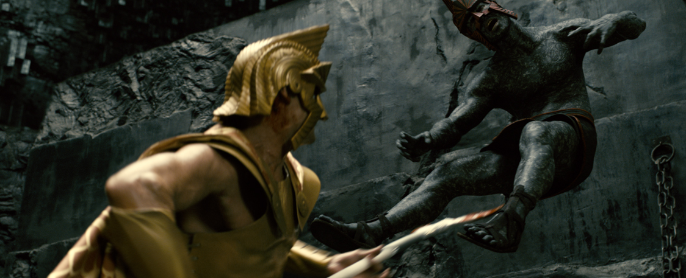
Myths Explained the World
Lets watch a few videos explaining and illustrating Greek Mythology.
Creation & the Titanomachy
Click Here!

Slide 6
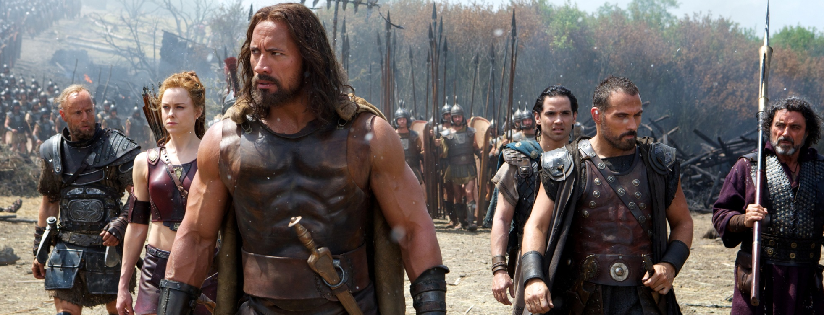
Myths Explained the World
Hercules’s Twelve Labors
Click Here!

Slide 7
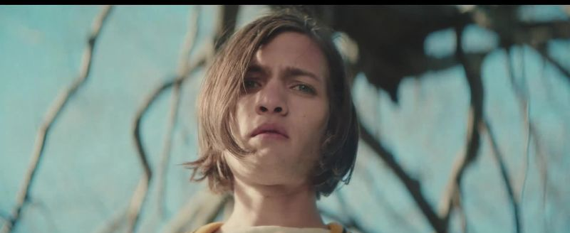
Myths Explained the World
Click Here!
Orpheus and Eurydice

Slide 8
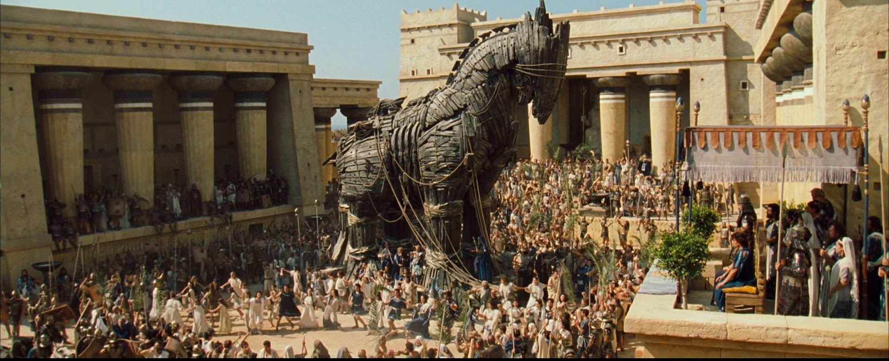
Ancient Greek Literature
Lets watch a video illustrating Greek poetry.
Homer’s The Iliad
Click Here!

Slide 9
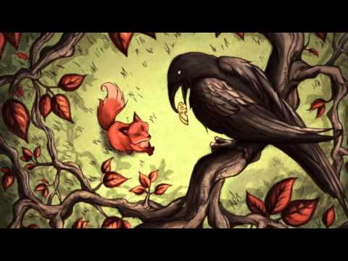
Ancient Greek Literature
Lets watch a video illustrating Greek story telling.
Aesop's Fables :: Fox and Crow
Click Here!

Slide 10
Final thoughts
The myths, poems and stories of ancient Greece have shaped how modern people speak, read and write. Like Democracy, they are Greece’s legacy to our civilization

Slide 11
NEXT
Vs.
PERSIA
Jim Soto © 2019

