Slide 1
One Writer’s Process
Jim Soto

Slide 2
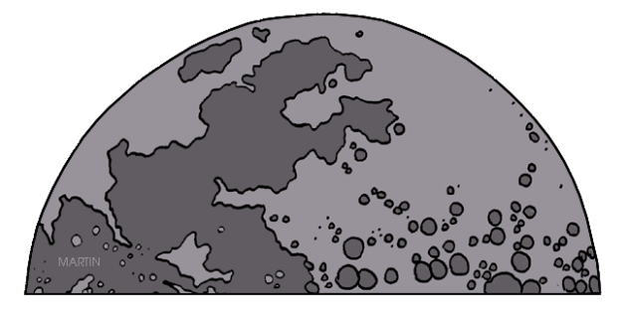
Famous Science fiction writer Ray Bradbury said -
“If you can't read and write you can't think. Your thoughts are dispersed if you don't know how to read and write. You've got to be able to look at your thoughts on paper and discover what a fool you were.”

Slide 3
Lesson Objective
Evaluate a writing sample using the writing process
Evaluate a writing sample by applying the traits of writing

Slide 4
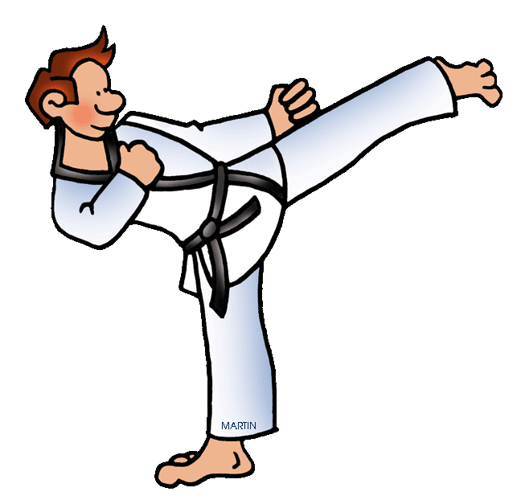
Setting Goals
Take a minute and read the story in page 11.
Why will we follow Kaylie’s writing experience?

Slide 5
Previewing the Goals
Goals for expository writing are:
Ideas
Organization
Voice
Word Choice
Sentence Fluency
Conventions
Take four minutes to answer the following questions in pg. 12:
Try It

Slide 6
The Writing Process: Prewriting
Listing is another type of prewriting technique that can help you explore a topic of your choice.
background | equipment | techniques | benefits
Started 1882 | Uniform called “Gi” | Throws - take partner down | Builds muscle strength
Based on Jujitsu | Color of belt tells level | Grapple - control partner | Improves mental discipline
In this case Kaylie decided to write about Judo.

Slide 7
The Writing Process: The Remaining Steps
Read pgs. 14-28 to discover how Kaylie engaged her writing assignment. Complete the Try It activities from pgs. 15, 16, 17, 18, 19, 20, 21, 22, and 23

Slide 8
Seatwork
In addition to the previous work you completed, here, enjoy more.
In your Skills Book complete pgs. 3-8 and 5-10. Then:
End Punctuation 1
End Punctuation 2
Commas Between Items in a Series 1

Slide 9
Next
Journals and Learning Logs
Jim Soto © 2015

