Slide 1
Q4
Research Writing
Jim Soto

Slide 2
Lesson Objective
Learn the difference between primary and secondary sources
Understand how to use the Internet
Learn how to use and evaluate reference material
Pages 363-376

Slide 3
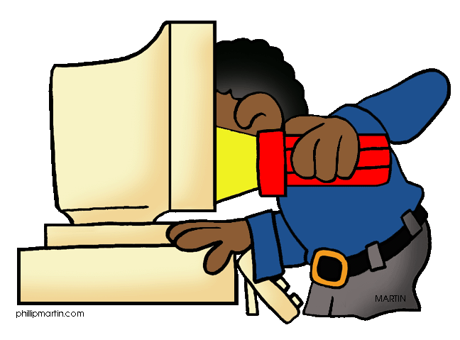
Research Writing
As a middle school student, a set of research skills you must possess includes:
Gathering relevant information from multiple sources, using research terms effectively, assessing the credibility and accuracy of each source, and quote or paraphrase the data and conclusions of others.

Slide 4
Back in the day...
When your mom and dad where your age, doing research meant using magazines, news papers, and books. Today, researchers use the Internet, CDs, DVDs, live web-casts, and e-mails. In other, words, there is more variety today.

Slide 5
Primary vs. Secondary
Information sources can either be primary, which means they are an original source; or as secondary, which means they contain information gathered by somebody else. To give you an idea: most nonfiction, newspapers, magazines, and web sites are secondary sources.

Slide 6
Primary vs. Secondary
In page 364 of your text book you’ll find some additional information, read it then complete the Try IT assessment at the end. Prepare for a discussion in ten minutes.

Slide 7
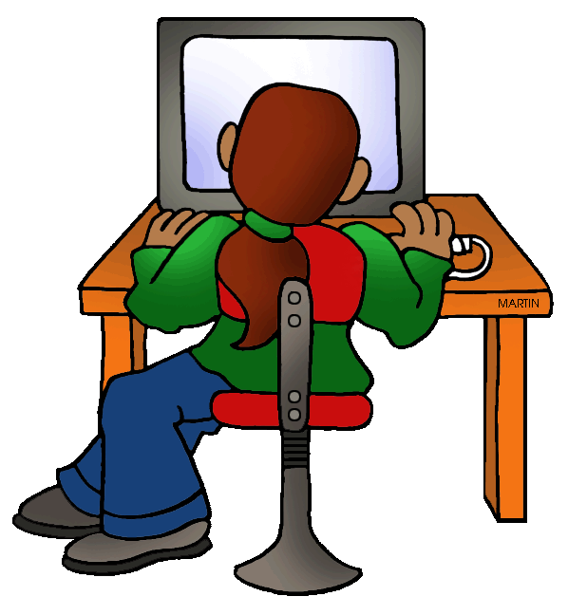
Using the Internet
The internet has rapidly become the most important informational medium in our world. It allows people from all around the world to access and share data almost instantaneously. Be careful when using it, because the information found there comes from a variety of persons and places.

Slide 8
Browsers
Chrome, Firefox, Opera, Safari, and Explorer are some names you’re probably familiar with. They are a type of software known as browsers.
Browsers are programs for “surfing” the Net. They enable you to find the information you’re looking for.

Slide 9
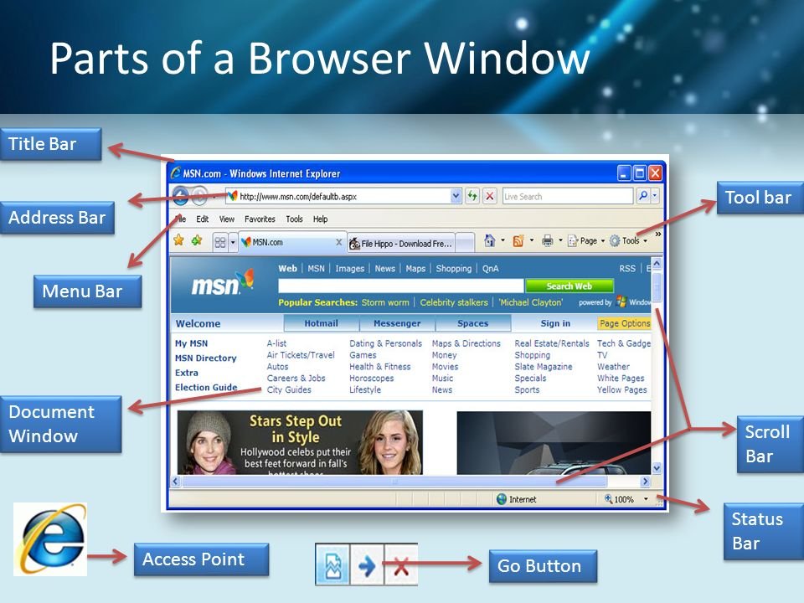
Parts of a Browsers

Slide 10
Using Browsers
If you know the Web address of a page on the Net, you can type into the address bar and use the “Return” or “Enter” keys to go there. Clicking the links on a page will get you to related pages. Navigation arrows let you return to pages you’ve been to. But a mouse controller makes things even easier.

Slide 11
Search Engines
Search sites or engines help catalog and navigate the Internet faster and more efficiently. Search engines are the taxi drivers of the Net.
Read page 366 for some important points about the Internet.

Slide 12
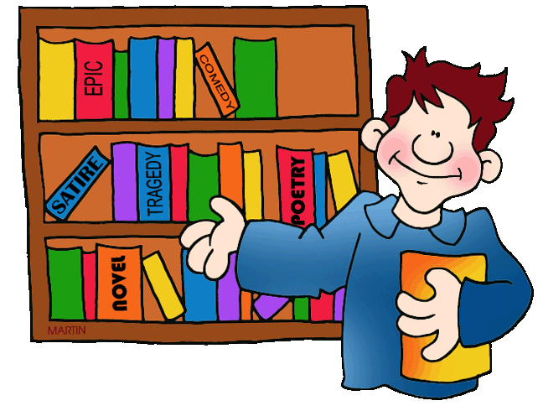
Libraries!!!
Once upon a time there where these wonderful places called libraries. They had books and books and more books.
They also had newspapers, magazines, DVDs, and a lot more. Some still exist.
Go to page 367 to learn all about them.

Slide 13
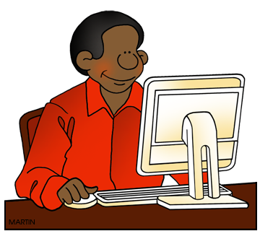
Searching a Computer Catalog
Every computer catalog is a little different. Consult your librarian or IT for help. With a computer catalog, you can find information on the same book (title, author, subject).Depending on the subject matter of the book you can use a key word to help you find what you’re looking for. Go to page 368 to learn all about them.

Slide 14
Searching a Card Catalog
Chances are that when you go to college you’ll be using a library. They might have a card catalog. You’ll find them in a cabinet full of drawers that contain title, author, subject cards that are arranged alphabetically. Check out page 369 for specific details.

Slide 15
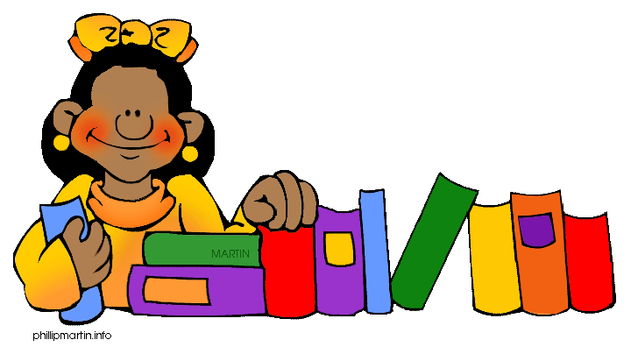
Finding Books
Each catalog entry for a book includes a call number. You can use this number to find the book you’re looking for.
Read page 370 to learn about the Dewey system to arrange books works, then complete the Try IT assessment. Prepare for a discussion in five minutes.
973
M

Slide 16
Parts of a Books
Understanding the parts of a nonfiction book can help you use them more efficiently. The title page, copyright page, preface, table of contents, cross reference, appendix, glossary, bibliography, and the index are all essential book parts. Read about them in page 371, then complete the Try IT assessment. Prepare for a discussion in five minutes.

Slide 17
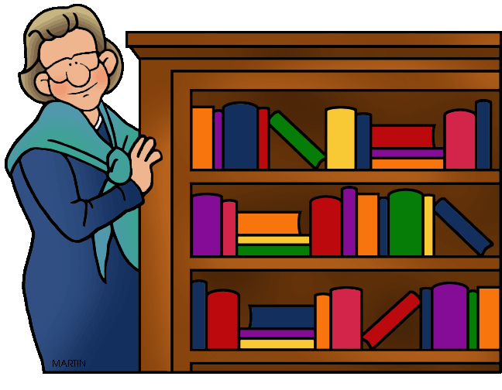
Using Encyclopedias
Before the advent of the Internet, the most used reference were encyclopedias. Encyclopedias are a set of books, a CD or a website with articles on any subject imaginable with topics arranged alphabetically. Read page 372 for additional details. Complete the Try IT assessment. Prepare for a discussion in five minutes.

Slide 18
Finding Magazine Articles
Magazines are also called periodicals because they are published at regular intervals. Periodical guides are found in the reference section of a library and they list magazine articles about different topics. Read page 373 for additional details. Complete the Try IT assessment. Prepare for a discussion in five minutes.

Slide 19
Checking a Dictionary
Dictionaries are very important research tools. They reflect how languages are constantly changing. They remain the most reliable source for learning the different meanings of words. Read about them in page 374-375, then complete the Try IT assessment. Prepare for a discussion in five minutes.

Slide 20
Evaluating Sources
How do you decide whether a source will be useful for your research? Ask yourself the following questions:
Is the source primary or secondary?
Is the source an expert?
Is the information accurate?
Is the information complete?
Is the information up to date?
Is the source biased?

Slide 21
Homework
In your Skills Book complete pgs. 141-146.
Common & Proper Nouns
Concrete & Abstract Nouns
Subject & Object Nouns
JOY!

Slide 22
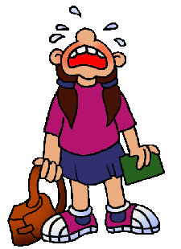
Next
Taking Notes
Jim Soto © 2016

