Slide 1
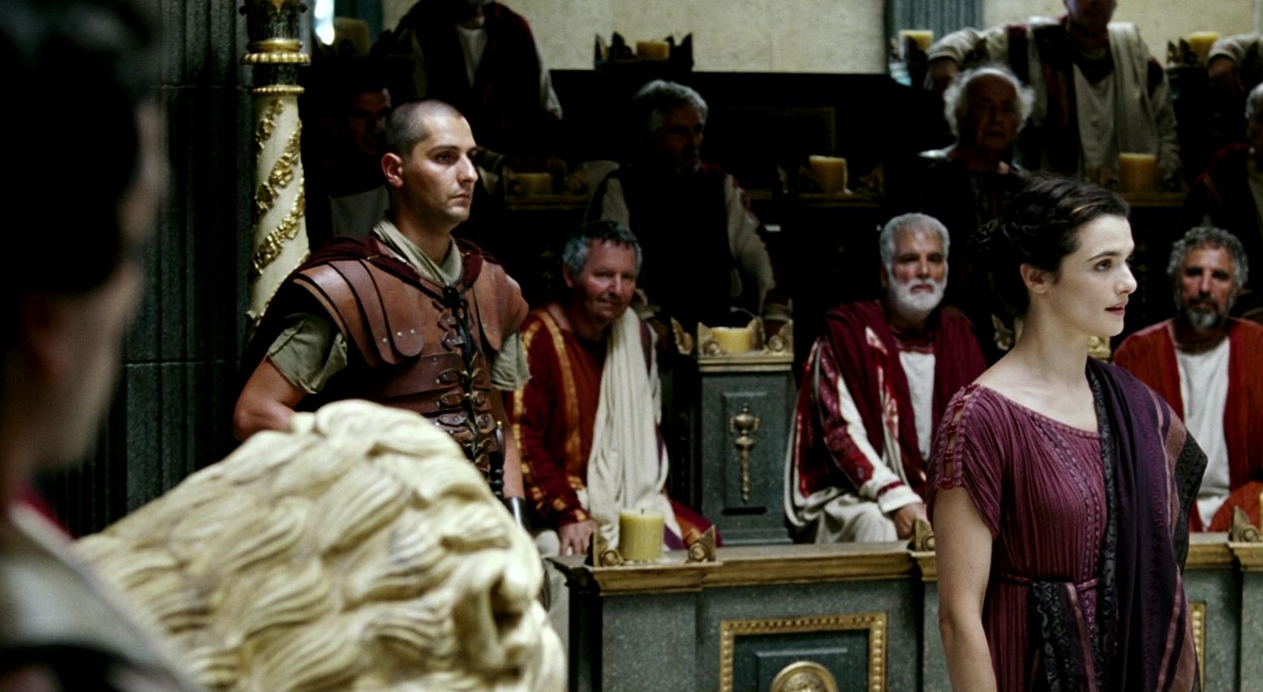
WORLD HISTORY
with Mr. Jim Soto
Government in Athens

Slide 2
Think...
For many years your city has been ruled by a small group of rich men. They have generally been good leaders. They have built new buildings and protected the city from invaders. Recently a new leader wants to let all free men help run the government. It wont matter if whether they are rich or poor. Some people, however, have a problem with giving power to ordinary people.
What do you think about this new government model?
Take a minute to write down your answer.

Slide 3
The decision to change a city’s government was not unusual in Greece. Many cities tried several forms of government before people were satisfied, To see how these changes came about, we can look at one city whose government changed many times – Athens.

Slide 4
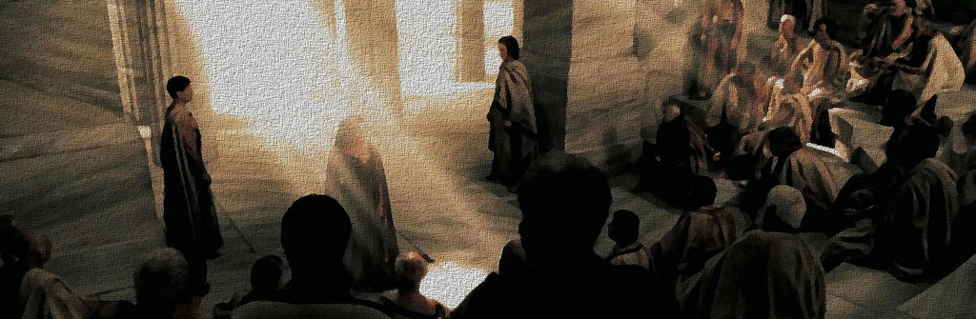
To learn more about this topic and others, read pages 236 thru 241 and
complete the section 2 assessment. Show me the completed work when complete.

Slide 5
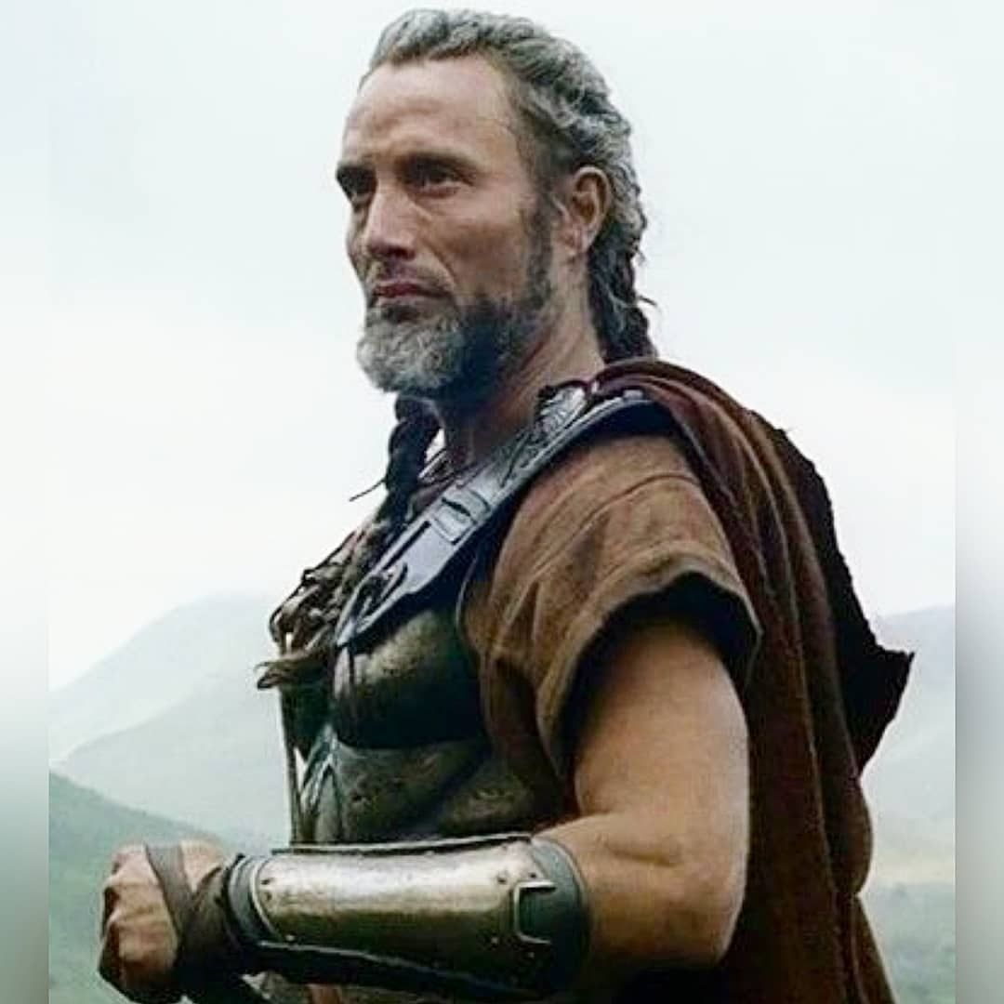
Aristocrats & Tyrants Rule
In early Athens, kings ruled the polis until Aristocrats, rich land and business owners, developed a rule by the “best” system of government. These rich people controlled the city, the army and the economy. This small group created a system very similar to the one we live under.
An oligarchy is the government by a few rich people. Ordinary people have little to no say in how the government is run.

Slide 6
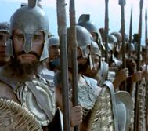
By 600’s BC unrest amongst the population developed because they didn’t like being marginalized. They demanded a say in government matters. After being ignored, they rebelled, but failed.
As a result tyrant rule (from “tyrant” meant “one who takes over with the people’s support”)
began to take form with leaders like Draco. He created harsher laws that allowed him to exert more control over Athenians.
Click Here!

Slide 7
In 594 BC, a reformer named Solon created 1st Constitution,
or set of principles and rules for governing in Athens. Consequently, the laws became less harsher and non-aristocrats were given more rights.
Under these laws, all free men in the polis became citizens, people who had the right to participate in government affairs. These were the first steps in ending the oligarchy.

Slide 8
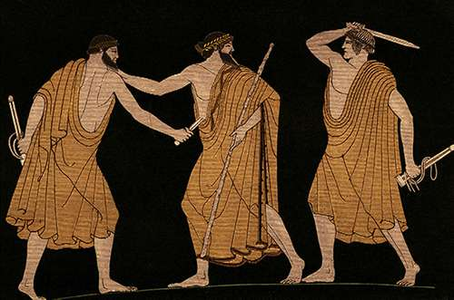
Unfortunately, in 546 BC, a noble named Peisistratus overthrew the oligarchy, but seized control of Athens. He became the first of many tyrants, or leaders who held power through the use of force, that followed. Today, tyrant means a harsh ruler, but in ancient Greece, tyrants usually governed well, but had support of the army and powerful people.
Click Here!

Slide 9
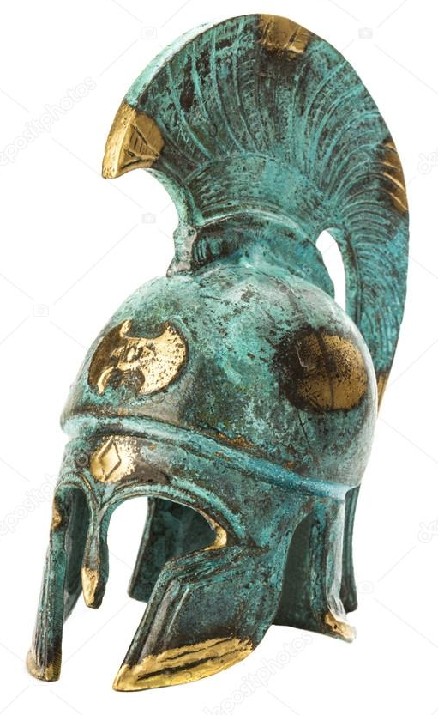
Peisistratus’s rule was quite prosperous.
Athens improved. His stable reign made growing several types of crops viable, and before long Athens was producing enough to become an export economy. He literally sowed the seeds of future greatness. After his death, other tyrants, that were not as powerful, succeeded him. The aristocrats, not quite so happy, plotted a comeback. After a foreign invasion they assisted, they took control of Athens again.

Slide 10
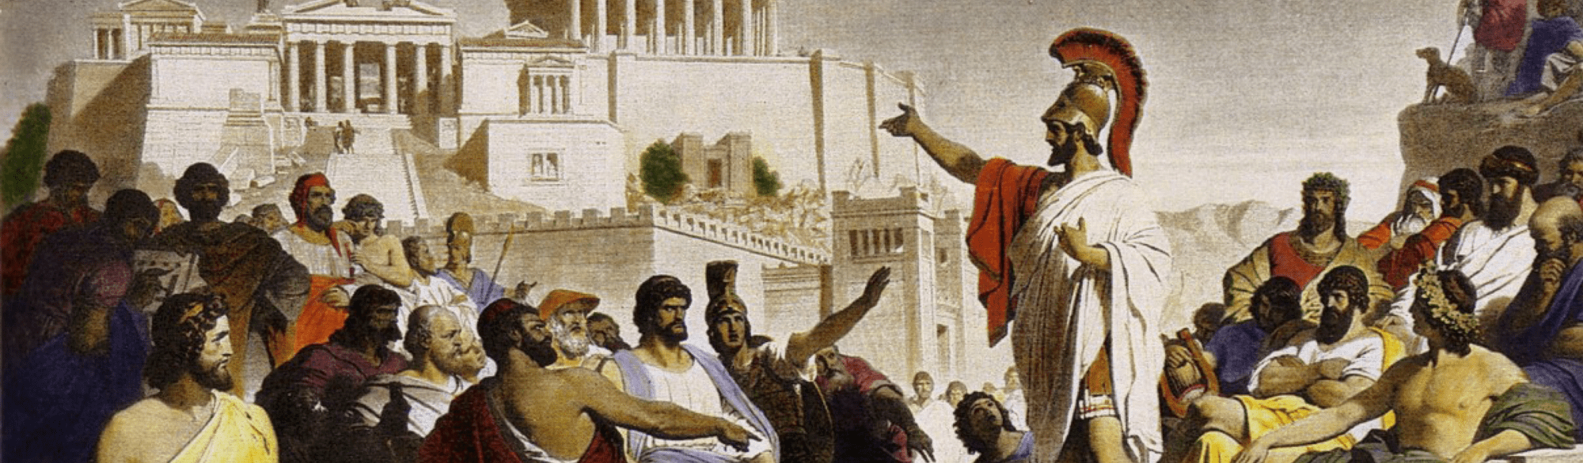
Athens Creates Democracy
The first real democratic constitution was created by Cleisthenes, an aristocrat himself, in 508 BC with the support of the people. Getting rid of the oligarchy once an for all, he created a new type of government, one never seen before in the history of the world.

Slide 11
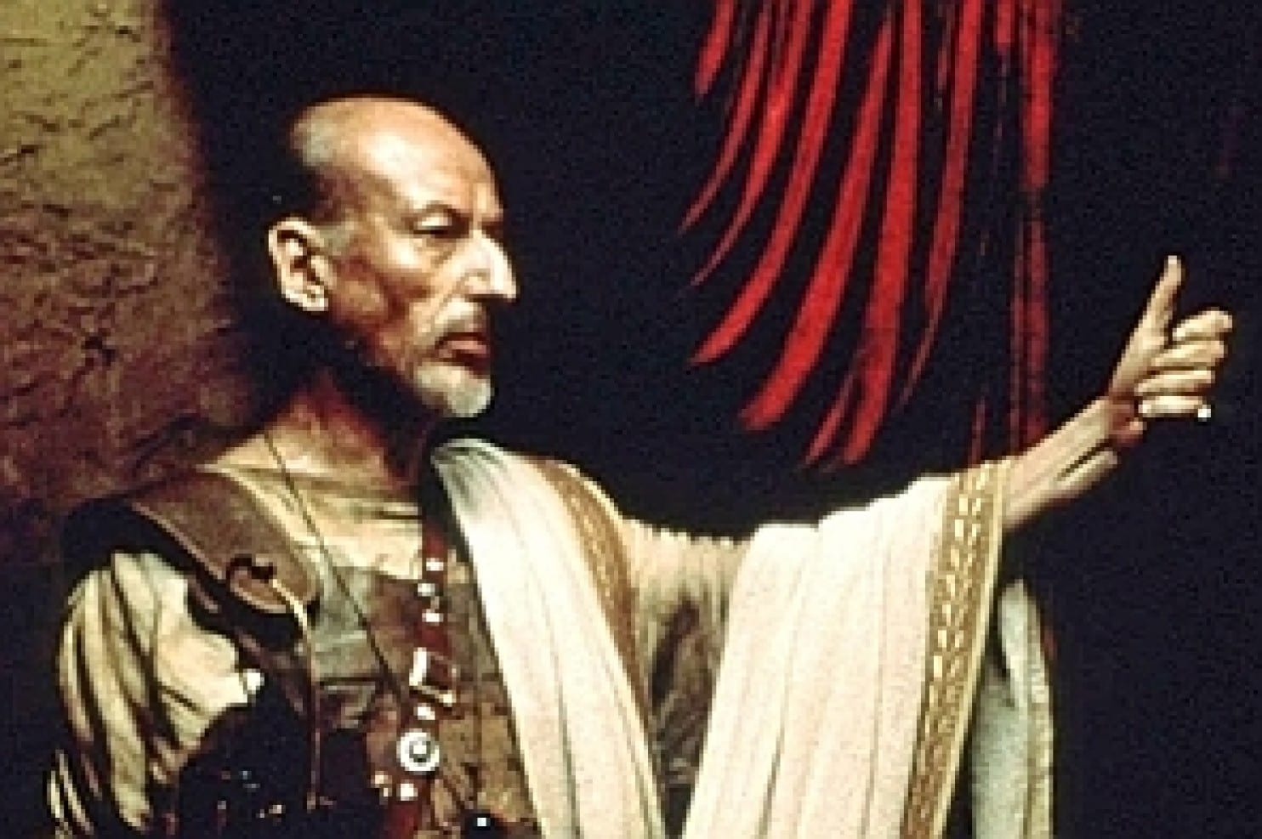
The new type of government was called democracy, or a government in which people rule themselves. All Athenian citizens (land owners) were able to participate in government- they could vote. However a sizable part of the polis were excluded. Women, people born outside of Athens, and slaves could not vote.

Slide 12
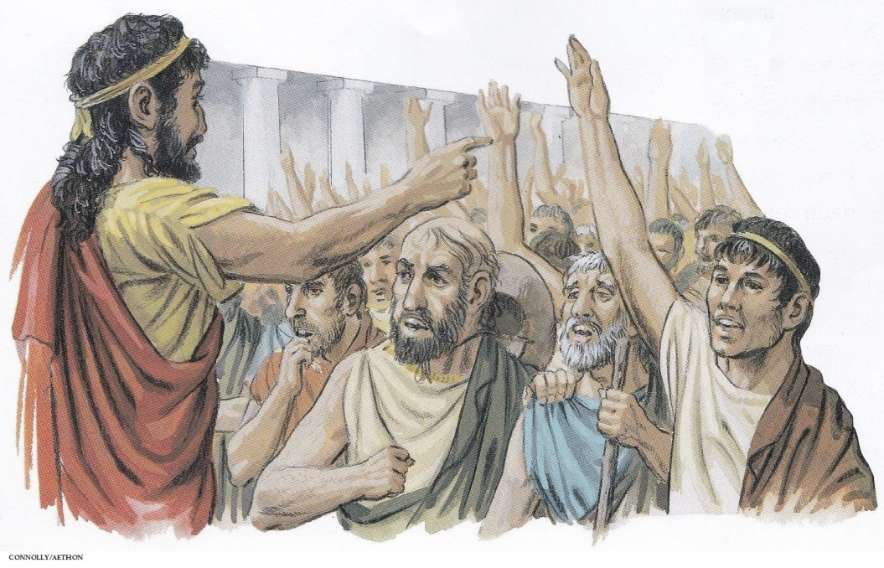
Cleisthenes, known as the “father of democracy”, had gatherings of citizens at hill sides that created laws at assemblies known as “ecclesia”. At these meetings anyone in attendance could raise up and speak their opinions. After debates on new legislations live votes usually took place. Some times votes were public and sometimes with secret ballots.

Slide 13
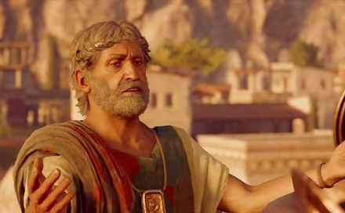
Running a democracy was a lot of hard work because it was very difficult to gather enough quorum to run an assembly at any given time. Sometimes government officials were voted in, sometimes chosen by a lottery! Athens was a democracy for about 170 years. This form of government reached its peak under the rule of Pericles.
Click Here!

Slide 14
Athenian Government Structure under Pericles
461 - 429 BC
This is what a democratically elected government looked like under Pericles. Not long after, the Macedonians from the north conquered all of Greece and ended democracy. After all, they had a king.

Slide 15
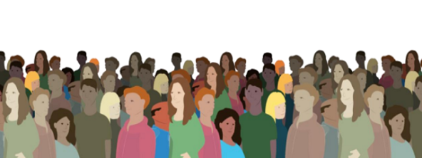
Ancient Democracy vs. Modern Democracy
The Greek democracy was different from the modern system because their government only granted the rights of citizenship to male property owners and who had completed military training. Their system excluded women, slaves, and children from full citizenship. Additionally, people who were not citizens, but lived in Athens could not vote. In today's “democratic” system in the United States, anyone born in the nation is considered a citizen.

Slide 16
While there are many similarities between the democracy of ancient Athens and that of the modern republics, and also many differences, the main difference would be that one can be termed as direct and the other as representative by the sheer sizes of the populations of modern countries.

Slide 17
Direct Democracy
is also often called “pure democracy” and involves having the citizens as individuals vote on issues instead of elected representatives. This system of democracy gave citizens an extraordinary amount of participation in the legislation process and granting them a maximum of political self-determination.

Slide 18
Representative
Democracy
is a form of government wherein its citizens vote for or elect a representative to represent them in Parliament, Congress or a Senate. These representatives then are supposed to make legislation in favor of their constituents.

Slide 19
Final thoughts
Athens witnessed the emergence of three new different government systems: the oligarchy, the tyranny, and democracy.
Athenian democracy greatly influenced the United States many years ago.

Slide 20
NEXT
TEST 3
Jim Soto © 2018

