Slide 1
Q4
Free Verse Poems
Jim Soto

Slide 2
Lesson Objective
Understand the content and structure of a free verse poem
Understand the use and effect of poetry techniques
Choose a poem topic to write about
Plan, draft, revise, and edit a free verse poem
Pages 353-361

Slide 3
A Thought About Poetry
A poem begins with a lump in the throat.
- Robert Frost
A poem doesn’t tell you what to feel, but rather leads you to discover the feeling by yourself. Most modern poems are written in free-verse style rather than meter.

Slide 4
What is Free Verse?
free verse is poetry that does not rhyme or have a regular meter. Even though they constitute an artistic expression, they sound somewhat like prose.
Let’s check one out...
CLICK HERE

Slide 5
Weather Poem
You will be composing a free verse poem about a weather memory. Read Lightning’s Song, in page 354, then complete the Respond to the reading assessment at the end. Prepare for a discussion in ten minutes.

Slide 6
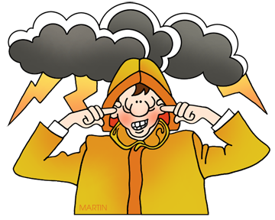
Getting Your Feet Wet
In pages 355 through 361 you’ll find instructions and assessments that will help you compose a free verse poem. Follow the five steps of the writing process for the poem you’ll be turning in soon.

Slide 7
Prewriting

Slide 8
Selecting a Topic
Listing
You will write a poem about a memory of some type of weather. To generate possible topics, you can make a list of weather memories.
Riding home with Mom during a thunder store.
My bare feet on the street in front of my house.
Hurricane Carlos last year!
Losing my green kite in a windy afternoon.
A thunder clap that scared Fido.

Slide 9
Selecting a Topic
Sensory Chart
Text books usually explain, poems describe. Create a sensory chart, similar to this one to help yourself create effective images for your poem.
SEE | HEAR | SMELL | TASTE | FEEL
bright flashes jagged lines dark clouds sun breaking through | crackle rumble boom | dampness ozone | moist air | mist rain heart thumping

Slide 10
Homework
In your Skills Book complete pgs. 107-111.
Subject-Verb Agreement 2
Subject-Verb Agreement 3
Subject-Verb Agreement 4
Subject-Verb Agreement Review
HIC!

Slide 11
Next
Research Writing
Jim Soto © 2016

