Slide 1
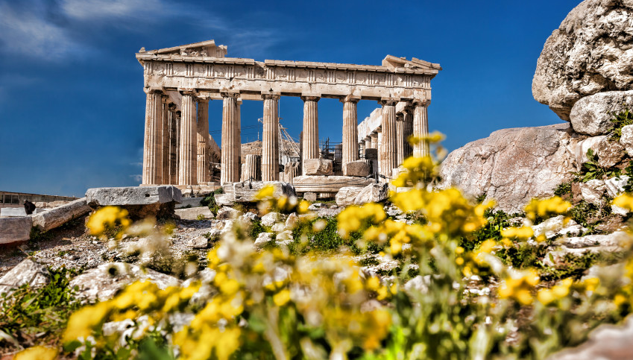
WORLD HISTORY
Geography & Ancient Greece
with Mr. Jim Soto

Slide 2
Think...
You live on the rocky coast of a bright blue sea. Across the water you can see dozens of islands and points of land jutting out into the sea. Rugged mountains rise steeply behind your village. It is hard to travel across the mountains in order to visit other villages. Near your home on the coast is a sheltered cove where it’s easy to anchor your boat.
What would you do to make a living in this place?
Take a minute to write down your answer.

Slide 3
Ancient Greece was made up of hundreds of city-states, grouped together at the southern end of a very large peninsula that jutted out into the Mediterranean Sea. Mountain ranges run right up to the coast in many places, making travel and farming quite difficult. Although it was not the easiest place to live in, Greece produced some of the ancient world’s greatest civilizations.

Slide 4
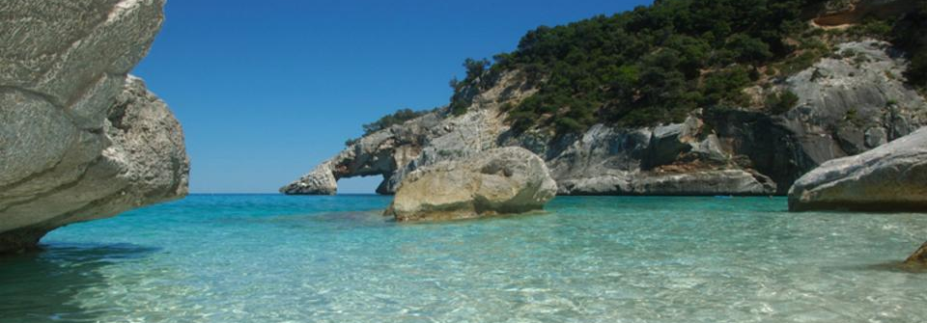
To learn more about this topic and others, read pages 228 thru 233 and complete the section 1 assessment. Show me the completed work when complete.

Slide 5
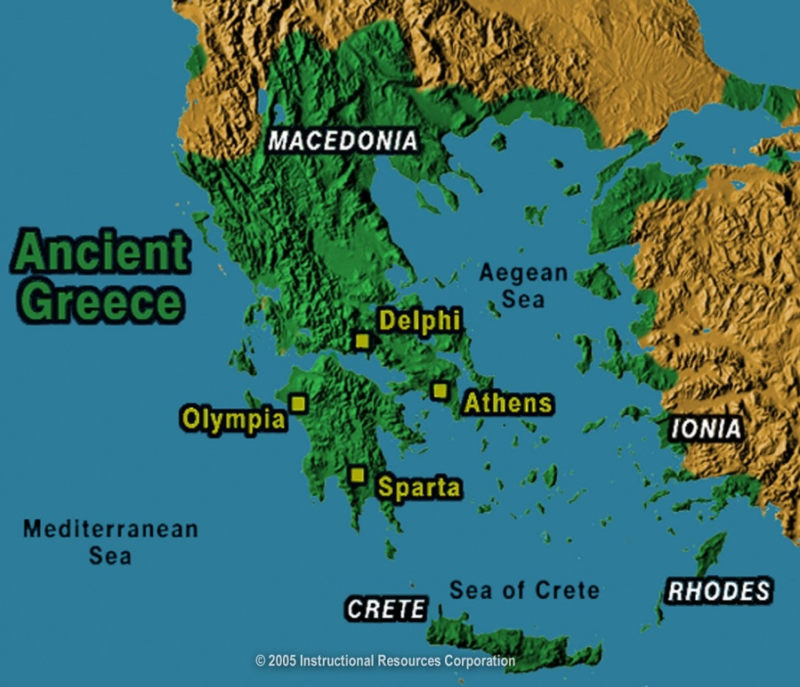
Geography Shapes Greek Civilization
The Greeks lived in a rocky, mountainous land, with extensive mountain ranges criss-crossing the area. There were very few valleys with no major rivers passing through. Farming was limited. However, a long coastline encouraged trade and fishing. The climate was mild. The other side of the peninsula was dotted by hundreds of small islands.
Click Here!

Slide 6
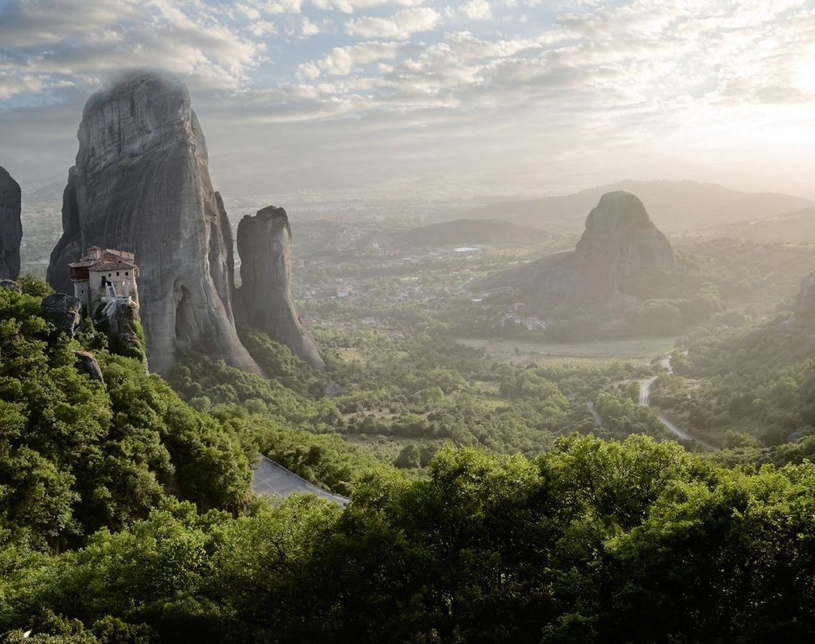
Mountains & Settlements
Greece is primarily a very mountainous country with more than 300 larger or smaller mountains. The most significant Greek mountain axis is the Pindus Mountain range, forming the “backbone” of Mainland Greece, which extends naturally to the mountains in the Peloponnese and Crete. All this made travel and farming somewhat difficult.

Slide 7
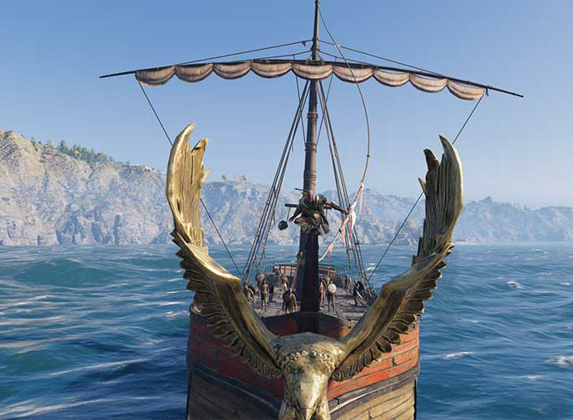
Seas & Ships
Since travelling inland was difficult, the early Greeks took to the seas. Greece is surrounded by three seas: the Ionian Sea to the west, the Aegean Sea to the East, and the Sea of Crete to the south. They are all northern extensions of the Mediterranean Sea that touches the south of the Peloponnese and Crete.
The Greeks became skilled shipbuilders, sailors, traders and fishermen.

Slide 8
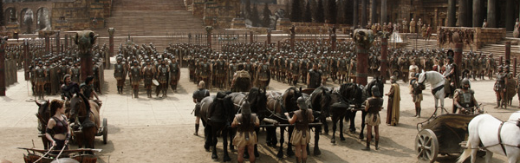
Trading Cultures Develop
Many cultures developed in Greece, however, two most influential were the Minoans, from the isle of Crete and the Mycenaens, from mainland Greece, mostly on the Peloponnese or southern region.

Slide 9
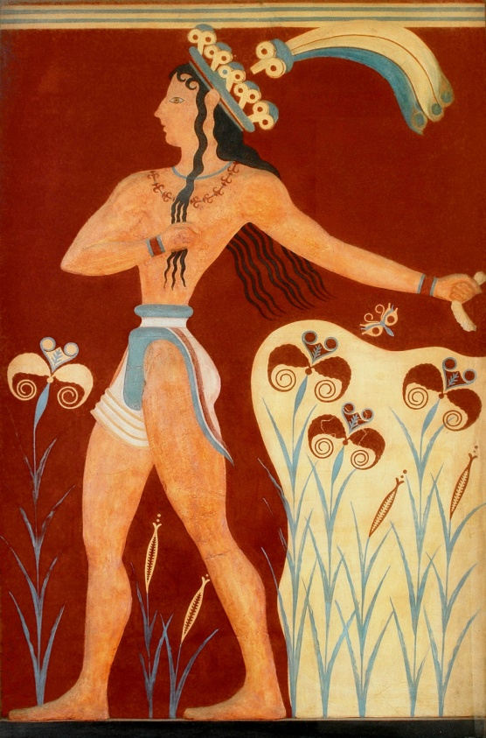
The Minoans
The Minoan civilization was the first European civilization. About 2,500 BC a sophisticated society grew up on the island of Crete. Copper was a much sought after commodity during this time, and it does not appear naturally in Crete. Most likely the Minoans imported copper from Cyprus. The skill of their metal smiths was renown in the ancient world, and many artisans worked abroad in mainland Greece and the Aegean islands. They traded in copper, gold, silver, wood, olive oil, and pottery.
Click Here!

Slide 10
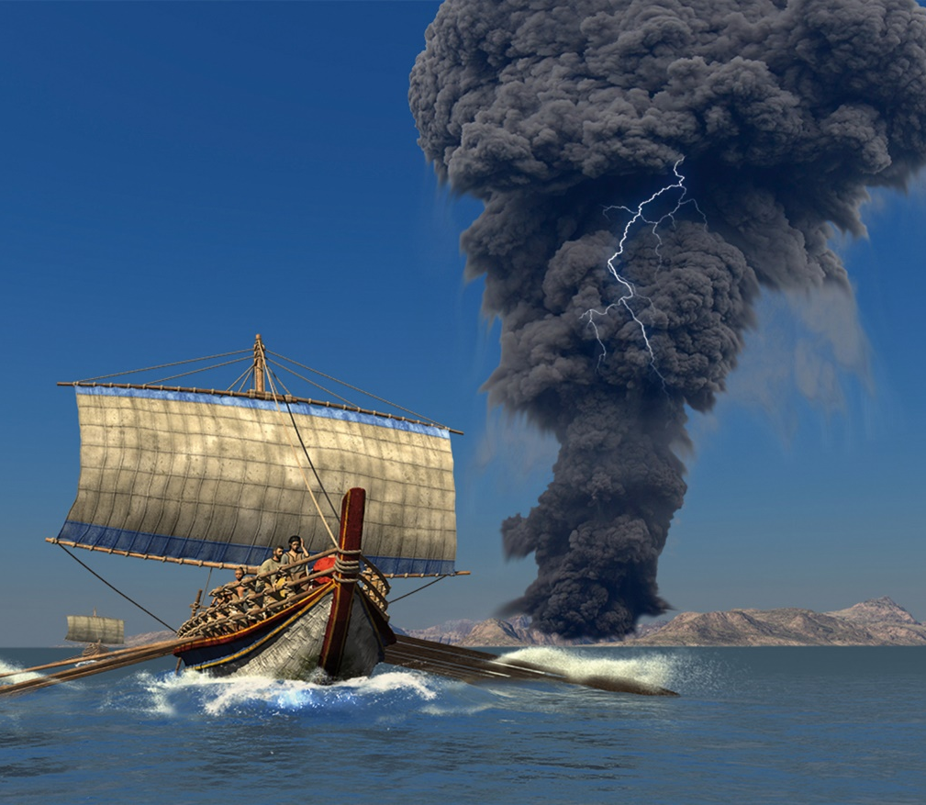
Attacks from the expanding Mycenaean weakened the Minoan civilization. Minoans disappeared so suddenly because of the massive volcanic eruption in the Santorini Islands. We know now that this eruption and the collapse of the volcanic cone into the sea caused tsunamis which devastated the coasts of Crete and other Minoan coastal towns. These events might be the basis for the legend of Atlantis.
Click Here!

Slide 11
The Mycenaean
Mycenaean is the term applied to the culture of Greece from ca. 1600 to 1100 B.C. The name derives from the site of Mycenae in the Peloponnesus, where once stood a great Mycenaean fortified palace. Many historians considered them to be the true first Greek civilization, instead of the Minoans, because Minoans didn’t speak Greek.

Slide 12
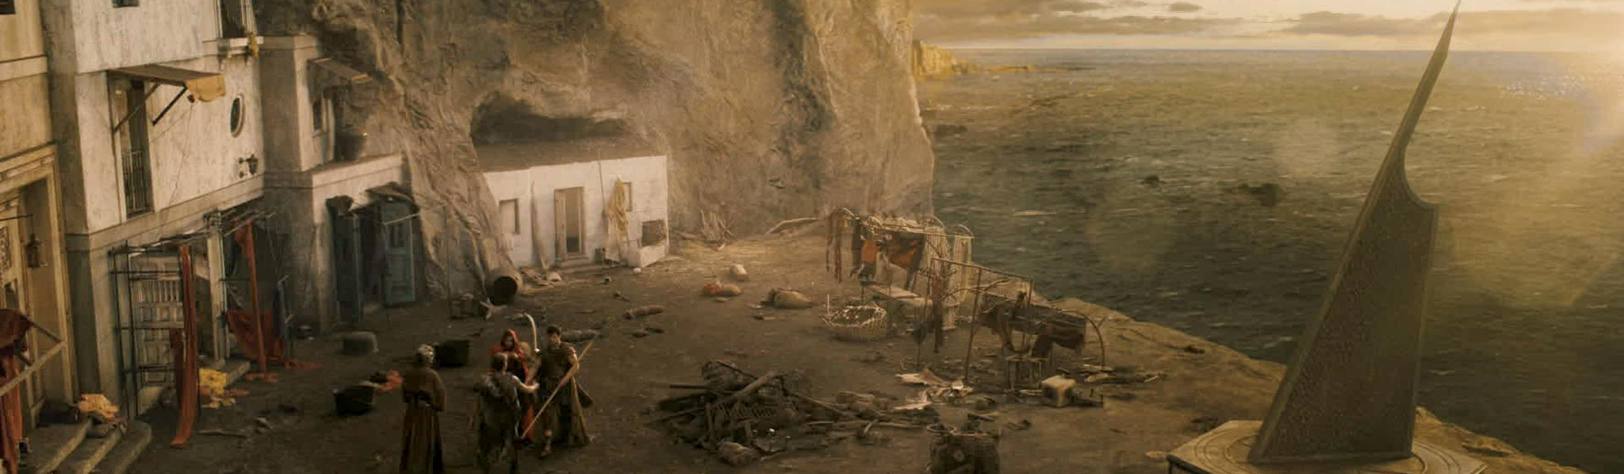
While the Minoans sailed through the Mediterranean, the Mycenaens, built fortresses all over Greece, mostly on the southern region. Mycenae, after which the Mycenaean take their name, was the largest fortress built by them.
They eventually took over Crete and became major trades in the area.

Slide 13
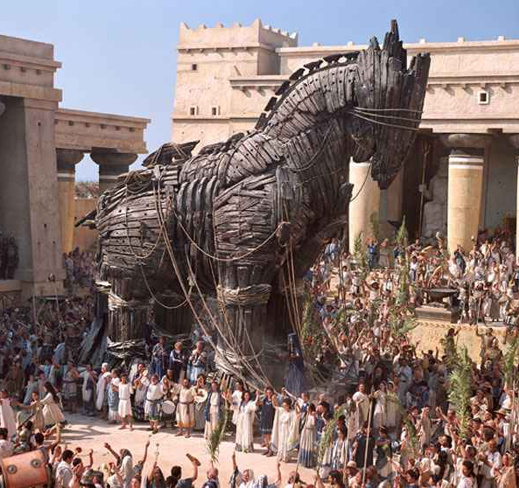
The Mycenaens traded with many different nations like Egypt, Cyprus, and Sicily. This trade brought in raw goods like ivory, copper, gold, and even glass. However they were not always peaceful people. Historians have hypothesized that the Mycenaens attacked the city of Troy, in Asia Minor. This was probably the basis to one of literature’s greatest works: Homer’s The Iliad.

Slide 14
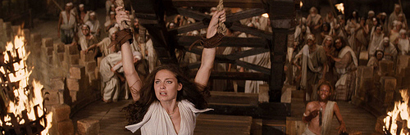
Mycenaens society declined after the 1200s BC when Dorian invaders from central Europe swept into Greece. In addition to this, several earthquakes badly destroyed many cities. As Mycenaean civilization declined, Greece entered a violent and chaotic period called the Dark Ages. Writing disappeared along with Mycenaean civilization so no written evidence exists for this mysterious period.
Click Here!

Slide 15
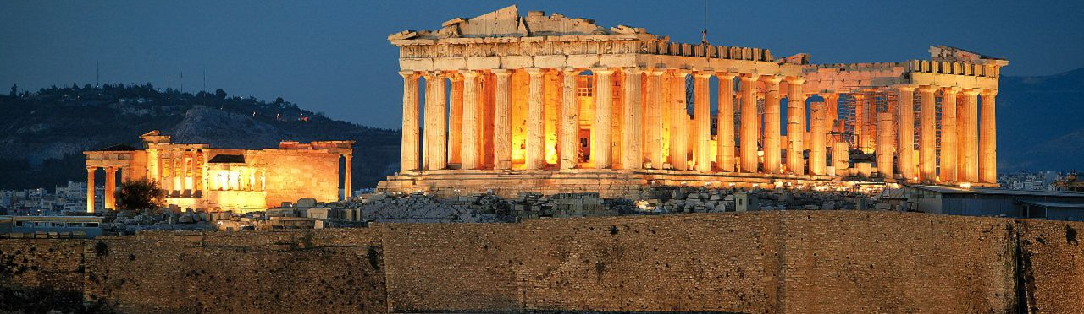
Greeks Create City-States
About 300 years after the Mycenaean civilization fell, the Greeks formed small groups for protection and stability. Over time these groups set up independent city-states called polis. This was the beginning of the Classical Age.

Slide 16
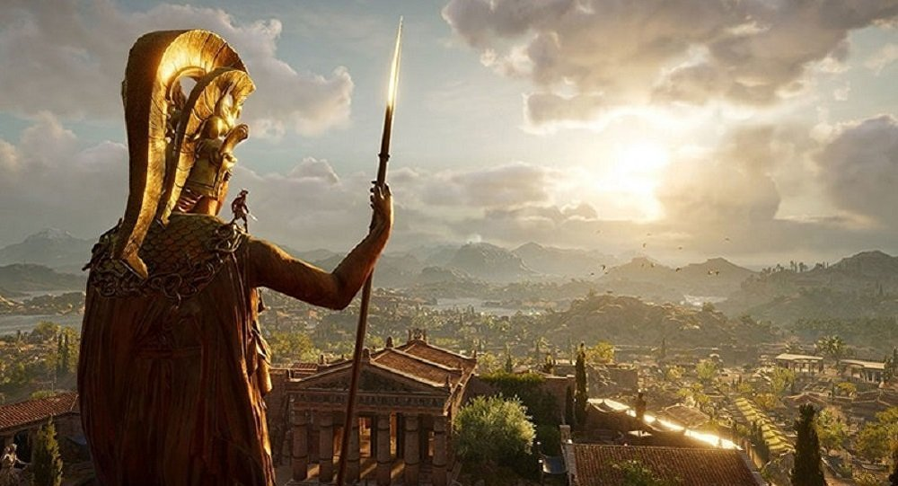
Most city-states (polis) in ancient Greece had at their center an Acropolis, or a rocky mound or hill where they built their important temples and where the people could retreat to if under attack. Acropolis means 'high city' in Greek.
It is the most characteristic monument of the ancient Greek civilization. The most famous acropolis is the one in Athens.

Slide 17
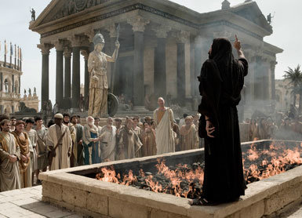
Another important space in a city-state was the agora, or open space serving as an assembly area and a place for commercial, civic, social, and religious activities. It could be used to celebrate public debates or as a bustling marketplace. In other words, it was the center of all aspects public life; political, economic, and cultural.

Slide 18
Final thoughts
Greece’s geography greatly impacted their civilizations.
The Greek civilization began with the Minoans and the Mycenaens.

Slide 19
NEXT
ATHENS
Jim Soto © 2018

