Slide 1
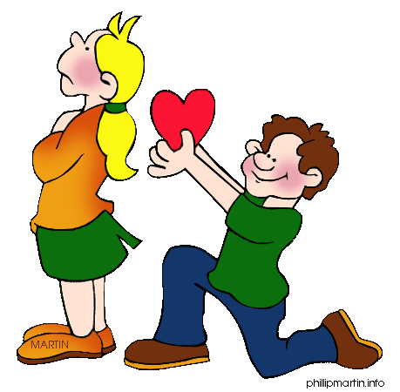
Q4
Poetry
Jim Soto

Slide 2
Lesson Objective
Learn the content and structure of poetry.
Analyze and explain what is good about poems.
Pages 323-328

Slide 3
A Bit of Context, Please?
All language fall under the 3 main categories. They are:
Prose
Drama
Poetry

Slide 4
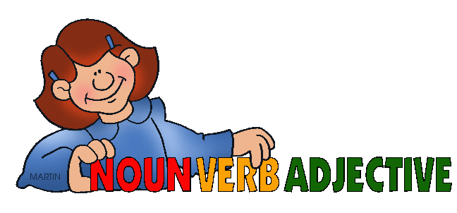
Prose
Prose’s main purpose is simply the communication, the exchange of information. We all speak using prose. Prose is usually divided into: fiction and non-fiction.

Slide 5
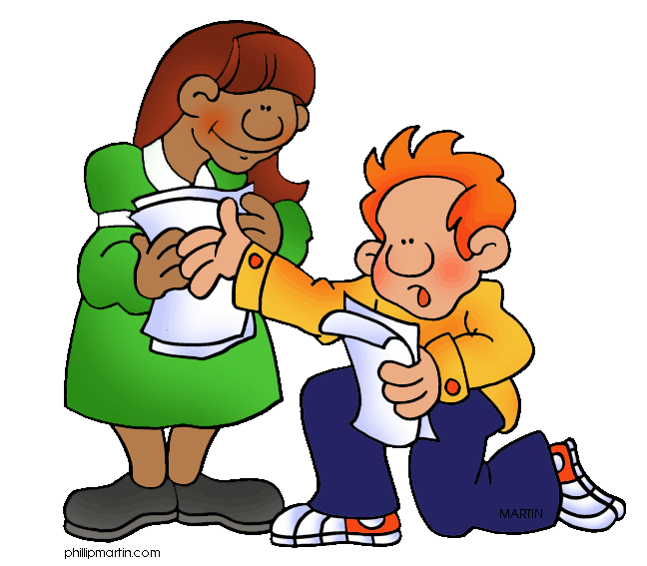
Drama
Drama
In literature, the word drama defines a genre, or style of writing. Drama is meant to be performed on a stage in front of an audience at the theatre. The word itself comes from the Greek word meaning 'action‘.

Slide 6
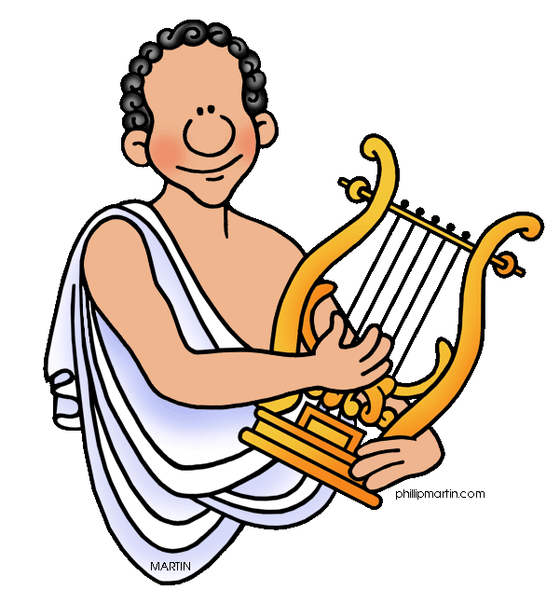
Poetry
Poetry’s purpose is entirely another. It deals with beauty.

Slide 7
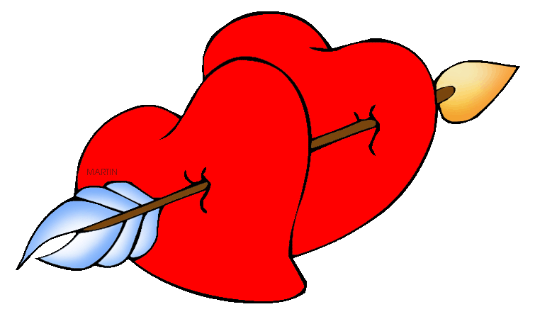
What is Poetry?
Poetry is the art of rhythmical composition, written or spoken, for exciting pleasure by beautiful, imaginative, or elevated thoughts.
In other words, it is mainly concerned with expressing the beauty of a language.

Slide 8
The Hawk
Checkout the Poetry Review in page 324 for the next couple of minutes to read the poem Teresha wrote. Then prepare for a group reading and discussion.

Slide 9
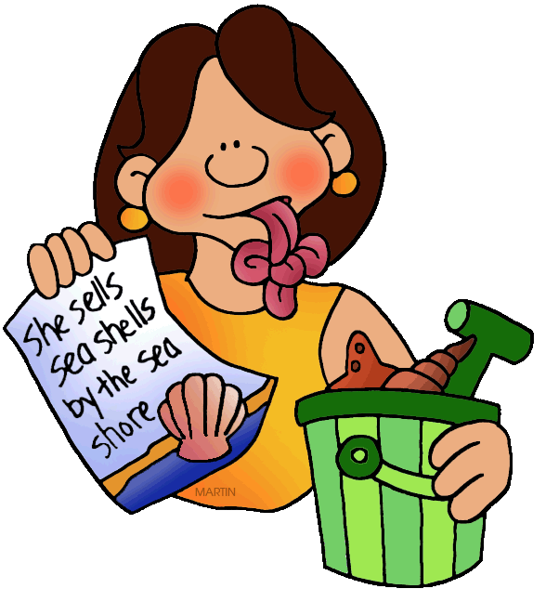
Poetry Uses...
Figures of Speech
Figures of speech is a tool that an author uses to help the reader visualize (or see) what is happening in a story or poem. The most common figures of speech are simile, metaphor, personification, and hyperbole.

Slide 10
Figures of speech include:
Simile A figure of speech which involves a direct comparison between two unlike things, usually with the words like or as.
Metaphor A figure of speech which involves an implied comparison between two relatively unlike things using a form of be. The comparison is not announced by like or as.

Slide 11
Figures of speech include:
Personification A figure of speech which gives the qualities of a person to an animal, an object, or an idea.
Hyperbole a way of ​speaking or writing that makes someone or something ​sound ​bigger, ​better, more, etc. than they are.

Slide 12
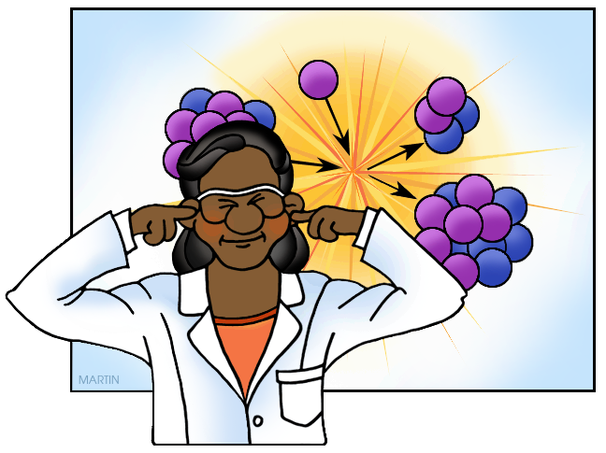
Poetry Uses...
Sounds
Poets use many techniques to make music out of words. The common sound effects used in poetry are also used in the songs you hear.

Slide 13
Poetry Uses...
Sounds of poetry include:
Alliteration - is the repetition of initial sounds in neighboring words. It’s also The matching or repetition of consonants. Example : The pompey pipped at the Post as Pippo pounces.
Assonance - takes place when two or more words close to one another repeat the same vowel sound but start with different consonant sounds. Example : Men sell the wedding bells.

Slide 14
Poetry Uses...
Sounds of poetry include:
Consonance - is typically used to refer to the repetition of ending sounds that are consonants anywhere within the word. Example : The lint was sent with the tent.
Onomatopoeia - is a word that phonetically mimics or resembles the sound of the thing it describes. Example : cuckoo, meow, honk, or boom.

Slide 15
Poetry Uses...
Sounds of poetry include:
Rhythm - is the pattern of stresses within a line of verse. All spoken word has a rhythm formed by stressed and unstressed syllables. When you write words in a sentence you will notice patterns forming.
Rhyme - A rhyme is a repetition of similar sounds (or the same sound) in two or more words, most often in the final syllables of lines in poems and songs.

Slide 16
Now go to pages 360-361 to find more figures of speech and poetic sounds, then complete the Try IT activity at the bottom of the page. Turn it in when completed.

Slide 17
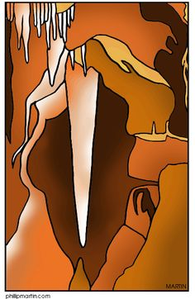
Writing a Poetry Review
Go to pages 324-325. Teresha’s review focused on the following elements:
MEANING▪ The 1st stanza described the topic.
IMAGERY ▪ The 2nd focused on the images.
SOUND▪ The 3rd deals with the poetic sounds.
THOUGHTS▪ The final stanza tells what Teresha thought of the poem.

Slide 18
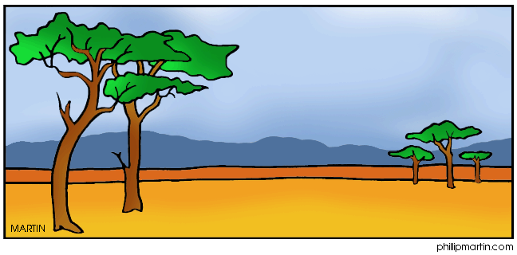
Read Flying with “The Hawk”, then complete the Respond to the reading assessment at the end. Prepare for a discussion in ten minutes.

Slide 19
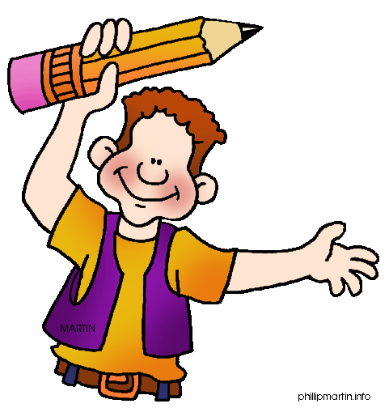
Homework
In your Skills Book complete pgs. 129-134.
Writing Complex Sentences Review
Sentence Expanding
Expanding Sentences with Phrases
MMM!

Slide 20
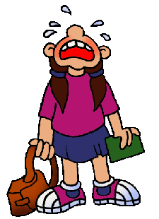
Next
Free Verse Poems
Jim Soto © 2016

