Slide 1
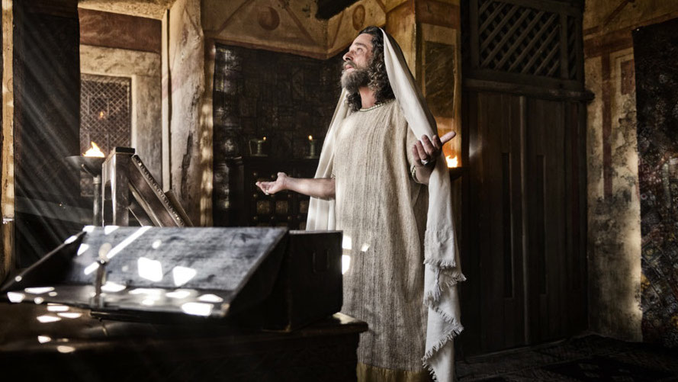
WORLD HISTORY
with Mr. Jim Soto
Judaism Over the Centuries

Slide 2
Think...
Foreign soldiers have taken over your homeland and are forcing you to obey their laws. So, some people are urging you to stand up and fight for freedom. But your conquerors come from a huge and powerful empire. If your people revolt, there will be little chance of winning. Will you join the rebellion?
Take a minute to write down why or why not.

Slide 3
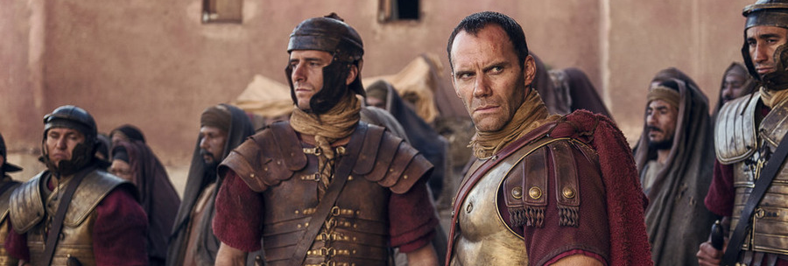
By 60 AD, many Jews in Jerusalem had to decide whether they would join a new rebellion against their foreign conquerors. For a little over a century, Judea had been under the rule of Rome. The Romans had a powerful army, but their disrespect for Jewish traditions was too much for many Jews.

Slide 4
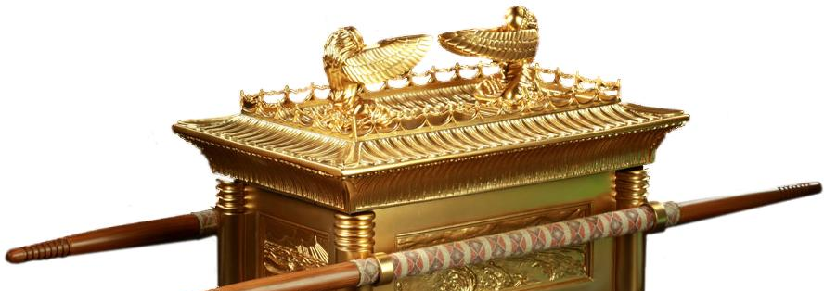
To learn more about this topic and others, read pages 214 thru 219 and complete the section 3 assessment. Show me the completed work when complete.

Slide 5
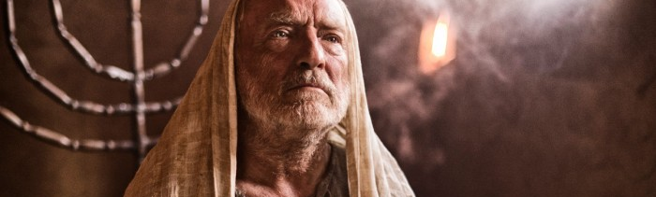
Revolt, Defeat, & Migration
During the first centuries BC and AD the Jews faced the biggest threat to their existence they had ever faced: Roman occupation! Zealots and Sicarii started a terrorist campaign to get rid of Rome.

Slide 6
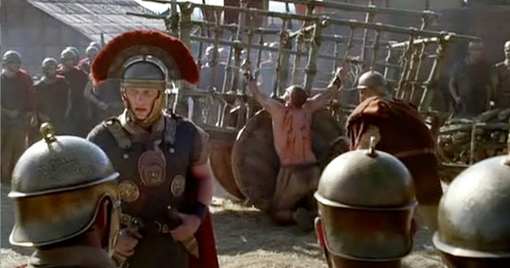
Open Revolt
The desire for independence, the corruption of both local and Roman governments in the area, and the clear hatred for anything Jewish brought about a riot in Caesarea in 66 AD. There, the Zealots, a rebellious band of nationalist anti-government Jews, wiped out the Roman-backed elites that had inhabited the area. This was the beginning of a four year war that didn’t end well for the Jews.
Click Here!

Slide 7
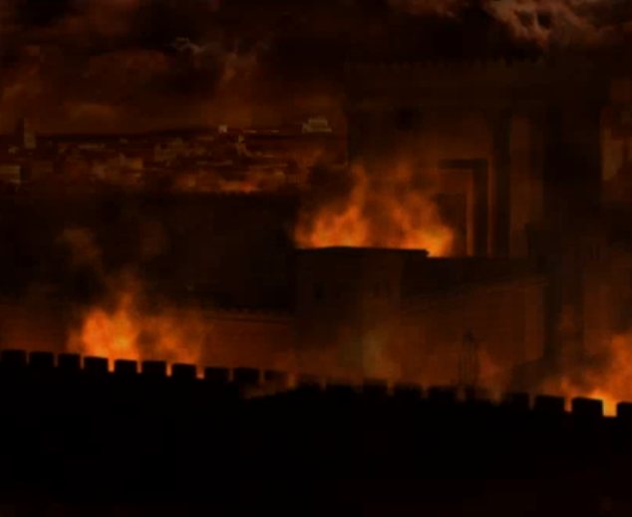
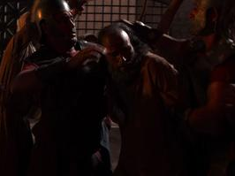
Emperor Nero, angry at the impudence of the Jewish rebels, sent the Roman military general Vespasian to destroy the rebel armies and punish the citizens in Judea. After killing around 10,000 Jews in Caesarea and northern Galilee, the Roman force arrived at Jerusalem to implement one of history’s most terrible sieges. By 70 AD, general Titus had the city and the Second temple laid a smoking ruin. All were either dead or surrendered, with the exception of a thousand…

Slide 8
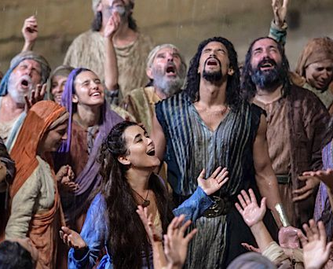
Masada
The surviving Jews were sold into slavery, except the thousand that escaped to the hard to reach mountain fortress of Masada. 15000 Roman soldiers were dispatched to capture them. The siege of Masada (73 -74 AD) ended in the mass suicide of all people, the Zealot/Sicarii rebels and their families hiding there. They’d rather die than become Roman slaves.

Slide 9
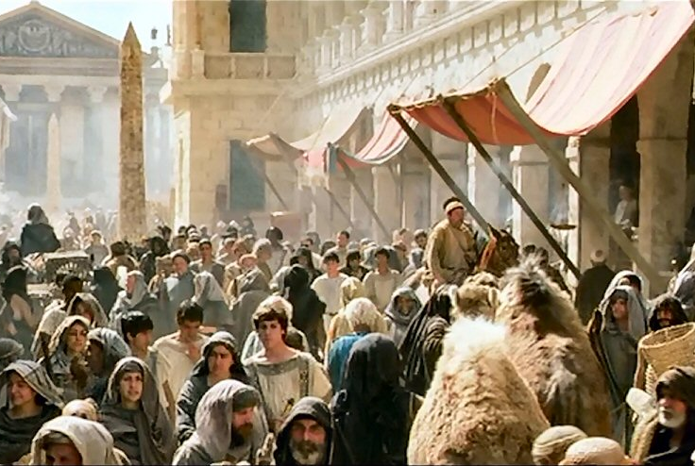
Results of the Revolt
After Masada, most of the Jewish population was either exterminated or taken to Rome. Since Jerusalem was uninhabitable the survivors moved to nearby cities or other parts of the Roman empire. The city of Alexandria (Egypt) in particular had a thriving Jewish population.

Slide 10
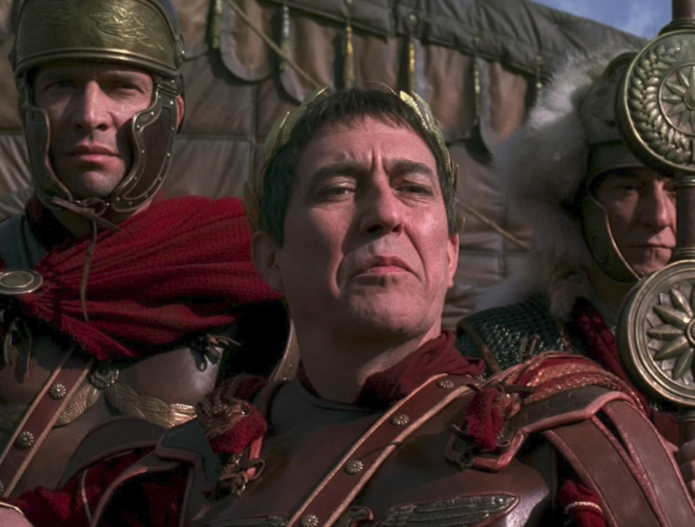
Second Revolt
Still, some Jews chose to linger around Jerusalem and raw about what had happened 60 years earlier, decided to begin another revolt. The Second Jewish Revolt (132–135 AD), against Roman rule in Judaea established an independent Jewish state, which lasted for three years. The leader Simon Bar Kokhba was slain, and the rebellion crushed in 135 AD.

Slide 11
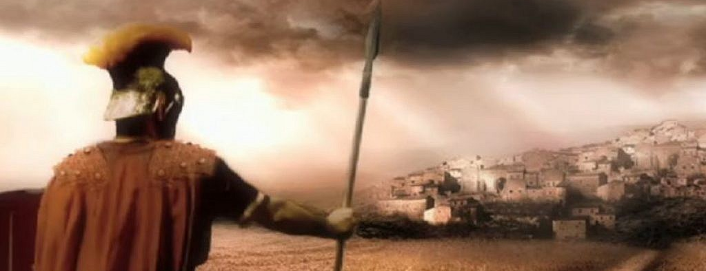
According to Christian sources, Jews were thenceforth forbidden to enter Jerusalem under pain of death. As a result of this Jewish migration to the Mediterranean increased greatly.

Slide 12
The Long Diaspora
Not being able to live in Jerusalem changed the nature of the Jewish religion. No longer having a single temple at which to worship made synagogues more important. Rabbis, or religious teachers, took the place of priests. They were responsible for interpreting and teaching the Torah. They helped shape the practice of Judaism for the next several centuries.

Slide 13
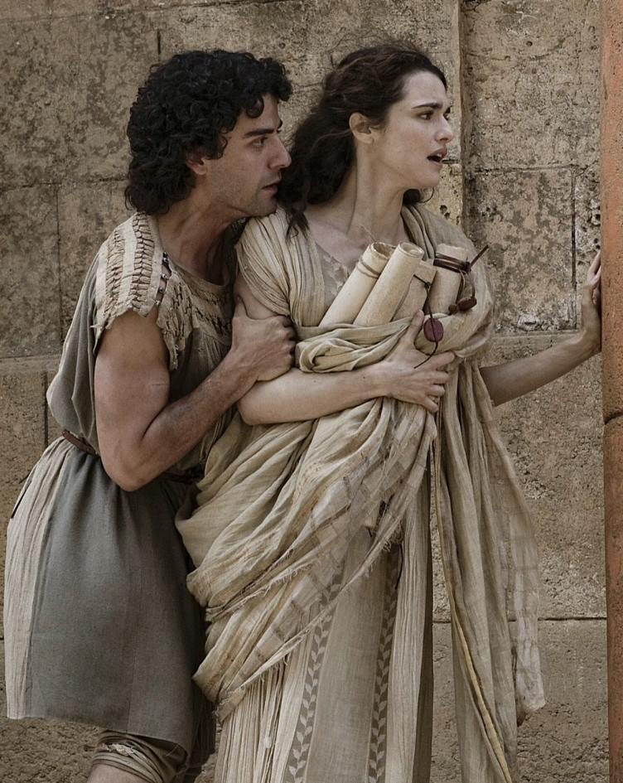
For a hundred years after the end of the revolt, all emperors viewed Judaism as a dangerous cult of trouble makers. Almost 2/3 of the world's Jewish population were killed by the Romans, and the dispersion of the Jews who remained meant that Jews would be the minority in virtually every place they lived for the next 2000 years. Settlement as a minority throughout the world meant that Jewish they would be easy targets for discrimination and abuse of every kind imaginable.

Slide 14
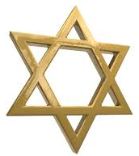
Two Cultural Traditions
From the mid-second century onward,
diaspora was the normative experience of Jews until the establishment of the state of Israel in 1948. During their exile in other lands new customs, languages, and rituals developed. Two main cultural traditions that still exist to this call our attention: The Ashkenazi and the Sephardim.

Slide 15
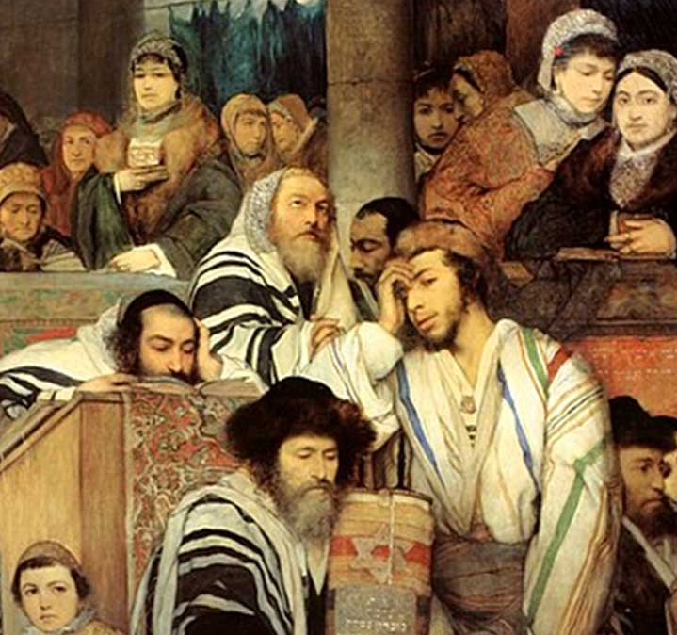
Jews in Eastern Europe
While the Jewish religion began in the Near East, and the Ashkenazi Jews were believed to have origins in the early indigenous tribes of this region, most Ashkenazi Jews mass converted to Judaism in the north Mediterranean around 2,000 years ago and later in west and central Europe. They developed their own language, Yiddish. Ashkenazi Jews make up the majority of Jews today.

Slide 16
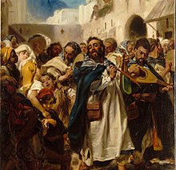
Jews in Iberia
Jew, of any ethnic origin, who follows the traditions of Sepharad. For religious purposes, "Sephardim" is most often used in this wider sense which encompasses most non-Ashkenazi Jews who are not ethnically Sephardi, but are mostly of West Asian or North African origin. They set communities throughout areas of Spain and Portugal, where they resided, evolving what would become their distinctive characteristics.

Slide 17
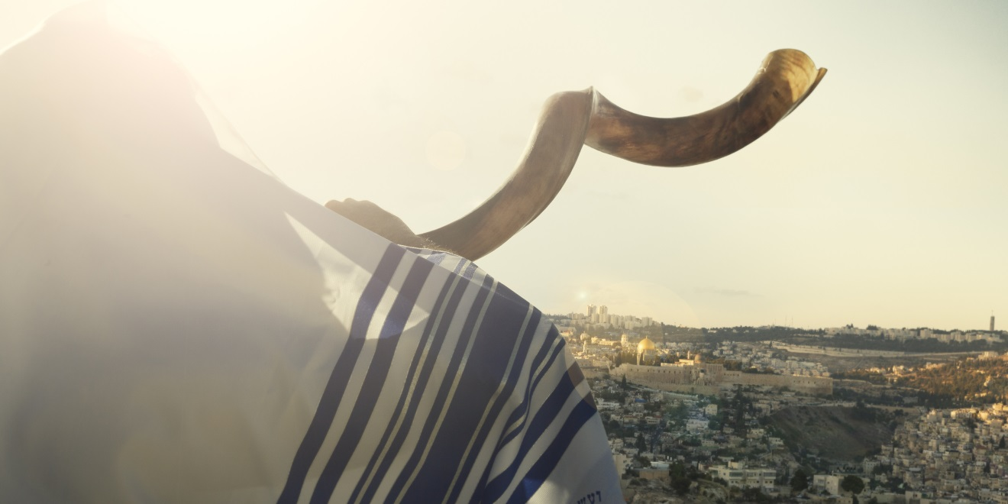
Traditions & Holy Days
As one of the world’s oldest cultures, Jews feel a strong connection to the past. They feel that understanding their history will help them be better Jews. That’s why the observance of traditions and holy days is so important.

Slide 18
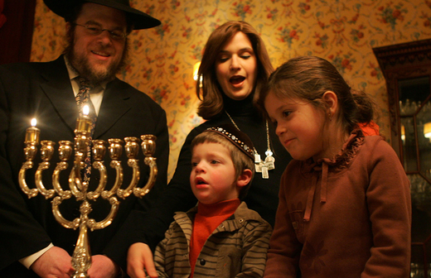
Hanukkah
The Hebrew word Hanukkah means rededication. Jewish festival, lasting eight days from the 25th day of Kislev (in December) and commemorating the rededication of the Temple in 165 BC by the Maccabees after its desecration by the Syrians. It is marked by the successive kindling of eight lights.

Slide 19
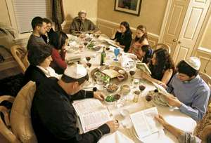
Passover
The major Jewish spring festival that commemorates the liberation of the Israelites from Egyptian slavery, lasting seven or eight days from the 15th day of Nisan. The Seder is observed to celebrate it. The Seder is a feast that includes reading, drinking wine, telling stories, eating special
foods, singing, and other Passover traditions.

Slide 20
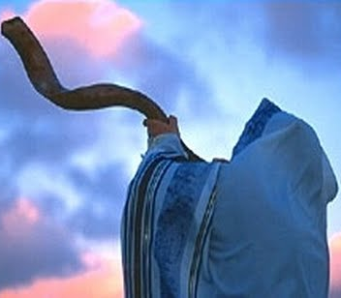
High Holy Days
Many Jews observe Rosh Hashanah, known as the New Year in the Jewish calendar, for two days, while others celebrate the event for one day. It is a time of family gatherings, special meals and sweet foods.
Yom Kippur is the day of atonement after the Jewish new year. On this day, Jews ask God for forgiveness for their sins to secure their fate. It's also known as the Sabbath of Sabbaths.

Slide 21
Final thoughts
The Jewish culture is one of the oldest in the world.
Over the course of their long history, their religion and traditions have helped them maintain a sense of identity and community.
This sense has helped Jews endure unimaginable hardships.

Slide 22
NEXT
THE
GREEKS
Jim Soto © 2018

