Slide 1
Q3
Persuasive Writing
Jim Soto

Slide 2
Lesson Objective
Learn the content and structure of a persuasive problem-solution essay
Plan, draft, revise, and edit a persuasive problem-solution essay
Pages 223-260

Slide 3
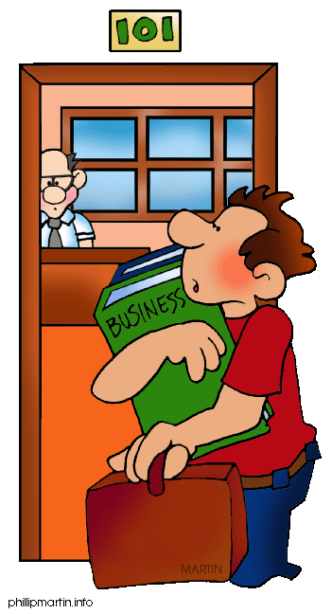
Writing a Persuasive Essay
Persuasive essays present a problem, convince readers that there is a need to fix the problem, and then offer a solution as the best way to accomplish it.

Slide 4
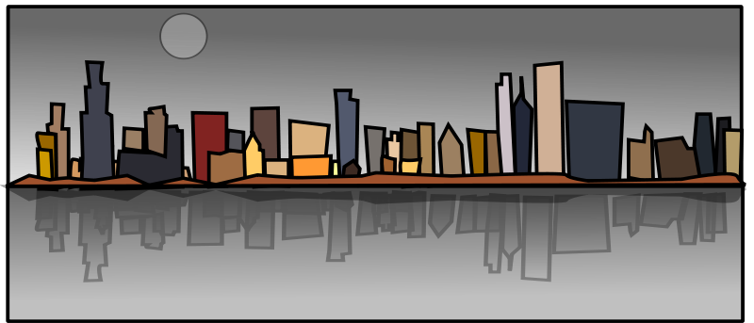
Reading Model
Read Waterfront Rescue, a problem-solution essay sample in pages 225-226, then complete the Respond to the reading assessment at the end. Prepare for a discussion in ten minutes.

Slide 5
Prewriting

Slide 6
Brainstorming!
Get together with your teammates to have a brainstorming session. Choose a topic idea from the following areas:
A neighborhood issue
A municipal issue
A Puerto Rican issue
A world wide issue

Slide 7
Starting a Problem-solution essay
neighbor’s dog
overgrowth
one bathroom
After brainstorming, a topic cluster can help you think of the problems around you.
city
home
noise pollution
problems
school
homework
no stage

Slide 8
Gathering Problem/Solution Chart
Problem- The school board may cancel science camp.
Why does the problem exist? | Why should it be solved?
Science camp costs $30 per student. | Without science camp, we wouldn’t get to do outdoor projects. mini-steam engine solar panels
This year the cost would be $3,000.
School’s budget has been cut. | Nature is the place to learn about nature. rock & plant id
The economy is in bad shape.
Everybody goes or nobody goes. | 6th graders want to save the camp.
Once you have chosen a problem, present it in a chart. In it, write several persuasive details as possible solutions.

Slide 9
Gathering Details About the Solution
Who?
what ?
Where ?
When ?
Why ?
how ?
Once you have chosen a solution, figure out how to implement it with a 5 W’s & H chart.

Slide 10
Plan Your Essay
An opinion statement names the problem and proposes a solution.
The problem
The solution
An opinion statement

Slide 11
Drafting

Slide 12
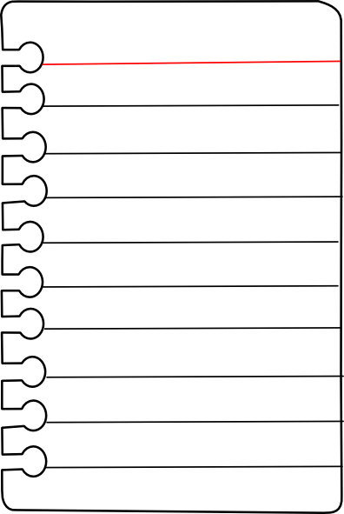
Keys to Effective Writing
Use your organized list or an outline as a planning guide.
Get all your ideas on paper in your first draft.
Write on every other line to make room for changes later.
Write a clear opinion statement.
Use specific details to convince your readers that the problem is serious and your solution will work.
Use clear logic and avoid “fuzzy thinking”.

Slide 13
Revising

Slide 14
Keys to Effective Revising
Read through your draft to feel how well your essay works.
Make sure your opinion statement names the problem and proposes the solution.
Make sure your paragraphs follow your writing plan.
Make sure your voice shines through.
Make sure your words and sentences are strong and clear.

Slide 15
Editing

Slide 16
Keys to Effective Editing
Use a dictionary, a thesaurus and the “Proofreader’s Guide” in this book.
Check for any words or phrases that might be confusing.
Check for punctuation, capitalization, spelling,and grammar.
Use the proofreading marks that appear in the inside cover of your textbook.

Slide 17
Publishing

Slide 18
Today you will start revising, editing and publishing to turn in your essay with all its steps next March 28, 2016, sharp!

Slide 19
Homework
In your Skills Book complete pgs. 123-128.
Writing Complex Sentences 1
Writing Complex Sentences 2
Writing Complex Sentences 3
doh!

Slide 20
Next
Taking Notes
Jim Soto © 2016

