Slide 1
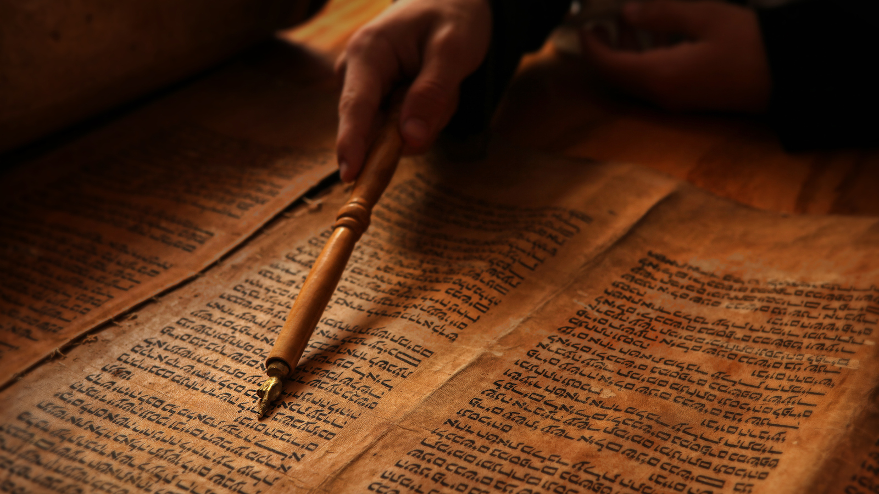
WORLD HISTORY
with Mr. Jim Soto
Jewish Beliefs & Texts

Slide 2
Think...
You live in a small town in Ancient Israel. Some people in your town treat strangers very badly. But you've been taught to be fair and kind to everyone, including strangers. One day, you tell one of your neighbors he should be kinder to strangers, He asks you why. How will you explain your belief in kindness to him?
Take a minute to write it down.

Slide 3
Leviticus 19:34 in the Hebrew Bible commands-
‘The stranger who resides with you shall be to you as the native among you, and you shall love him as yourself, for you were aliens in the land of Egypt; I am the LORD your God.’

Slide 4
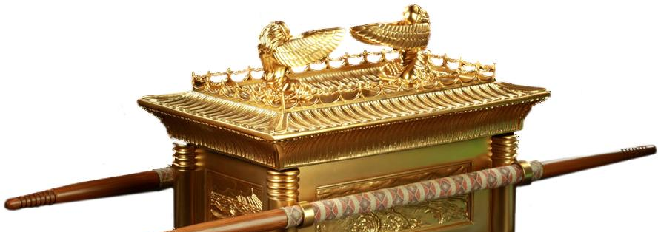
So as you see, the idea that we should treat people with kindness was already a common Jewish teaching. Sometimes, Jewish beliefs set them apart from other people in society. Their shared beliefs also tie them together as a religious community. Learn more about this topic by reading pages 208 thru 213 and complete the section 2 assessment. Show me the completed work when complete.

Slide 5
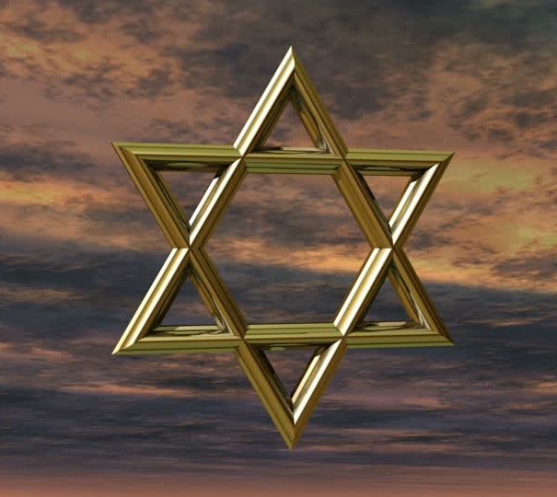
Jewish Beliefs Anchor Society
Their religion is the foundation upon which the Jews based their whole society. Much of their culture is based directly on their belief system. We can understand them better by examining their central beliefs on:
God
Education
Justice
Obedience

Slide 6
Belief in One God
Above, everything, Jews believe there is only one God. Yahweh, the god of the Israelites, whose name was revealed to Moses as four Hebrew consonants (YHWH) called the tetragrammaton. ... Thus, it became the artificial Latinized name Jehovah (JeHoWaH).
The belief in only one God is called monotheism. Judaism is the world’s oldest monotheistic religion. In the ancient world, this set them apart from everybody else.
Click Here!

Slide 7
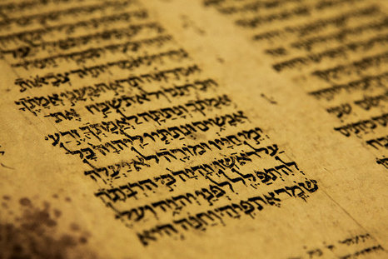
Belief in Education
Another foundational belief in Judaism is education. Raising up children in the basics of the Jewish faith has always been of great importance. However, in ancient times this was limited only to boys- not girls. Education continues being central to Jewish life to this day.

Slide 8
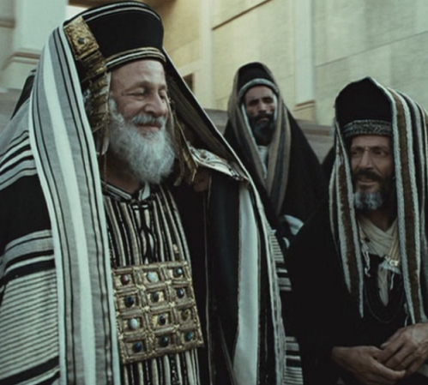
Belief in Justice & Righteousness
Yet, another foundational belief in Judaism are the ideas of justice and righteousness. In Jewish belief, justice means being fair and kind to others. EVERYONE deserves justice, even criminals.
Righteousness refers to doing what is proper. In Judaism, you are supposed to behave properly even if those around you don’t. Righteousness is more important than rituals or ceremonies.

Slide 9
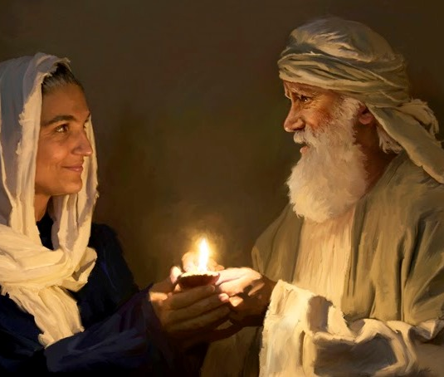
Belief in Obedience & Law
Morality and religious laws have guided Jews for centuries. The foundation of all the Jewish legal code is the Ten Commandments. But these are only part of a larger system of laws that were written down by Moses, thus the name Mosaic Law.
Mosaic Law governs all aspects of life such as: prayer, holidays, diet, etc.

Slide 10
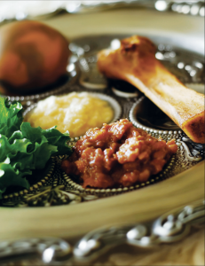
Two particularly important rules include:
The Sabbath- Jews are to separate the seventh day (between Friday & Saturday) of the week for resting from work.
Kosher- or fit, refers the rules governing what Jews can and cannot eat, and the proper preparation of these meals. For example, they cannot eat any shellfish or pork, because they are considered ritually unclean.
Click Here!

Slide 11
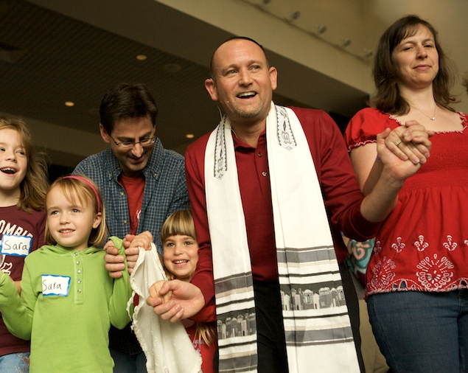
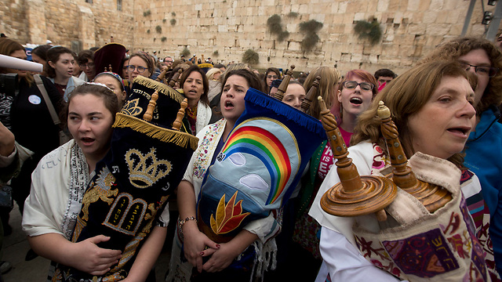
The 3 largest Jewish communities in the world today are:
ORTHODOX JEWS
Ultra-conservative branch. Believe in strict adherence to ALL the legal code and rituals of Judaism.
CONSERVATIVE JEWS
Moderate branch. Believe that some of the Mosaic code has to be updated or modernized.
REFORM JEWS
Liberal branch. What code?! If you don’t like it, throw it away!

Slide 12
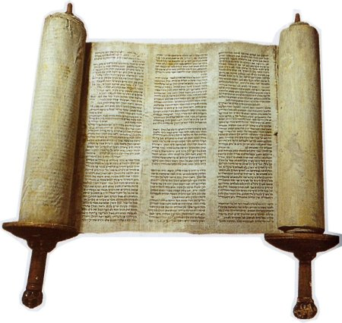
Texts List Jewish Beliefs
The principles and laws of Judaism are described in their sacred scriptures, or the Tanach (the Hebrew Bible) and explained in scholar written commentaries, or the Talmud, which contains in addition to commentaries, stories and folklore.

Slide 13
The Tanach
The Tanach consists of three parts of which the most important one is the Torah, the most sacred text in Judaism. Called the Pentateuch by Christians, It makes up the first 5 books of the scriptures.
Genesis (Bereshit: "In the beginning… ")
Exodus (Shemot: "Names")
Leviticus (Vayyiqra: "And he called… ")
Numbers (Bamidbar: "In the desert… ")
Deuteronomy (Devarim: "Words" or "Discourses")

Slide 14
The reading of the Torah during the Jewish religious service is central. Services are held at Jewish houses of worship called synagogues.
The Torah is only the first of 3 parts of the Tanach. The second is called the Prophets, who were men who received messages from God to teach others. The third parts consists of 11 books which include: poetry, songs, history, stories and sermons by lesser prophets.

Slide 15
The Talmud
The Talmud, or commentaries, appear in two versions : the quite large Babylonian Talmud (from the 5th century AD but includes earlier material) and the earlier Palestinian or Jerusalem Talmud. Jewish people revere it but do not consider the inspired literature, like the Tanach.

Slide 16
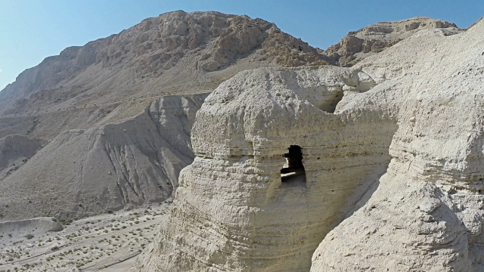
Scrolls Reveal Past Beliefs
One of the greatest archaeological discoveries to the 20th century was the discovery of the Dead Sea Scrolls, writings by Jews who lived in a community called Qumran about 2000 years ago.

Slide 17
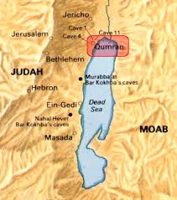
In 1947 a young boy taking care of some goats in the desert by the Dead Sea found a cave full of very ancient clay jars. Inside the jar were some very old written parchments. What had he stumbled across? Over a thousand manuscripts were discovered from around 250 BC – 70 AD, putting them in the Second Temple period and at time of the New Testament. Written mainly in Hebrew and Aramaic (with a few in Greek) they reveal the thought patterns of that movement in Judaism in that time.

Slide 18
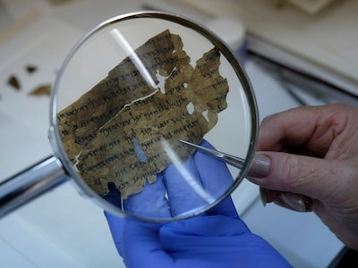
Why are the Dead Sea Scrolls so important? Comparing the text of the Dead Sea Scrolls to the Tanach (or Christian Old Testament) we have today (meaning the Masoretic text) we find them almost identical. This shows the Bible has not been corrupted for two thousand years! This is a fantastic testimony to the closeness of current texts to the long lost originals.

Slide 19
Final thoughts
Judaism is based in the belief in and obedience to God as described in the Torah and other sacred texts.
The influence of Jewish thought upon our civilization is undeniable and can be seen in our legal system, our ideas on work and rest, and the concept of helping the needy through charity.

Slide 20
NEXT
Through THE
Centuries
Jim Soto © 2018

