Slide 1
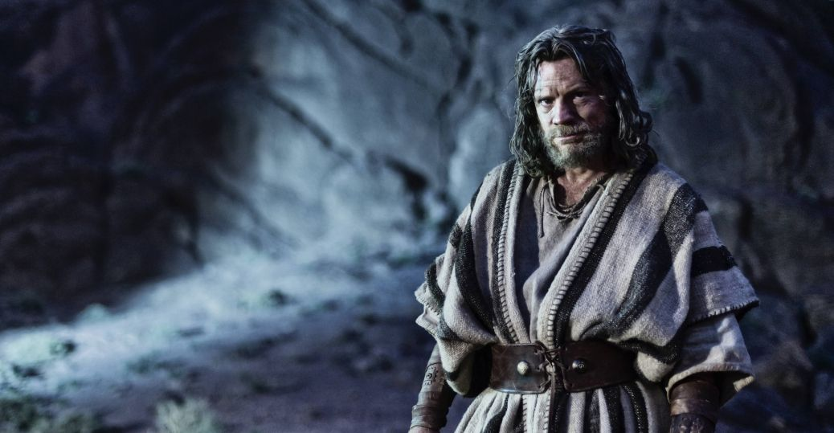
WORLD HISTORY
with Mr. Jim Soto
The Early Hebrews

Slide 2
Think...
You and your family are herders, looking after a large flock of sheep. Your grandfather is the leader of your tribe. One day you grand father says that the whole family will be moving to a new land where there is more water and food for your flock. The trip will be long and difficult.
How do you feel about moving to this distant land?
Take a minute to write down your answer.

Slide 3
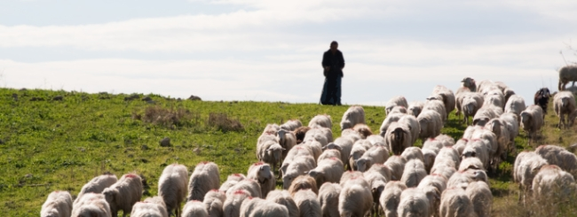
Like the family described above, the early Hebrews moved to new lands in Ancient times. According to Hebrew tradition, their history began when God told an early Hebrew leader to travel west to a new land.

Slide 4
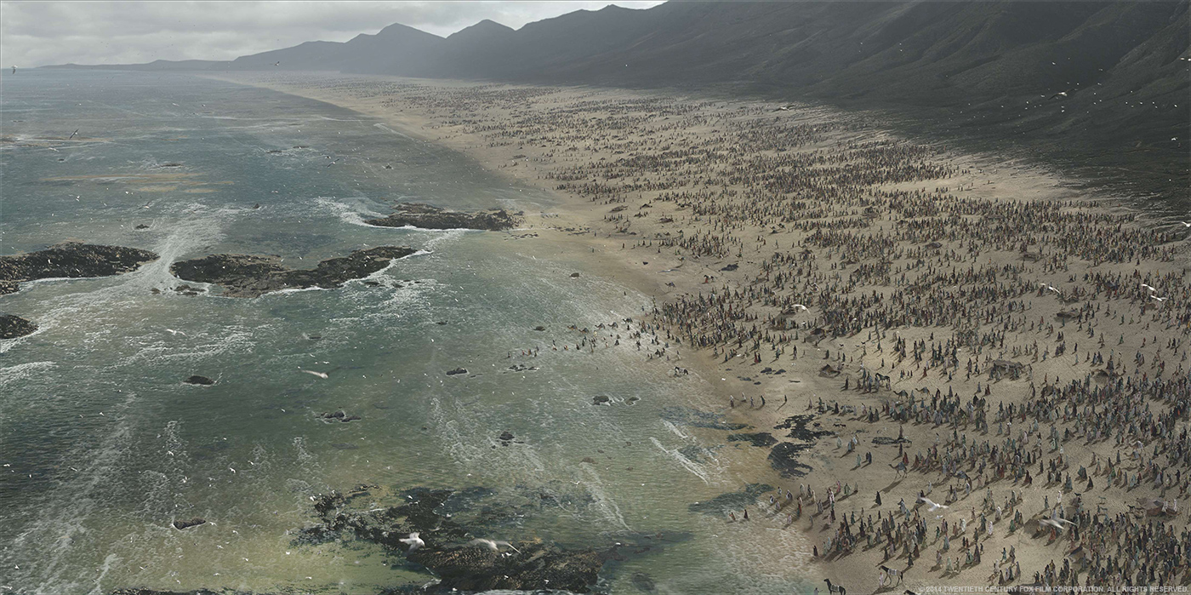
To learn more about this topic and others, read pages 202 thru 207 and complete the section 1 assessment.
Show me the completed work when complete.

Slide 5
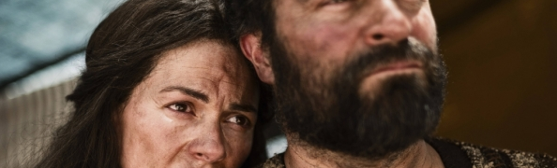
Beginning in Canaan & Egypt
Sometime between 2000 and 1500 BC a new people appeared in Southwest Asia. They were the Hebrews, simple herders that developed one of history’s most influential civilizations.

Slide 6
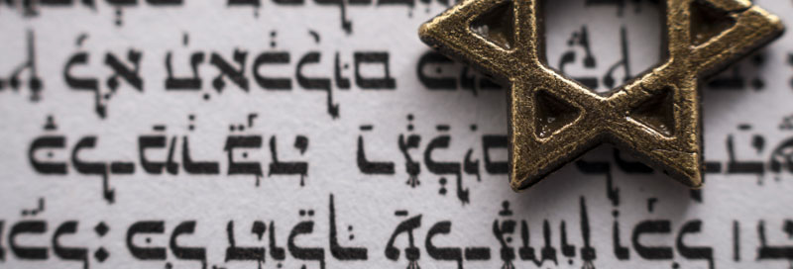
Most of what is known about these people’s history comes from archaeology and accounts written by Hebrew scribes. These accounts describe their early history and the laws of Judaism, the Hebrew religion. In time these accounts became the Hebrew Bible.

Slide 7
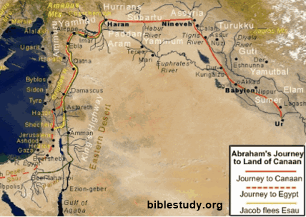
Hebrew scriptures trace the Hebrews back to a man call Abraham, a Mesopotamian from Ur. There he was instructed by God to leave Ur and travel west with his family where he was promised a new land for his descendants to become a mighty nation.
He came to settle in the land of Canaan where his descendants lived as herders for many years.
Click Here!

Slide 8
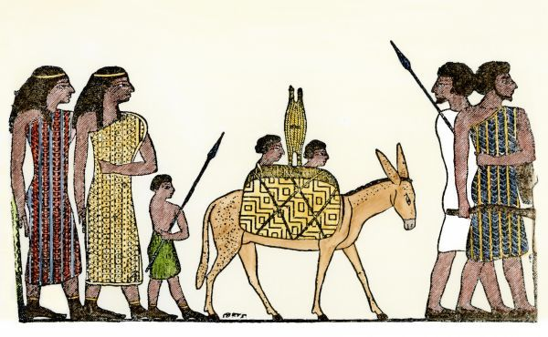
Years later, a famine force many Hebrews to move into Egypt. There they live relatively well for some years and flourished until an Egyptian pharaoh took notice and decided that their population was too large. Out of fear they would become too powerful, he enslaved them. Their enslavement was brutal.
Click Here!

Slide 9
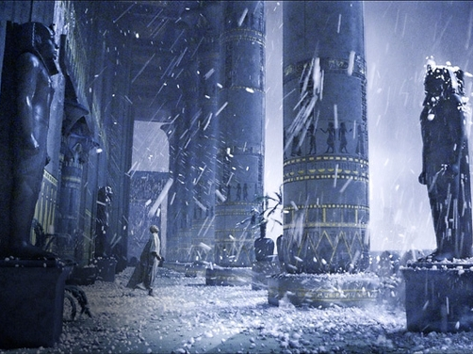
The Exodus
During this time Moses was born. The Hebrews had already been in Egypt for more than 400 years. In the 1200s BC, God told Moses to lead his people out of Egypt. He went to the pharaoh to demand the liberation of his people only to be denied.
Soon afterwards 10 terrible plagues or disasters struck Egypt. They proved to be so effective that the pharaoh relented.

Slide 10
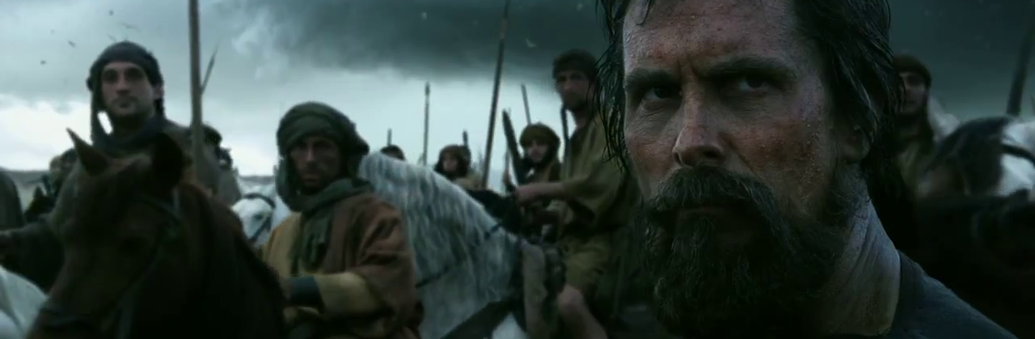
Moses lead the Hebrews out Egyptian enslavement in a journey called the Exodus. To the Hebrews, this was proof of God’s love and watchful protection. The Exodus is a defining moment in Hebrew history. This has been an inspiration for many people all over the world.
Click Here!

Slide 11
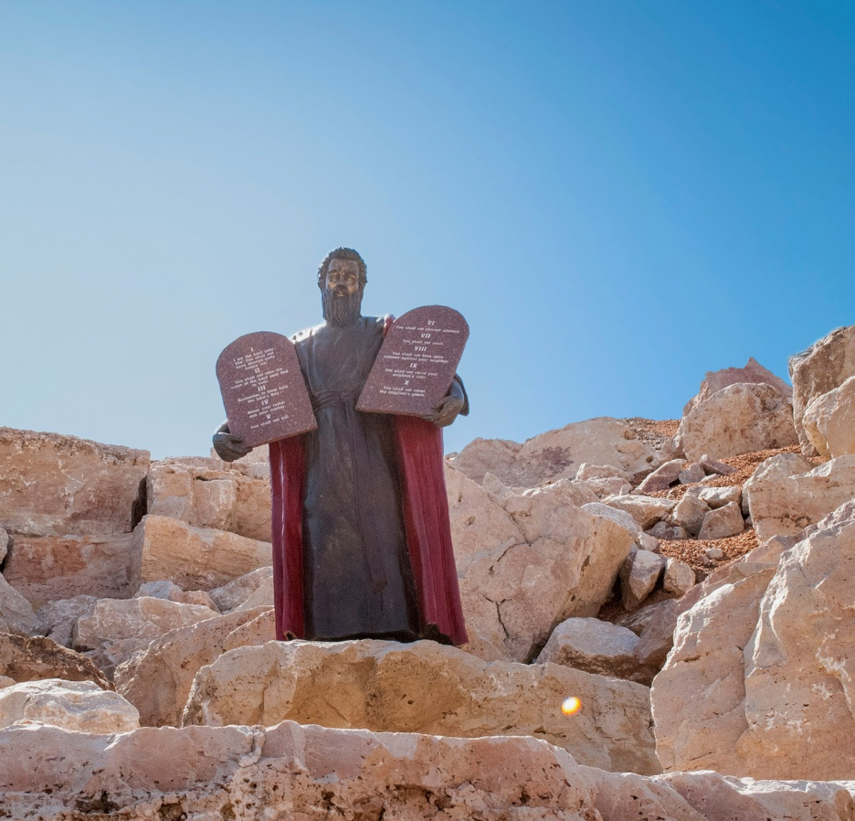
On their way to Canaan (AKA the Promised Land), they arrived at Mt. Sinai. On that mountain, it is said that Moses received from God, two stone tablets with a written code of moral laws known as the Ten Commandments.
By accepting these commandments, the Hebrews entered a covenant with God where they would only worship him and live just, moral lives.
Click Here!

Slide 12
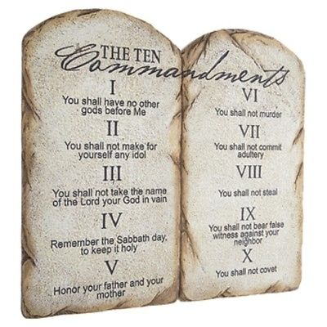

Slide 13
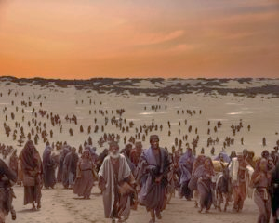
The Return to Canaan
After wandering through the desert for 40 years, the Hebrews arrived at Canaan, where they fought for control of the region before settling.
After this conquest and settling, the Hebrews became known as the Israelites. They lived in small scattered communities without a central government. These villages had judges that enforced the law and settled disputes.
Click Here!

Slide 14
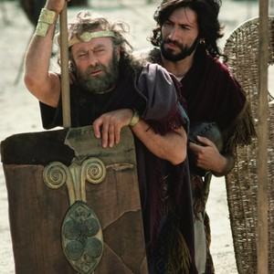
Kings Unite the Israelites
New threats arose that demanded a new type of leadership. This threat came from the Philistines who were descendants of the Phoenicians. In the mid 1000s BC the Philistines invaded the Israelite lands.
The Israelites decided to unite under one ruler that could lead them into battle. Thus, Israel’s 1st King was chosen: Saul. He proved to be quite ineffective as a leader.

Slide 15
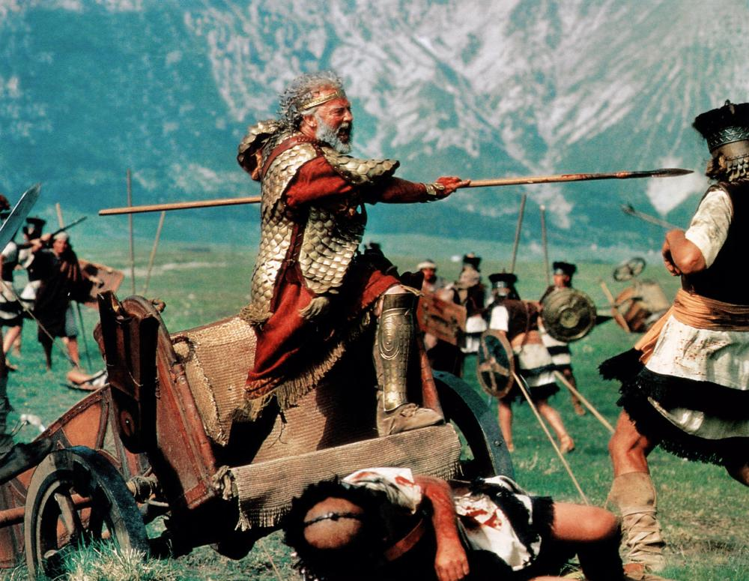
Saul also had a spotty record as a military commander. Later in his rule, he lost support of the tribal and religious leaders and often had strong disagreements with them. Eventually, he committed suicide after having a disastrous loss at the Battle of Mount Gilboa, during which three of his sons were also killed.

Slide 16
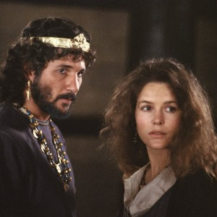
King David
From shepherd ,to giant slayer, to king, David’s life was truly remarkable. The young boy that slew Goliath, the Philistine’s mightiest warrior caught the attention of King Saul. As his popularity grew, so did Saul’s hatred and jealousy of him. This forced him to live as an outlaw for a time. When Saul died, popular support catapulted David to the throne of Israel.

Slide 17
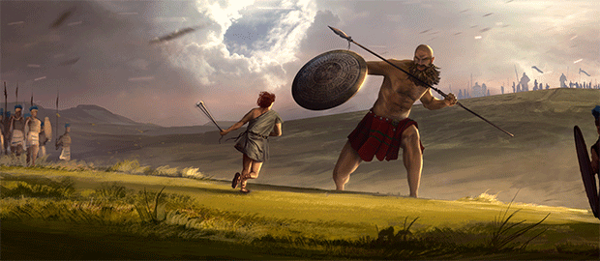
David was the warrior-musician-poet-king, that was responsible for the Psalms, one of the world’s most beautiful collection of poems and worship songs. He established Jerusalem as the capital of Israel.

Slide 18
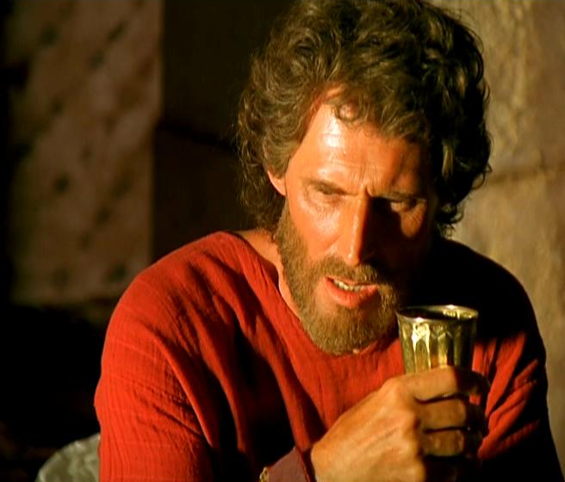
King Solomon
David’s son Solomon, considered on of the wisest men who ever lived, took the throne in 965 BC. He expanded his father’s kingdom and became allies with Egypt and Phoenicia. Trade during his rule made Israel very rich. With this wealth, Solomon built the Great temple in Jerusalem. This temple became the center of the Israelite’s religious life and a symbol of their faith.

Slide 19
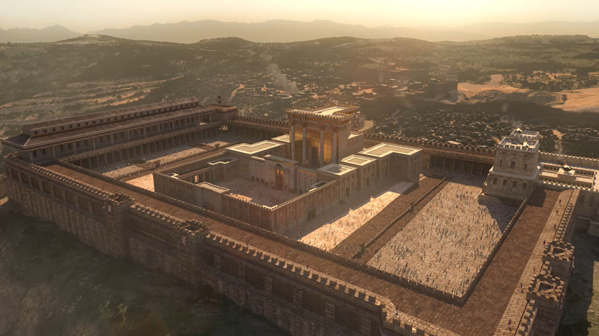
Civil War, Invaders & the Diaspora
After Solomon’s death, a number of weak rulers caused revolts to brake out over who should be king. Eventually this caused the kingdom to spilt into two. The northern part would remain Israel, but the south would known as Judah.

Slide 20
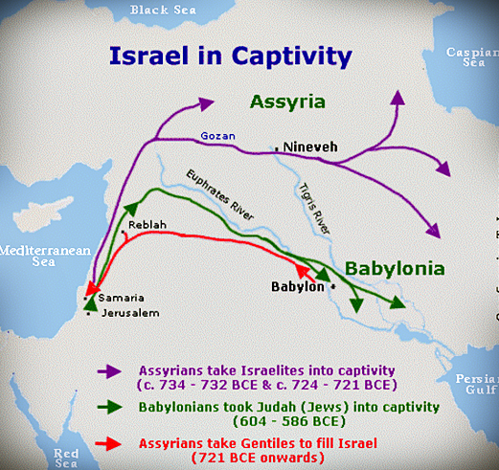
After several tumultuous centuries, both kingdoms were conquered. Israel fell to the Assyrians in 722 BC with most of its population scattering; and Judah fell shortly after to the Chaldeans.

Slide 21
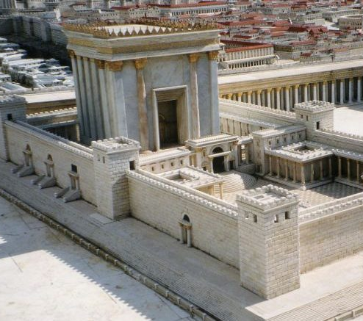
During the Chaldean siege of Jerusalem, Solomon’s temple was destroyed. Thousands of Jews were marched to Babylon, the Chaldean capital at the time. Their enslavement there lasted around 50 years.
During the 530s BC, the Persians conquered Babylon and allowed the Jews to return to Jerusalem. Most returned, however some remained in Persia. This scattering of Jews outside of their native land is called the Diaspora.

Slide 22
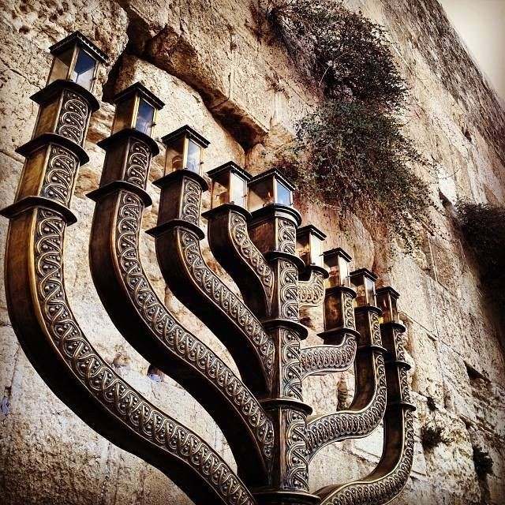
Independence and Reconquest
Although, the Jews were allowed back, they remained part of the Persian Empire. After the rebuilding of the temple and tired of foreign rule, a family nicknamed the Maccabees led a successful revolt in the 160s BC.
Jewish independence lasted until 63 BC, when Rome invaded Judah. The brutal Roman occupation would end in 70 AD with the siege of Masada and the destruction of Jerusalem.

Slide 23
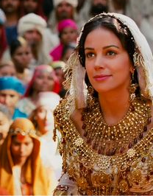
Hebrew Women
Hebrew society was patriarchal. Women had few rights. They had to obey their fathers and husbands, Marriages were arranged by the fathers. Women couldn’t own property unless they had no brother.
However, some Hebrew women made very important contributions to their society. Among them:
Queen Esther
Judge Deborah
Miriam
Ruth

Slide 24
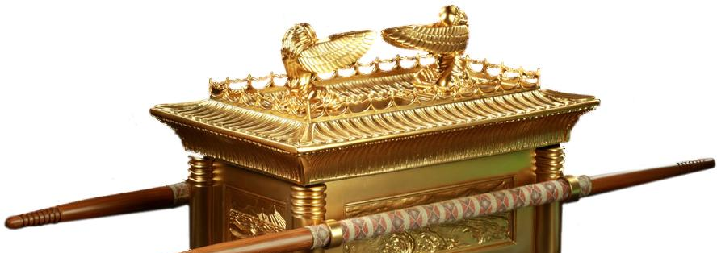
Final thoughts
The history of the Hebrews and Judaism began some 4000 years ago.
The instructions that Jews believe God gave to the early Hebrews shaped their religion: Judaism.

Slide 25
NEXT
BELIEFS
Jim Soto © 2018

