Slide 1
Q3
Writing
a Phase Autobiography
Jim Soto

Slide 2
Lesson Objective
Understand the content and structure of a phase autobiography
Use narrative writing skills to create a phase autobiography
Plan, draft, revise, edit, and share a phase autobiography
Pages 135-140

Slide 3
What is it?
A phase autobiography* tells about an extended period of time that has changed you in some important way and the effect it created.
* How is an autobiography different from a biography?

Slide 4
Intro Article
Take a minute and read the article in page 135.
How are our lives similar to a Saturn V rocket?

Slide 5
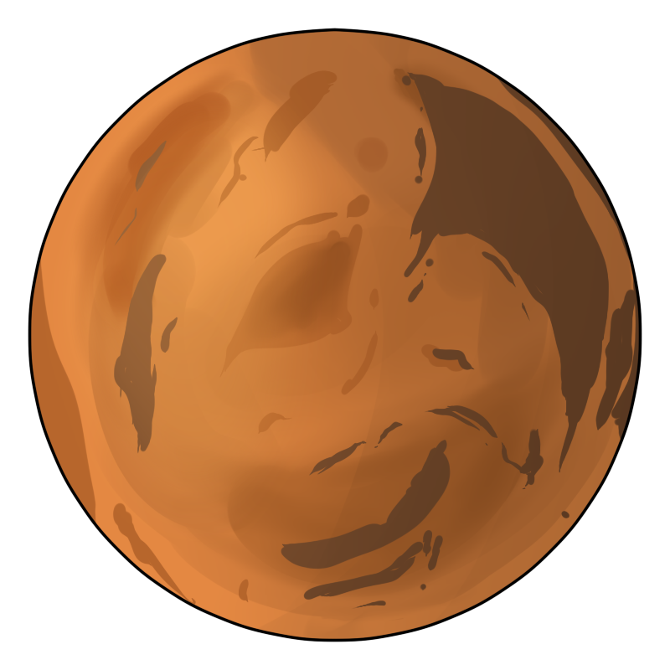
Reading Model
Read Rocket to Mars, a phase autobiography sample in pages 136-137 of your text book, then complete the Respond to the reading assessment at the end. Prepare for a discussion in ten minutes.

Slide 6
Prewriting

Slide 7
A Life Map is a great tool (graphic organizer) that helps you see the important events that have led your life to where you are today. Before you do your own, let’s analyze the map in the next slide.

Slide 8
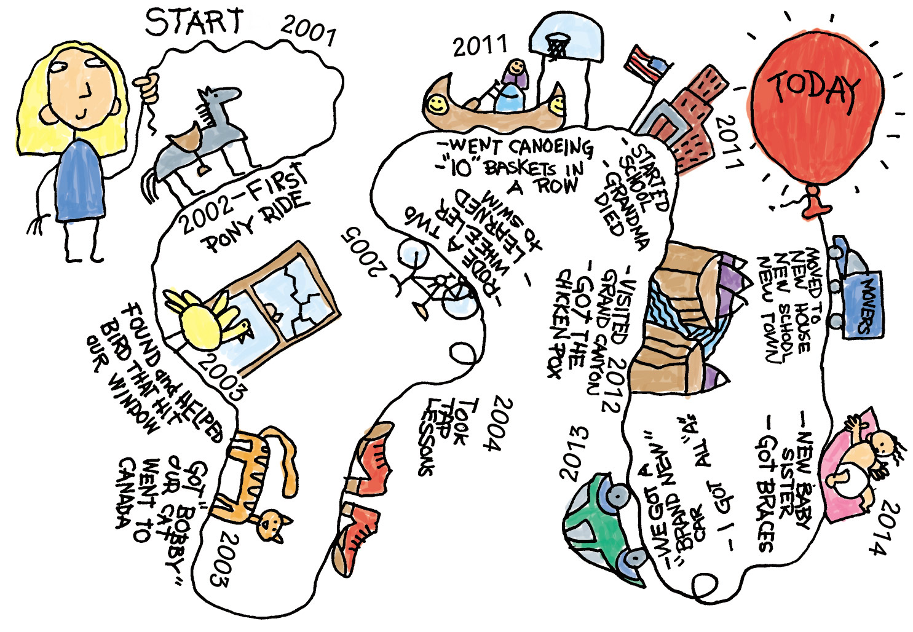
Selecting a Topic
A Life Map

Slide 9
Grouping Details
A Time Line
Write a time line. List the events in time order. In a phase auto- biography you can’t include every thing that happened, so you must choose the most important events. Andy, the boy from the textbook’s life map, made the following time line.
1. Dad gave me a sketchbook.
2. Dad lost his job at the factory.
3. I started drawing rockets.
4. Dad said we had to move.
5. My rockets became space stations.
6. Dad got a better job.

Slide 10
Drafting

Slide 11
Beginning, Middle, and End
BEGINNING ▪ Start with a first event.
Start in the middle of the action.
Start with an interesting fact.
MIDDLE▪ Be selective.
Use sensory detail.
Use action and dialogue.
Build to a high point.
ENDING ▪ Reveal why this stage was important.
Tell how the experience changed you.

Slide 12
Revising

Slide 13
Improve Your Writing
Revise your first draft keeping the following in mind:
IDEAS ▪ Have you focused on the most important details?
ORGANIZATION▪ Are your ideas presented in the best order?
VOICE ▪ Does the dialogue in your story sound natural?
WORD CHOICE ▪ Have you used strong nouns and verbs?
SENTENCE FLUENCY▪ Does the story carry the reader along smoothly from sentence to sentence?

Slide 14
Editing

Slide 15
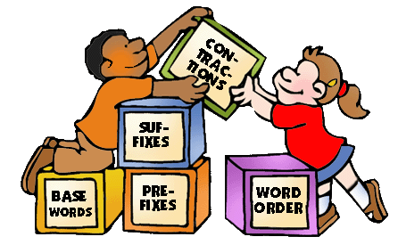
Conventions, Conventions, Conventions
While a phase autobiography is not as formal as a report, it should still be free of errors in punctuation,
capitalization, spelling, and grammar.

Slide 16
Publishing

Slide 17
Live it up!
As you work on your new story, follow the procedure in pages 138-142 of your text book, then complete the assessments at the end of each step.

Slide 18
Homework
In your Skills Book complete pgs. 115-118.
Combining Sentences with a Series of Words or Phrases
Combining Sentences with Compound Subjects and Predicates
boom!

Slide 19
Next
Writing a Persuasive Paragraph
Jim Soto © 2016

