Slide 1
WORLD HISTORY
The Han Dynasty & Contact with Others
with Mr. Jim Soto

Slide 2
Think...
You are a young Chinese student from a poor family. Your family has worked hard to give you a good education so that you can get a government job and have a great future. Your friends laugh at you. They say that only boys from wealthy families win great jobs. They think it is better to join the army. Will you take the entrance exam or join the army?
Take a minute to write down your answer and explanation.

Slide 3
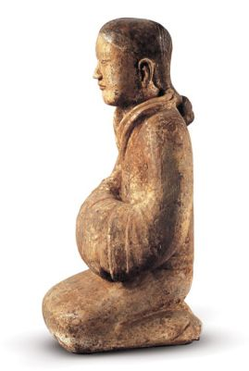
Part I: The Han Dynasty
Though it was harsh, the rule of the first Qin emperor helped to unify northern China. With the building of the Great Wall, he strengthened defenses on the northern frontier. But his successor could not hold on to power. The Qin gave way to a new dynasty that would last for 400 years.

Slide 4
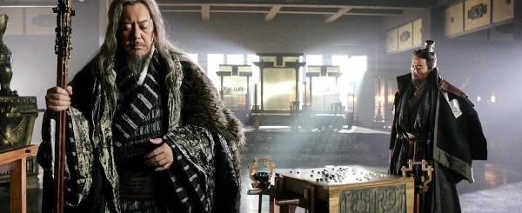
To learn more about this topic read pages 178 thru 185 and complete the section 4 assessment. Show me the completed work when complete.

Slide 5
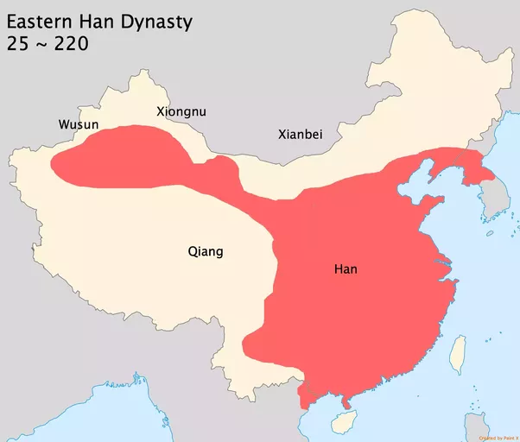
Rise of the Han Dynasty
Liu Bang (c.256-195 BC) and his army won the civil wars that followed the collapse of the Qin Dynasty, and was the founder of the Han Dynasty, which ruled with a short break for four centuries. Because of the belief in the Mandate from Heaven by the Chinese population, he was able to secure his power.
He was one of only two peasants or rose to become Emperor (the other being the founder of the Ming dynasty).

Slide 6
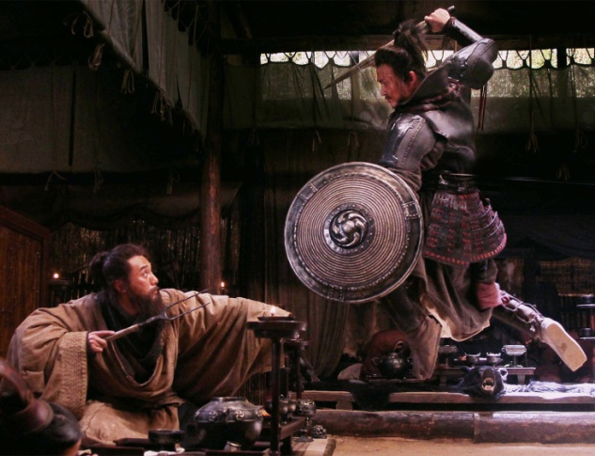
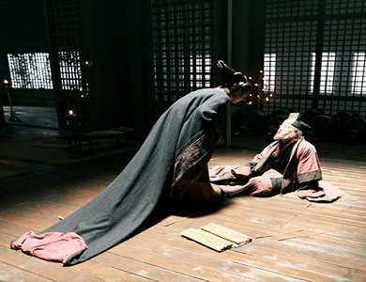
People were more comfortable with Liu Bang’s rule because his brand of Legalism was less strict than Shi Huangdi’s. With new government reforms that lowered taxes to the poor, improved education and made punishments less severe, Liu Bang ushered in a 400-year period of prosperity—sometimes referred to as China's first golden age.

Slide 7
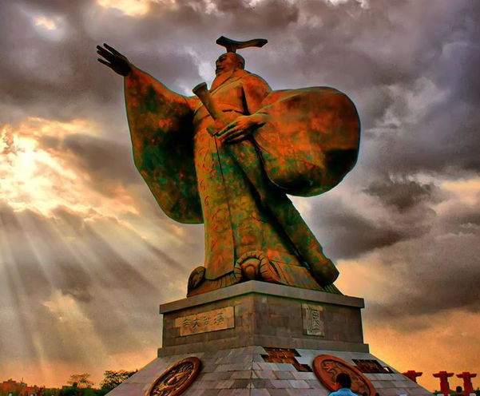
Wudi Creates a New Government
Emperor Wudi of Han, was the seventh emperor of the Han Dynasty. He ruled the empire from 141 to 87 BC. Emperor Wudi inherited the Han empire when he was 15. He expanded the empire. By 101, Wudi's troops had extended Chinese control in all directions. Wudi is also known for making Confucianism the official state religion.

Slide 8
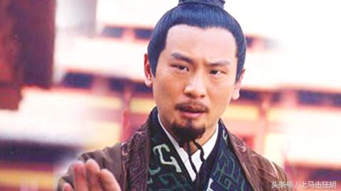
Wudi learned from his father’s rule – treat your people well and they in turn will not rise up against you. He established an academy to train young men in the classics to assure a line of Confucian-thinking government officials. The academy grew to more than 10,000 by the end of the dynasty.

Slide 9
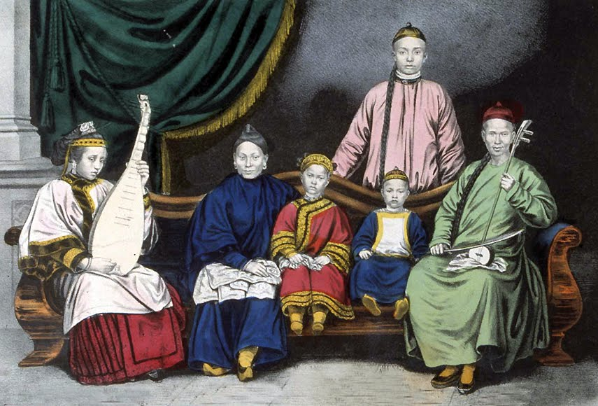
Family Life
The daily life in China had become much better during the Han Dynasty, particularly during Wudi’s rule.

Slide 10
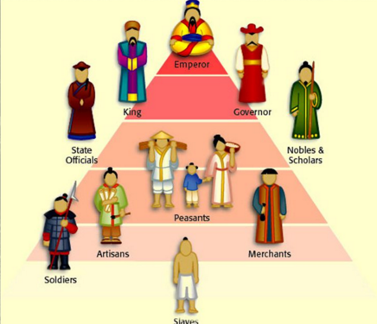
Social Classes
The Han dynasty was characterized by a strong social class structure based on Confucianism. Yes, it was divided into different social classes with a very clear definition within each social class. It comprised of a three-tier system with the emperor at the top, followed by his court, officials and scholars, peasants, and finally merchants.

Slide 11
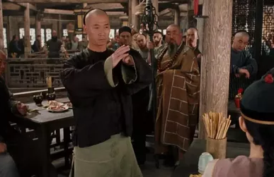
The Rich & the Poor
Interestingly enough, social rank was not necessarily an indicator of wealth or power. For example, although peasants were in a higher tier than merchants, they were much poorer. Many merchants held much wealth and power in spite of being at the social bottom.

Slide 12
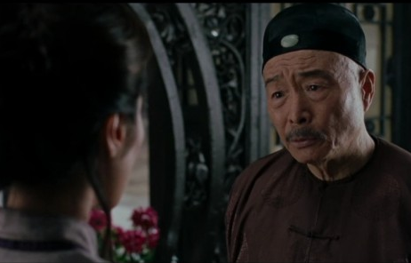
The Revival of the Family
Most of the Han lived in a two-parent family group, and usually had two or three children. The father was the head of the house, based off Confucius' relationship models that emphasized a patriarchy. Being obedient to the father figure was highly valued in Han society. It was vital to have sons because they continued the family line, as well as performed rites for ancestors.

Slide 13
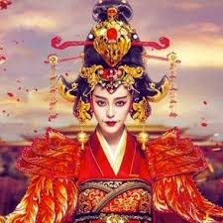
Women, however, did have some rights: they were protected by the law, and often worked outside the home in various professions. There were also ways for women to work around the patriarchal system to wield power. An emperor's mother could override him/his laws, and his wife had a fair amount of power as well.

Slide 14
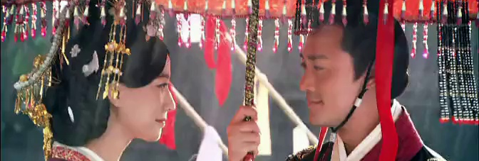
Marriages were arranged as bonds between two “clans”. Once married, a woman became part of her husband's clan. Men usually married around 17, and women around 15, as unmarried women were often taxed heavily. Commoners usually only married once, but richer men often married many times, or supported concubines.

Slide 15
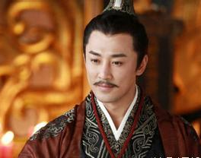
Han Achievements
Han rule was a time of great accomplishments in art, poetry, literature, medicine, infrastructure and innovations. The largest Chinese historiographical work, known as the “Records of the Grand Historian” or Shiji, was written during the Han Dynasty by Sima Qian, who is referred to as the father of Chinese historiography.

Slide 16
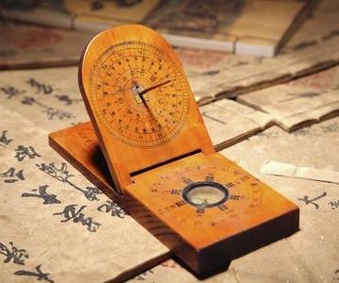
The sundial is a clock that uses the position of the Sun to indicate the time. Typically a rod casts a shadow upon a plane or surface. On this surface are found markings that indicate the time by the position of the shadow.
Additionally, the seismograph, an instrument scientists use to measure the strength of an earthquake, was of great interest to Han emperors.

Slide 17
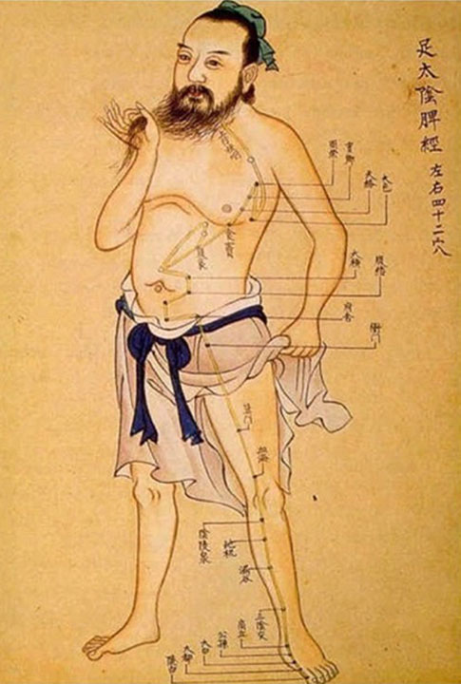
Acupuncture, which appeared during Han rule, involves the insertion of very thin needles through your skin at strategic points on your body to treat pain. Increasingly, it is being used for overall wellness, including stress management.

Slide 18
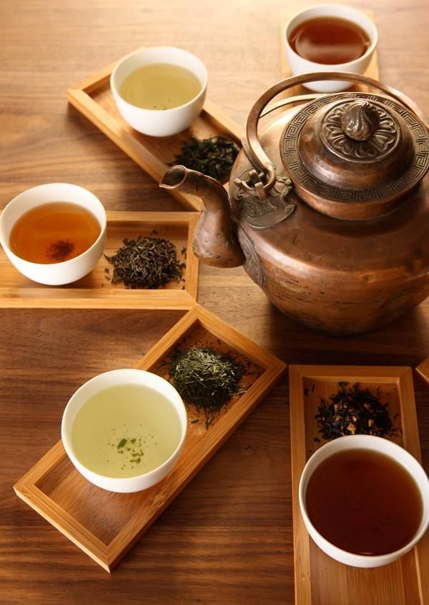
Other ancient Chinese inventions include:
Paper Making 105 A.C.
Movable Type Printing 960-1279 AD.
Gunpowder 1000 A.D.
Compass 1100 A.D.
Alcohol 2000 BC-1600 BC.
Mechanical Clock 725 A.D.
Tea Production 2,737 BC.
Silk 6,000 years ago.

Slide 19
Part II: Han Contacts with Other Nations
During the Han dynasty Chinese society returned its focus to Confucian ideas, and new inventions were developed. In addition, increased trade allowed other countries to learn about the rich culture of China.

Slide 20
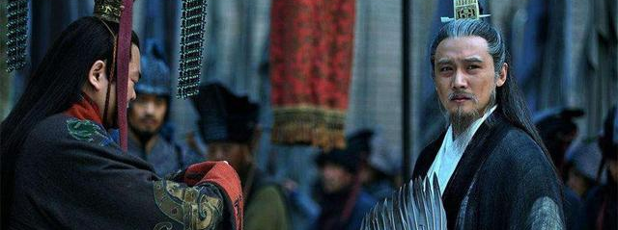
To learn more about this topic read pages 1?? thru 1?? and complete the section 5 assessment. Show me the completed work when complete.

Slide 21
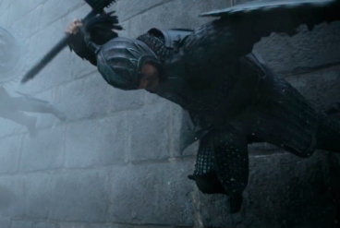
Farming & Manufacturing
Advances in manufacturing during the Han period, resulted in increased productivity that paved the way for China to open up and contact other people of other cultures.
At this time, the Chinese were master ironworkers. Iron armor and weapons made the armies of the time more powerful. Iron plows and wheelbarrows improved farming.

Slide 22
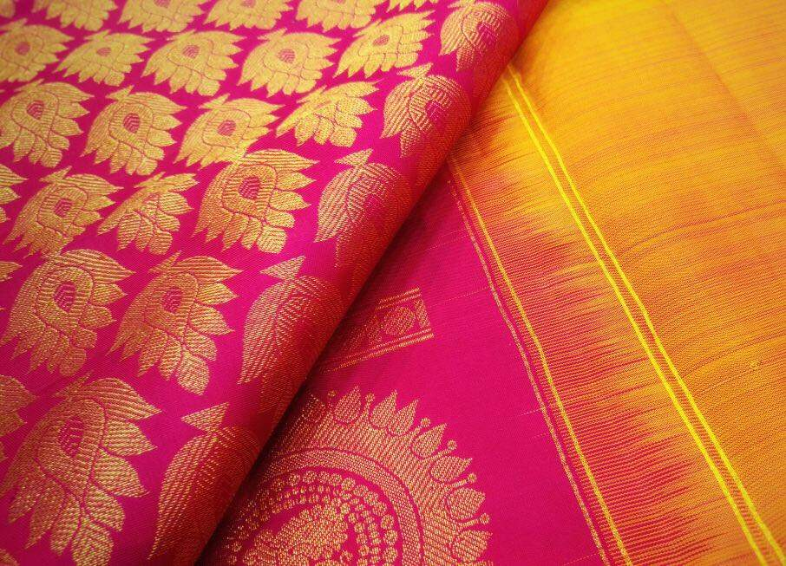
Silk, a delicate, soft, highly valued cloth made from a thread produced by silkworms, was a valuable Chinese commodity. The process of its production was a highly guarded secret that if breached was punishable by death.

Slide 23
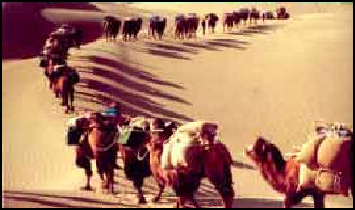
Trade Routes
Han conquests in Central Asia helped improve trade. The most important route was known as Silk Road, not an actual road, but a 4,000-mile long network of trade routes that connected China to Europe, the Middle East and North Africa. Bandits made travel along the Silk Road very dangerous.

Slide 24
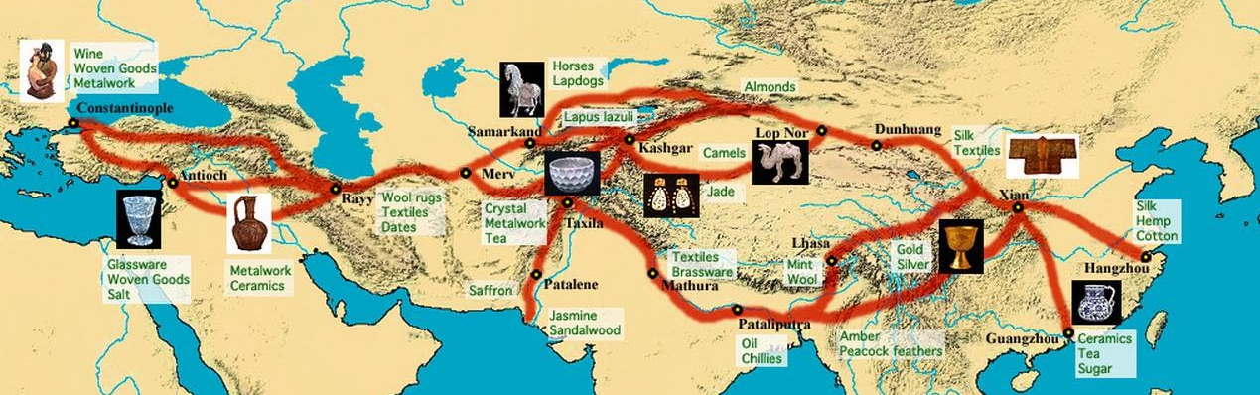
It was very rare for the large, well protected Chinese caravans to travel the whole distance since the trade system functioned as a chain. Chinese traders would unload their goods in Central Asia. Merchants from faraway places such as Rome, were shipping goods back and forth from one trade center to the other. In addition to silk, major commodities traded included gold, jade, tea and spices.

Slide 25
Buddhism Comes to China
Buddhism was It was introduced to China through the Silk Road, by monks from India during the latter part of the Han dynasty (ca. 150 CE) and took over a century to become assimilated into Chinese culture. One of the key forces of Buddhism's success was Daoism. Both Buddhism and Daoism benefited from this exchange.

Slide 26
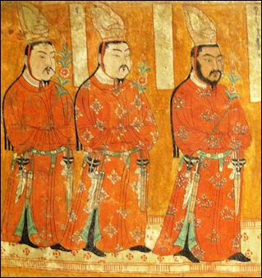
The Buddhism that first became popular in China during the Han dynasty was deeply colored with magical practices, making it compatible with popular Chinese Daoism (a combination of folk beliefs and practices and philosophy). Many Chinese saw in Buddhism’s message a more hopeful religion. Later Chinese emperors worshiped Lao-tzu and the Buddha on the same altar.

Slide 27
Final thoughts
Han rulers moved away from Legalism and based the new government on Confucianism.
Under the Han China flourished into a stable and prosperous society.
Contact with other people brought Buddhism into the country.

Slide 28
NEXT
TEST 2
Jim Soto © 2018

