Slide 1
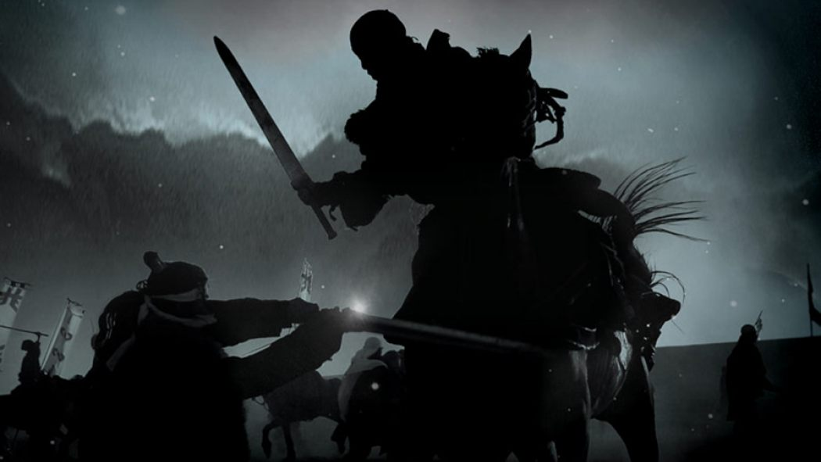
WORLD HISTORY
The Qin Dynasty
with Mr. Jim Soto

Slide 2
Think...
You are a scholar living in China in about 210 BC. You have a large library of Chinese literature, poetry and philosophy. The new emperor is a harsh ruler with no love for learning. He says you must burn all the books that disagree with his ideas. You find the whole idea repulsive. But if you disobey, the punishment may be very severe. Will you burn the books?
Take a minute to write down your answer and explain why or why not.

Slide 3
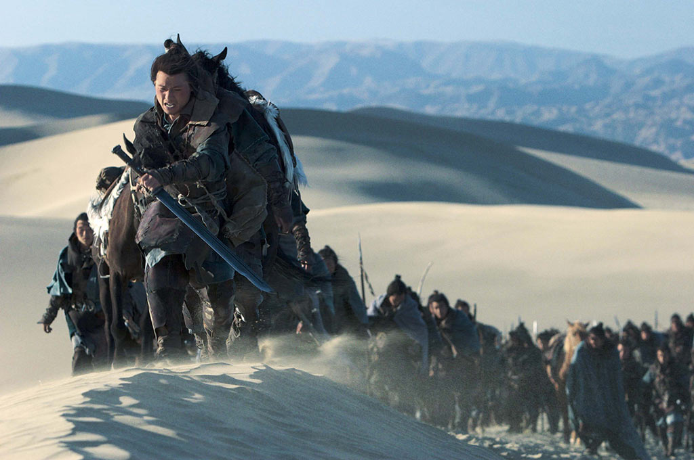
Different dynasties held very different ideas about how to rule. As the Zhou period came to an end, putting new ideas into effect brought great challenges.

Slide 4
To learn more about this topic read pages 172 thru 177 and complete the section 3 assessment. Show me the completed work when complete.

Slide 5
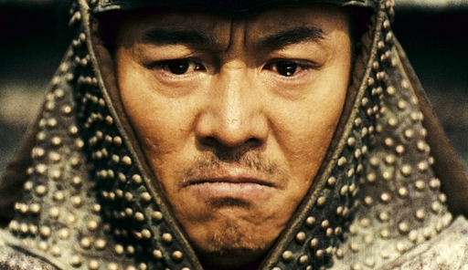
The Qin Emperor’s Strong Government
The Warring States period marked a time when several states battled each other for total domination of China. Qin, one of these factions, won by defeating all other with their powerful army. Eventually, the new Qin dynasty united China under one emperor.

Slide 6
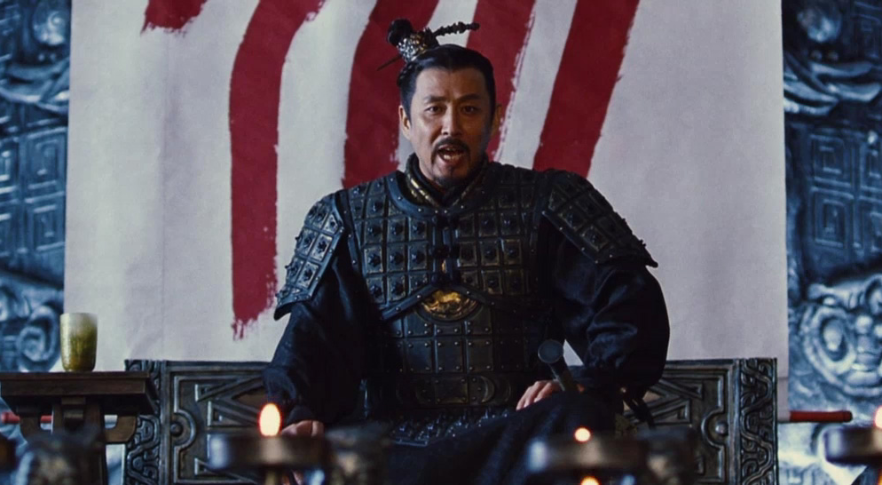
Ying Zheng was the first Chinese sovereign to proclaim himself "Shi Huangdi”, or First Emperor, after unifying China in 221 BC. He followed Legalist political beliefs. His government created strict laws with harsh punishments.
Click Here!

Slide 7
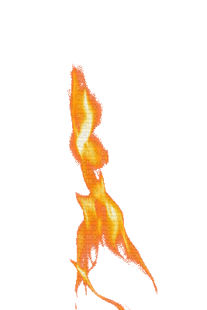
Qin Shi Huangdi Changes Chinese Life
Qin Shi Huangdi wanted to strengthen and unify China so…
He took direct control over China’s provinces.
The Lords under the Zhou had passed on positions to their sons. Now, only the emperor had the power to appoint the lords/governors.
Shi Huangdi ruled with all control and swift, harsh punishment.
Anyone who disagreed with him was punished or killed.
Writings that displeased him were burned.
Shi Huangdi increased power of his government by appointing censors. Their job was to make sure the government workers did their work.

Slide 8
Additionally…
Qin Shi Huangdi created a currency, or type of money, that everyone has to use.
He hired scholars to simplify and set rules for the Chinese writing system.
Building projects, including his own tomb. His tomb was so large that it housed an army of life-sized clay soldiers and horses.
Qin ordered thousands of farmers to build palaces, roads, dams, and a huge canal. This canal connected the Chang Jiang in central China to the city of Guangzhou in Southern China.
Supplies were transported on the canal to soldiers in distant territories.

Slide 9
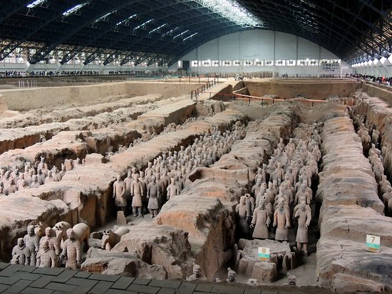
One of the most important archaeological findings of the 20th century, the excavation site around the Emperor Qin Shi Huang’s Mausoleum in Xi’an. The Mausoleum is the tomb of first emperor of China who started building his tomb which took 11 years to finish. The most important features of this site are the life size terracotta warriors and horses arranged as if in a battle.
Click Here!

Slide 10
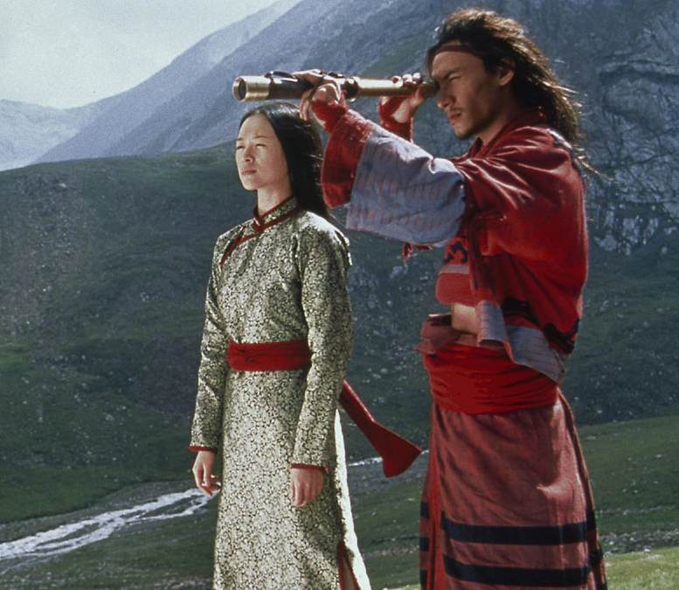
Qin Policies
Qin rule perused uniformity in order to achieve unity. Since the geography of China divide the country into distinct regions, a variety of customs, currency, languages, writing styles, and laws emerged.
The emperor set up a uniform system of law. The rules and punishments would be the same for all subjects in the empire.

Slide 11
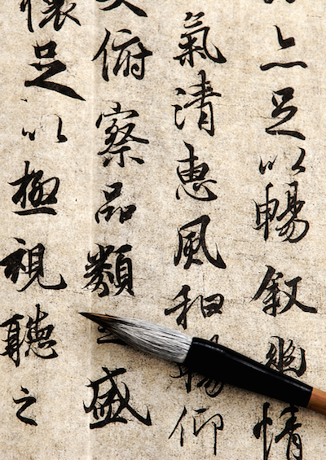
Qin Shi Huangdi also standardized the written language. People everywhere had to used the same symbols, so regardless of the region people would share a same culture and identity.
Additionally, a new currency was set up, as were also the weights and measures. All these changes would make trade among the regions easier.

Slide 12
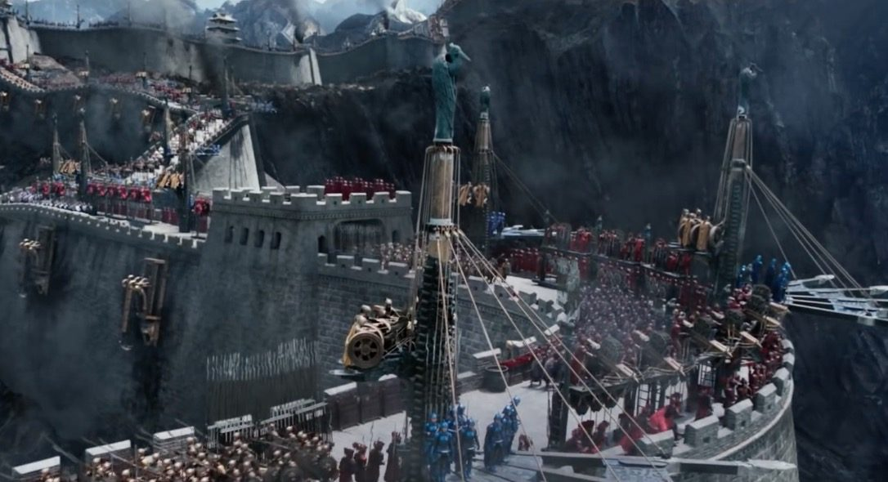
Qin Shi Huangdi, wanting to protect China from invasions from up north, ordered construction of a Great Wall, a barrier that linked earlier walls across the northern border. This wall required many years and hundreds of thousands of laborers.
Click Here!

Slide 13
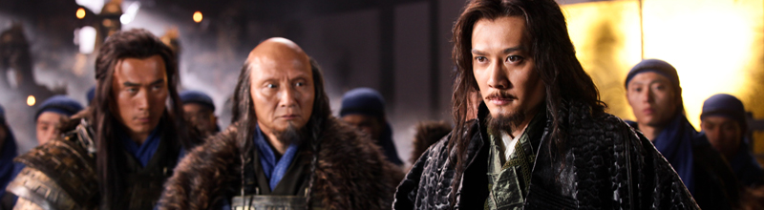
Fall of the Qin
Qin Shi Huangdi’s policies unified China. However, his policies also stirred resentment. Many subjects of all ranks hated his harsh ways. Still, Shi Huangdi held the empire together until his death. This didn’t last very long.

Slide 14
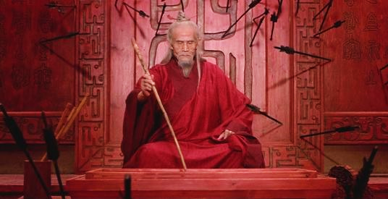
A rebellion formed across the country some years later. Different factions claimed to have received the mandate from Heaven to become the new rulers. One of these groups Burned down the Imperial palace. With no clear central government, civil war erupted.

Slide 15
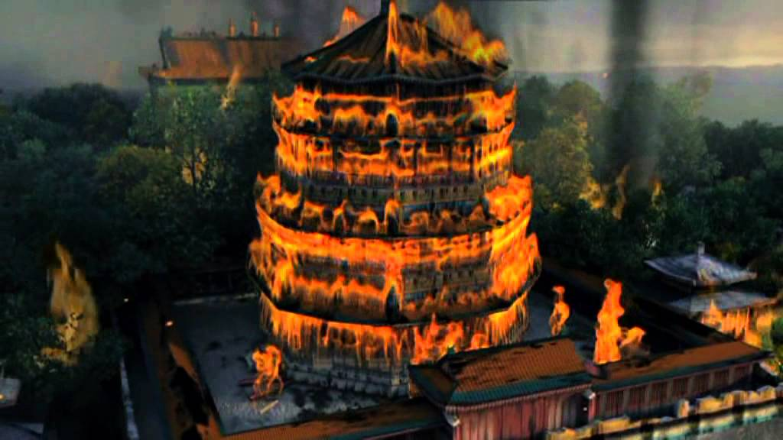
External and internal changes within and outside the dynasty, peasant revolts, the rise of Sun Yat-Sen and overall western influence caused the collapse .

Slide 16
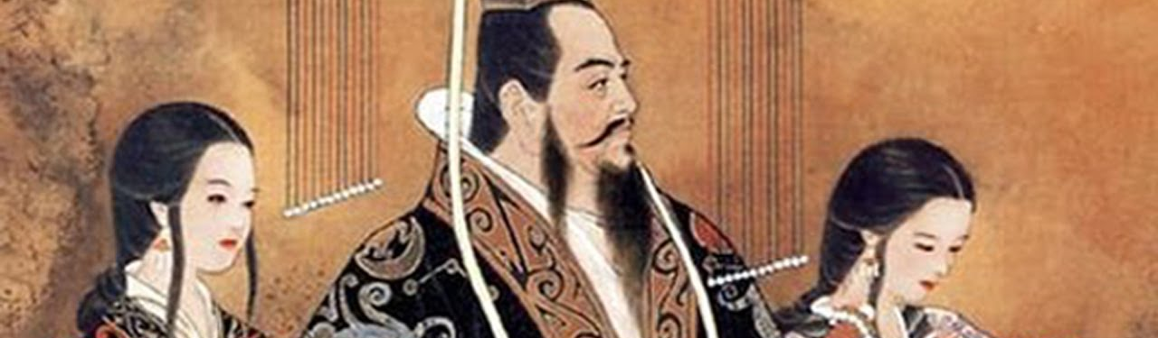
Emperor Shi Huang
A noted egomaniac, Qin Shi Huang was also known for building large, extravagant structures. He was also paranoid of attack from insiders. Almost immediately after taking power, he began construction on a large wall that would link up pieces of existing defensive walls throughout the country.
Click Here!

Slide 17
Final thoughts
Qin emperor Shi Huangdi’s policies and achievements unified China, but his harsh rule led to resentment.
After his death, the dynasty fell apart.

Slide 18
NEXT
The Han
Dynasty
Jim Soto © 2018

