Slide 1
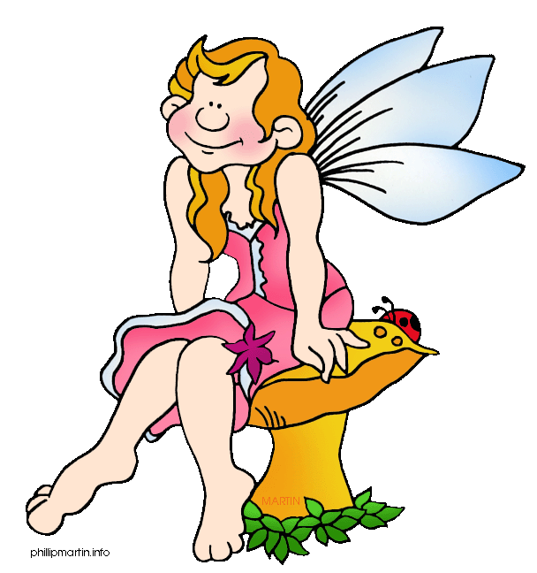
Q3
More Writing
Stories
Jim Soto

Slide 2
Lesson Objective
Understand the content and structure of a short story
Choose a topic to write about
Plan, draft, revise, and edit a short story
Pages 346-352

Slide 3
Writing a Short Story
Everybody loves a story! Today you will begin writing your own story. It will be about an important decision that the main character will need to make. It’s important that you make it as entertaining as possible.

Slide 4
Prewriting

Slide 5
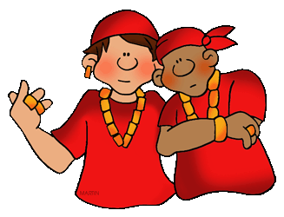
Short Stories: Selecting a Topic
A choice or decision in a story is as interesting as the character behind it. A first step in writing a story should be creating an interesting character (or characters). Pg. 346 has a diagram you can use to make this step easier.

Slide 6
Short Stories: Creating a Conflict
Tough decisions create greater conflicts for the characters. Great conflicts make for great stories! Remember that conflict is what fuels a story. Pg. 346 has a decision list you can use to either choose or get ideas from .

Slide 7
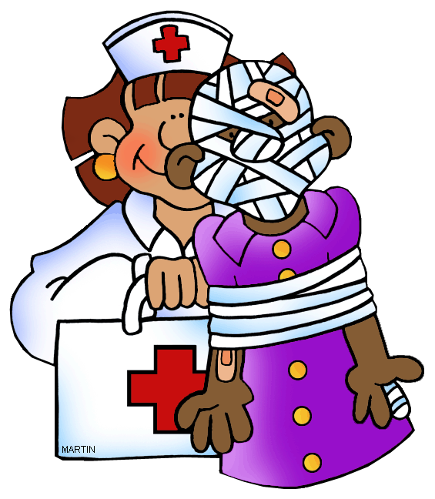
Short Stories: Setting the Scene
The place and time in which your story takes place should make solving the conflict more difficult. The more challenging, the more interesting the story can be. Pg. 347 has a sensory chart you can use to either choose or get ideas from .

Slide 8
Drafting
^{(“group up” for a while)}

Slide 9
Short Stories: Write a 1st Draft
Now that you have you main components, it’s time to write a draft of the story ( pg. 348). Share story ideas with your team mates for immediate feedback by:
folding a paper into thirds
writing a different beginning in each row
passing the paper around for feedback from your peers about which is best

Slide 10
Revising

Slide 11
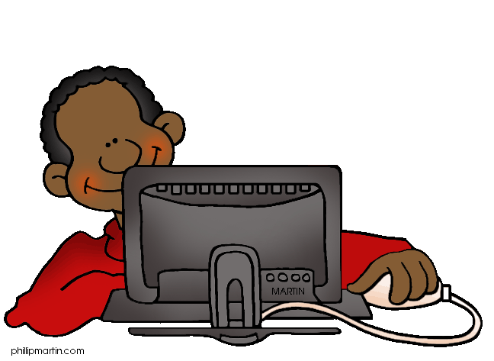
Short Stories: Improve It!
As you revise make sure use details and dialogue that show, not tell the reader what is happening. Add details:
that help the reader see, hear, smell, taste, and feel what’s happening.
about a character’s movements, facial expressions or gestures.
that create more distinctive dialogues.

Slide 12
Editing

Slide 13
Short Stories: Check for Conventions
Double...
Triple...
Quadruple check for conventions.
And after you’ve done that, maybe now is a good time to create a title for your story! Check for tips in page 349.

Slide 14
Publishing

Slide 15
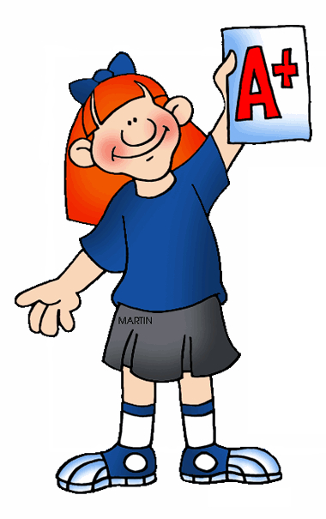
Short Stories: Share the Story!
To publish it, type the story in your computer. Try drawing a cover for it that depicts an important scene from the story. Place it over your final version and share it!

Slide 16
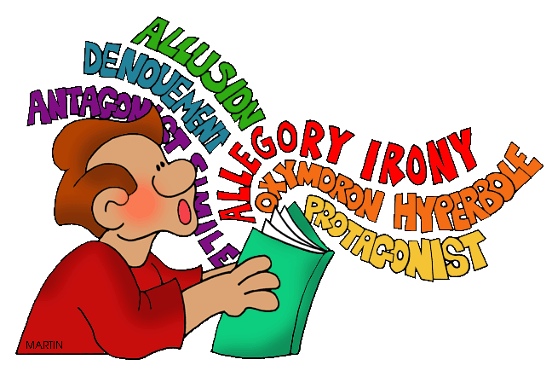
StoryPatterns and Elements
Read Story Patterns & Elements of Fiction, in pages 350-352 of your book, then complete the Try It assessment at the end. Prepare for a discussion in fifteen minutes.

Slide 17
Homework
In your Skills Book complete pgs. 112-114.
Sentence Problems Review 3
Combining Sentences Using Key Words
YIPE!

Slide 18
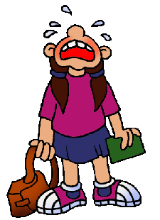
Next
Research Writing
Jim Soto © 2016

