Slide 1
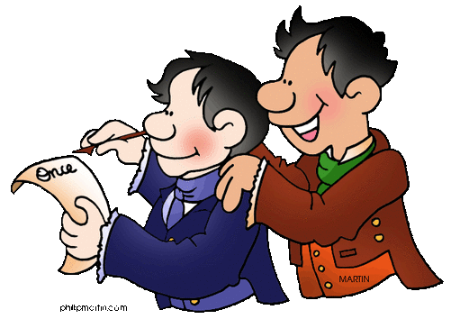
Q3
Writing
Stories
Jim Soto

Slide 2
Lesson Objective
Understand the content and structure of a short story
Choose a topic to write about
Pages 343-345

Slide 3
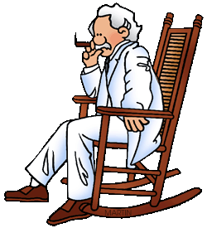
Creative Writing
Creative writing is writing that expresses ideas and thoughts in an imaginative way. It is any writing that goes outside the bounds of normal journalistic, academic, or technical forms, its main objective being the telling of a story.

Slide 4
Short Stories
A short story has these characteristics:
It is a short piece of literature with only a few characters.
It usually concerns just one problem (or conflict).

Slide 5
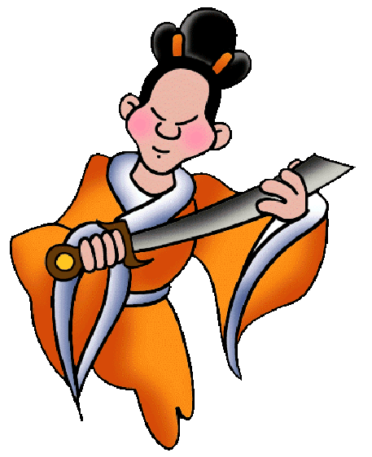
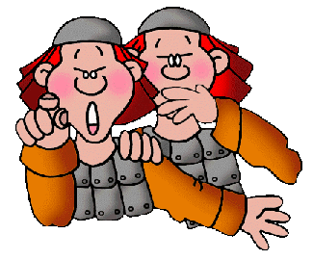
Short Stories
A short story has:
A plot
Characters
A setting
The greatest challenge in writing a short story is its short length. Everything must happen in a relatively short amount of time.

Slide 6
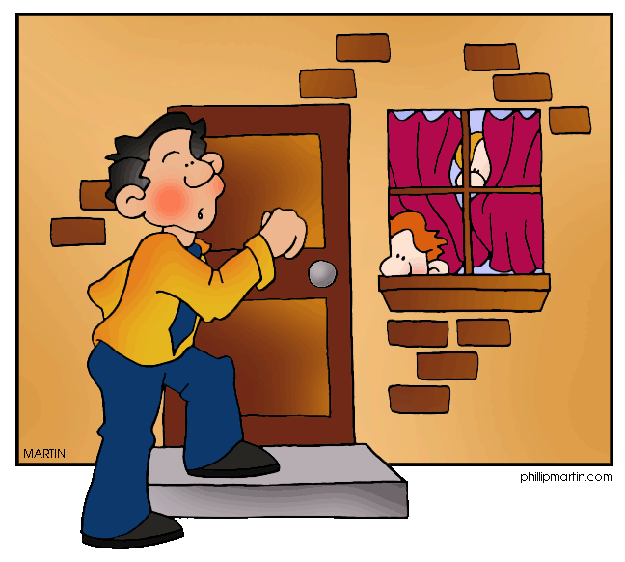
Plot
Plot refers to the sequence of events that involves the characters in conflict. Plots have certain common elements. These are:
Introduction
Complication
Climax
Resolution

Slide 7
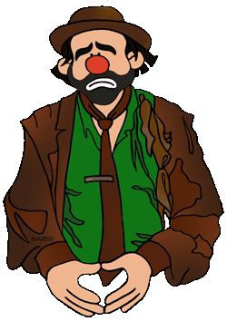
Characters
A fictional construct, a character is the representation of a person in a narrative or dramatic work of art (such as a novel, play, or film).

Slide 8
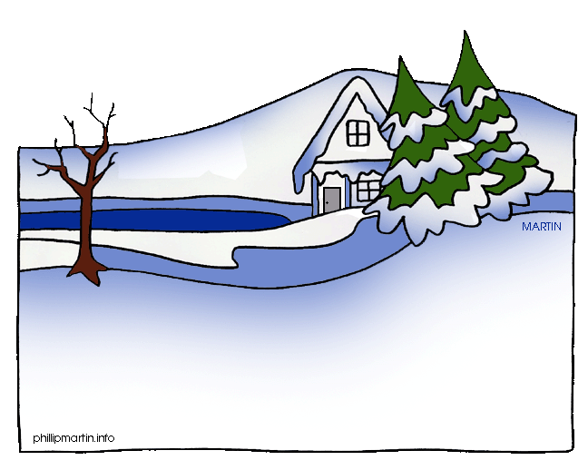
Setting
The setting of a story is the time and location in which it takes place. Broadly speaking, the setting provides the main backdrop for the story.

Slide 9
The Plot Map
A plot map is a tool used to organize a story into certain segments. Once the parts of the plot map are identified, it is easier to analyze the content. A plot map also gives a common framework for analyzing and understanding stories.
CLIMAX
RISING ACTION
(COMPLICATION)
FALLING ACTION
RESOLUTION
INTRODUCTION

Slide 10
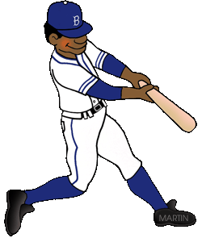
The Plot Map: Exercise
Think in a favorite movie you’ve seen or book you’ve read recently and draw a plot map like the one shown in the previous slide. You have 10 minutes before sharing the map with the rest of the class.

Slide 11
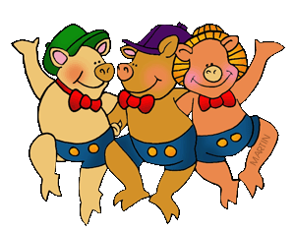
What Elements Make a Good Short Story?
IDEAS ▪ The main character finds the confidence needed to act upon a decision already made.
▪ The action and dialogue show the different personalities of the characters.

Slide 12
What Elements Make a Good Short Story?
ORGANIZATION ▪ Suspense is created by a plot line that has a strong beginning, a rising action that builds to a climax, and an ending that quickly follows and solves the story’s conflict.

Slide 13
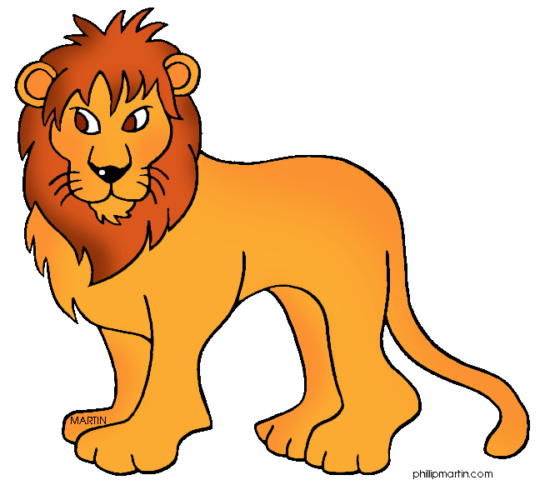
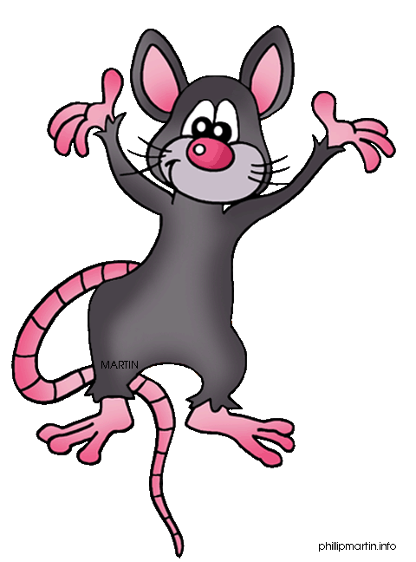
What Elements Make a Good Short Story?
VOICE AND WORD CHOICE ▪ Interest is created by characters who speak in natural voices using contemporary language.
▪ Action words and phrases capture the character, conflict, and setting.

Slide 14
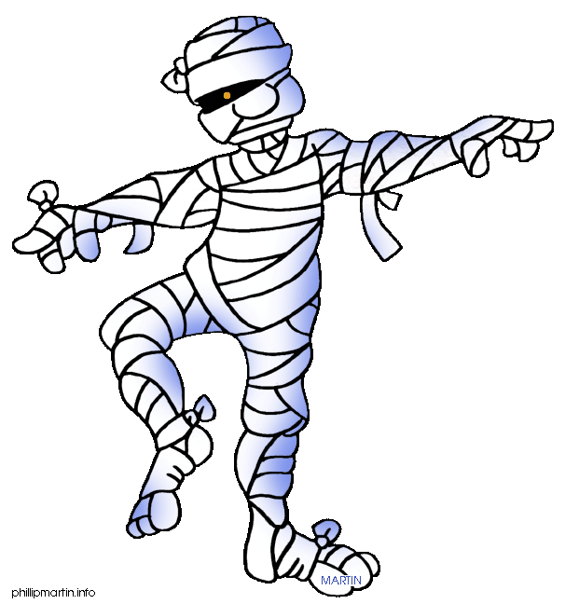
Time to Get Our Feet Wet...
Read Just Keep Going..., a short story sample in page 344 of your text book, then complete the Respond to the reading assessment at the end. Prepare for a discussion in ten minutes.

Slide 15
Homework
In your Skills Book complete pgs. 107-111.
Subject-Verb Agreement 2
Subject-Verb Agreement 3
Subject-Verb Agreement 4
Subject-Verb Agreement Review
HIC!

Slide 16
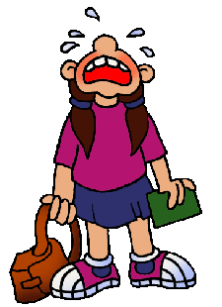
Next
More Writing Stories
Jim Soto © 2016

